Slide 1
A₁
A₂
A₁
A₂
A₃
A₃

Slide 2

Linear Regression Logistic Regression
∈ R
σ
W1
W2 … Wd
W1
W2 … Wd
X⋅W
X⋅W
X1
X2
…
Xd
X1
X2
…
Xd
x ∈ [0,1]

Slide 3
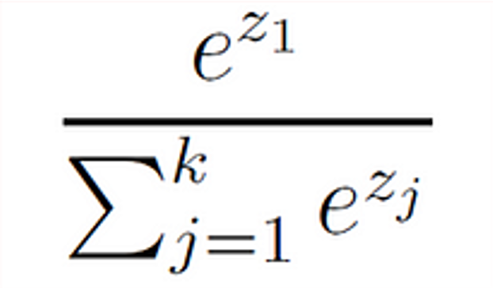
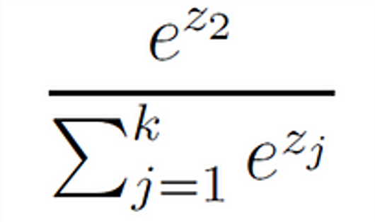
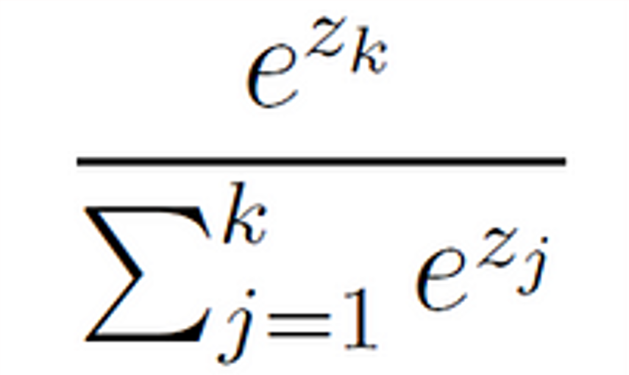
class
probabilities
softmax
X1
W1 ⋅ X
P1
X2
W2 ⋅ X
P2
.
.
.
X3
.
.
.
.
.
.
Wk ⋅ X
P3
Xm

