Slide 1







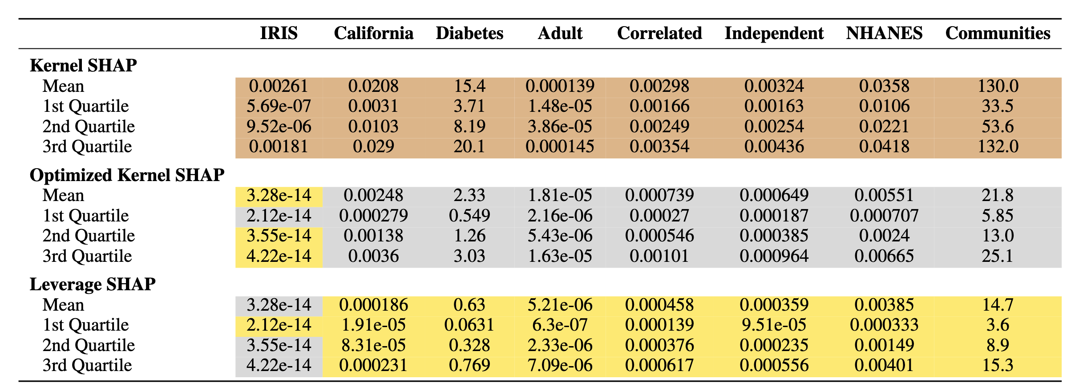





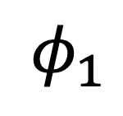
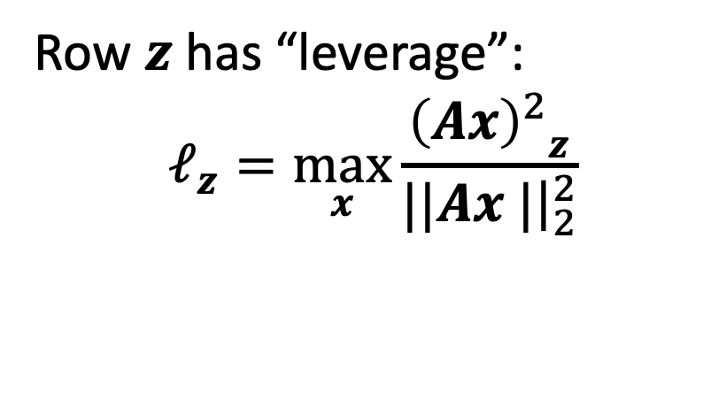





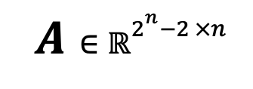
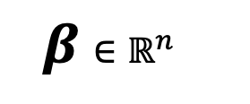

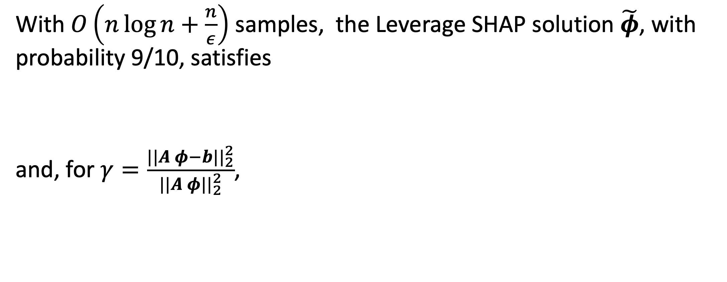
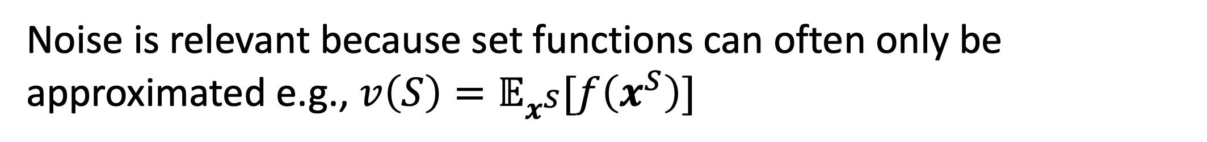





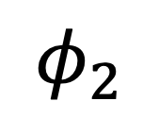




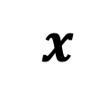





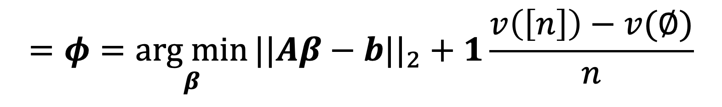





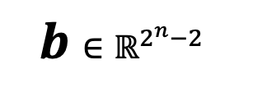

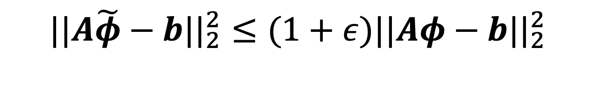
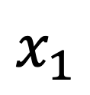




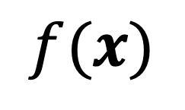


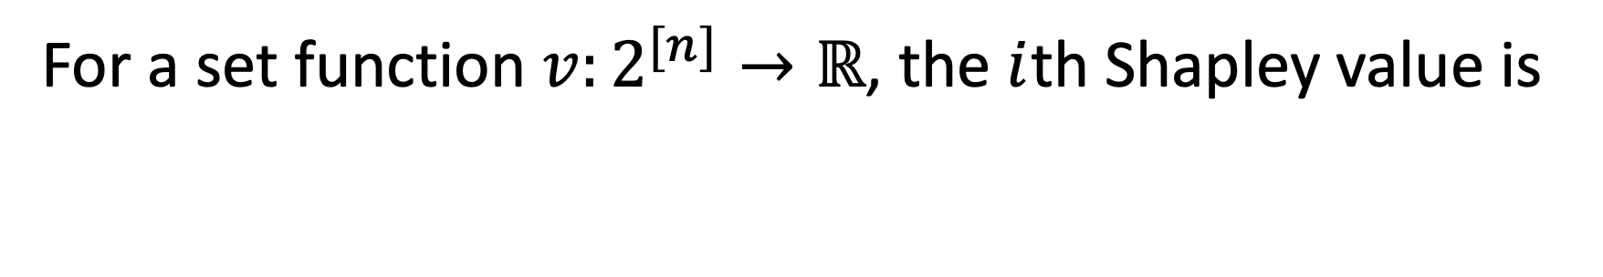


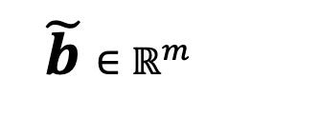
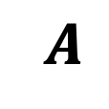

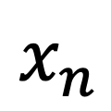


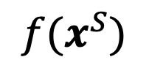


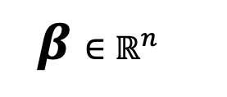
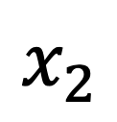
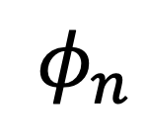




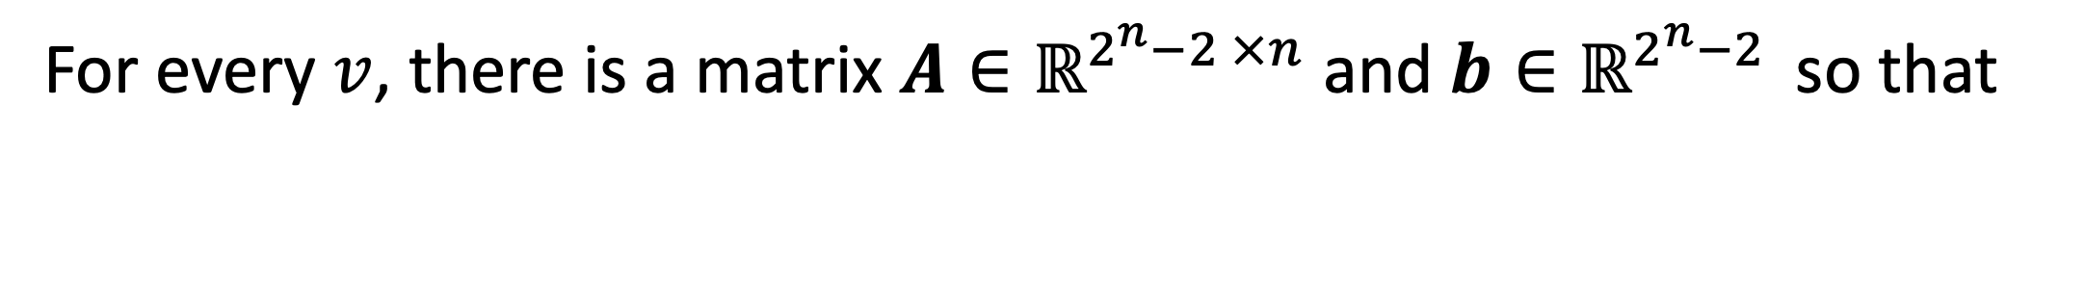
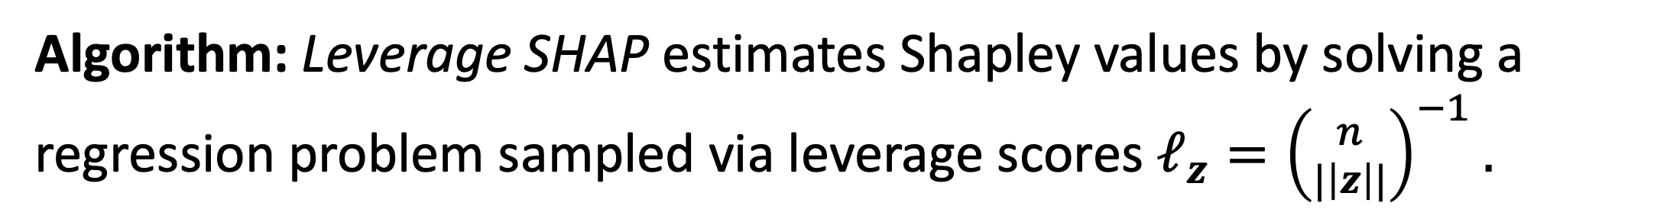
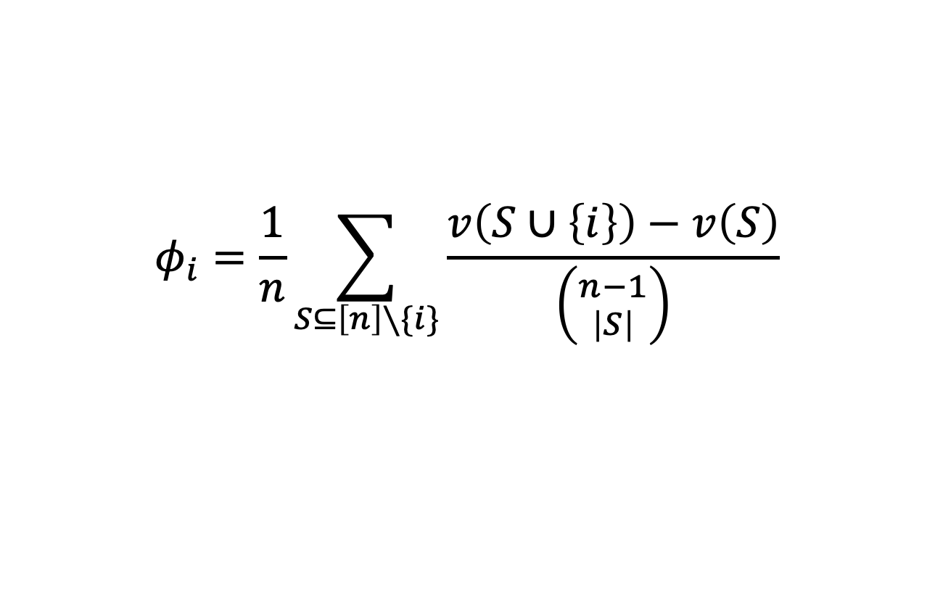




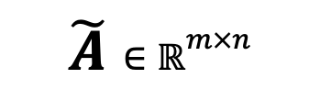
Provably Accurate Shapley Value Estimation via Leverage Score Sampling^{1,2}
Christopher Musco and R. Teal Witter
New York University
Explainable AI
Leverage Score Sampling
Theoretical Guarantees
Goal: Explain the output of an opaque function.
If the regression problem is too large, how should we sample?
With $O\left(n\log{n}+\frac{n}{ε}\right)$ samples, the Leverage SHAP solution $\tilde{φ}$, with probability 9/10, satisfies
and, for $γ=\frac{||A φ−b||_{2}^{2}}{||A φ||_{2}^{2}}$,
$$x$$
$$f$$
$$A$$
$$x$$
$$=$$
$$Ax$$
Row $z$ has “leverage”:
$$ℓ_{z}=\max_{x}{\frac{{{\left(Ax\right)}^{2}}_{z}}{||Ax |{\left.​\right|}_{2}^{2}}}$$
$$x_{1}$$
$$||A\tilde{φ}−b||_{2}^{2}≤(1+ε)||Aφ−b||_{2}^{2}$$
$$x_{2}$$
$$f(x)$$
$$⋮$$
$$x_{n}$$
How useful is row $z$?
If there is an $Ax$ like this, then we need row $z$.
Example: How does changing traffic (an input feature) change the enjoyment of a bike ride (the output)?
$||\tilde{φ}−φ||_{2}^{2}≤ε γ||φ||_{2}^{2}$.
Temperature
$$73°$$
$$89°$$
$$S$$
$$f(x^{S})$$
Leverage SHAP
Performance by…
Wind speed
$11$mph
$1$mph
$$\{2,3\}$$
$$89°$$
$11$mph
$$30\%$$
$$5$$
$$3$$
$$5/10$$
Chance of rain
$$30\%$$
$$0\%$$
$$\{2,3,5\}$$
$$89°$$
$11$mph
$$30\%$$
$$5$$
$$8$$
$$4/10$$
Algorithm: Leverage SHAP estimates Shapley values by solving a regression problem sampled via leverage scores $ℓ_{z}={\left({n \atop |\left|z\right||}\right)}^{−1}.$
Sample Size
Helicopters
$$2$$
$$5$$
$$\{1\}$$
$$73°$$
$1$mph
$$0\%$$
$$5$$
$$3$$
$$6/10$$
Traffic
$$8$$
$$3$$
$$\{1,5\}$$
$$73°$$
$$0\%$$
$$5$$
$$8$$
$$8/10$$
$$⋮$$
$$⋮$$
$1$mph
Explicand
Baseline
Our answer will attribute the model output to each input using…
$$A∈ℝ^{2^{n}−2 ×n}$$
$β$ $∈ℝ^{n}$
$b$ $∈ℝ^{2^{n}−2 }$
$$\tilde{A}∈ℝ^{m×n}$$
$β$ $∈ℝ^{n}$
$\tilde{b}$ $∈ℝ^{m}$
Shapley Values
$$≈$$
$$≈$$
For a set function $v:2^{[n]}→ℝ$, the $i$th Shapley value is
$$φ_{i}=\frac{1}{n}\sum_{S⊆\left[n\right]∖\{i\}}{\frac{v\left(S∪\left\{i\right\}\right)−v\left(S\right)}{\left({n−1 \atop \left|S\right|}\right)}}$$
$$=\frac{1}{n}\sum_{k∈[n−1]}{\frac{1}{\left({n−1 \atop k}\right)}\sum_{S⊆\left[n\right]∖\left\{i\right\}:\left|S\right|=k}{v\left(S∪\left\{i\right\}\right)−v(S)}}$$
Leverage SHAP vs Kernel SHAP
Noise
Average over sets of size $k$
Distribution Over Sampled Subset Size
Average over all sizes $k$
Over sample
We will set $v\left(S\right)=f(x^{S})$.
Regression Formulation
Under sample
For every $v$, there is a matrix $A∈ℝ^{2^{n}−2 ×n}$ and $b∈ℝ^{2^{n}−2 }$ so that
Error Over 100 Runs
Noise is relevant because set functions can often only be approximated e.g., $v\left(S\right)=𝔼_{x^{S}}[f\left(x^{S}\right)]$
$$φ_{1}$$
$$=φ=\underset{β}{arg min}{{||Aβ−b||}_{2}}+1\frac{v\left(\left[n\right]\right)−v(∅)}{n}$$
Notes
$$φ_{2}$$
$$⋮$$
$$φ_{n}$$
¹Our work is available on arXiv at ttps://arxiv.org/abs/2410.01917
²This work was supported by the National Science Foundation under Grant No. 2045590 and Graduate Research Fellowship Grant No. DGE-2234660
We can compute Shapley values by solving a regression problem!

