Slide 1

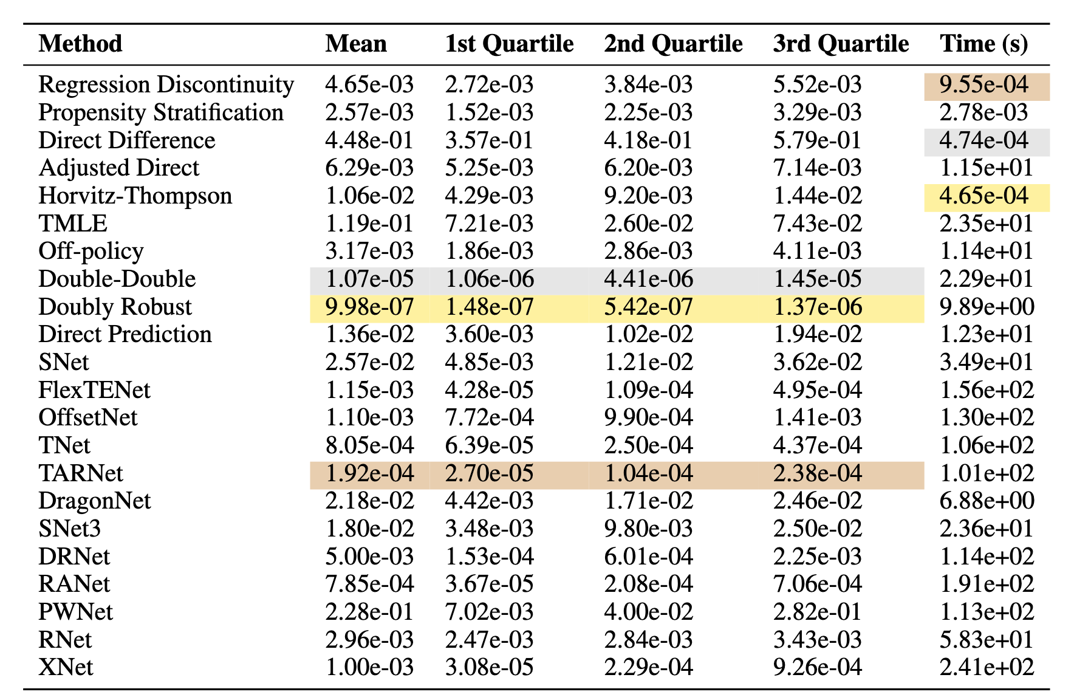
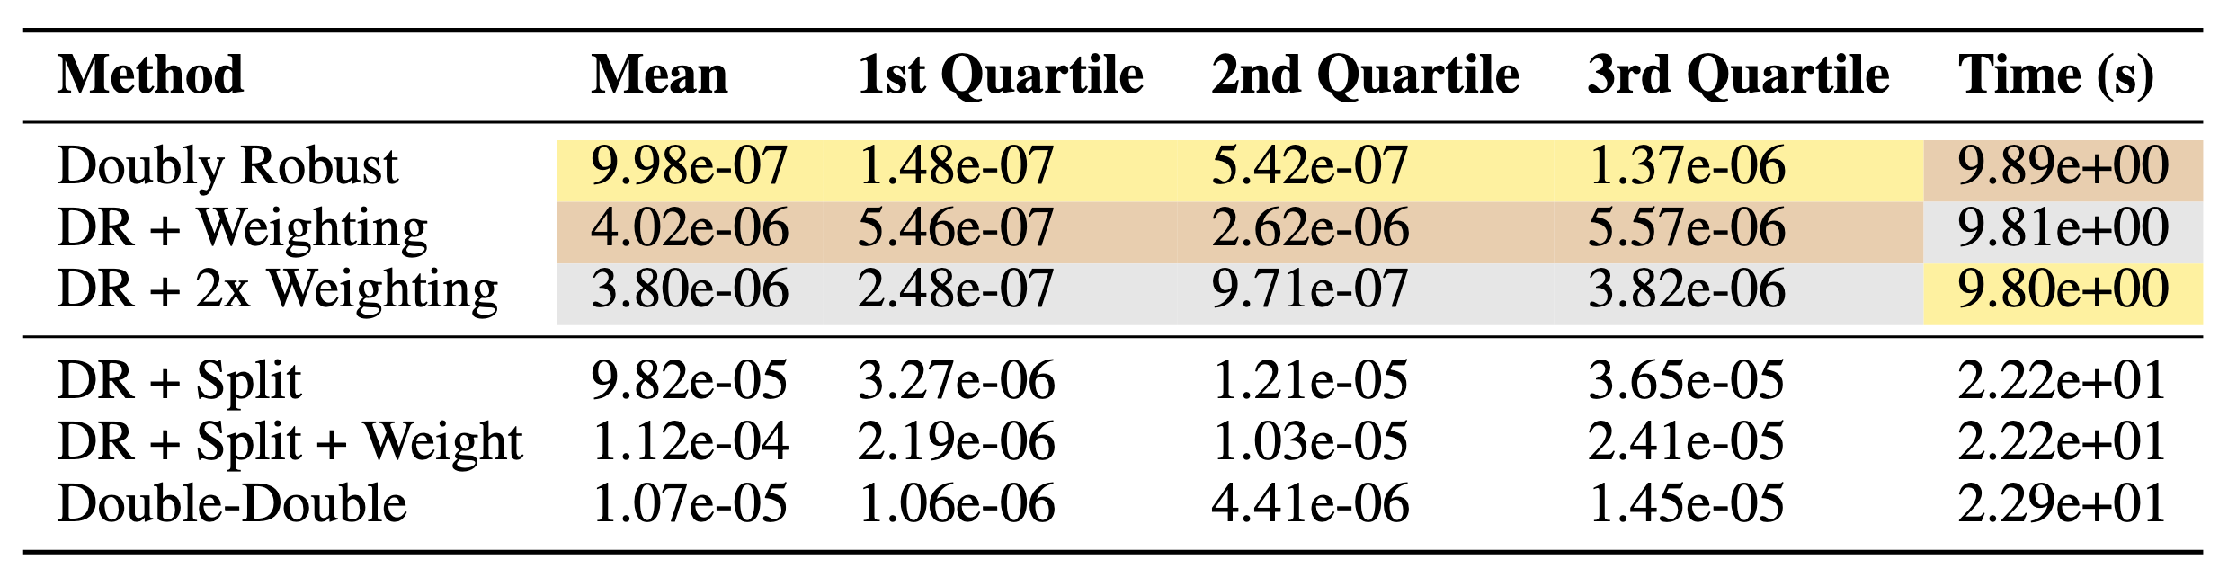
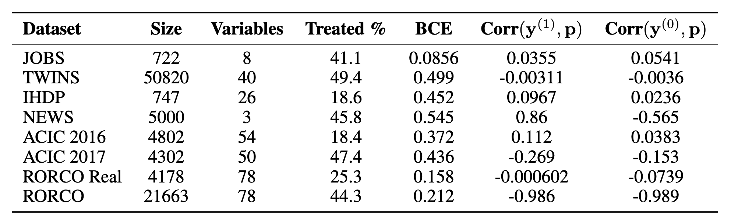
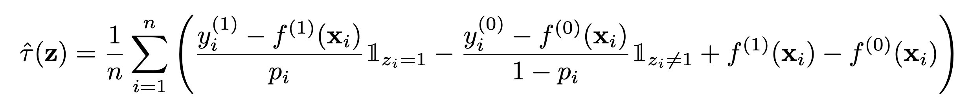
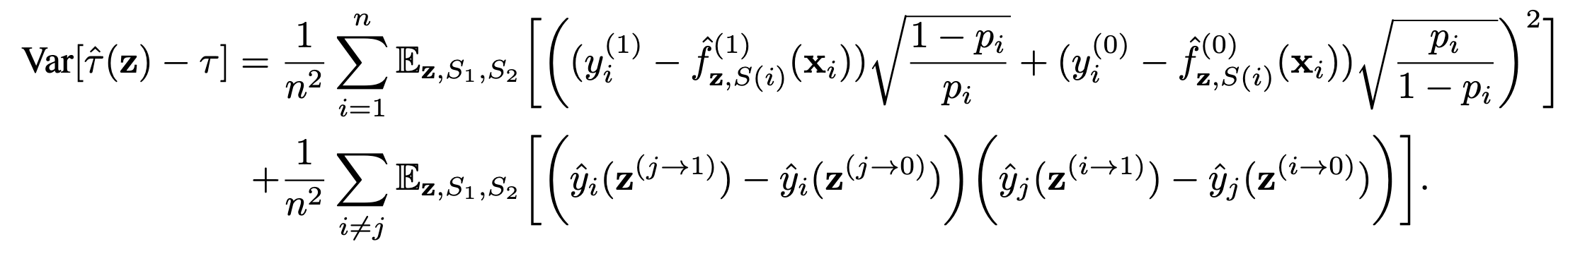
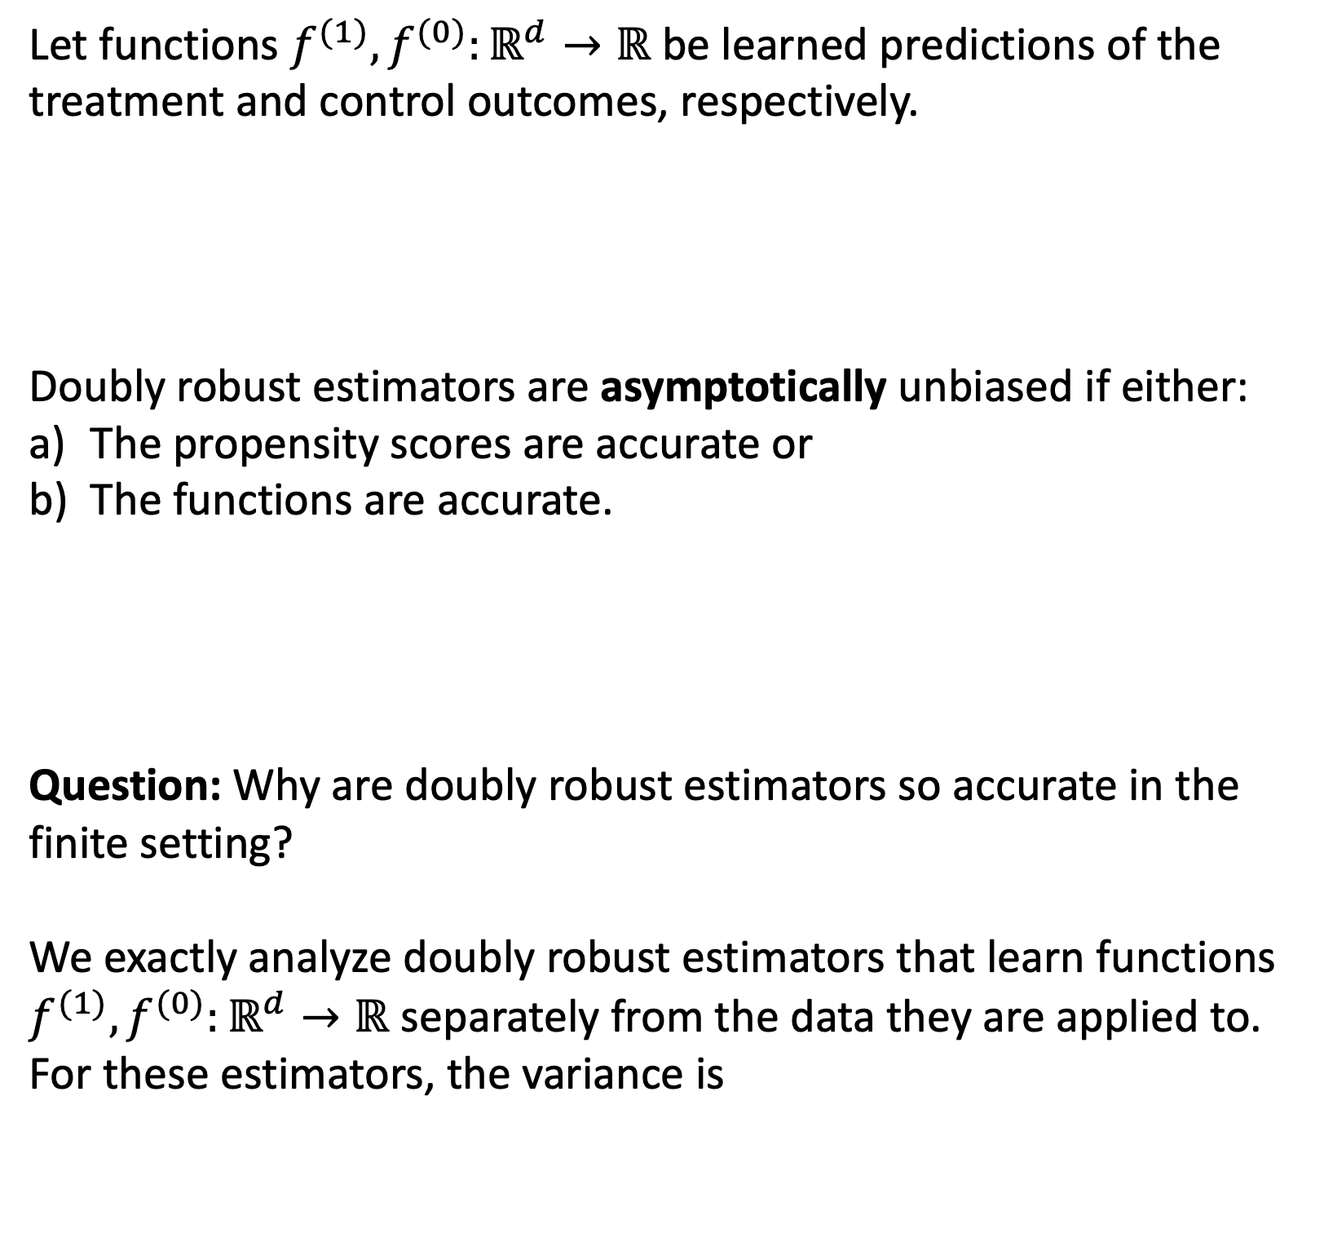

Benchmarking Estimators for Natural Experiments^{1,2,3}
R. Teal Witter and Christopher Musco
New York University
Treatment Effect Estimation
Benchmark
Double-Double Algorithm
Problem Setup: There are $n$ observations, each with covariates $x_{i}∈ℝ^{d}$ for $i∈[n]$. Each observation $i$ receives the “treatment” with propensity $p_{i}∈(0,1)$ and the “control” otherwise. We then observe either the treatment outcome $y_{i}^{(1)}$ or the control outcome $y_{i}^{(0)}$, but not both.
Goal: Estimate the average treatment effect:
$$τ=\frac{1}{n}\sum_{i∈[n]}{y_{i}^{(1)}−y_{i}^{(0)}}$$
Reach Out and Read Colorado (RORCO) is an early childhood literacy nonprofit that gives children books at pediatric visits.
RORCO Real includes student covariates and standardized literacy scores while RORCO includes student covariates and synthetic outcomes designed by literacy experts.
Challenge: RORCO prioritizes under-served children to maximize the positive impact of their work, causing
Confounding between outcomes and propensity and
Confounding between treatment effect and propensity.
Squared error on RORCO over 100 runs.
Insight: What if we learn the functions to minimize an upper bound on the exact variance?
Doubly robust estimators without the training split perform better but they effectively use twice as much data as doubly robust estimators with the training split.
A Novel Treatment Effect Dataset
Performance by Sample Size
Doubly Robust Estimators
Let functions $f^{(1)}, f^{(0)}:ℝ^{d}→ℝ$ be learned predictions of the treatment and control outcomes, respectively.
Doubly robust estimators are asymptotically unbiased if either:
The propensity scores are accurate or
The functions are accurate.
Question: Why are doubly robust estimators so accurate in the finite setting?
We exactly analyze doubly robust estimators that learn functions $f^{(1)}, f^{(0)}:ℝ^{d}→ℝ$ separately from the data they are applied to. For these estimators, the variance is
Confoundedness
Non-asymptotic Analysis
Natural Experiments Package
import naturalexperiments as ne
X, y, z = ne.dataloaders[‘RORCO’]() # Load datasets
estimator = ne.methods[‘Double-Double’] # Load estimator
p = ne.estimate_propensity(X, z) # Estimate propensity
estimated_effect = estimator(X, y, z, p, ne.train)
¹The datasets and code are available at github.com/rtealwitter/naturalexperiments
²Our work is available on arXiv at arxiv.org/abs/2409.04500
³This work was supported by the National Science Foundation under Grant No. 2045590 and Graduate Research Fellowship Grant No. DGE-2234660

