Slide 1

Enhancing Focused Ultrasound Literature Review Efficiency through NLP-Driven Text Classification
Sponsors: Focused Ultrasound Foundation
Student Team: Rose Eluvathingal Muttikkal, Abhishek Singh, Skye Jung, Reanna Panagides
Faculty Mentor: Heman Shakeri

Slide 2

Table of Contents
01
Project Purpose and Background
02
Data Discussion
03
Project Plan
04
Models
05
Solution

Slide 3
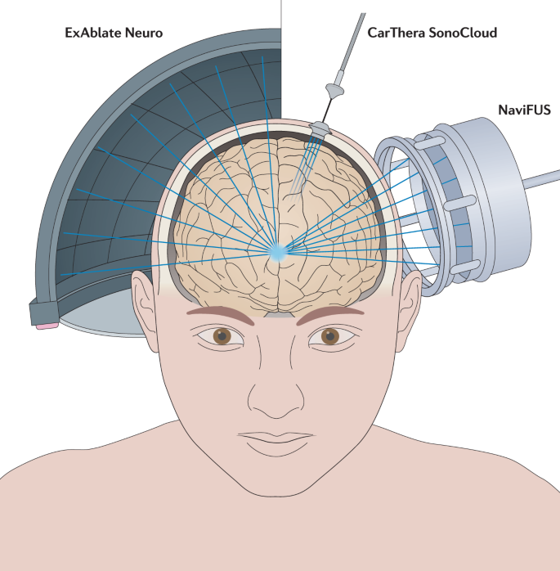
Project Purpose and Background
Problem: The current literature review process is timely, inefficient, and prone to error
Proposed solution: Utilize machine learning techniques to enhance the efficiency of classifying scientific literature about emerging applications and indications of focused ultrasound therapies
Meng et al, 2021

Slide 4
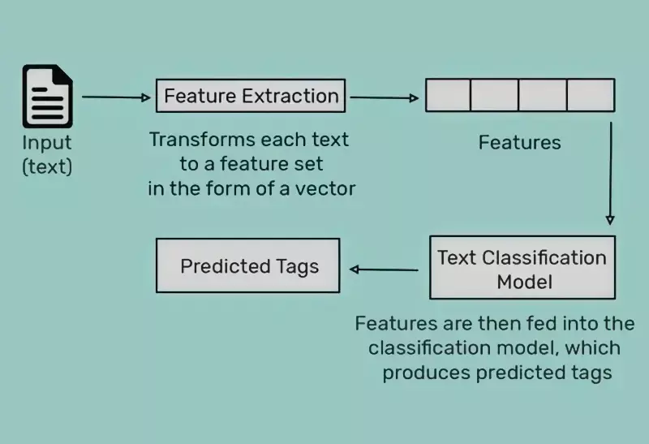
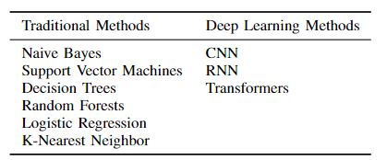
Brief Background on Text Classification
What is the general process of text classification?
Approaches to classifying text:
Chaturvedi, 2021

Slide 5
Project Plan
Data format
EDA
Data prep
Train
Assess
Excel to pandas dataframe
Labeled articles
Remove NAs + duplicates, supplement data
SL approach
BERT
Test data
FUSF feedback

Slide 6
Data Discussion
Target Variables
FUS Identification
Curated collection of scientific articles related to focused ultrasound (FUS) and its applications within healthcare
Literature review excel files from Feb-Aug 2023
Updated dataset (1794 FUS related, 1794 Non-FUS)
Dropped duplicates and missing data
Supplemented dataset
Previous intern’s data
Zotero database
Non-FUS articles from PubMed
Data Challenges
Lack of Data
Imbalanced Data

Slide 7
Models

Slide 8

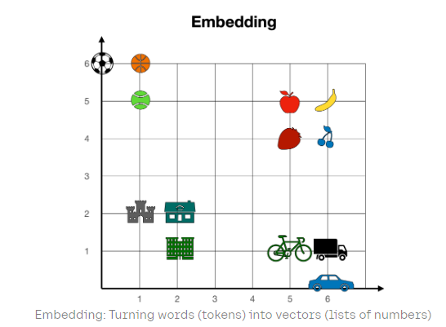
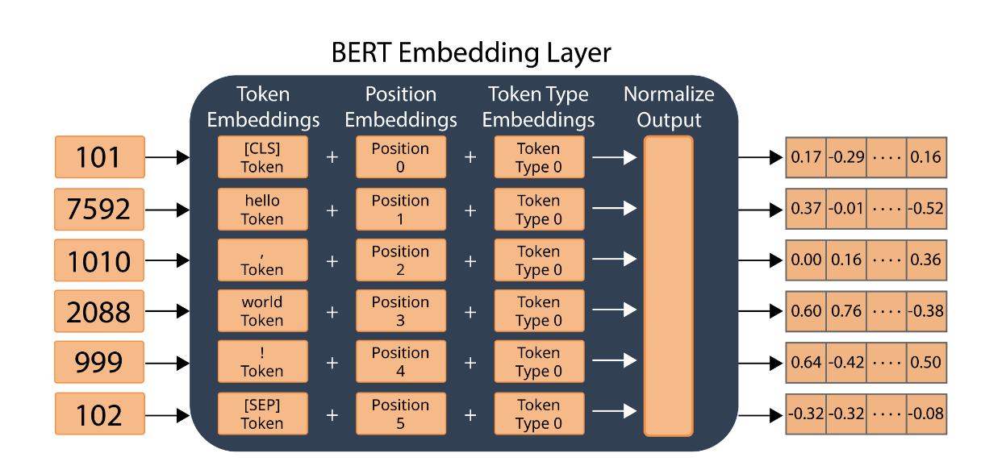

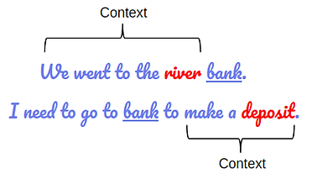
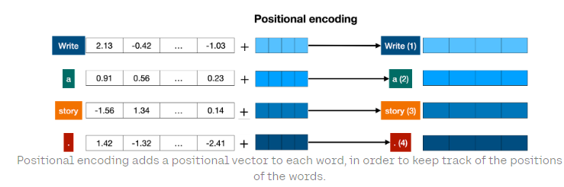
BERT (Bidirectional Encoder Representations from Transformers)
Transformer-based model developed in 2018 by researchers at Google AI Language
One of the first large language models (LLMs)
NLP tasks → question answering, sentiment analysis, text generation, summarizing text, language translation, autocomplete tasks
Assess
Test data
FUSF feedback
Notes:
Text is converted to numerical representations called tokens, and each token is converted into a vector via looking up from a word embedding table
Citations
https://huggingface.co/blog/bert-101#2-how-does-bert-work https://www.datacamp.com/blog/what-is-bert-an-intro-to-bert-models
https://txt.cohere.com/what-are-transformer-models/
https://www.theaidream.com/post/google-bert-understanding-the-architecture

Slide 9
Pretrained models
(Khadhraoui et al, 2022)
Model | Dataset/Size | Characteristics
DistilBERT | General domain corpora similar to BERT (Wikipedia, BookCorpus)/3.3M | General domain Reduced size of BERT (40% less parameters)
Clinical + BioBERT | MIMIC III database/880M | Clinical domain
TinyBERT | General domain corpora and task-specific fine-tuning datasets | General and specific domains Significantly smaller than BERT (7.5x smaller)
SciBERT | Semantic Scholar/1.14M | Scientific domain
Notes:
What’s units?

Slide 10
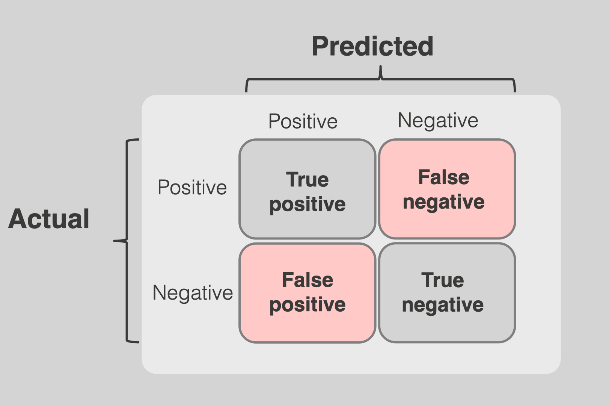
Model Performance Metrics
Metric | Definition | Equation
Accuracy | Proportion of true results (both true positives and true negatives) among the total number of cases examined | (TP + TN) /( TP + TN + FP + FN)
Precision | Proportion of true positive results in all positive predictions made by the model | (TP) /( TP + FP)
Recall | Proportion of true positive results among all actual positives | (TP) / (TP + FN)
F1 Metric | Harmonic mean of precision and recall, providing a single metric to balance the trade-off between the two | 2 * (Precision * Recall) / (Precision + Recall)
Assess
Test data
FUSF feedback
Notes:
https://assets-global.website-files.com/6266b595eef18c96eef938e2/644c356471ca41434dc5ac4b_classification_metrics_img_source_grey.001-min.png

Slide 11
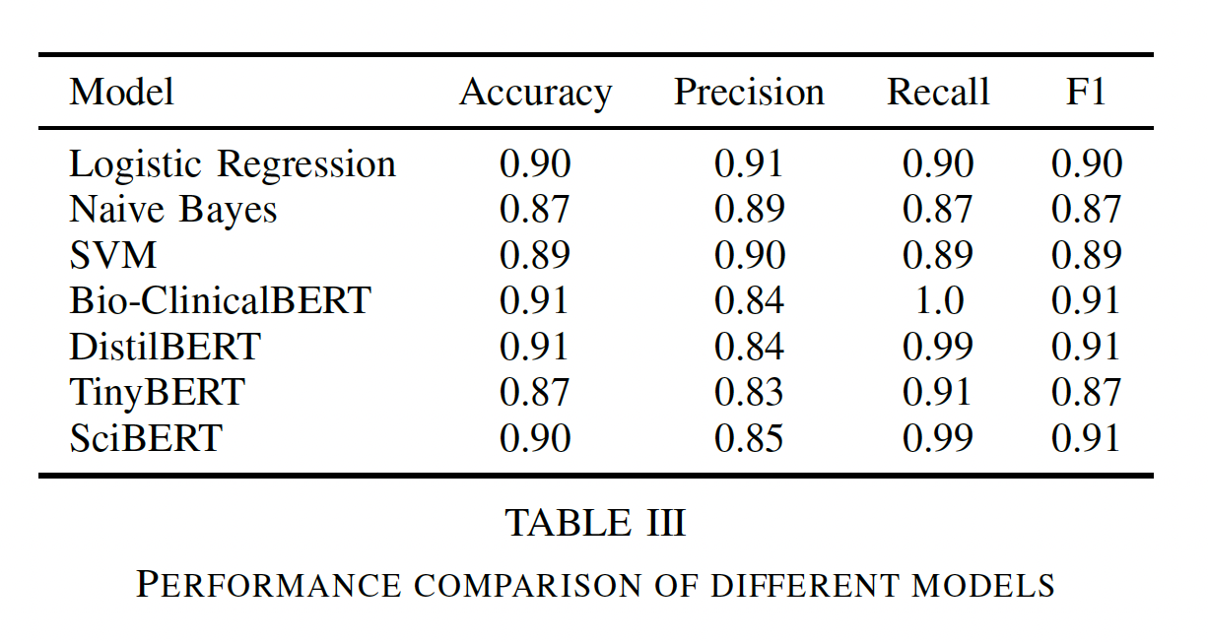
Classification Performance (test data)
Notes:
Accuracy = (Number of Correct Predictions) / (Total Number of Predictions)
Recall = TruePositives / (TruePositives + FalseNegatives)
Precision = TruePositives/ (TruePositives + FalsePositives)
F1 Metric → the harmonic mean of precision and recall

Slide 12
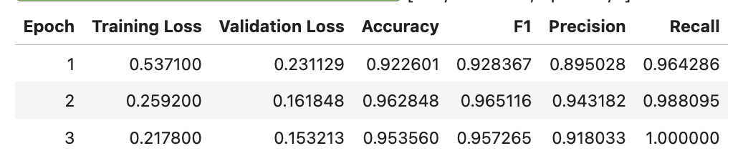
SciBERT (validation data)
Notes:
Accuracy = (Number of Correct Predictions) / (Total Number of Predictions)
Recall = TruePositives / (TruePositives + FalseNegatives)
Precision = TruePositives/ (TruePositives + FalsePositives)
F1 Metric → the harmonic mean of precision and recall

Slide 13
Solution

Slide 14
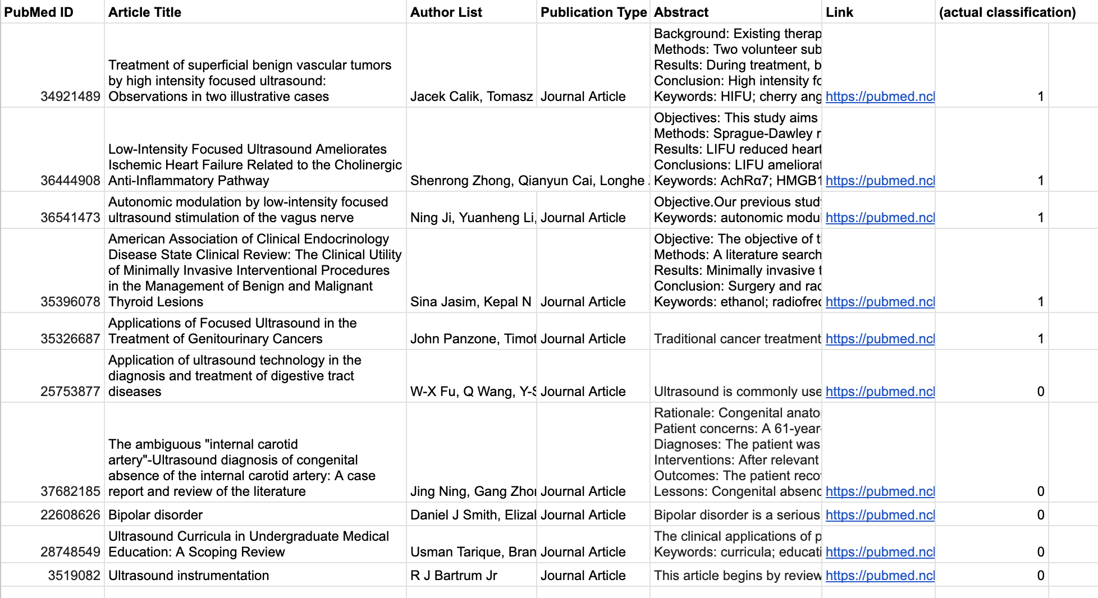
Model Input
Literature Review Excel File
Assess
Test data
FUSF feedback

Slide 15
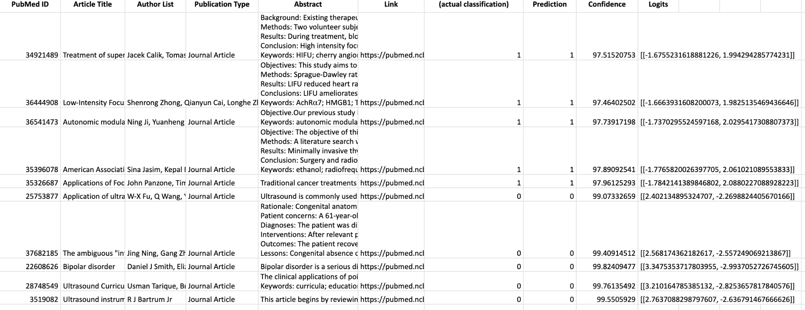
Model Output
Updated Literature Review Excel File
Assess
Test data
FUSF feedback

Slide 16
Example FUS Classification
Title: Applications of Focused Ultrasound in the Treatment of Genitourinary Cancers
Abstract:
Traditional cancer treatments have been associated with substantial morbidity for patients. Focused ultrasound offers a novel modality for the treatment of various forms of cancer which may offer effective oncological control and low morbidity. We performed a review of PubMed articles assessing the current applications of focused ultrasound in the treatment of genitourinary cancers, including prostate, kidney, bladder, penile, and testicular cancer. Current research indicates that high-intensity focused ultrasound (HIFU) focal therapy offers effective short-term oncologic control of localized prostate and kidney cancer with lower associated morbidity than radical surgery. In addition, studies in mice have demonstrated that focused ultrasound treatment increases the accuracy of chemotherapeutic drug delivery, the efficacy of drug uptake, and cytotoxic effects within targeted cancer cells. Ultrasound-based therapy shows promise for the treatment of genitourinary cancers. Further research should continue to investigate focused ultrasound as an alternative cancer treatment option or as a complement to increase the efficacy of conventional treatments such as chemotherapy and radiotherapy. Keywords: cancer; review; treatment; ultrasound.
Insert Abstract into ‘predict_abstract’ function:
Assess
Test data
FUSF feedback

Slide 17
Example Non-FUS Classification
Title: Application of ultrasound technology in the diagnosis of digestive tract diseases
Abstract:
Ultrasound is commonly used in clinical examination which is economic, non-invasive and convenient. Ultrasound can be used for the examination of solid organs and hollow organs. Due to the presence of air, routine ultrasound examination of the digestive tract is not very appropriate, Because of the development of endosonography and its related technology, diagnosis of gastrointestinal diseases have been improved which is valuable in clinic. This review focused on the application of ultrasound technology in the diagnosis of digestive tract diseases.
Insert Abstract into ‘predict_abstract’ function:
Assess
Test data
FUSF feedback

Slide 18
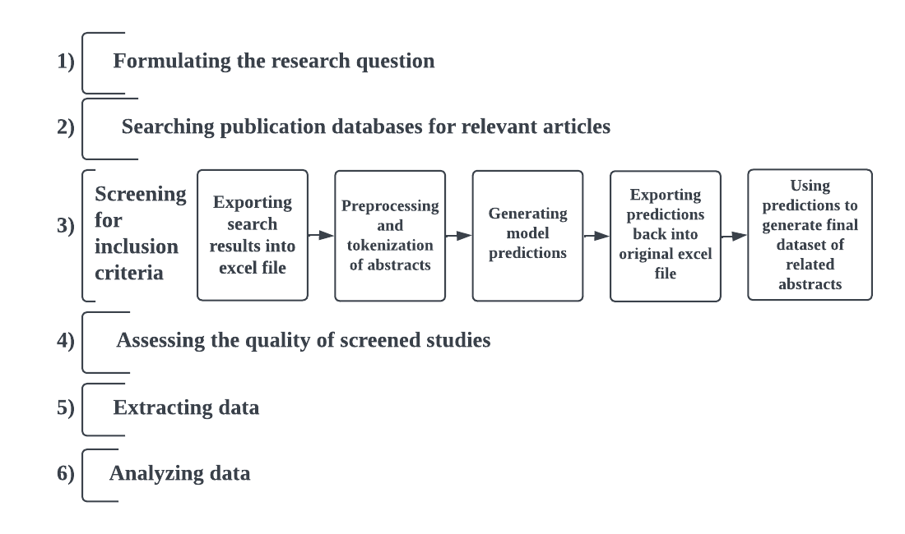
Integration into Current Workflow

Slide 19
Next Steps
Add tags column to model output
Feedback from clinical team on model output
Excel files with labels Sep 2023 - April 2024
Feedback from data management team on proposed workflow
Transition model to production at FUSF

Slide 20
Potential Background Resources
Focused Ultrasound Foundation (FUSF) Disease and Condition Webpage
FUSF State of Field Reports
FUSF Workshop Documents
FUSF ‘Hot Topic’ Webinars
FUSF’s Indication & Synonyms Excel Sheet
Snapshot of FUSF’s Indication & Synonyms Excel Sheet
Indication | Synonym
Arthritis, Facetogenic | Low Back Pain
Bladder Tumors | Urinary Bladder Neoplasms
Congestive Heart Failure | CHF

Slide 21
Potential Concerns and Blockers
Assumptions
Limitations
Concerns
Blockers
Metadata and keywords from abstracts are sufficient for article classification
The chosen model’s inherent limitations will affect performance metrics (accuracy, precision, FNR, FPR, etc.)
Address gaps in technical expertise by utilizing online courses and seeking school funding for training
Overcome potential technical hurdles by leveraging mentors, classmates, and insights from prior models
Prioritizing the reduction of false positives/negatives in the model
Relying solely on abstracts could limit classification accuracy
Combat low model performance through early intervention and mentor guidance for optimization
Tackle potential poor performance on unlabeled indications by reassessing the model and collecting additional data

Slide 22
Questions?

Slide 23
Citations
01
Khadhraoui, Mayara, Hatem Bellaaj, Mehdi Ben Ammar, Habib Hamam, and Mohamed Jmaiel. 2022. "Survey of BERT-Base Models for Scientific Text Classification: COVID-19 Case Study" Applied Sciences 12, no. 6: 2891. https://doi.org/10.3390/app12062891

Slide 24
Citations
01
Meng, Y., Hynynen, K. & Lipsman, N. Applications of focused ultrasound in the brain: from thermoablation to drug delivery. Nat Rev Neurol 17, 7–22 (2021). https://doi.org/10.1038/s41582-020-00418-z
02
Chaturvedi, Naina. December 31, 2021. Day 59: 60 days of Data Science and Machine Learning Series. Medium. https://medium.com/coders-mojo/day-59-60-days-of-data-science-and-machine-learning-series-3786d513fcbd

