Slide 1

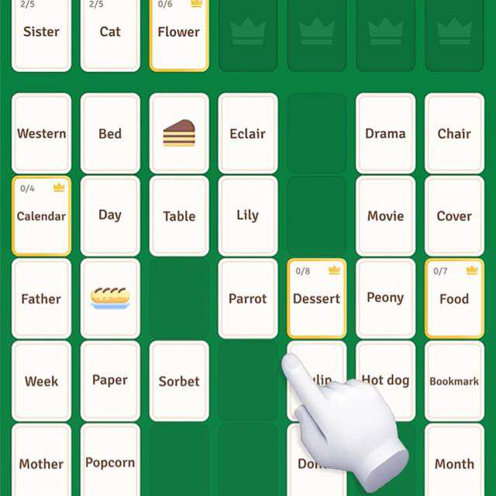
CHEMISTRY SOLITAIRE
Website Development Milestone Plan
Full-Stack Developer

Slide 2
Development Scope
Programmer milestone based on the agreed Chemistry Solitaire MVP
1
Front-end
Responsive pages and learner-facing game interface
2
Back-end
Authentication, database, progress and gameplay data
3
Gameplay
Matching logic, scoring, hints, feedback and progression
4
Testing
Responsive behavior, accessibility and bug fixing
5
Deployment
Production setup and final live release

Slide 3
Website Build Schedule — Part 1
Enter your preferred calendar dates in the Date column
Day 1
Project Setup
• Create project structure
• Configure database
• Set up GitHub/version control
• Prepare development environment
Date: 8th of August
Day 2
Homepage
• Responsive navigation
• Hero/project introduction
• Main call-to-action sections
• Mobile and desktop layout
Date: 12th of August
Day 3
Registration & Login
• User registration
• Login and logout
• Authentication flow
• Basic user profile data
Date: 13th of August
Day 4
User Dashboard
• Learner dashboard
• User information
• Navigation to topics
• Progress summary area
Date: 14th of August
Day 5
Topic Selection Page
• Chemistry topic cards
• Topic selection
• Level/difficulty selection
• Connect selection to game
Date: 15th of August

Slide 4
Website Build Schedule — Part 2
Enter your preferred calendar dates in the Date column
Days 6–7
Game Board UI
• Solitaire-style card interface
• Theme/matching areas
• Card interactions
• Responsive gameplay layout
Date: 17th of August
Days 8–9
Game Logic
• Card selection and matching
• Correct-match validation
• Incorrect-answer feedback
• Core game rules
Date: 19th of August
Day 10
Score & Hints
• Scoring system
• Moves counter
• Hints
• Learner feedback
Date: 21st of August
Day 11
Level Progression
• Completion logic
• Level progression
• Completion screen
• Next-level navigation
Date: 24th of August
Day 12
Progress Tracking
• Save scores and attempts
• Track time spent
• Store hints used
• Save completion status
Date: 28th of August

Slide 5
Website Build Schedule — Part 3
Enter your preferred calendar dates in the Date column
Day 13
Testing & Bug Fixes
• Functional testing
• Responsive testing
• Accessibility checks
• Fix identified bugs
Date: 16th of October
Day 14
Deployment
• Production configuration
• Database/hosting setup
• Final live testing
• Deploy web MVP
Date: On the completion of the
project

Slide 6
Final Milestone
Expected output after the development schedule
Working Chemistry Solitaire Web MVP
✓ Responsive homepage and navigation
✓ Registration, login and learner dashboard
✓ Chemistry topic and level selection
✓ Playable card-matching game board
✓ Scoring, hints, feedback and progression
✓ Progress tracking and basic teacher view
✓ Tested and deployed web application

