Slide 1



Survival Prediction of Acute Respiratory Distress Syndrome
Please use 20 font size for your sub-title

Slide 2
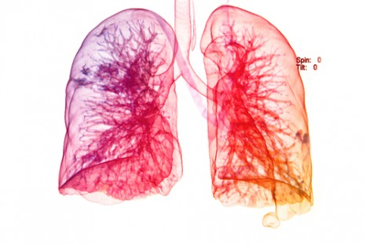
Introduction
Project background
Aims of the project
Exploratory data analysis
Methods
Advanced Section: Imputation

Slide 3
Background: ARDS
Acute Respiratory Distress Syndrome (ARDS)
Common and often fatal cause of respiratory failure
Prevalence of 10% among critically ill patients worldwide^{1,2}
30-40% mortality^{1,2}
Defined as:
acute hypoxic respiratory failure (PaO₂/FiO₂ < 300 mmHg)
bilateral chest infiltrates
absence of cardiac failure as primary diagnosis
[1] Rubenfeld GD, Caldwell E, Peabody E, et al. Incidence and outcomes of acute lung injury. N Engl J Med 2005; 353: 1685–93.
[2] Bellani G, Laffey JG, Pham T, et al. Epidemiology, patterns of care, and mortality for patients with acute respiratory distress syndrome in intensive care units in 50 countries. JAMA 2016; 315: 788–800.
Notes:
https://www.nhs.uk/conditions/acute-respiratory-distress-syndrome/
Acute respiratory distress syndrome (ARDS) is a life-threatening condition where the lungs can't provide the body's vital organs with enough oxygen.
It's usually a complication of a serious existing health condition. Most people have therefore already been admitted to hospital by the time they develop ARDS.
Symptoms of ARDS can include:
severe shortness of breath
rapid, shallow breathing
tiredness, drowsiness or confusion
feeling faint

Slide 4
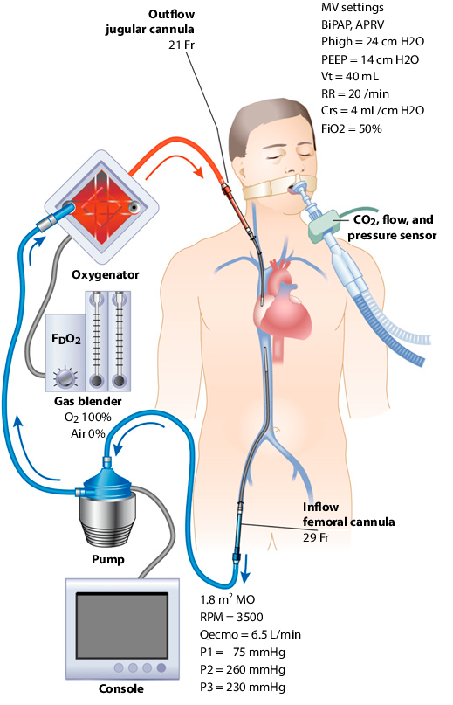
Background: ECMO
Extracorporeal membrane oxygenation (ECMO)
New treatment thought to improve disease outcome
[image] Combes A, Pesenti A, Ranieri VM. Fifty Years of Research in ARDS. Is Extracorporeal Circulation the Future of Acute Respiratory Distress Syndrome Management?. Am J Respir Crit Care Med. 2017 May 1;195(9):1161-1170. doi: 10.1164/rccm.201701-0217CP. Review. PubMed PMID: 28459322.
Notes:
Early studies had shown survival benefit with use of ECMO for people in acute respiratory failure especially in the setting of acute respiratory distress syndrome.^{[6][7]}
Peek, GJ; Moore, HM; Moore, N; Sosnowski, AW; Firmin, RK (1997). "Extracorporeal membrane oxygenation for adult respiratory failure". Chest.
Lewandowski, K.; Rossaint, R.; Pappert, D.; Gerlach, H.; Slama, K.-J.; Weidemann, H.; Frey, D. J. M.; Hoffmann, O.; Keske, U. (1997). "High survival rate in 122 ARDS patients managed according to a clinical algorithm including extracorporeal membrane oxygenation". Intensive Care Medicine.
https://www.semanticscholar.org/paper/Fifty-Years-of-Research-in-ARDS.-Is-Extracorporeal-Leprince-Pesenti/ca0ada0ed074e8c7c09fe0fdfe2f084be0758563

Slide 5
Aims of Project
Can PreECMO biomedical markers be used to accurately predict survival after ECMO treatment?
Do we need all PreECMO variables or just a subset to make accurate predictions?
What is the expected performance of future predictions?

Slide 6
Exploratory Data Analysis
Missing Data Plot

Slide 7
Exploratory Data Analysis
Pairs Plot

Slide 8
Exploratory Data Analysis
Violin Plot

Slide 9
Methods: Models
Logistic Regression
Logistic Regression + LASSO
LDA
QDA
KNN
Classification Tree
Random Forest
SVM

Slide 10
Methods: Model Evaluation
ROC
AUC
F1 Score

Slide 11
Advanced Section: Imputation
Tables of full data vs missing data in list-wise deletion

Slide 12
Advanced Section: Imputation
List-wise deletion
Mean imputation
MICE
Other?

Slide 13

Thank you
2416963E@student.gla.ac.uk

Slide 14
Supplementary Slides

Slide 15
Hypothesis Tests

