Slide 1
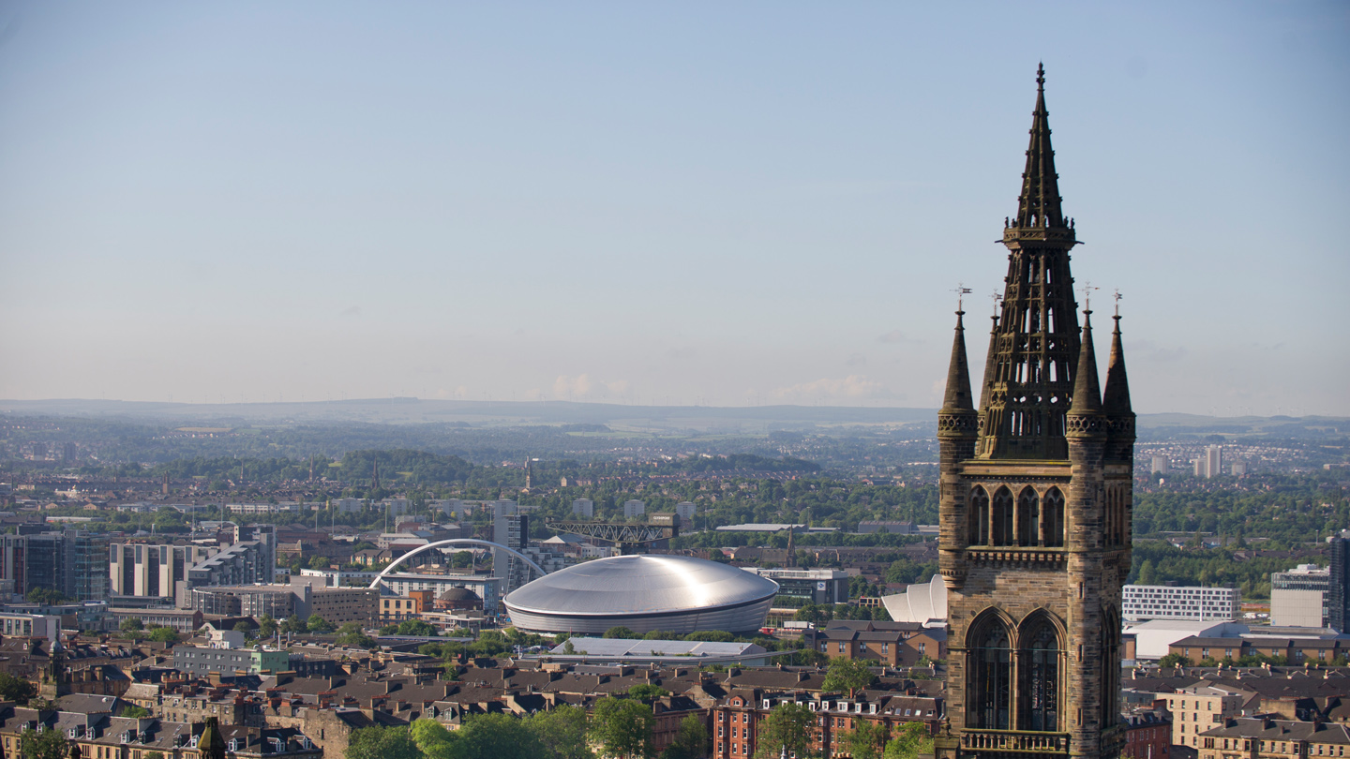


Survival Prediction of Acute Respiratory Distress Syndrome
Please use 20 font size for your sub-title

Slide 2
Guidance notes
These slides are intended to support staff who are making presentations about the University. If appropriate you may also use slides from the other University Powerpoint templates.
Slides 3 and 4 are approved and non-editable.
Please do not put images on top of the full images in the template. If using your own images, diagrams or tables please use the blank slide (Slide 14).
We recommend using the images supplied in this template where possible. If you require additional images the best resource is the University image bank at www.glasgow.ac.uk/photo/restricted. Contact mrio-design@glasgow.ac.uk for the password.
If you require assistance or guidance, please email marketing-brand@glasgow.ac.uk

Slide 3
Acute Respiratory Distress Syndrome
Project background
Aims of the project
Data description
Notes:
https://www.nhs.uk/conditions/acute-respiratory-distress-syndrome/

Slide 4
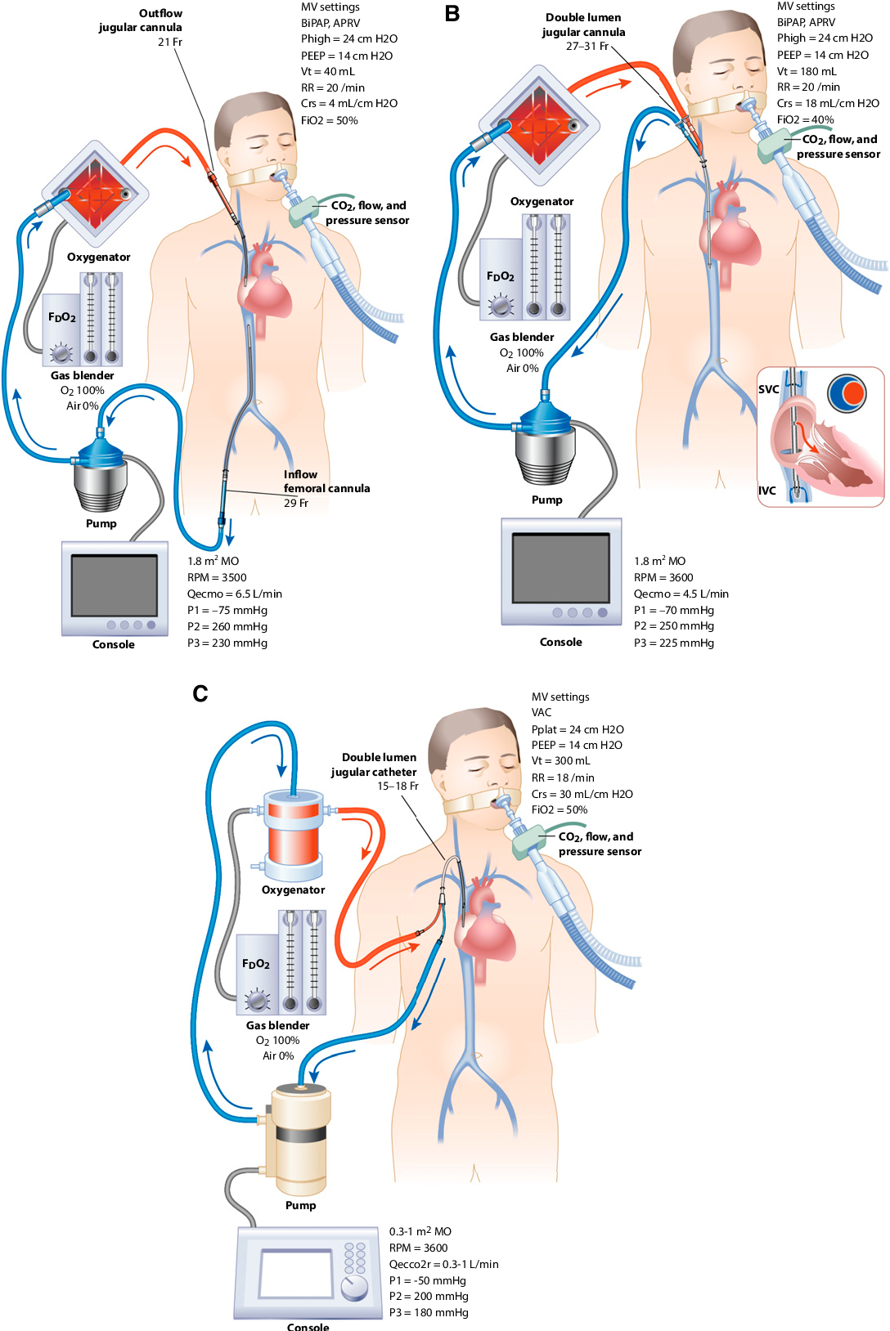
Extracorporeal Membrane Oxygenation (ECMO)
Project background
Aims of the project
Data description
Notes:
Early studies had shown survival benefit with use of ECMO for people in acute respiratory failure especially in the setting of acute respiratory distress syndrome.^{[6][7]}
Peek, GJ; Moore, HM; Moore, N; Sosnowski, AW; Firmin, RK (1997). "Extracorporeal membrane oxygenation for adult respiratory failure". Chest.
Lewandowski, K.; Rossaint, R.; Pappert, D.; Gerlach, H.; Slama, K.-J.; Weidemann, H.; Frey, D. J. M.; Hoffmann, O.; Keske, U. (1997). "High survival rate in 122 ARDS patients managed according to a clinical algorithm including extracorporeal membrane oxygenation". Intensive Care Medicine.
https://www.semanticscholar.org/paper/Fifty-Years-of-Research-in-ARDS.-Is-Extracorporeal-Leprince-Pesenti/ca0ada0ed074e8c7c09fe0fdfe2f084be0758563

Slide 5
Questions of Interest
Can PreECMO biomedical markers be used to accurately predict ECMO survival?
Do we need all PreECMO variables or just a subset to make accurate predictions?
What is the expected performance of future predictions?

Slide 6
Exploratory Data Analysis
Your body text should be minimum size 16.
We recommend that you use headings or bullet points
Your audience want to hear and see you present not read from a slide.
To insert an image, right-click (ctrl + click Mac) and select ‘send to back’, to place it behind the University marque at the top.

Slide 7
Logistic Regression
Your body text should be minimum size 16.
We recommend that you use headings or bullet points
Your audience want to hear and see you present not read from a slide.
To insert an image, right-click (ctrl + click Mac) and select ‘send to back’, to place it behind the University marque at the top.

Slide 8
K-Nearest Neighbours
Only for continuous variables

Slide 9
LDA/QDA
Only for continuous variables

Slide 10
Trees / Random Forrests
Your body text should be minimum size 16.
We recommend that you use headings or bullet points
Your audience want to hear and see you present not read from a slide.
To insert an image, right-click (ctrl + click Mac) and select ‘send to back’, to place it behind the University marque at the top.

Slide 11
Support Vector Machines
Your body text should be minimum size 16.
We recommend that you use headings or bullet points
Your audience want to hear and see you present not read from a slide.
To insert an image, right-click (ctrl + click Mac) and select ‘send to back’, to place it behind the University marque at the top.

Slide 12
Comparison of Methods
ROC
AUC
F1 Score

Slide 13
Advanced Section: Imputation
Your body text should be minimum size 16.
We recommend that you use headings or bullet points
Your audience want to hear and see you present not read from a slide.
To insert an image, right-click (ctrl + click Mac) and select ‘send to back’, to place it behind the University marque at the top.

Slide 14
Advanced Section: Imputation
These slides are intended to support staff who are making presentations about the University. If appropriate you may also use slides from the other University Powerpoint templates.
Slides 3 and 4 are approved and non-editable.
Please do not put images on top of the full images in the template. If using your own images, diagrams or tables please use the blank slide (Slide 14).
We recommend using the images supplied in this template where possible. If you require additional images the best resource is the University image bank at www.glasgow.ac.uk/photo/restricted. Contact mrio-design@glasgow.ac.uk for the password.
If you require assistance or guidance, please email marketing-brand@glasgow.ac.uk

Slide 15




This is your closing slide
You can add your contact details, a call to
action or a simple Thank you using this slide
#UofGWorldChangers
@UofGlasgow

