Slide 1
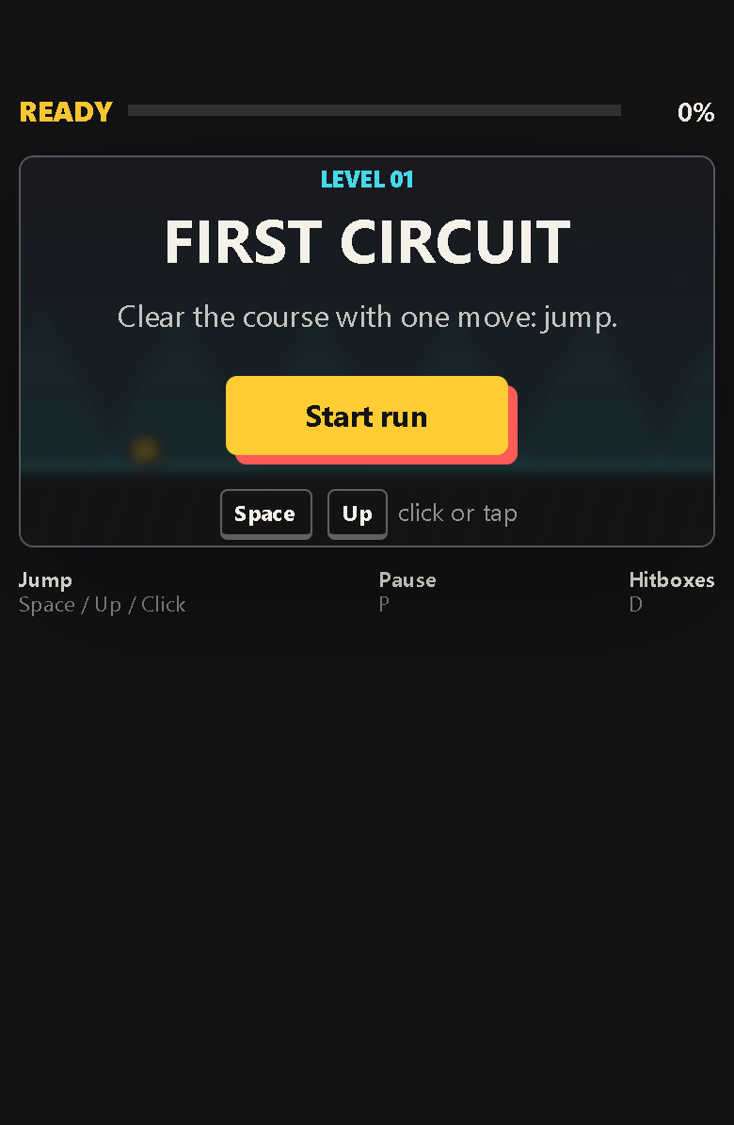
PULSE RUN 07
Packaging the
Phone Edition
Why one distributable file can be easier to move and open
Beginner coding tutorial
Notes:
Open the phone edition directly from its saved location. Emphasize that its gameplay is the same; only the delivery format has changed. Source: local Pulse_Run_Phone_Edition.html.

Slide 2
Learning goals
07
By the end of this tutorial, students can:
Distinguish editable source files from a distribution build
Explain how relative file paths create dependencies
Describe how CSS and JavaScript can be placed inside HTML
Identify the benefits, limits, and tests for a one-file edition
Key question
Why keep several source files when one file is easier to share?
Pulse Run 07: Packaging the Phone Edition
2
Notes:
Use the key question to surface two different needs: humans need maintainable source code, while players need a reliable package.

Slide 3
The source project uses three files
07
css/style.css
appearance
index.html
structure
Browser combines
the files
js/game.js
behaviour
The links are relative paths. Move or omit one file and the page can lose its style or game logic.
Pulse Run 07: Packaging the Phone Edition
3
Notes:
Show the link and script tags in index.html. A relative URL is resolved from the document's location. Source: local index.html. Reference: https://developer.mozilla.org/en-US/docs/Web/CSS/Reference/Values/url_value

Slide 4
Packaging places the dependencies inside HTML
07
<style>
/* contents of style.css */
</style>
<canvas id="gameCanvas"></canvas>
<script>
// contents of game.js
</script>
The browser receives one HTML document
No CSS or JavaScript path can break
The same game code still runs offline
No internet connection is introduced
Inlining changes where the code lives, not what the code means.
Pulse Run 07: Packaging the Phone Edition
4
Notes:
Compare this slide with the original link and script tags. The build script reads the source files and inserts their contents between style and script tags. Source: local build-phone-edition.mjs and generated phone HTML.

Slide 5
Each format serves a different audience
07
Teaching source
Phone edition
HTML, CSS, and JavaScript stay separate
Beginners can find each responsibility
Editing and debugging are easier
This remains the master version
One item is easier to send or copy
Relative dependency errors disappear
The combined file is harder to study
It must be rebuilt after source changes
Pulse Run 07: Packaging the Phone Edition
5
Notes:
Do not present one format as universally better. Separation helps authors; bundling helps distribution. Platform file-opening rules can still vary, especially on phones.

Slide 6
Use one source of truth
07
Edit source
Bundle files
Test phone
edition
Distribute
Never hand-edit both copies. Rebuild the phone edition from the readable source after every approved change.
Pulse Run 07: Packaging the Phone Edition
6
Notes:
Demonstrate the generated comment at the top of the phone edition. The bundler also checks that no external script or stylesheet remains. Source: local build-phone-edition.mjs.

Slide 7
Checkpoint: audit a portable build
07
Prove that the phone edition is genuinely portable.
Test checklist
Evidence
Confirm that only one game file is required
Open it without an internet connection
Test tap, pause, sound, collision, and restart
Check portrait and landscape orientations
A completed checklist and one noted limitation of the device or browser.
Pulse Run 07: Packaging the Phone Edition
7
Notes:
Airplane mode is a useful classroom test, but direct opening still depends on the phone's file manager and browser. Installing a web app is a different process and commonly requires a secure web origin. Reference: https://developer.mozilla.org/en-US/docs/Web/Progressive_web_apps/Tutorials/CycleTracker/Secure_connection

