Slide 1

Game Animation & Development Studio
First meet and greet
Today is for names, interests, expectations, and the big idea behind the studio.
Notes:
Welcome students warmly. Keep the tone conversational.
Source context: D:\0_AnimationAndGameDesign\Curriculum\Wednesday_Studio_Session_Types.md and Academic_Year_Course_Outline_Find_It_Fix_It.md.
Image source: local workspace image game-development-google-classroom-photoreal-1600x400.png.

Slide 2
Meeting Agenda
Session 1
01
Welcome
What the studio is for
02
Introductions
Names, interests, and experience
03
Studio culture
How we build and give feedback
04
Big ideas
Games, animation, users, and testing
05
Starting pathway
Where each student begins next
Discussion prompt
What would make this studio worth showing up for each week?
Game Animation & Development Studio 2
Notes:
Use this as a timing guide, not a rigid lecture.
Invite short responses early so students know the session expects voices, not silence.
Source context: Orientation And Placement Meeting agenda in Wednesday_Studio_Session_Types.md.

Slide 3
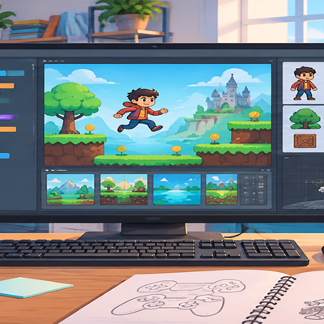
How we do things: Progress not perfection
Students will learn by making visible progress, testing early, and explaining how each change affects the audience.
A game idea becomes clearer when someone else tries it.
An animation becomes stronger when motion, timing, and feeling connect.
A small improvement can teach more than a large unfinished plan.
Discussion prompt
Think of a game, animation, or app you like. What does it make the audience do or feel?
Game Animation & Development Studio 3
Notes:
Connect the studio to audience experience. This is the first big idea.
Image source: local workspace image game-development-google-classroom.png.

Slide 4
Studio Culture
Good creative work needs trust, iteration, and clear feedback
Test early
Save often
Show rough work before it feels finished.
Protect progress before risky changes.
Describe problems clearly
Focus feedback on the work
Name what happened and where it happened.
Critique the design, experience, or communication.
Credit assets
Improve one small thing
Respect the people whose work helps your project.
Choose a change you can test this week.
Discussion prompt
Which norm will help us most when the work gets difficult?
Game Animation & Development Studio 4
Notes:
These norms are adapted from the Studio Level 1 manual.
Ask students which one they think the group will need most.
Source context: StudioLevel1_Explorer_Game_Foundations_Instruction_Manual.md.

Slide 5
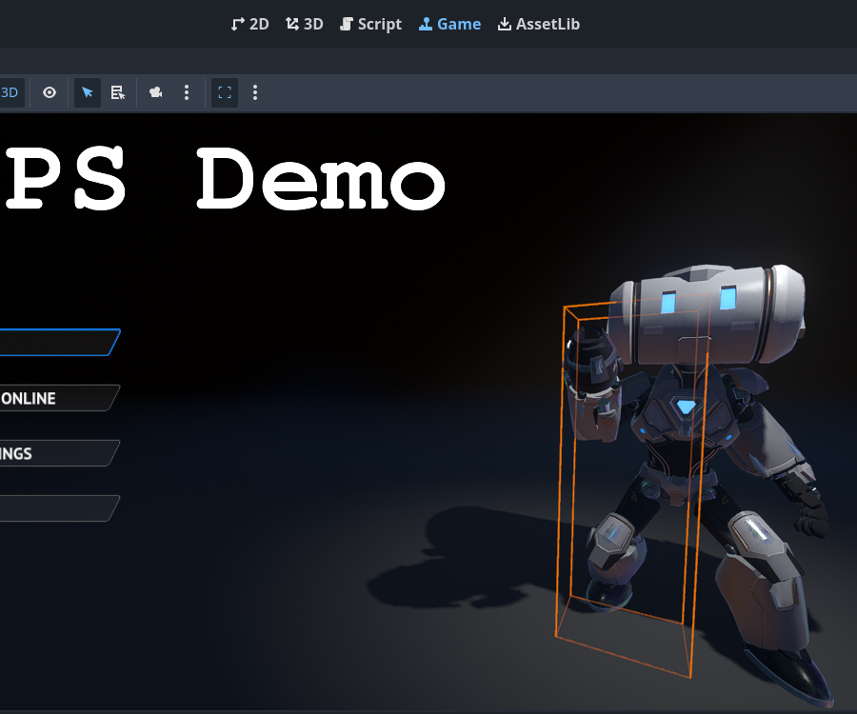
Big Idea: Designed Experiences
Games and animations are built from choices that shape what people notice
Player action
What the player does
Goal
What the player tries to achieve
Rule
What limits or guides the action
Feedback
How the work tells the audience what changed
Feeling
The response the design is trying to create
Discussion prompt
When you play or watch something, what makes you say I understand what to do?
Game Animation & Development Studio 5
Notes:
Keep this slide interactive. Ask for examples from students' games, shows, apps, or videos.
Image source: local Godot documentation image editor_intro_workspace_game.webp.
Source context: Lesson 1 vocabulary in StudioLevel1_Explorer_Game_Foundations_Instruction_Manual.md.

Slide 6
Big Idea: Find It, Fix It, Play It
The first projects start with small changes to working or partly working examples
Find
Fix
Test
Explain
What is unclear, missing, unfair, broken, or weak?
Change one thing that a player can notice.
Let another person try it before you explain it.
Describe how the player experience changed.
First task mindset: one small improvement, tested with a real person.
Discussion prompt
What kind of problem do you notice first in games: controls, fairness, story, visuals, sound, or instructions?
Game Animation & Development Studio 6
Notes:
This is the course pathway in plain language.
Source context: Core Teaching Principle and Year Goal in Academic_Year_Course_Outline_Find_It_Fix_It.md.

Slide 7
Starting Pathways
Students can begin at different levels and still share the same studio rhythm
Explorer
Modify and explain a simple 2D game prototype.
Builder
Repair, tune, and extend an arcade-style game.
Designer
Improve story, UI, feedback, systems, and user experience.
Developer
Contribute to a team project with a defined production role.
Director
Prepare a polished demo, pitch, and documentation.
Discussion prompt
Where do you think you are starting, and what would help you move up one level?
Game Animation & Development Studio 7
Notes:
Do not make placement feel fixed. Emphasize starting point, not ranking.
Source context: Studio Level Fit table in Academic_Year_Course_Outline_Find_It_Fix_It.md.

Slide 8
Let’s Chat
What games, animations, tools, or stories have shaped your taste?
Next step
What have you made before, even if it was small or unfinished?
Join Google Classroom, complete the interest form, and bring one idea or example to the next session.
What do you want to learn first: art, code, story, level design, sound, UI, or production?
What access do you have to a laptop, files, and Google Classroom?
Thank you
Notes:
Let students answer in pairs first if the room is quiet.
Source context: Orientation And Placement Meeting outputs in Wednesday_Studio_Session_Types.md.

