Slide 1
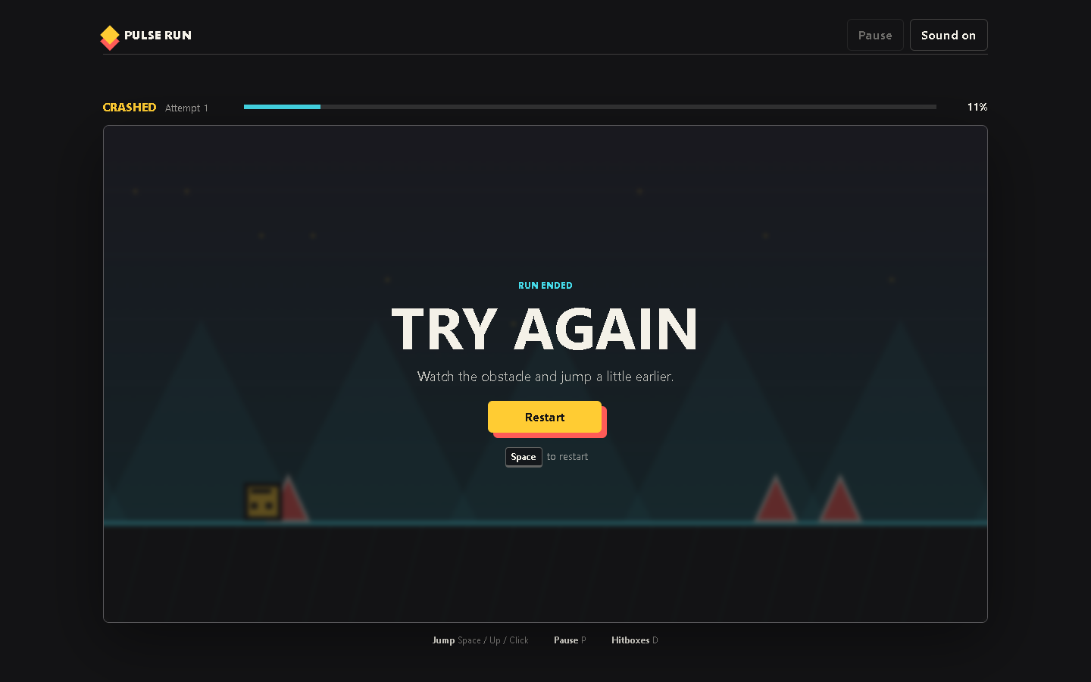
PULSE RUN 05
Collision and Game States
How invisible rectangles control loss, landing, pause, and victory
Beginner coding tutorial
Notes:
Press D during play. Explain that the green rectangles are the boundaries used by code.

Slide 2
Learning goals
05
By the end of this tutorial, students can:
Explain rectangular overlap
Describe why hitboxes can be smaller than artwork
Distinguish landing from crashing
Trace ready, playing, paused, lost, and won states
Key question
How does the game decide what should happen after contact?
Pulse Run 05: Collision and Game States
2
Notes:
Collision becomes easier when students separate detection from the response that follows.

Slide 3
Rectangles overlap when all edges cross
05
return a.x < b.x + b.width &&
a.x + a.width > b.x &&
a.y < b.y + b.height &&
a.y + a.height > b.y;
Each line compares one pair of edges
All four conditions must be true
One false condition means separation
The test works for player and obstacles
Pulse Run 05: Collision and Game States
3
Notes:
Use two books or sheets of paper to demonstrate overlap physically. Source: game.js.

Slide 4
Artwork and hitboxes serve different purposes
05
Visible shape
Collision shape
Communicates the object
May rotate or contain empty space
Can change during the art pass
Supports the visual style
Defines contact
Uses simple rectangles
Stays predictable
Can be slightly forgiving
Pulse Run 05: Collision and Game States
4
Notes:
Point out the inset in playerRect() and the narrow spike rectangle. Source: game.js.

Slide 5
A block can support or stop the player
05
const fallingOntoBlock =
state.player.velocityY >= 0 &&
previousBottom <= blockTop + 8;
if (overlaps(player, collision) &&
fallingOntoBlock) {
// place player on top
}
Velocity confirms downward movement
Previous position shows the approach
The tolerance allows a fair landing
Other overlap causes a crash
Pulse Run 05: Collision and Game States
5
Notes:
The previous position prevents side contact from becoming a landing. Source: game.js.

Slide 6
Game states control available actions
05
Ready
Playing
Paused
Lost or won
Input means something different in each state, but one state is active at a time.
Pulse Run 05: Collision and Game States
6
Notes:
Discuss transitions: Start, P, collision, finish, Restart. Source: state.mode and related functions in game.js.

Slide 7
Checkpoint: diagnose a collision
05
Use debug mode to explain one collision before changing code.
Task steps
Evidence
Press D to show hitboxes
Approach one obstacle
Pause near contact
Compare visible and collision shapes
Describe which edges overlap
A screenshot or sketch with the four relevant edges labelled.
Pulse Run 05: Collision and Game States
7
Notes:
The aim is explanation. Students should not change hitboxes until they can describe the current result.

