Slide 1
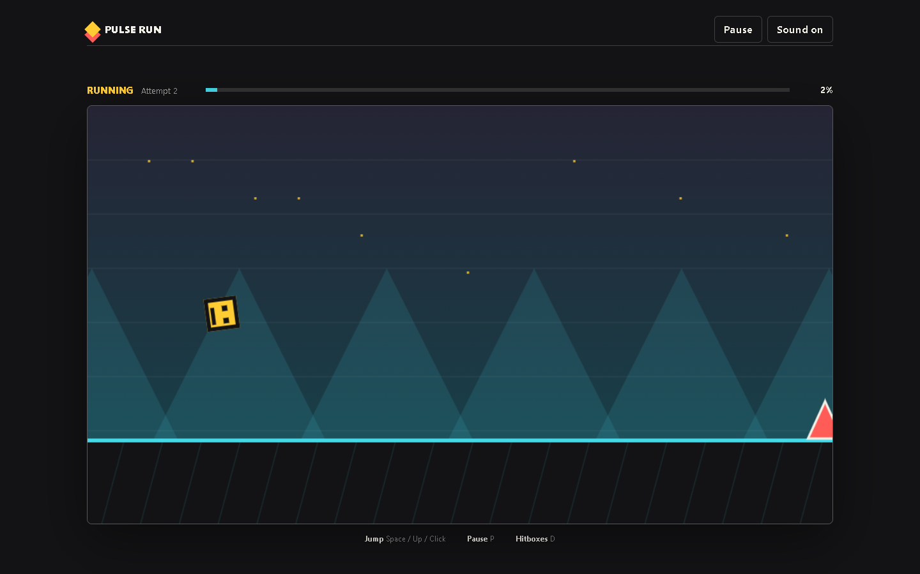
PULSE RUN 02
The Game Loop
How the browser updates and redraws a moving game
Beginner coding tutorial
Notes:
Run the game and pause after one jump. Explain that the still image came from many rapid updates.

Slide 2
Learning goals
02
By the end of this tutorial, students can:
Describe the update and draw cycle
Explain the role of requestAnimationFrame
Use delta time to reason about movement
Identify why update stops during pause
Key question
What must happen during every frame of play?
Pulse Run 02: The Game Loop
2
Notes:
Students should leave with a conceptual loop before studying individual formulas.

Slide 3
One frame of the game
02
Read input
Update values
Check collisions
Draw scene
The browser repeats this cycle before each visible frame.
Pulse Run 02: The Game Loop
3
Notes:
Ask students which steps change data and which step only shows data. Source: MDN Anatomy of a video game and local game.js.

Slide 4
The browser schedules each frame
02
function frame(time) {
const elapsed = Math.min(
(time - state.lastTime) / 1000,
0.034
);
state.lastTime = time;
if (state.mode === "playing") {
update(elapsed);
}
draw();
requestAnimationFrame(frame);
}
time comes from the browser
elapsed measures seconds
Only playing mode updates
draw still shows paused scenes
Pulse Run 02: The Game Loop
4
Notes:
Trace top to bottom. Source: game.js. Reference: https://developer.mozilla.org/docs/Games/Anatomy

Slide 5
Update and draw stay separate
02
update(deltaTime)
draw()
Changes distance
Applies gravity
Moves the player
Checks collisions
Changes game state
Clears the old picture
Draws background and ground
Draws obstacles and finish
Draws the player
Never changes the rules
Pulse Run 02: The Game Loop
5
Notes:
Ask what bug might occur if drawing changed player position. Source: game.js.

Slide 6
Delta time controls speed
02
state.distance +=
RUN_SPEED * deltaTime;
state.player.velocityY +=
PLAYER.gravity * deltaTime;
state.player.y +=
state.player.velocityY * deltaTime;
Speed describes change per second
A frame uses only part of a second
Multiplication converts rates into frame changes
Slow displays still move at similar speed
Pulse Run 02: The Game Loop
6
Notes:
Use a simple example: 300 pixels per second times 0.02 seconds gives 6 pixels. Source: game.js.

Slide 7
Checkpoint: follow one frame
02
Narrate one frame while the player is airborne.
Task steps
Evidence
Name the current mode
Calculate what gravity changes
Describe the collision check
List the final drawing order
A spoken or written frame trace that uses update and draw correctly.
Pulse Run 02: The Game Loop
7
Notes:
Listen for the misconception that requestAnimationFrame moves objects by itself.

