Slide 1
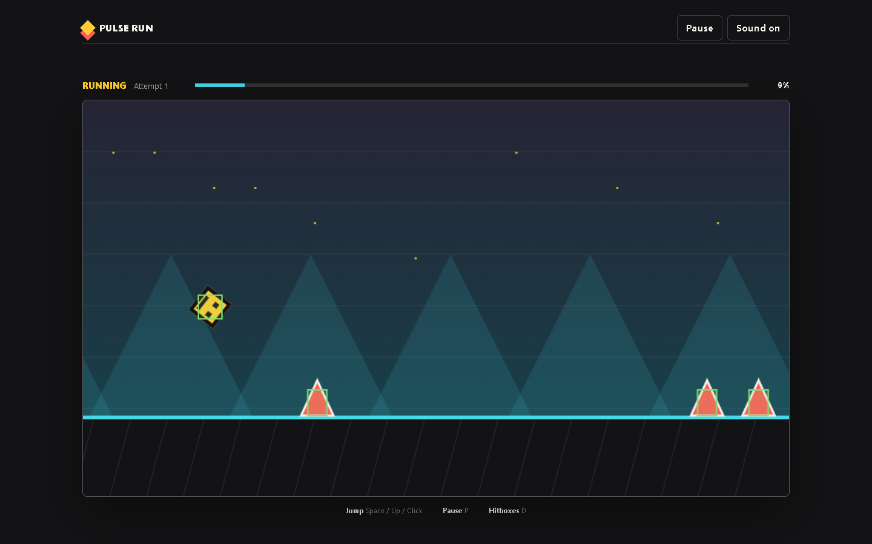
PULSE RUN 03
Input and Jump Physics
How one button changes velocity and creates a jump
Beginner coding tutorial
Notes:
Turn on hitboxes with D and pause during a jump. Ask students which values must be changing.

Slide 2
Learning goals
03
By the end of this tutorial, students can:
Read Canvas x and y coordinates
Explain vertical position and velocity
Describe how gravity changes a jump
Connect several inputs to one game action
Key question
How do velocity and gravity create a complete jump arc?
Pulse Run 03: Input and Jump Physics
2
Notes:
Keep the focus on relationships between values. Formal physics terminology can come later.

Slide 3
The jump changes over time
03
Jump sets
negative speed
Player rises
Gravity slows
the rise
Player falls
Ground stops
the fall
One impulse begins the jump. Gravity shapes everything that follows.
Pulse Run 03: Input and Jump Physics
3
Notes:
In Canvas, smaller y values are higher on screen. Source: game.js.

Slide 4
The jump begins with one assignment
03
if (state.mode !== "playing" ||
!state.player.grounded) return;
state.player.velocityY =
-PLAYER.jumpSpeed;
state.player.grounded = false;
The guard rejects invalid jumps
Negative y speed moves upward
One value starts the whole arc
grounded blocks air jumps
Pulse Run 03: Input and Jump Physics
4
Notes:
Ask students to predict what happens if the minus sign disappears. Source: game.js.

Slide 5
Gravity reverses the motion
03
state.player.velocityY +=
PLAYER.gravity * deltaTime;
state.player.y +=
state.player.velocityY * deltaTime;
Gravity adds downward speed
Velocity eventually reaches zero
Positive velocity produces falling
Position changes after velocity
Pulse Run 03: Input and Jump Physics
5
Notes:
Sketch a simple number line on the board: -900, -500, 0, +500. Source: game.js.

Slide 6
Many inputs, one action
03
Input events
requestJump()
Space key
Up Arrow key
Mouse click
Screen tap
Starts from ready
Restarts after a result
Checks grounded during play
Applies jump velocity once
Pulse Run 03: Input and Jump Physics
6
Notes:
The input devices differ, but they call the same function. Source: game.js.

Slide 7
Checkpoint: tune the jump
03
Change one physics value and predict the effect before testing.
Task steps
Evidence
Choose gravity or jumpSpeed
Write a prediction
Change the value by about 10 percent
Run three trials
Compare the result with the prediction
Before and after values plus one sentence explaining the changed game feel.
Pulse Run 03: Input and Jump Physics
7
Notes:
Encourage one variable at a time. Restore the source value after the experiment.

