Slide 1
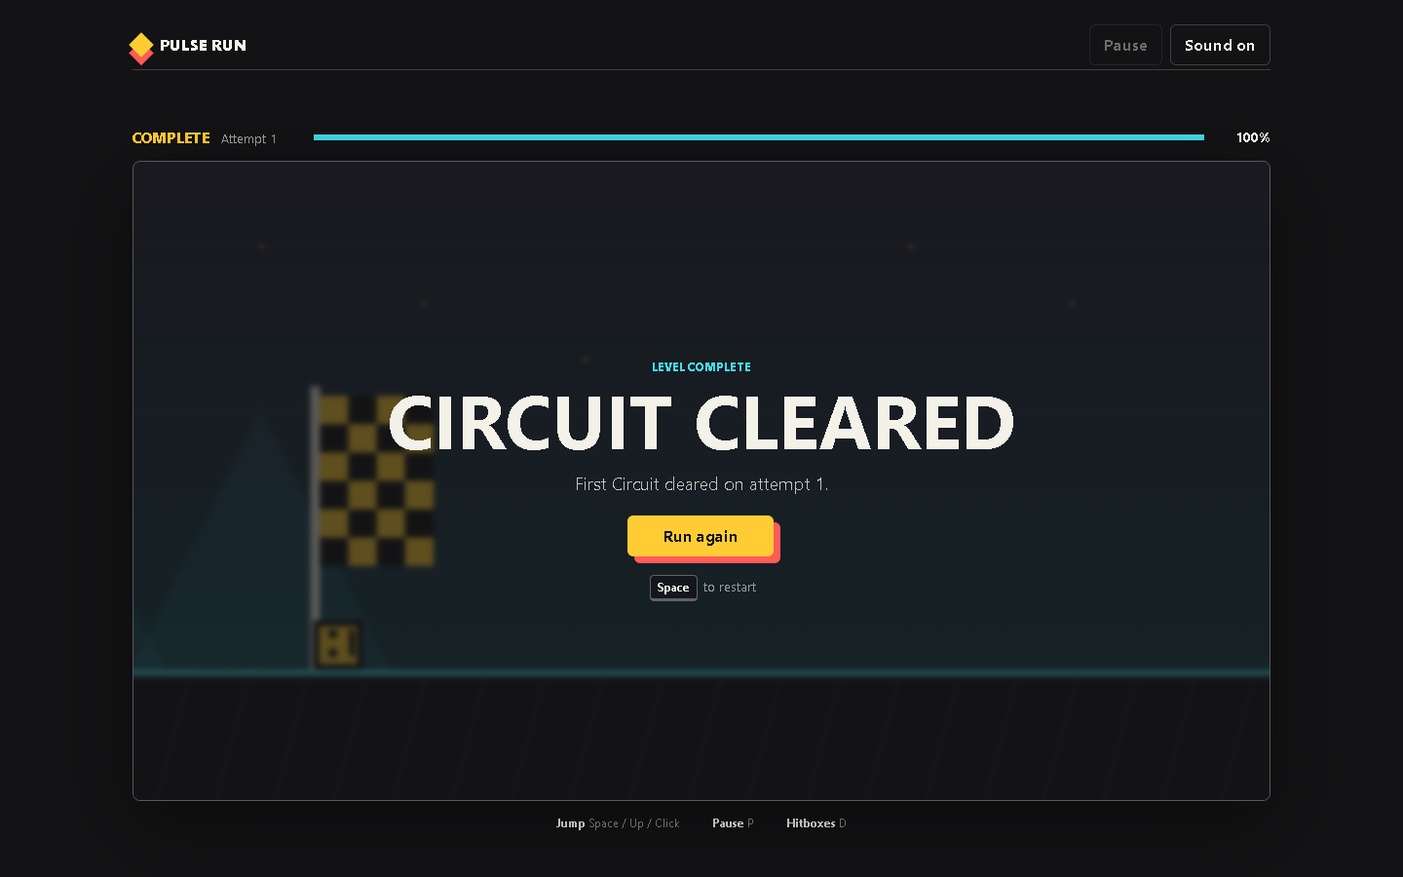
PULSE RUN 06
Testing and Extension
How to change the game without losing a working version
Beginner coding tutorial
Notes:
Begin with the completed screen. Ask what had to work correctly for the game to reach this state.

Slide 2
Learning goals
06
By the end of this tutorial, students can:
Use debug tools and focused test cases
Check keyboard, pointer, and mobile layouts
Change one system at a time
Explain how a revision affects the player
Key question
What evidence shows that a change improved the game?
Pulse Run 06: Testing and Extension
2
Notes:
Testing should connect code changes to player experience, not only to the absence of errors.

Slide 3
Different tests answer different questions
06
Code behaviour
Player experience
Does Start begin one loop?
Does collision end the run?
Does Pause freeze updates?
Does victory reach 100 percent?
Is the first obstacle readable?
Does jumping feel responsive?
Are hitboxes fair?
Can a new player recover quickly?
Pulse Run 06: Testing and Extension
3
Notes:
A technically correct game can still confuse players. Use both columns during review.

Slide 4
Debug mode reveals invisible rules
06
if (event.code === "KeyD") {
state.debug = !state.debug;
}
if (state.debug) {
drawHitbox(playerRect());
}
A Boolean stores on or off
The D key toggles the value
Rendering reads the value
Game rules remain unchanged
Pulse Run 06: Testing and Extension
4
Notes:
Debug displays should observe the system without altering its behaviour. Source: game.js.

Slide 5
A controlled revision cycle
06
Predict
Change one value
Run the same test
Observe
Explain
Keeping the test constant makes the effect of one change easier to identify.
Pulse Run 06: Testing and Extension
5
Notes:
Connect this process to the studio's Find It, Fix It, Play It model.

Slide 6
A complete offline test set
06
Inputs and states
Display and delivery
Space and Up Arrow
Click or tap
Pause and resume
Mute and unmute
Restart after loss
Desktop viewport
Narrow mobile viewport
Direct file:// launch
No missing local assets
A full winning run
Pulse Run 06: Testing and Extension
6
Notes:
Use this as a release checklist before students submit a project folder.

Slide 7
Studio challenge: a 10 second segment
06
Design, test, and explain one original course segment.
Task steps
Evidence
Sketch the intended jump rhythm
Add obstacle records
Test from a clean restart
Observe another player
Revise one problem
Playable folder, one feedback note, and a short explanation of the revision.
Pulse Run 06: Testing and Extension
7
Notes:
Assess understanding, testing, and explanation more heavily than decoration or difficulty.

