Slide 1
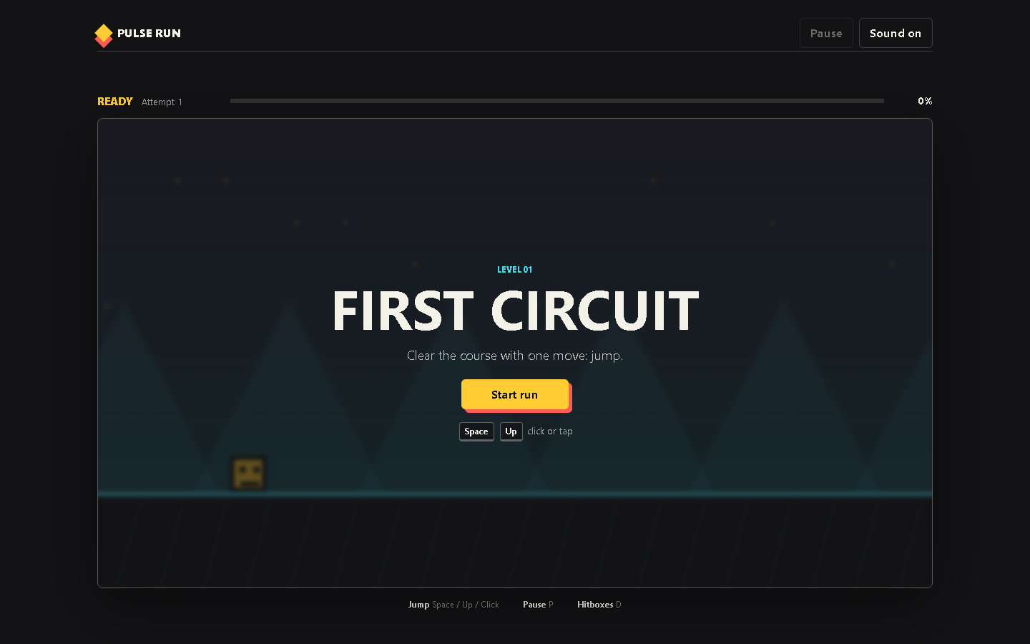
PULSE RUN 01
Project Structure and Canvas
How HTML, CSS, and JavaScript divide the work
Beginner coding tutorial
Notes:
Open index.html before presenting. Ask students what they think the browser must load before the game can appear.

Slide 2
Learning goals
01
By the end of this tutorial, students can:
Explain the purpose of index.html, style.css, and game.js
Identify which interface elements belong in HTML
Describe why the moving world belongs inside Canvas
Trace how the script connects to the page
Key question
Which file should change when the game needs a new behaviour?
Pulse Run 01: Project Structure
2
Notes:
Use the goals as a diagnostic. Students may know HTML or CSS but still confuse structure, appearance, and behaviour.

Slide 3
Three files, three responsibilities
01
HTML
Structure
CSS
Appearance
JavaScript
Behaviour
The browser combines all three files into one playable experience.
Pulse Run 01: Project Structure
3
Notes:
Ask for one example from the game for each box. Source: local index.html, style.css, and game.js.

Slide 4
The page loads the game
01
<canvas id="gameCanvas"
width="960" height="540">
</canvas>
<script src="js/game.js"></script>
Canvas supplies the drawing surface
The id lets JavaScript find it
The script loads after the HTML
A classic script works from file://
Pulse Run 01: Project Structure
4
Notes:
Point to the closing body tag in index.html. Ask why loading the script last helps. Source: index.html.

Slide 5
Canvas and HTML have different jobs
01
Canvas game world
HTML interface
Player and obstacles
Background and ground
Frame by frame movement
Debug hitboxes
Start and restart buttons
Progress and attempt text
Pause and sound controls
Accessible status messages
Pulse Run 01: Project Structure
5
Notes:
Stress that Canvas is pixels while HTML contains real controls and readable text. Source: index.html and game.js.

Slide 6
JavaScript finds HTML elements
01
const canvas = document.querySelector(
"#gameCanvas"
);
const startButton = document.querySelector(
"#startButton"
);
# means an element id
The result is stored in a constant
Later code can draw or listen for clicks
The lookup happens once at startup
Pulse Run 01: Project Structure
6
Notes:
Have students locate both ids in index.html, then find these constants in game.js. Source: game.js.

Slide 7
Checkpoint: trace one control
01
Trace the Start button from HTML to JavaScript.
Task steps
Evidence
Find id="startButton" in index.html
Find the matching querySelector
Find its click event listener
Explain which function runs
A four step explanation using the actual names from the source.
Pulse Run 01: Project Structure
7
Notes:
Expected chain: button element, startButton constant, addEventListener, startRun().

