Slide 1
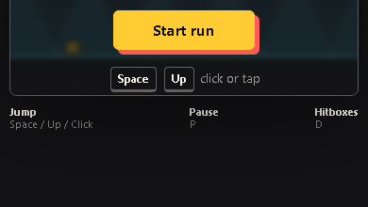
PULSE RUN 04
Level Data and Rendering
How obstacle records become a scrolling course
Beginner coding tutorial
Notes:
Show the mobile view to reinforce that logical game coordinates remain the same when the Canvas appears smaller.

Slide 2
Learning goals
04
By the end of this tutorial, students can:
Read an obstacle object
Explain world and screen positions
Trace how type selects a drawing method
Edit level pacing without rewriting the engine
Key question
How can one drawing function render many different obstacles?
Pulse Run 04: Level Data and Rendering
2
Notes:
Students should see data as a design tool, not merely as syntax.

Slide 3
Obstacles are stored as data
04
const obstacles = [
{ type: "spike",
x: 980, width: 44, height: 48 },
{ type: "block",
x: 2150, width: 86, height: 72 }
];
type chooses behaviour and drawing
x places the object in the level
width and height describe size
One array contains the course
Pulse Run 04: Level Data and Rendering
3
Notes:
Ask students which property they would change to move a spike later. Source: game.js.

Slide 4
World position becomes screen position
04
Obstacle
world x
Subtract
distance
Add player
screen x
Current
screen x
The player stays near the left while the level moves past the camera.
Pulse Run 04: Level Data and Rendering
4
Notes:
Use x = obstacle.x - state.distance + PLAYER.x. Source: game.js.

Slide 5
Type selects the drawing
04
if (obstacle.type === "spike") {
// draw a triangle
} else {
// draw a block
}
obstacles.forEach(drawObstacle);
The loop visits every record
One function handles both types
New records reuse existing logic
Visible objects skip no game rules
Pulse Run 04: Level Data and Rendering
5
Notes:
Distinguish adding a new object from adding a new object type. Source: game.js.

Slide 6
Foreground and background move differently
04
Gameplay layer
Background layer
Ground uses full distance
Obstacles use full distance
Movement must match collision
Timing affects challenge
Mountains use a small multiplier
Stars move even more slowly
Parallax suggests depth
No collision rules apply
Pulse Run 04: Level Data and Rendering
6
Notes:
Source: drawBackground(), drawGround(), and drawObstacle() in game.js.

Slide 7
Checkpoint: add a fair obstacle
04
Add one new spike to a safe part of the course.
Task steps
Evidence
Choose an x position with enough warning
Copy one spike record
Change only the x value
Run the full approach
Ask another person to test
The new data record and one observation from a playtest.
Pulse Run 04: Level Data and Rendering
7
Notes:
Check commas carefully. A syntax error in an array often comes from missing punctuation.

