Slide 1



W1D2 - The Dev Workflow

Slide 2

Agenda
INTRODUCTION
CURRICULUM OVERVIEW
APPROACH TO LECTURES
TOOLS
VERSION CONTROL
INCREMENTAL DEVELOPMENT
DEMO & CODE

Slide 3


Slide 4


INTRODUCTION
RYAN TERNIER
Business Owner – Currently working with the Government of Alberta as a Portfolio Architect heading up their enterprise grants systems
15 years managing, coaching, and cultivating high performing technology teams
20+ years experience as an Enterprise Solution architect & Full Stack Developer
Notes:
Orient – Explain my teaching approach, my expectations: Professionalism, considerate, and fun.
Behavior – Comments, hands up, be present.
Comfort – Everyone has a different comfort level when it comes to participation. I love active participation, but don’t feel you need to participate. Also, don’t get caught off guard if I call you out to answer something.
Activities – Throughout various lectures I will break you into random groups to do some problem solving or coding. The Goal here is to make sure you all feel supported by your peers, and to build some cohesion in this group.

Slide 5

Curriculum Overview
What have you got yourselves into?
Notes:
Flex Program-Curriculum Outline - Google Slides

Slide 6

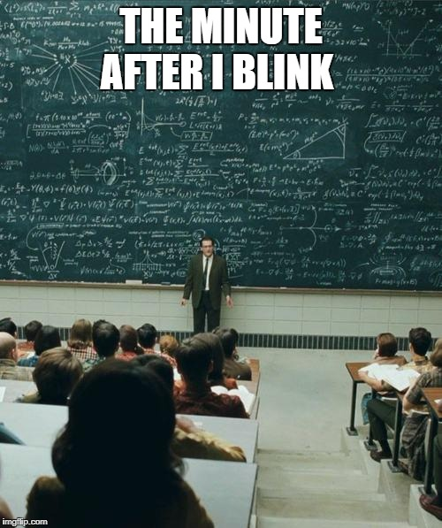
Approach to lectures
Notes:
Let’s jump into some examples. We’re going to load up an API I’ve written in .NET 7. Now we can interact with this multiple ways: Swagger, or a sample web page. We’re going to use Swagger and a sample web app.
In the demo, We will look at a web application that is vulnerable to SQL injection by allowing user input to be included in SQL queries without proper validation or sanitization.
Next we will review how the injection attack will be executed on the remote server.
Finally, we’ll look at how to secure the application against these attacks by using: Parameters, Input validation, and other best practices

Slide 7
Approach to Lectures
Lecture over Zoom:
Instructor will provide a Zoom link in your slack channels 15-20 minutes before lecture. You’re welcome to join to just chill and have a chat.
Lecture start at 10:00 am PST / 1:00 pm EST. Be on time!
There is a 10 minutes break around 11:00 am PST / 2:00 am EST.
Lectures might go a bit over 2 hours sometimes!

Slide 8
Approach to Lectures
Lecture over Zoom:
Turn your camera on.
Active Engagement
Building Relationships
Accountability and Professionalism
Overcoming Shyness and Anxiety
LHL is required to take attendance
Lecture Notes, code, and video recording will be sent out after the lecture in Discord.
Notes:
Active Engagement: Turning on the camera allows students to actively engage with the professor and classmates. It helps create a sense of presence and connection, similar to an in-person classroom setting. Seeing each other's faces can encourage participation and foster a more interactive learning experience.
Building Relationships: Having cameras on allows students to build relationships and connect with their peers. Seeing each other's faces promotes a sense of community, which can lead to collaboration, networking opportunities, and forming study groups. These connections can be beneficial both academically and professionally.
Accountability and Professionalism: Turning on the camera demonstrates accountability and professionalism. It shows that students are actively participating and are attentive to the lecture. In a professional setting, such as web development, being comfortable and confident with video calls is crucial, and starting this practice during college can help develop those skills.
Overcoming Shyness and Anxiety: Participating in virtual classrooms with cameras on can help students overcome shyness and social anxiety. It provides a safe environment for gradually building confidence in public speaking and presenting oneself professionally.
It's worth noting that individual circumstances may vary, and some of you might have valid reasons for not turning on you cameras, such as privacy concerns or technical limitations. In such cases, I will always be understanding and will accommodate. However, as

Slide 9

Approach to Lectures
The goal here is to provide learning building blocks allowing you to understand concepts, best practices, and fundamentals that you will use and apply during the daily activities.

Slide 10
Approach to Lectures
Mix a theory and practice, more practice.
Provide context and explain why.
More code demonstration (like pair coding).
Focused on the approach
Problem Solving
Step by step incremental development
Error driven development
Notes:
Active Engagement: Turning on the camera allows students to actively engage with the professor and classmates. It helps create a sense of presence and connection, similar to an in-person classroom setting. Seeing each other's faces can encourage participation and foster a more interactive learning experience.
Building Relationships: Having cameras on allows students to build relationships and connect with their peers. Seeing each other's faces promotes a sense of community, which can lead to collaboration, networking opportunities, and forming study groups. These connections can be beneficial both academically and professionally.
Accountability and Professionalism: Turning on the camera demonstrates accountability and professionalism. It shows that students are actively participating and are attentive to the lecture. In a professional setting, such as web development, being comfortable and confident with video calls is crucial, and starting this practice during college can help develop those skills.
Overcoming Shyness and Anxiety: Participating in virtual classrooms with cameras on can help students overcome shyness and social anxiety. It provides a safe environment for gradually building confidence in public speaking and presenting oneself professionally.
It's worth noting that individual circumstances may vary, and some of you might have valid reasons for not turning on you cameras, such as privacy concerns or technical limitations. In such cases, I will always be understanding and will accommodate. However, as

Slide 11
Approach to Lectures
Don’t expect to understand 100% of the content right off the bat!
Don’t feel you need to code or replicate the demo code. My lectures are not a code along session
Focus on the lecture, do not try to multi-task. This is not the time to do daily work, projects, or other activities.
Ask questions!
Raise your hand (Alt-Y)
Use chat
Use your voice.
Notes:
Active engagement

Slide 12
TOOLS
Shortcuts (Learn your shortcuts!! Don’t use the mouse!)
VS Code Cheat Sheet:
https://code.visualstudio.com/shortcuts/keyboard-shortcuts-macos.pdf
https://code.visualstudio.com/shortcuts/keyboard-shortcuts-windows.pdf
https://code.visualstudio.com/shortcuts/keyboard-shortcuts-linux.pdf
Useful Add-Ons
Eslint
Prettier (but not for first few weeks)
Don’t use GitHub Copilot!
Google
Good habit to search for a solution (Stack Overflow)
Notes:
Tools like CoPilot, ChatGPT and other systems that write code for you aren’t recommended. Yes, they might give you the answer, but that’s not going to help you in the long run. I want everyone hear to fully understand concepts, and how to implement those concepts. AI tooling and code-gen can come later when you understand what is being generated, and you would be able to generate it by hand.

Slide 13
VERSION CONTROL - GIT
What, Why git?
Repositories (one repo per projects)
Save milestones
Keeps an history of your code (commits)
Backup copy on github
Work better as teams, branches
Do use git
You will have to use git in team projects

Slide 14
VERSION CONTROL - GIT
GIT Workflow (add files to staging area, commit changes, update github)
GIT Commands:
git status
git add .
git commit -m "message"
git remote -v (or add origin, rm origin)
git push
git pull
git log
Notes:
You will want to master GIT command line before jumping into the GUI tools out there.

Slide 15
VERSION CONTROL - GIT
Best Practices
Commit and push daily.
Make sure your code works first.
Don’t be afraid of branching.
Create meaningful commit messages
PULL before Pushing.
Back up
Git is a distributed version system, but it is essential to backup your repositories.
If you ever get into a GIT issue (rebase / merge) ZIP it up.

Slide 16
INCREMENTAL DEVELOPMENT
How to approach problem solving
List the steps in order to solve a problem. Not thinking about the syntax.
Step-by-step process:
State the hypothesis
Verify the hypothesis
Make changes
Comment decisions when code is not self-documenting
Notes:
Incremental development is an approach used in web development, where you break down a large project into smaller, manageable pieces or increments. Instead of attempting to build the entire website at once, you divide the development process into multiple iterations or stages. Each iteration focuses on implementing a specific set of features or functionalities, and at the end of each iteration, you have a working and potentially deployable version of the website.
Please utilize this for every project you do. Software development can sometimes be daunting, and trying to solve for everything at once isn’t going to work. Break it up into bite size pieces.
Think of a house – You don’t just build a house. You start with the plans, foundation, work on the walls, then the roof, plumbing etc.
In web development you want to break your project into bits, working on one bit of the system at a time, one method at a time.

Slide 17

Notes:
Incremental development is an approach used in web development, where you break down a large project into smaller, manageable pieces or increments. Instead of attempting to build the entire website at once, you divide the development process into multiple iterations or stages. Each iteration focuses on implementing a specific set of features or functionalities, and at the end of each iteration, you have a working and potentially deployable version of the website.
Please utilize this for every project you do. Software development can sometimes be daunting, and trying to solve for everything at once isn’t going to work. Break it up into bite size pieces.
Think of a house – You don’t just build a house. You start with the plans, foundation, work on the walls, then the roof, plumbing etc.
In web development you want to break your project into bits, working on one bit of the system at a time, one method at a time.

Slide 18
INCREMENTAL DEVELOPMENT
Build a piece at a time.

Slide 19
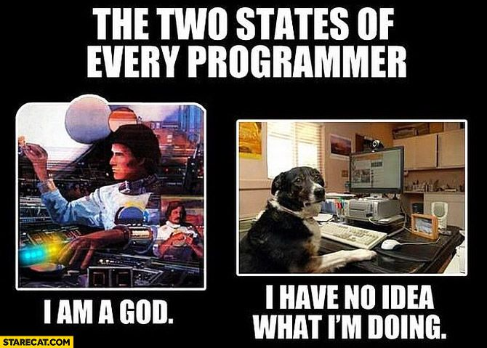
As developers, we express ourselves through code much like an author writing a book.
Much like an author, we are writing code for others to understand.
Much like some authors, we have no idea what we’re writing

Slide 20
DEMO TIME
Write a node program that takes in an unlimited number of command line arguments, goes through each and prints out the sum of them. If any argument is not a whole number, skip it. Do support negative numbers though. If any argument is not a number, output an error message. We need at least 2 arguments.

Slide 21
Questions?

