Slide 1



W1D2 - Callbacks

Slide 2

Agenda
FUNCTIONS, FIRST-CLASS OBJECTS
HIGHER-ORDER FUNCTIONS
CALLBACKS
DESIGN PATTERN - SINGLE RESPONSIBILITY PATTERN
ARROW FUNCTIONS
CODE EXCERCISE

Slide 3
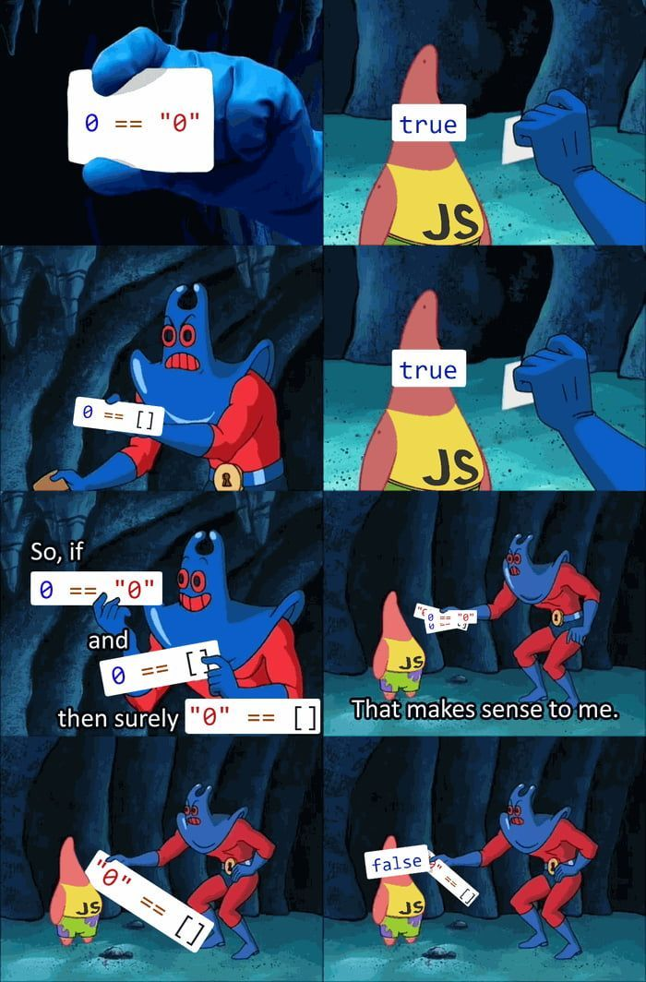
Any questions
From last week?
Notes:
Any questions from last lecture?

Slide 4

Callbacks
What have you got yourselves into?

Slide 5

I just met you, And this is crazy, But here's my number, So if something happens (event), Call me, maybe (callback)?
Callbacks
Notes:
There are three things here, Event, Delegate, and Callback.
Delegates in are interchangeable with Callbacks in Javascript. In languages like C# and Java they are important.
Events in JavaScript are mechanisms that enable the subscription and notification of specific actions or occurrences, allowing for decoupled and modular code.
Callbacks in JavaScript are functions that are passed as arguments to asynchronous operations, allowing for the execution of code once the operation completes, ensuring non-blocking behavior.

Slide 6
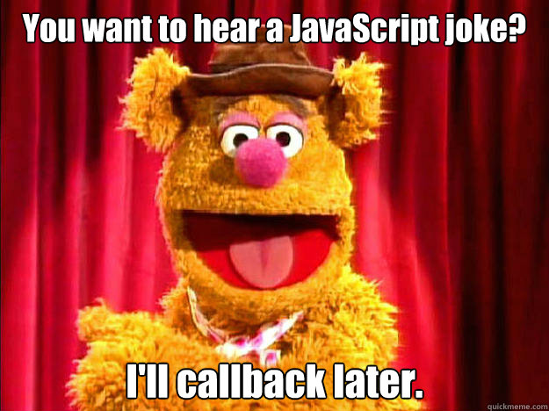

Slide 7
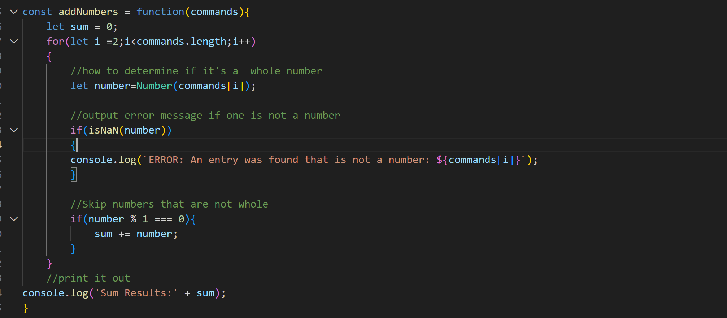
Review: Functions as Values
Functions can be assigned to Variables
Functions can be stored in a data structure
Functions can be passed as an argument.
Notes:
In JavaScript, functions are first-class citizens, meaning they can be assigned to variables, stored in data structures, and passed as arguments.

Slide 8
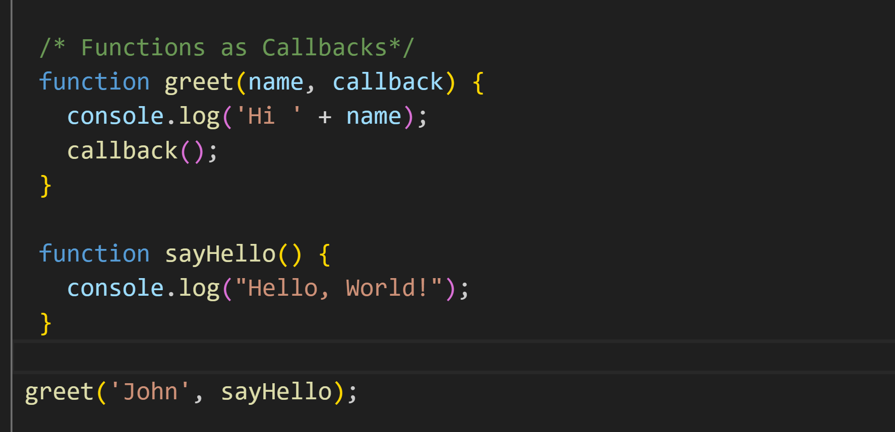
Functions as Callbacks
Passing a function into another function as an argument
Notes:
A callback function is a function that is passed into another function as an argument, which is then invoked inside the outer function to complete some kind of action or routine.

Slide 9
Functions as Callbacks
Implementing filterWords
const startsWithC = function (word) {
return word[0] === 'c';
};
const filterWords = function (wordsArr, callback) {
const filteredArr = [];
for (let word of wordsArr) {
if (callback(word)) {
filteredArr.push(word);
}
}
return filteredArr;
};
filterWords(scrabbleWords, startsWithC)
startsWithC and callback are 2 variables that point to the same anonymous function.
Executing callback(word) is executing the same anonymous function as startWithC.
Notes:
A callback function is a function that is passed into another function as an argument, which is then invoked inside the outer function to complete some kind of action or routine.

Slide 10
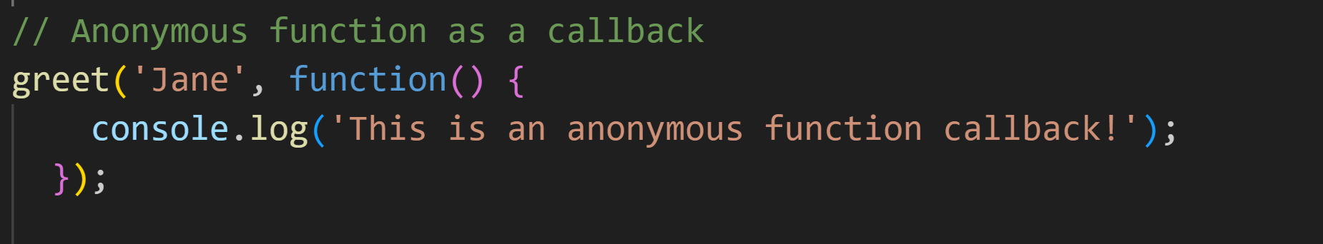
Anonymous Functions
No Declared Name
Used for One-Time tasks, as callbacks, or assigned to a variable
Notes:
Anonymous functions are functions without a declared name. They are commonly used for one-time tasks, as callback functions, or assigned to a variable.

Slide 11
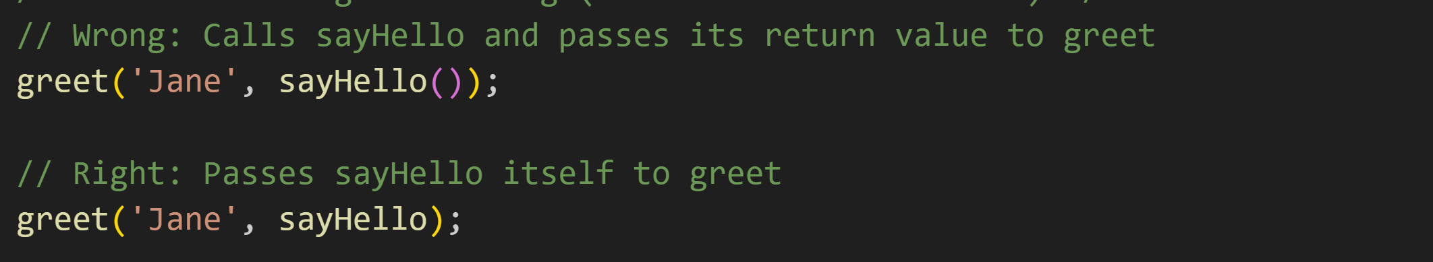
Function Calling vs Passing (reference to a function)
You call a function by using () – the function call operator.
You can pass a reference to a function.
Notes:
Remember the difference between calling a function (which executes it) and passing a reference to a function (which can be called later).
The () operator in JavaScript, when appended to the name of a function, is known as the function call operator. This operator invokes, or calls, the function it follows, causing the code inside the function to be executed.
When you write a function's name followed by (), the JavaScript engine will execute that function right there and then. For example, if you have a function named sayHello, you could call it like this:

Slide 12
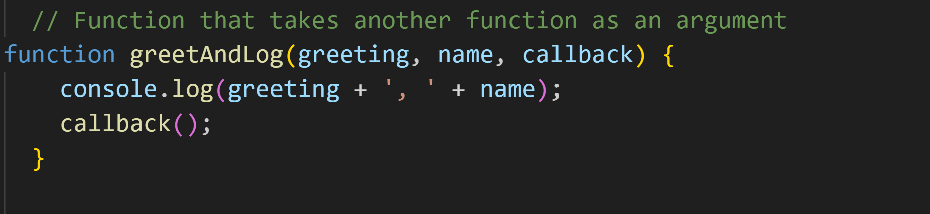
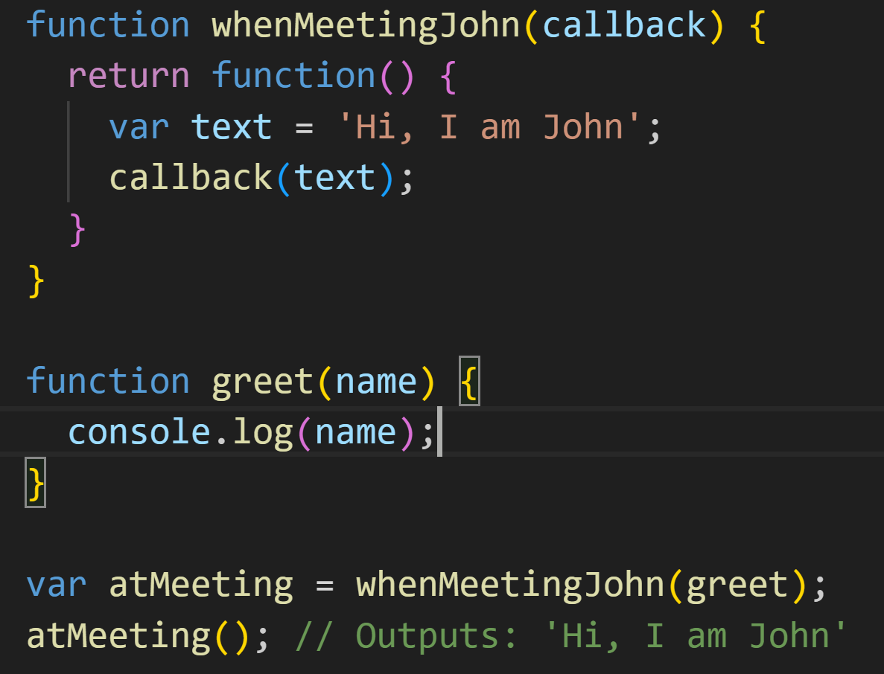
Higher Order Functions
It is a function that takes one or more functions as arguments
Returns a function or both.
Notes:
A higher order function is a function that takes one or more functions as arguments, returns a function, or both.

Slide 13
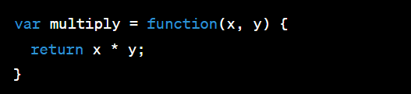
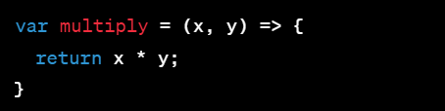
Arrow Functions
Mainly used with Higher Order Functions, Callbacks.
Shorter Syntax
Notes:
Arrow functions provide a shorter syntax for writing function expressions. They are often used with higher order functions and callbacks.
They’re a more concise syntax for writing function expressions in JavaScript. They are a new way to write anonymous functions, which means they do not have their own name.
The function keyword is replaced with an arrow (=>) placed between the argument list and the function body. The return keyword is still used to specify the value returned.
Arrow functions also have an even shorter syntax for "one-liner" functions that immediately return a value. We can remove the return keyword and the function body brackets. Here's the multiply function written this way:
You will go into more detail with arrow functions later, including ‘this”. We will not go through that in this lecture.

Slide 14
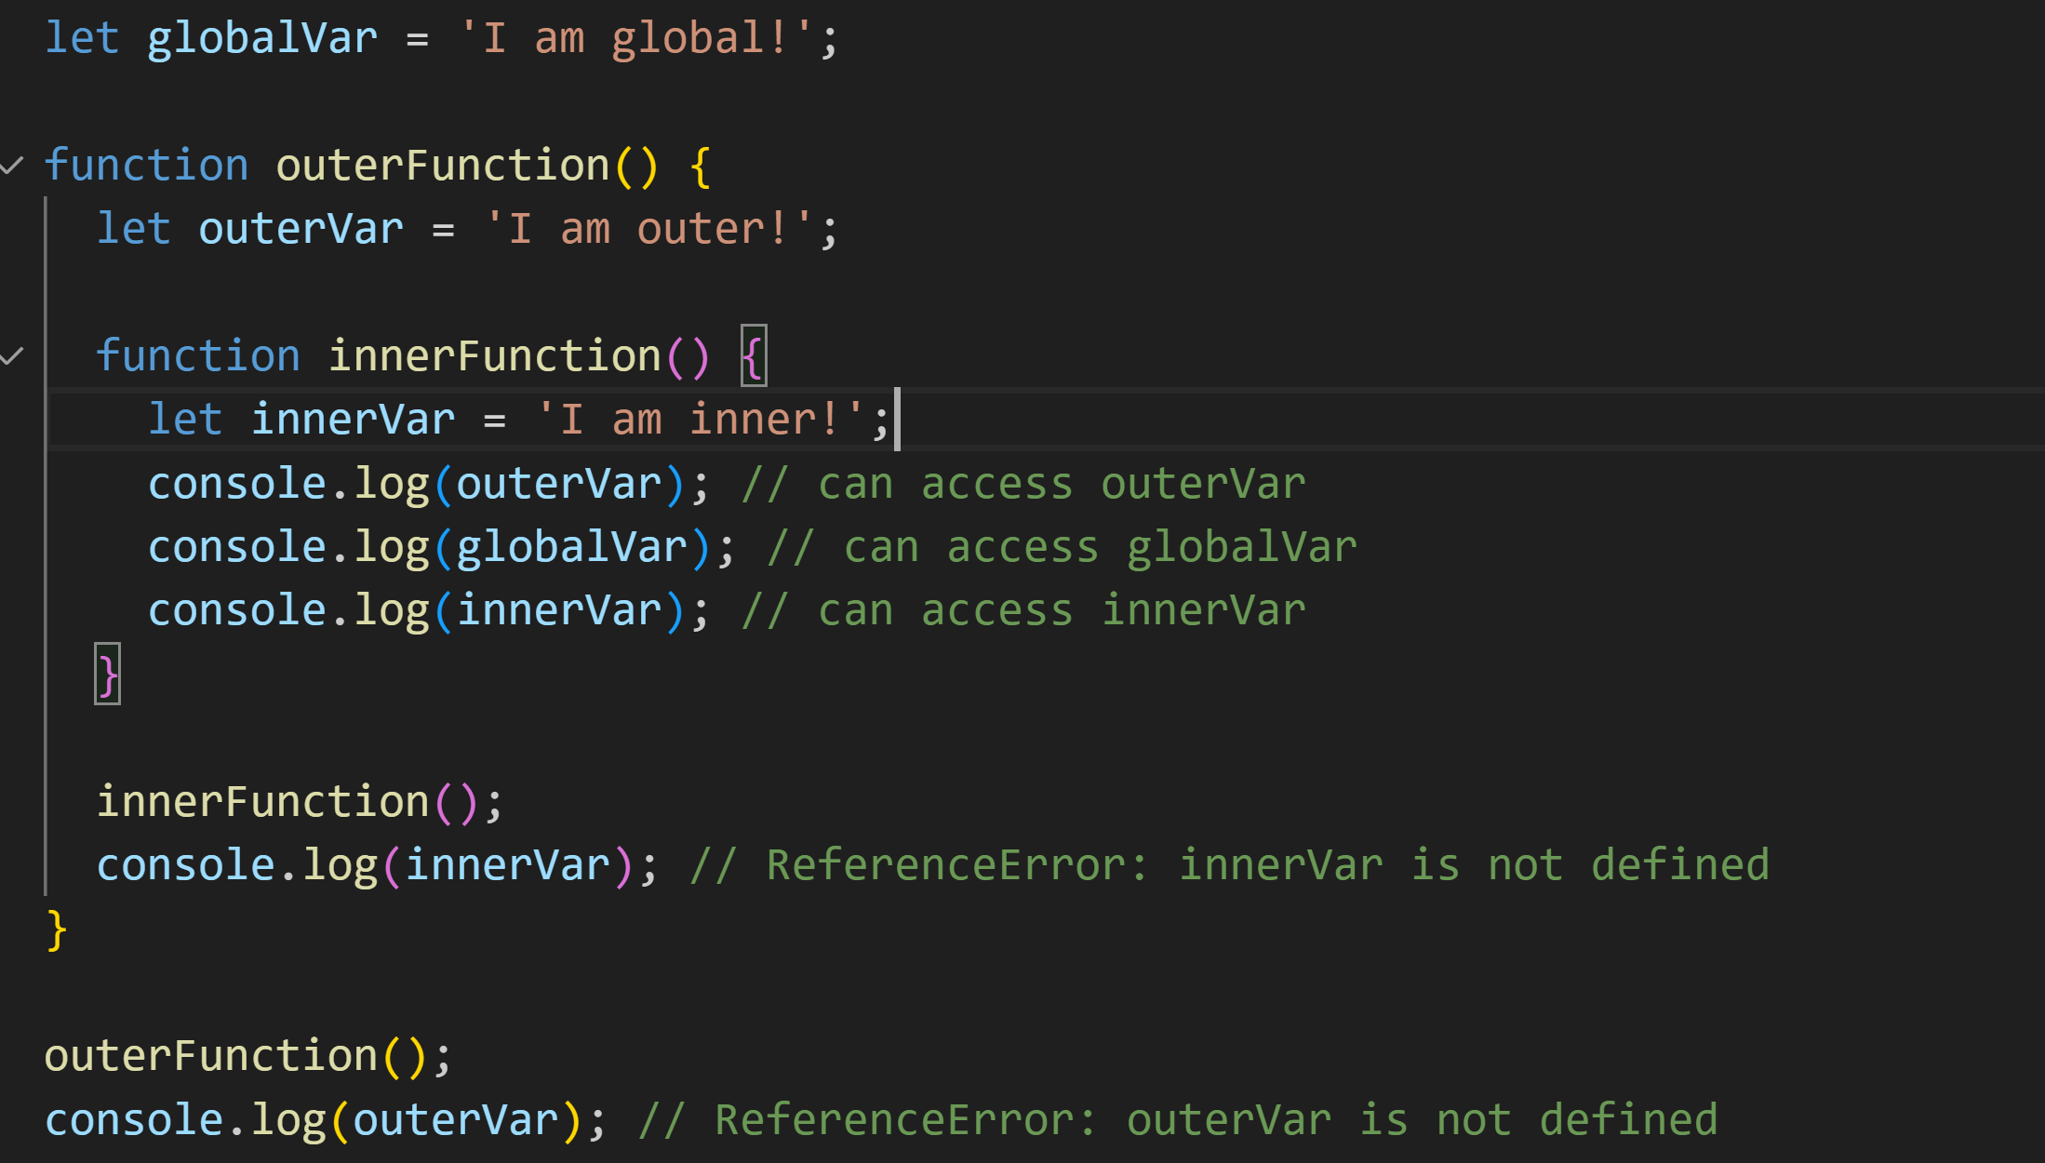
Nested Scope and Scope Chain
Each function has its own Scope.
Scope is created through {}’s
You can access scope from outer (parent) scope in a chain.
Notes:
In JavaScript, variables have different levels of scope depending on where they're declared. Variables declared outside of any function have a global scope, and can be accessed from anywhere in the code. On the other hand, variables declared inside a function have local scope, and can only be accessed within that function or any nested functions.
The Scope Chain is the hierarchical arrangement of these scopes. In essence, it means that an inner scope has access to its own local scope, any outer scopes, and the global scope. However, an outer scope does not have access to inner scope variables.
Here's an example illustrating these principles:
Regarding the code:
innerFunction has access to its own scope (including innerVar), the scope of outerFunction (including outerVar), and the global scope (including globalVar).
outerFunction has access to its own scope (including outerVar) and the global scope (including globalVar), but it does not have access to the scope of innerFunction. So, when it tries to log innerVar, a ReferenceError is thrown.
The global scope does not have access to outerVar or innerVar, so when we try to log outerVar in the global scope, a ReferenceError is thrown.

Slide 15
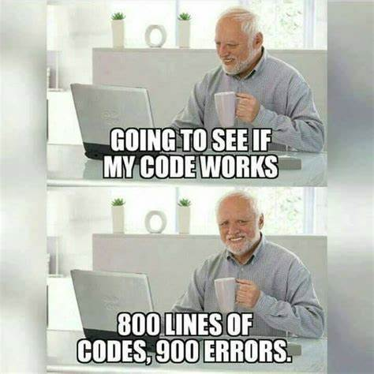
Code (about damn time)

Slide 16
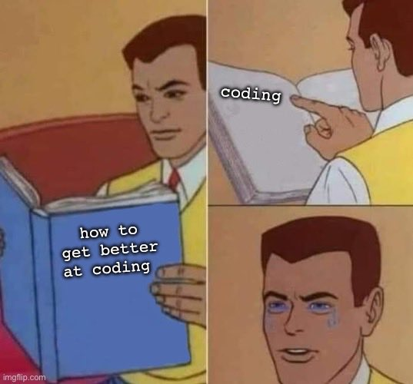
Code (about damn time)

Slide 17
Questions?

