Slide 1
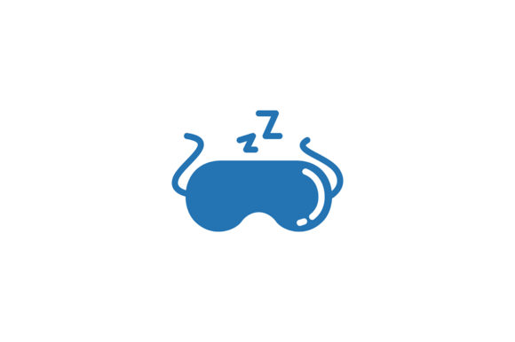
SynchroSleep
Wake up rested again.
A sleep application by Robert Tesoriero

Slide 2
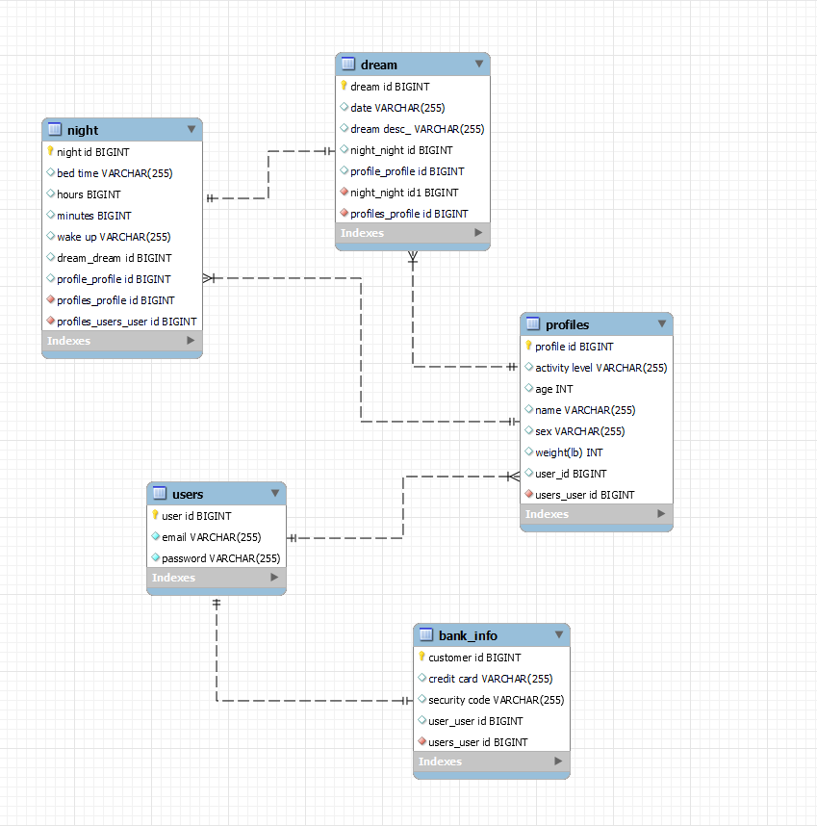
Relational Schema
One-to-One Relationships:
Bank_Info to User
Dream to Night
Many-to-One Relationships:
Profiles to User
Nights to Profile
Dreams to Profile

Slide 3
What’s the need?
According to the CDC, about one in three adults doesn't get enough sleep. Even those of us who do often are not getting the right kind of sleep…
SynchroSleep is here to help. Learn how and when to sleep with a schedule that has been customized to you!
Say goodbye to alarms and snooze buttons, and let your body do what it does best by giving you the sleep you need when you need it!

Slide 4
Technical overview
This Application is capable of the following:
Registering a User and storing a hashed password using BCrypt, and authenticating their login.
Letting a User create multiple Sleep Profiles (akin to a Netflix account with multiple profiles attached to it.)
The ability to easily Update or Delete those Sleep Profiles.
The utilization of Sleep Profile attributes to calculate an optimized sleep schedule.
The ability to log entries to a Dream Journal to record potential dreams.
The ability to sign up to become a “Premium Member”

Slide 5
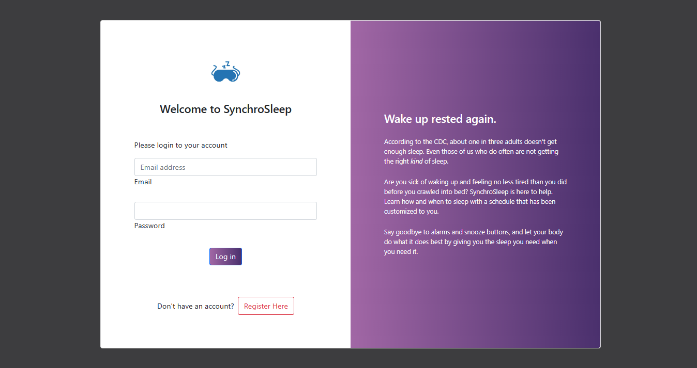
And now for a User Story…

Slide 6
Future Features
Membership Specific features…
Diet/Exercise tracker to ensure better quality sleep.
Guided meditations to help ease restless sleepers to bed.
Profile Rest Review
Culiminative stats per profile related to their sleep habits. (Average Hours slept per month, etc.)
Smartwatch App?
Can include things like heart-rate tracker, and see if the wearer tosses and turns in bed.

Slide 7
What I Learned…
How to utilize SpringFramework alongside Thymeleaf to create dynamic webpages.
The efficiency of Lombok when it comes to handling POJOs.
How to hash and store passwords into a database through BCrypt.
How to create Custom Queries through @Query.

