Slide 1
AION → IBM ODM
Flights migration
implementation evidence
SFO
CHI
NYC
2,982 miles
Rule Designer, Rule Execution Server and live REST validation
live shortest-route result
The migrated decision service is implemented, deployed and returning the expected shortest route.
AUHN migration proof point • August 2026

Slide 2
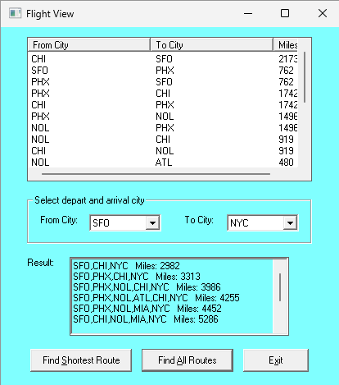
MIGRATION APPROACH
The Flights migration follows a repeatable Aion-to-ODM path
1
2
3
4
5
6
Analyze Aion
Build XOM
Expose BOM
Convert rules
Rebuild inference
Deploy & test
Capture inputs, outputs and source behavior
FlightRequest, Flight, Node and response classes
Business vocabulary and helper operations
14 reviewable ODM action rules
Ruleflow plus RetePlus search tasks
Ruleset in RES with live REST verification
Legacy behavior
Route search, shortest-route selection and all-routes mode become the behavioral baseline.
Migration principle
Preserve the Aion decision behavior while expressing data, vocabulary, inference and deployment in native ODM artifacts.
02

Slide 3
PLAN-READY DELIVERABLES — DEFINITION
Definition deliverables establish an approved migration baseline
PROJECT PHASE
REQUIRED DELIVERABLES
COMPLETION / ACCEPTANCE GATE
1 Inventory & source analysis
Approved Aion KB Inventory; complexity assessment; scope baseline
Inventory reconciled and scope approved
2 Business workshops & source behavior
Signed Business Behavior Catalogue; golden input/output scenarios
Business SME validates expected behavior
3 Decision modeling
Signed Decision Model; rule taxonomy; decision requirements and dependencies
Business and architecture sign-off
4 Inference & execution reconstruction
Inference Semantics Specification; ODM execution-mode mapping
All Aion inference behaviors mapped
5 Architecture, ruleflow & subflows
Approved ODM Solution Design; ruleflow/subflow diagrams; interface specification
Architecture review approved
Each gate is a schedulable milestone: the phase is complete only when its named deliverables are reviewed and accepted.
03

Slide 4
DELIVERY WORK PRODUCTS
Build deliverables make completion and acceptance measurable
PROJECT PHASE
REQUIRED DELIVERABLES
COMPLETION / ACCEPTANCE GATE
6 XOM, BOM, vocabulary & helpers
Compilable XOM; reviewed BOM vocabulary; helper API catalogue
Build clean and vocabulary accepted
7 Rules, RETE tasks & orchestration
Versioned ODM Rule Project Archive; task configuration; peer-review record
Ruleset builds and technical review completes
8 Traceability, governance & review
Aion-to-ODM traceability matrix; exception log; governance checklist
100% source objects mapped or dispositioned
9 Decision operation & deployment
Decision operation; RuleApp/ruleset archive; configuration and deployment record
Deployed and endpoint health check passed
10 Testing & acceptance
Regression, negative-path and performance pack; evidence; defect closure
Pass thresholds met and UAT signed off
11 Documentation, KT & contingency
Runbook; support model; training; RAID/change log; final estimate
Ownership accepted and open items baselined
Planning use: assign an owner, planned date, reviewer and status to every deliverable—not only to the activity that produces it.
04

Slide 5
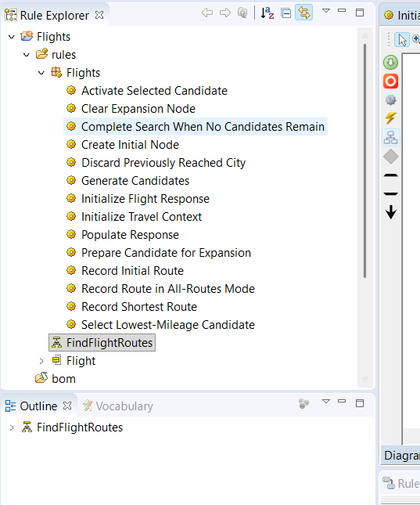
IMPLEMENTATION EVIDENCE
Rule Designer makes the migrated Flights logic reviewable
14
action rules
✓
FindFlightRoutes ruleflow
Controls initialization, inference, route recording and response population.
✓
Flight variable set
Request, response, travel context, candidates and selected expansion node.
✓
BOM vocabulary + helper methods
Business-facing rule language stays readable; Java helpers manage object and list operations.
Result: traceable business logic instead of a black-box rewrite.
05

Slide 6
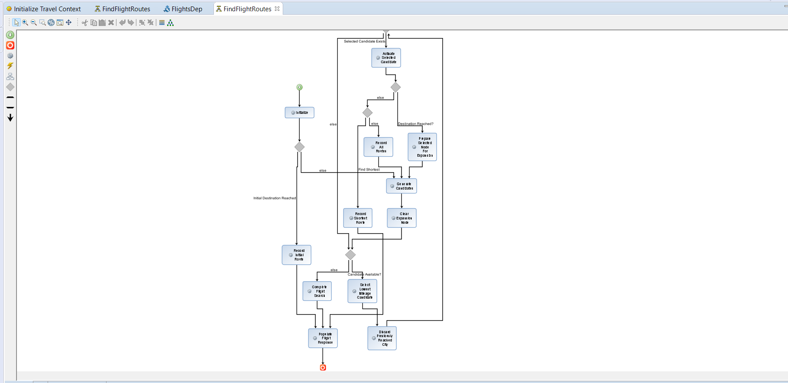
INFERENCE AND ORCHESTRATION
The ruleflow reconstructs Aion’s inference loop in ODM
Execution model
Initialize
Sequential
Search loop
RetePlus
All-routes recording
Fastpath
Inference pattern
Generate candidates → select lowest mileage → reject revisits → record route → repeat.
06

Slide 7
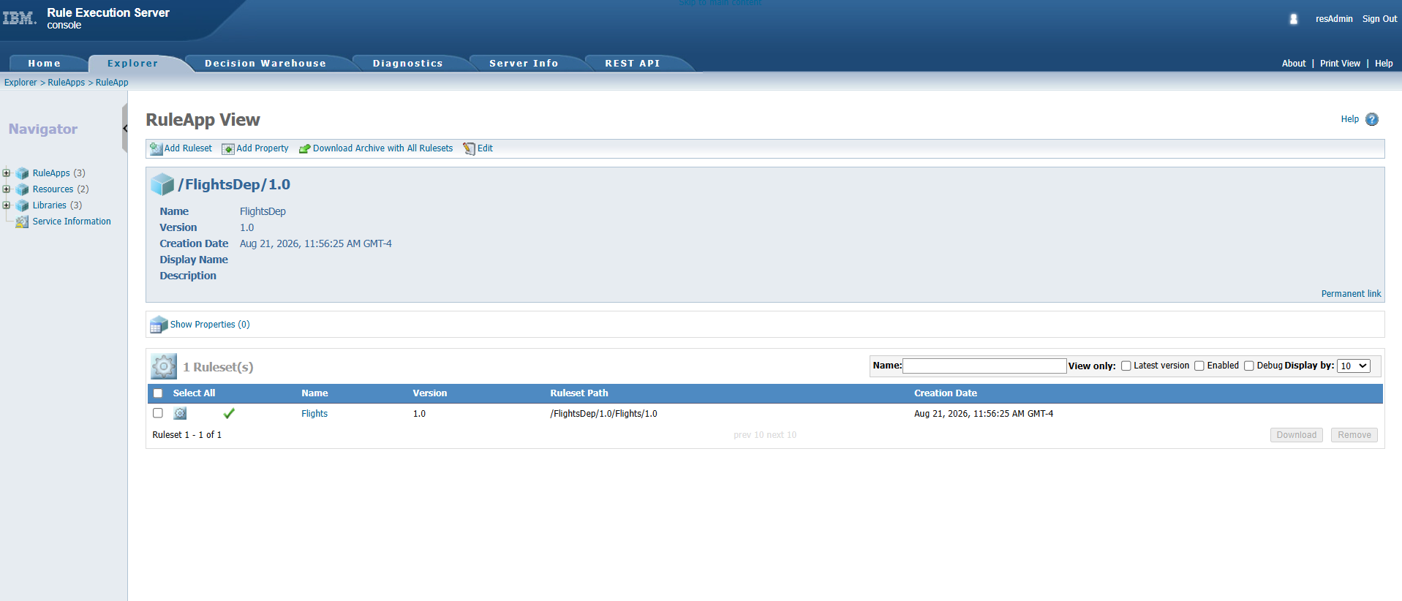
DEPLOYMENT EVIDENCE
Flights is deployed and enabled in Rule Execution Server
RuleApp FlightsDep / 1.0
Ruleset Flights / 1.0
/FlightsDep/1.0/Flights/1.0
● ENABLED
07

Slide 8
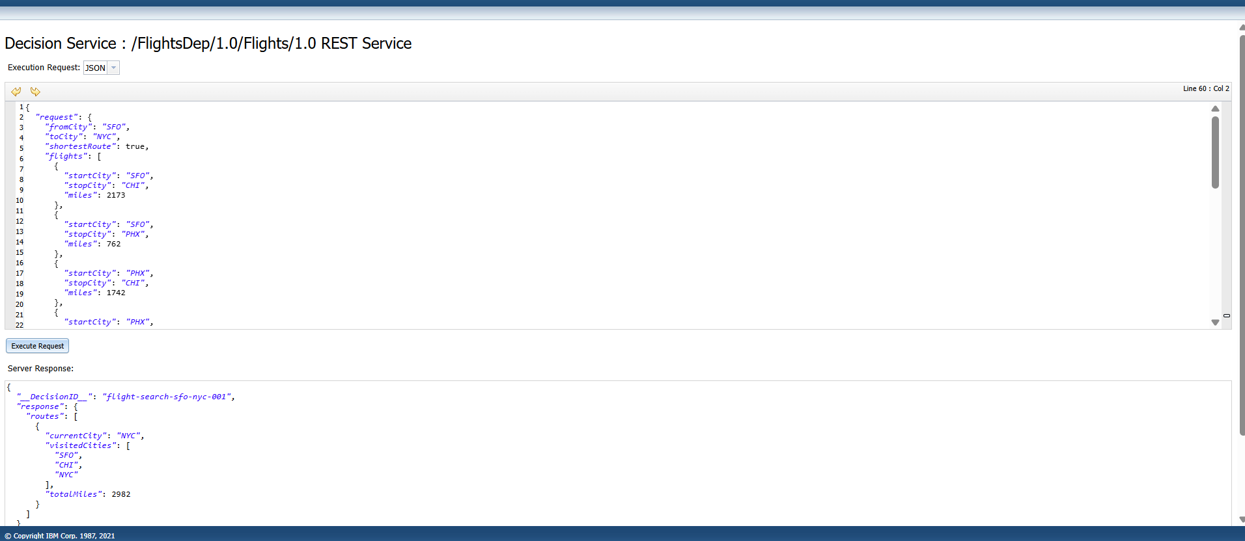
EXECUTION EVIDENCE
A live REST execution returns the shortest route
INPUT
OUTPUT
DECISION ID
SFO → NYC | shortestRoute = true
SFO → CHI → NYC | 2,982 miles
flight-search-sfo-nyc-001
08

Slide 9
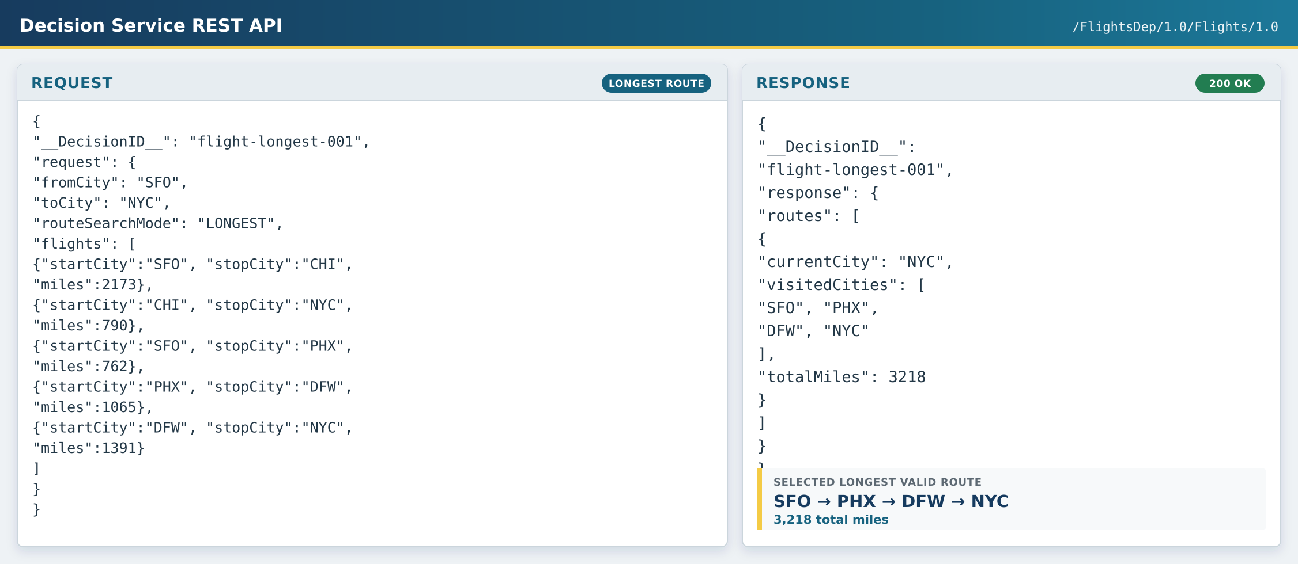
EXECUTION EVIDENCE
A longest-route request returns the most distant valid path
INPUT
OUTPUT
DECISION ID
SFO → NYC | LONGEST
via PHX + DFW | 3,218 mi
flight-longest-001
09

Slide 10
MIGRATION CONFIDENCE
Flights provides a high-confidence
proof point for the AUHN migration
✓
Source behavior analyzed
Aion inputs, outputs and route-selection behavior captured
✓
ODM implementation completed
XOM, BOM, vocabulary, helpers, rules and ruleflow are present
✓
Inference reconstructed
Candidate generation, lowest-mileage selection and revisit prevention execute as a loop
✓
Decision service deployed
FlightsDep / 1.0 and Flights / 1.0 are enabled in RES
✓
Live result verified
SFO → CHI → NYC returned at 2,982 miles
Flights proves the migration pattern; each AUHN knowledge base still requires its own regression pack and business sign-off.

