Slide 1
EventLite © Team Green

Slide 2
CONCEPT
1. Ticketmaster for amateurs
2. App for pop-up events
3. Resource for politcal events
4. EventLite: App for finding free events in Chicago

Slide 3
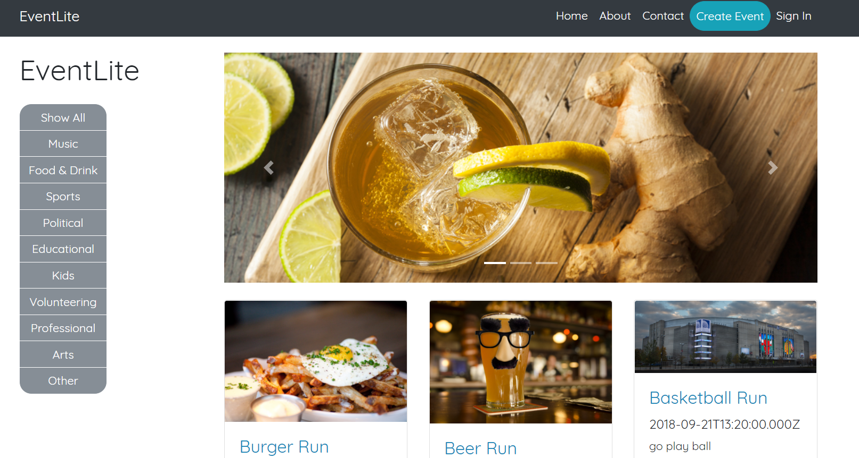
Place your screenshot here

Slide 4

Final Product
H E R E

Slide 5
CHALLENGES
Front-End
Text here
Text
Text
text
Back-End
Text here
Text
Text
text
Other
Merging front-end and back-end code
Github repo malfunctions
Time constraints

Slide 6
FUTURE DEVELOPMENT
Filtering
Due to time constraints, we were unable to implement date filtering and keyword filtering for events.
Event Registration
Text here
EventBrite API
Text here
Google API
Text here
Mobile-Friendly
Text here
Cleaner Interface
Logo development, color scheme, layout – it could’ve looked better!

Slide 7
THANKS!
Any questions?

