Slide 1
EventLite © Team Green

Slide 2
CONCEPT
1. Ticketmaster for amateurs
2. App for pop-up events
3. Resource for politcal events
4. EventLite: App for finding free events in Chicago

Slide 3
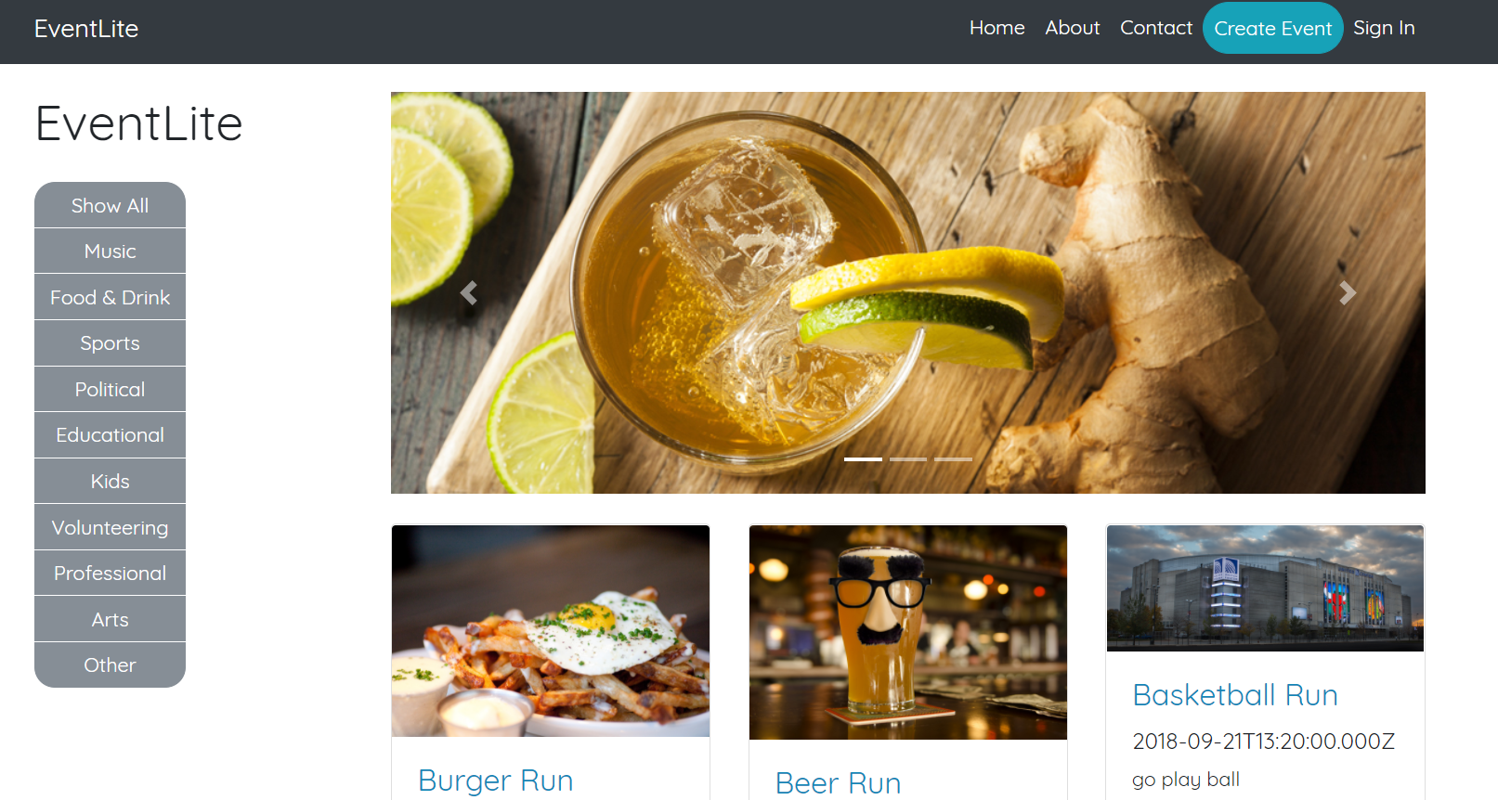
Place your screenshot here

Slide 4

Final Product
H E R E

Slide 5
CHALLENGES
Front-End
Handlebars
Connecting to server
Templating
Displaying information
Back-End
Heroku
CORS (but resolved)
Other
Merging front-end and back-end code
Learning Github
Time constraints

Slide 6
FUTURE DEVELOPMENT
Filtering
Due to time constraints, we were unable to implement date filtering and keyword filtering for events.
Event Registration
RSVP function, ticketing function, reservations, etc etc
EventBrite API
Initially we were supposed to populate event info from EventBrite, but problems arose…
Google Maps API
For directions to the event!
Mobile-Friendly
Could be more responsive – currently not mobile-friendly ☹
Cleaner Interface
Logo development, color scheme, layout – it could’ve looked better!

Slide 7
THANKS!
Any questions?

