Slide 1


Practical - 4 Introduction
Accredited with 'A' by NAAC - Govt. of India
Accredited with 'A' by KCG - Govt. of Gujarat
CS381
Full Stack Development

Slide 2
What is React?
React, sometimes referred to as a frontend JavaScript framework, is a JavaScript library created by Facebook.
React is a tool for building UI components.
React is a declarative, efficient, and flexible JavaScript library for building user interfaces. It lets you compose complex UIs from small and isolated pieces of code called “components”.
How does React Work?
React creates a VIRTUAL DOM in memory.
Instead of manipulating the browser's DOM directly, React creates a virtual DOM in memory, where it does all the necessary manipulating, before making the changes in the browser DOM.
React only changes what needs to be changed!
React finds out what changes have been made, and changes only what needs to be changed.

Slide 3
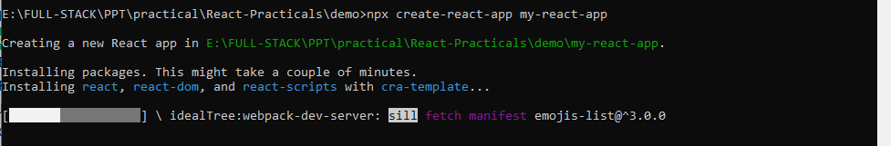
Built an Environment for basic React app
Setup an environment for React by downloading Node.js and install React framework along with its packages. Understand the folder structure used by React and develop a “Hello World Application”.
To use React in production, we need npm which is included with Node.js.
Run this command to create a React application named my-react-app:
npx create-react-app my-react-app

Slide 4
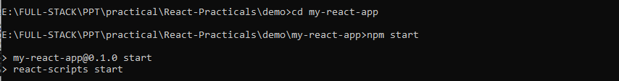
Run the React Application
Run this command to move to the my-react-app directory:
cd my-react-app
Run this command to run the React application my-react-app:
npm start

Slide 5
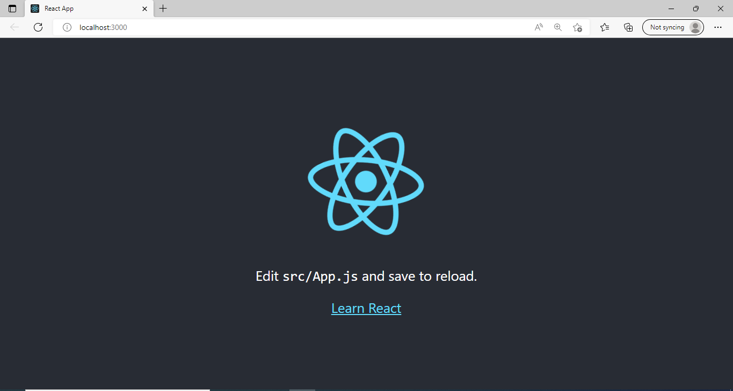

Slide 6
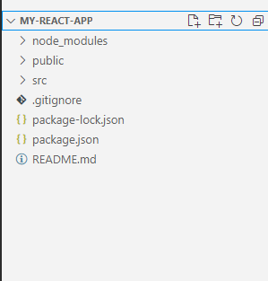
node_modules: It contains the React library and any other third party libraries needed.
public: It holds the public assets of the application. It contains the index.html where React will mount the application by default on the <div id="root"></div> element.
src: It contains the App.css, App.js, App.test.js, index.css, index.js, and serviceWorker.js files. Here, the App.js file always responsible for displaying the output screen in React.
package-lock.json: It is generated automatically for any operations where npm package modifies either the node_modules tree or package.json. It cannot be published. It will be ignored if it finds any other place rather than the top-level package.
package.json: It holds various metadata required for the project. It gives information to npm, which allows to identify the project as well as handle the projects dependencies.
README.md: It provides the documentation to read about React topics.

Slide 7
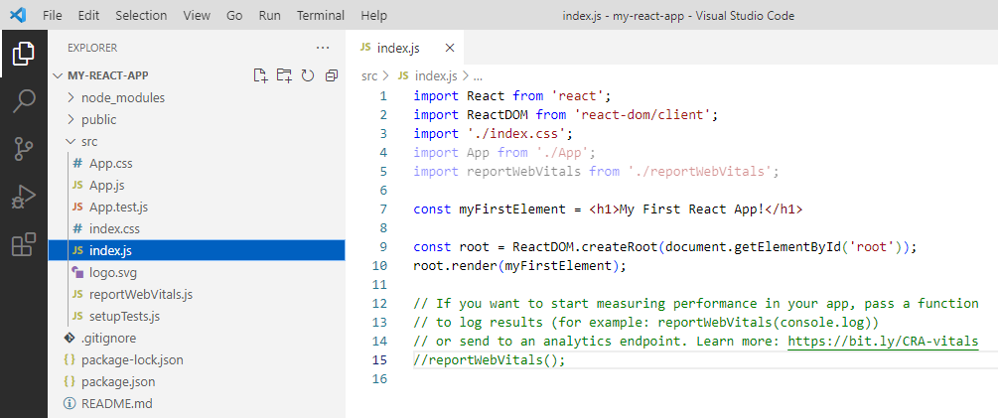

Slide 8
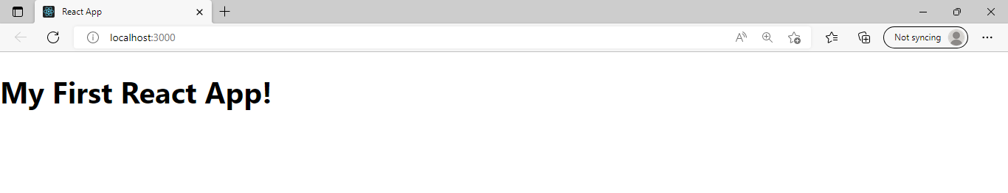

Slide 9
Practical – 4
Concept : | Navbar using
Practical - 4: | Implement React Routing for navigating 5 different webpages. Design a responsive navbar in ReactJS by using media queries, Material-UI/React-Bootstrap.
Requirement : | Knowledge of HTML, CSS and Javascript, Media Query, Material-UI, Bootstrap-5, Reactjs
Required Software : | Nodejs, Visual Studio Code/Sublime text/etc.
Link to refer : | https://www.youtube.com/watch?v=VzWBLj_CfpE

Slide 10
References
https://reactjs.org/
https://www.w3schools.com/REACT/react_es6_classes.asp

Slide 11
Thank You

