Slide 1


Practical - 3 Introduction
Accredited with 'A' by NAAC - Govt. of India
Accredited with 'A' by KCG - Govt. of Gujarat
CS381
Full Stack Development

Slide 2
ES6 Variables
A variable is a named space in the memory, which stores the values. The names of the variable are known as identifiers.
Initialization of Variable
It is the process to store the value in the variable. A variable can be initialized at any time before its use.
The ES6 syntax used the keyword var to declare a variable. In ES5, we declare the variable like this:
var x; //Declaration of a variable by using the var keyword
Example:
var $example=value
var example=value
var _example$=value

Slide 3
In ES6, the variables are declared by
Using let.
Using const.
let:
Any variable which is declared by using the let keyword is assigned the block scope. Block scope is nothing but a section where the let variable gets declared whether it is a function{}, a block{}, or a global (script).

Slide 4
For example: var v/s let
By using var
var x = 1;
var x=2;
console.log(x);
Output:
2
By using let
let x = 1;
let x=2;
console.log(x);
Output:
SyntaxError: Identifier 'x' has already been declared

Slide 5
const
ES6 gives a new way to declare a constant using the const keyword. The keyword const creates a read-only reference to the value.
Properties:
It cannot be reassigned a value.
It is block scoped.
A constant cannot be re-declared.
Constants must be initialized at the time of declaration.
Example:
const y=100
y=200 // It will result in an error
Output:
TypeError: Assignment to constant variable.

Slide 6
JavaScript Variable Scope
The scope of a variable is the region of your program in which it is defined. Traditionally, JavaScript defines only two scopes-global and local.
Global Scope − A variable with global scope can be accessed from within any part of the JavaScript code.
Local Scope − A variable with a local scope can be accessed from within a function where it is declared.

Slide 7
"use strict"
function test() {
var num = 10
console.log("value of num in test() "+num) {
console.log("Inner Block begins")
let num = 20
console.log("value of num : "+num)
}
}
test()
var num = 10
function test() {
var num = 20
console.log("value of num in test() "+num)
}
console.log("value of num outside test() "+num)
test()
Output :
value of num outside test() 10
value of num in test() 20
value of num in test() 10
Inner Block begins
value of num : 20

Slide 8
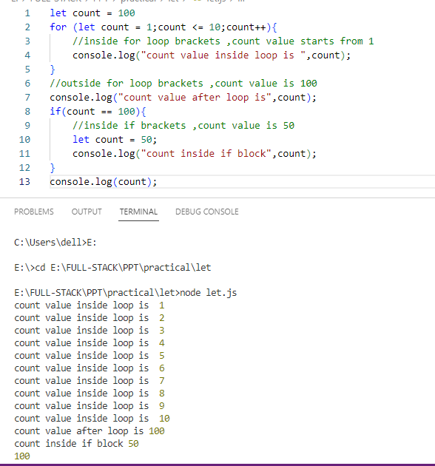

Slide 9
func: A function to be executed every delay milliseconds. The first execution happens after delay milliseconds.
Code: An optional syntax allows you to include a string instead of a function, which is compiled and executed every delay milliseconds. This syntax is not recommended for the same reasons that make using eval() a security risk.
delay Optional: The time, in milliseconds (thousandths of a second), the timer should delay in between executions of the specified function or code. Defaults to 0 if not specified. See Delay restrictions below for details on the permitted range of delay values.
arg0, ..., argN Optional: Additional arguments which are passed through to the function specified by func once the timer expires.
Return value: The returned intervalID is a numeric, non-zero value which identifies the timer created by the call to setInterval(); this value can be passed to clearInterval() to cancel the interval.
setInterval()
The setInterval() method, offered on the Window and Worker interfaces, repeatedly calls a function or executes a code snippet, with a fixed time delay between each call.
This method returns an interval ID which uniquely identifies the interval, so you can remove it later by calling clearInterval().
Syntax
setInterval(code)
setInterval(code, delay)
setInterval(func)
setInterval(func, delay)
setInterval(func, delay, arg0)
setInterval(func, delay, arg0, arg1)
setInterval(func, delay, arg0, arg1, /* ... ,*/ argN)

Slide 10
Practical – 3 (a)
Concept : | ECMAScript 6 - var vs let
Practical - a: | Create a functionality that changes the color of the two headings every 1 second is activated when you click the Start Button. The first heading’s colour is stored in var, while the second heading's colour is declared using let. Note : Use setInterval() function of javascript. Following that, both of them are accessed outside of the function block. Var will operate properly, but let-declared variables fail since let is block-scoped. Q -1 Write down the difference between var, let, and const.
Requirement : | Knowledge of HTML, CSS and Javascript, ES-6
Required Software : | Nodejs, Visual Studio Code/Sublime text/etc.

Slide 11
References
https://developer.mozilla.org/en-US/docs/Web/API/setInterval
https://www.tutorialspoint.com/es6/es6_variables.htm
https://www.javatpoint.com/es6-variables

Slide 12
ES6 Classes
Classes are an essential part of object-oriented programming (OOP). Classes are used to define the blueprint for real-world object modeling and organize the code into reusable and logical parts.
Before ES6, it was hard to create a class in JavaScript. But in ES6, we can create the class by using the class keyword. We can include classes in our code either by class expression or by using a class declaration.
A class definition can only include constructors and functions. These components are together called as the data members of a class. The classes contain constructors that allocates the memory to the objects of a class. Classes contain functions that are responsible for performing the actions to the objects.

Slide 13
Syntax: Class Expression
var var_name = new class_name {
}
Syntax: Class Declaration
class Class_name{
}
Example - Class Declaration
class Student{
constructor(name, id){
this.name = name;
this.id = id;
}
}
Example - Class Expression
var Student = class{
constructor(name, id){
this.name = name;
this.id = id;
}
}
Instantiating an Object from class
Like other object-oriented programming languages, we can instantiate an object from class by using the new keyword.
Syntax
var obj_name = new class_name([arguements])
Example
var student1 = new Student(‘Srushti’, 1)

Slide 14
Accessing functions
The object can access the attributes and functions of a class. We use the '.' dot notation (or period) for accessing the data members of the class.
Syntax
obj.function_name();

Slide 15
Practical – 3 (b)
Concept : | ECMAScript 6 - Class Concept
Practical - b: | Create a Student class that contains the constructor with the parameters rollno, firstname, lastname, and one getter method to print the full name. Create a Student class that contains a constructor with the parameters rollno, firstname, lastname, and one setter method to set the full name.
Requirement : | Knowledge of HTML, CSS and Javascript, ES-6
Required Software : | Nodejs, Visual Studio Code/Sublime text/etc.

Slide 16
References
https://www.javatpoint.com/es6-classes

Slide 17
Thank You

