Slide 1


Slide 2
Contents
Introduction to Microservices
Web services vs Microservices
Microservice creation with Spring Boot
Netflix Eureka Registry
Netflix Eureka Discovery
Load balancing using Netflix Ribbon

Slide 3
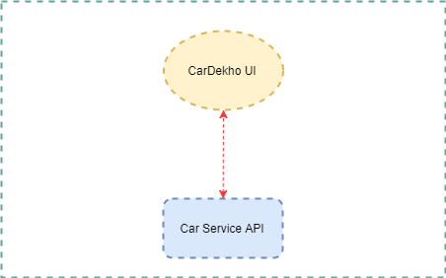
Web services

Slide 4
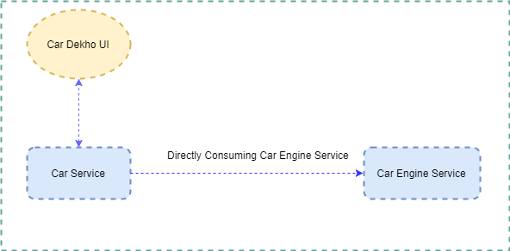
Microservices

Slide 5
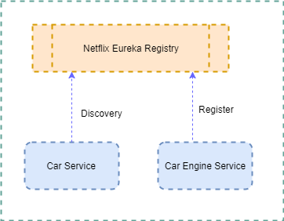
Microservices Netflix Eureka

Slide 6
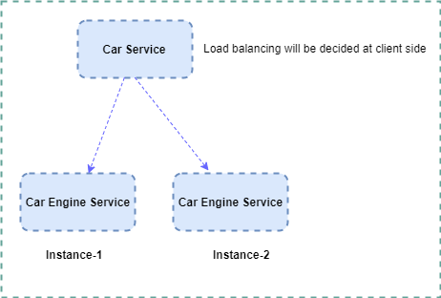
Microservices Load Balancing (Netflix Ribbon)

Slide 7
Thanks

