Slide 1
Hibernate Basics

Slide 2
What is Hibernate
An ORM Tool
Used in the data layer of application
Implements JPA
Open source
Database independent Query
Reduce manual Interaction with Database

Slide 3
JDBC vs Hibernate way
JDBC | Hibernate
JDBC database Configuration | Hibernate Configuration
Model Object | Annotations
Service method to create the model object | Use hibernate API
Database design | Not needed
Save object using SQL query | Not needed

Slide 4
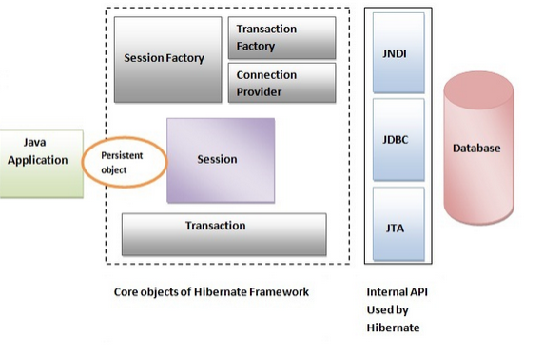
Hibernate Architecture

Slide 5
Basic Configurations and Annotations
hibernate.cfg.xml
@Entity
@Table
hbm2ddl.auto
Primary Keys
Natural Key – Any unique field which already exist in the object
Surrogate Key – Key which is generated by the system
- Auto : Database Provider will provide PK based on the primary key attribute , it is like an incremental key.
- Identity : Generated by identity column in the database so dependendent on database
- Sequence : Hibernate provides the SequenceStyleGenerator class
- Table : It uses an underlying database table that holds segments of identifier generation values.
Note: Auto generation type is the default generation

Slide 6
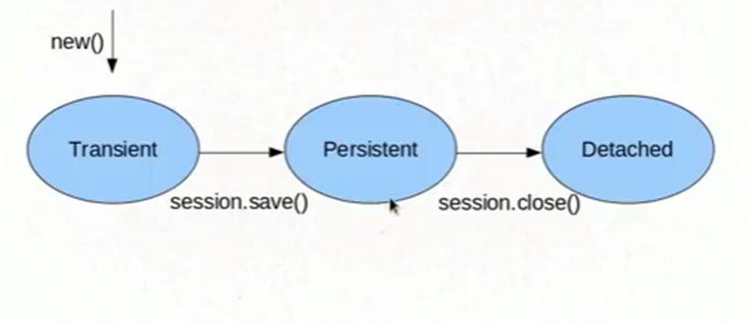
Object States

Slide 7
Mappings and Cascade Types
Mappings
OneToOne
OneToMany
ManyToOne
ManyToMany
CascadeTypes
Detach
Merge
Persist
Refresh
Remove

Slide 8
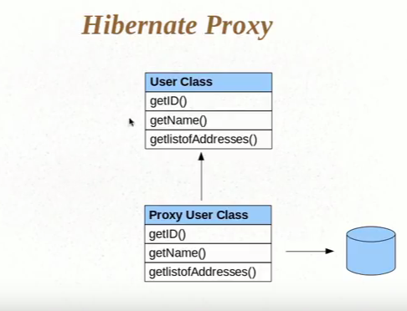
Proxy Objects : Eager and Lazy

Slide 9
HQL , Named Queries and Criteria API
HQL is similar to SQL but the main difference is it fires the queries on objects instead of tables.
Query:
: We can define HQL directly where we want to use
NamedQuery
: We can define HQL query inside the entity which can be used anywhere in the application
NamedNativeQuery
: We can define SQL query also instead of HQL
Criteria API
: Criteria API gives more flexibility to put restrictions using methods (like, between , in, gt, lt etc)

Slide 10
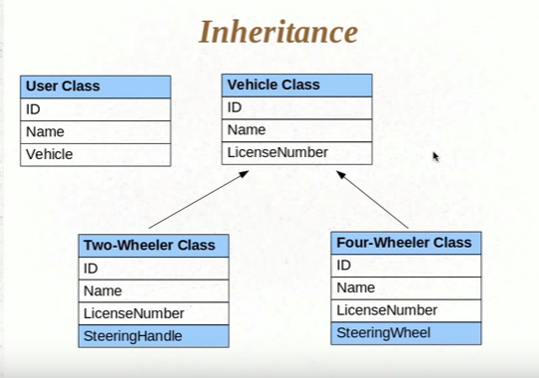
Inheritance
Single table strategy : Default Strategy
Table per class : Better to use as it is normalized
Joined strategy

Slide 11
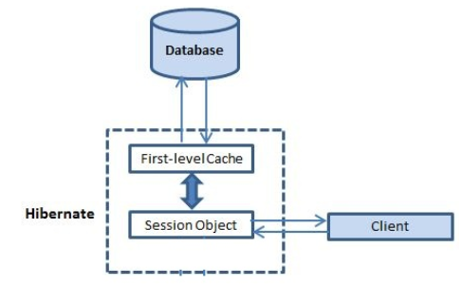
Caching in Hibernate
First Level Cache
- It works within the boundary of session.
It is by default true by the hibernate and you can not disable it even forcefully.
The whole session cache can be removed using clear() or evict() method
-

Slide 12
Caching in Hibernate
Second level cache
There is no boundary of session , it works throughout the application.
CacheConcurrencyStrategy
- READ_ONLY
It will be used only to read data from the database
- NONSTRICT_READ_WRITE
There is no strict rule that all update will change at runtime
There might be some dirty data
- READ_WRITE
It strictly follow read write for the data , there is no dirty read
- TRANSACTIONAL
It will do complete transaction , it is rarely used.

Slide 13
Thanks

