Slide 1

Internet and Prosperity
Bridging the connectivity challenge
The Data DusterS

Slide 2
Introduction
Cybera, ISAIC, and RMA partnered to host this Hackathon with support from CIRA.
The main goals of the hackathon are to:
Identify underserved communities in rural Alberta by assessing the connectivity barriers and gaps.
Assess correlation between social and economic indicators, and connectivity to find impact of internet speed in community sustainability and development.
Nowadays, countries are connected globally through digital access to the internet. High speed, reliable internet exists in more places than ever before, however efficient internet connectivity still remains unavailable in some regions. Canada has many of these regions due to the remoteness of some of its communities, and this remoteness makes improving internet connectivity costly and difficult to expand. All of this means that there are still some rural areas in Alberta which do not even reach a maximum download speed of 5 Mbps.
Experts says the situation is reflective of the larger competitive dynamic in telecommunications service in Canada. Canada ranks 53rd in the world and below the global average of 7.6Mbps according to Ookla.

Slide 3
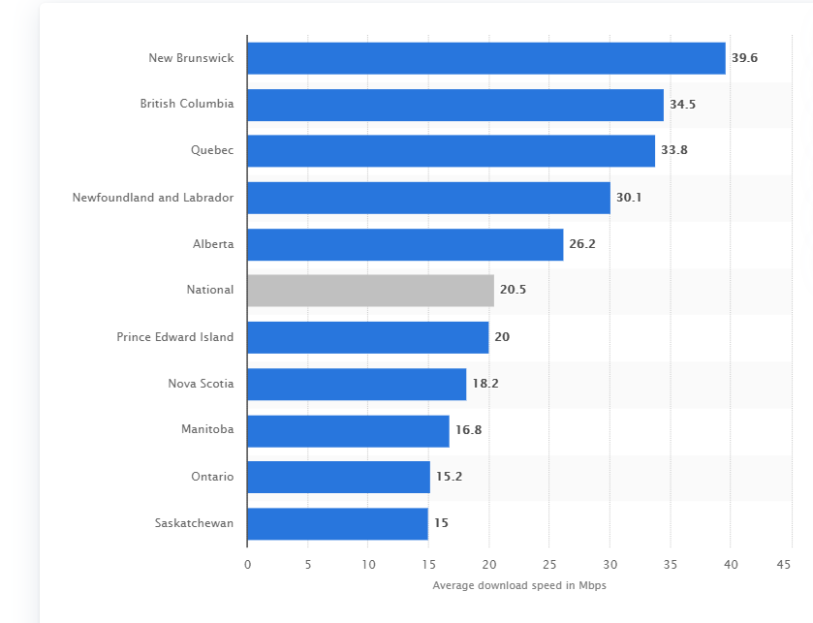
First question was where is Alberta’s download speed compared to the rest of the Canadian provinces?
Average internet download speed in Canada as of march 2018, by province (in Mbps)

Slide 4
Methodology
The team worked with different software to compile and format our data. SQL was used to design relational databases and Python libraries such as Pandas, Folium and Matplotlib, Geopandas were used to manipulate, analyse, and visualize the data.
We started by analyzing the data provided by RMA and CIRA, and viewing the shapefiles in order to get a better understanding about the geospatial distribution of the data.
We decided to work with the Mlab test data because we saw that it had more representative download and upload data compared to the RMA dataset. We also found discrepancies between the two datasets with the ClientCity column data.
We compiled all the test data into one dataframe using Pandas concatenation, giving us one complete dataset, and used SQL queries to find socio-economic indicators.

Slide 5
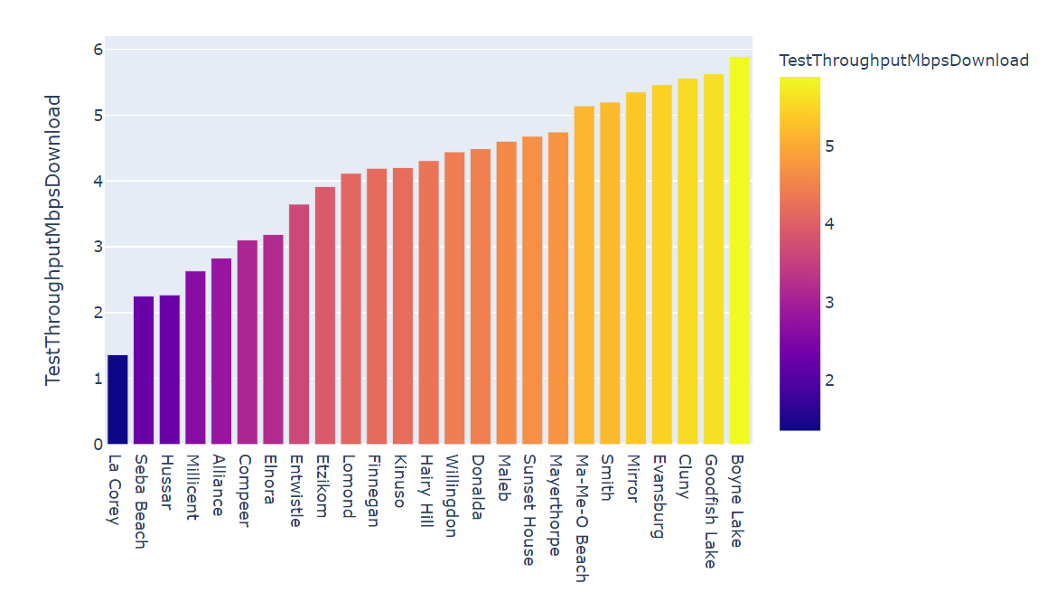
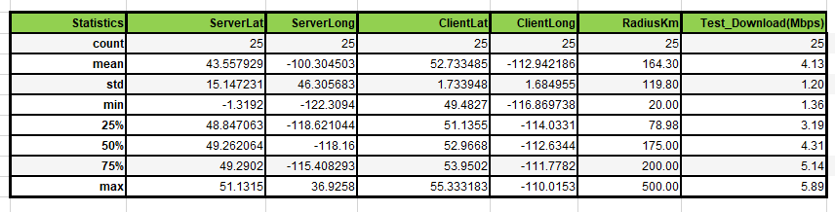
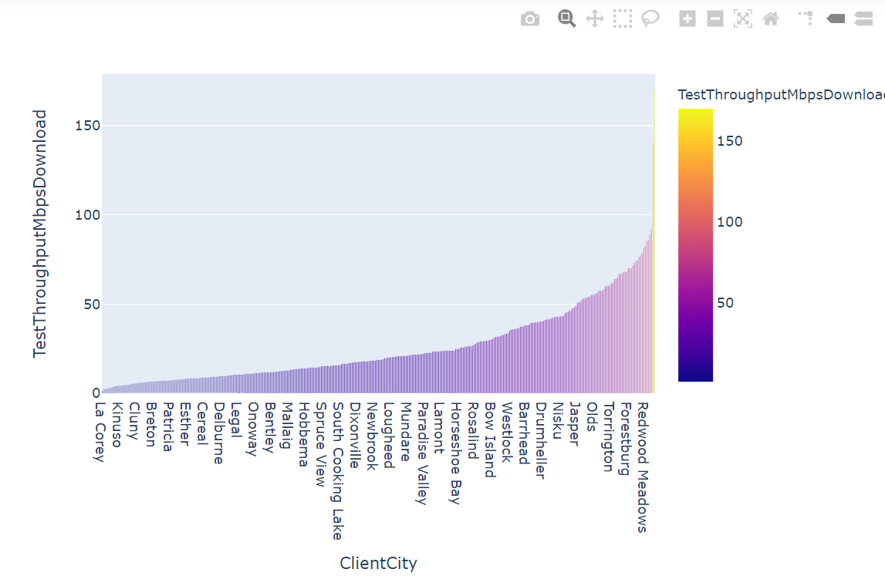
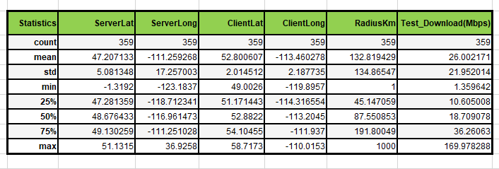
Data Analysis using Python
Goal 1: Identifying underserved rural areas with low-internet speed. We decided to use the download speed data as it is the data most commonly used to measure connectivity quality.
From 359 counties, we decided to focus our analysis on the 25 counties with lowest internet download speeds.
We found that the best way to visualize the download speeds was to plot the data in a bar graph using Plotly.

Slide 6
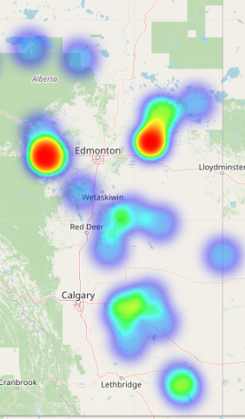
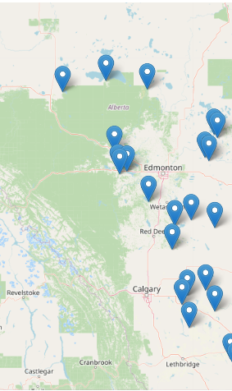
Data Visualization in Python
Heatmap on the left and a marker map at the right indicating the location of the counties and the variability of the internet downloads speeds.
The colors ranges goes light blue 1.38 to red 5.89.

Slide 7
Discoveries
It took a lot of time to find the correct data that we wanted to use for the 25 counties selected.
Financial analysis was done based on municipality public statements for 2019.
We found that the revenue of equities for the counties were very low; less than 1%.
The average download speeds for the 25 counties was less than 10 Mbps
Small population sizes may have played a big role on why internet service provider companies are reluctant to invest in upgrading infrastructures.
Municipalities, together with the provincial and federal government, need to implement tax incentives to encourage internet service provider companies to invest in racheting up speeds.
The internet services providers may have an agreements with other big companies making the changes difficult.

Slide 8
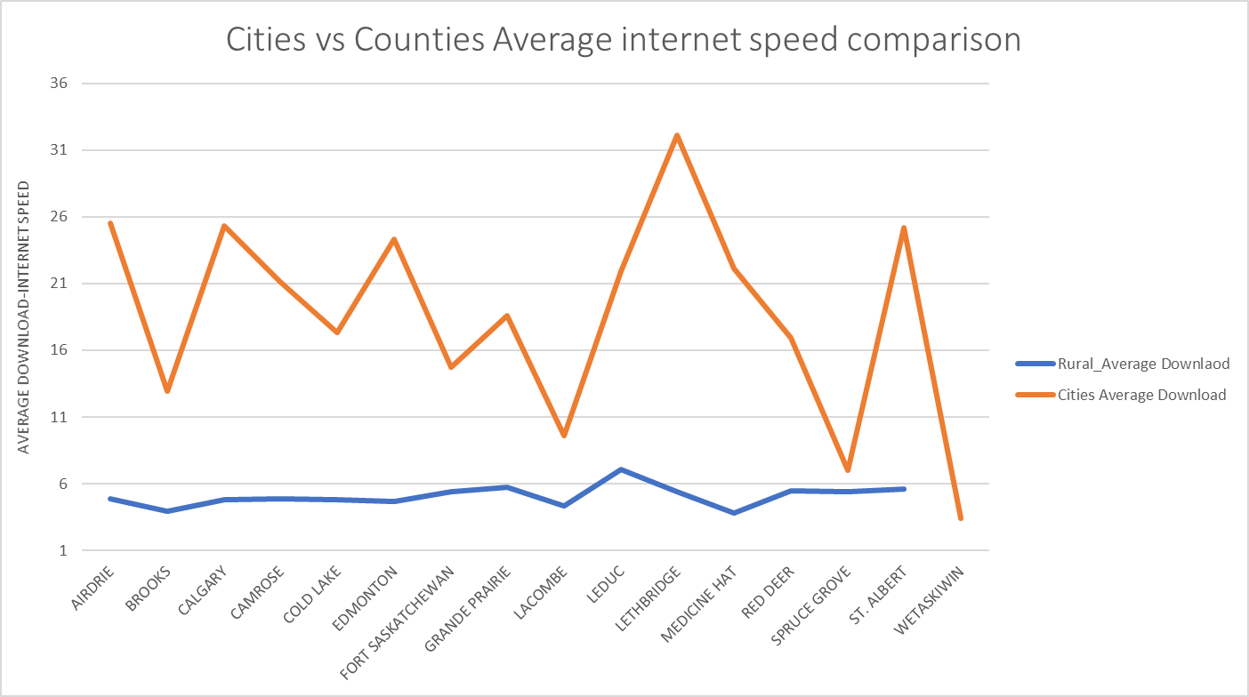
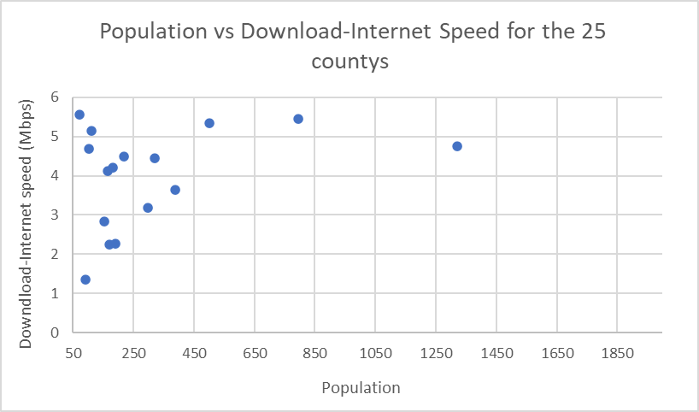
Correlations
B
C
A
We can observed 3 types of clusters: A,B and C.

Slide 9
Actual vs Future
Low speed internet may HAVE limited the Sustainability
Of rural areas of Alberta
Implement taxes incentive
To attract big companies
The PANDEMIC HAS CAUSED PEOPLE TO RELY ON DIGITAL COMMUNICATION MORE than ever.

Slide 10
Conclusions
1. We found that the biggest cause of the low connectivity speeds fount in Alberta’s rural areas could be the lack of implementing tax incentives/subsidies to upgrade or built better infrastructures.
2. Rural Municipalities are facing a bad financial conditions
3. The lack of demographic data such as personal income, average age, education etc. makes it difficult to get an idea on what percentage of people are most affected by low internet speeds.
4. We found three clusters when comparing population with internet download speeds and further analysis needs to be done to see if there are correlations between these two variables.

Slide 11
References
1. https://www.statista.com/statistics/544943/average-data-download-speed-canada-province/
2. https://www.statista.com/topics/4865/internet-usage-in-canada/#dossierSummary
3. https://regionaldashboard.alberta.ca/region//#/
4. Why rural connectivity is an issue for EVERY Canadian – Cybera
5. https://open.alberta.ca/opendata
6. https://crtc.gc.ca/eng/acrtc/prx/2020cramer.htm
7. https://regionaldashboard.alberta.ca/#/

