Slide 1
Readme

Slide 2
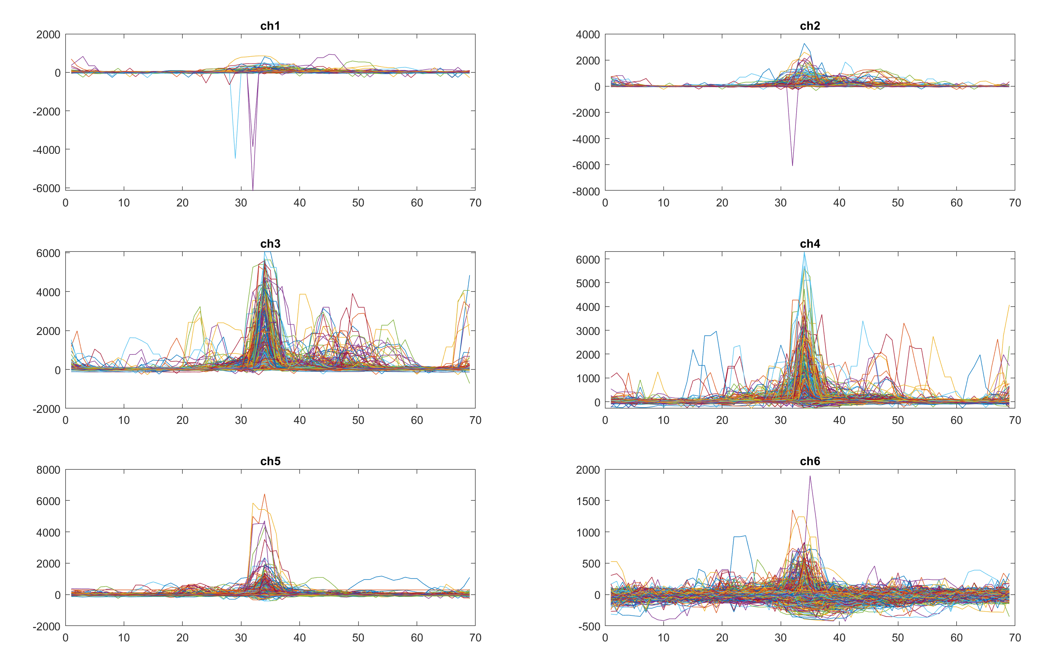
*10 downsampled plot of the trainset
37 files per terrain
Minimum step length (69)
Sometimes, first of the recordings of each step sample tends to have a weird step length ( ~50 or less). Those were ignored.
Both ends trimmed to 69 counts for all samples.

Slide 3
Each row is a step sample
ch1
ch2
ch3
ch4
ch5
ch6
label
And there are 5990 rows.
If you want the data arranged in a different way or want to include other information such as rpm, please let me know.

