Slide 1


Social Media Scraping with Python
Robert Thorstad
Rob O’Reilly
November 20, 2019

Slide 2
How many of you…

Slide 3
Used social media today?

Slide 4
… on your way to the workshop?

Slide 5
Which social networks did you use?

Slide 6







Most Americans Use Social Media
% of US Adults
(PEW Institute, 2019)

Slide 7
Often, Every Day
% Who Use
At Least 1X/Day
(PEW Institute, 2019)

Slide 8
Social media can be used to

Slide 9
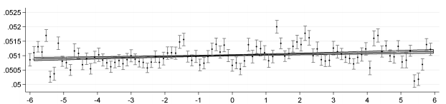

Infer Worldwide Mood
N = 1
billion!
Positive
Words
Daylight
Sentiment Analysis
(Golder & Macy, 2011, Science)
Notes:
Include: a DOI or a URL to link out to it.

Slide 10
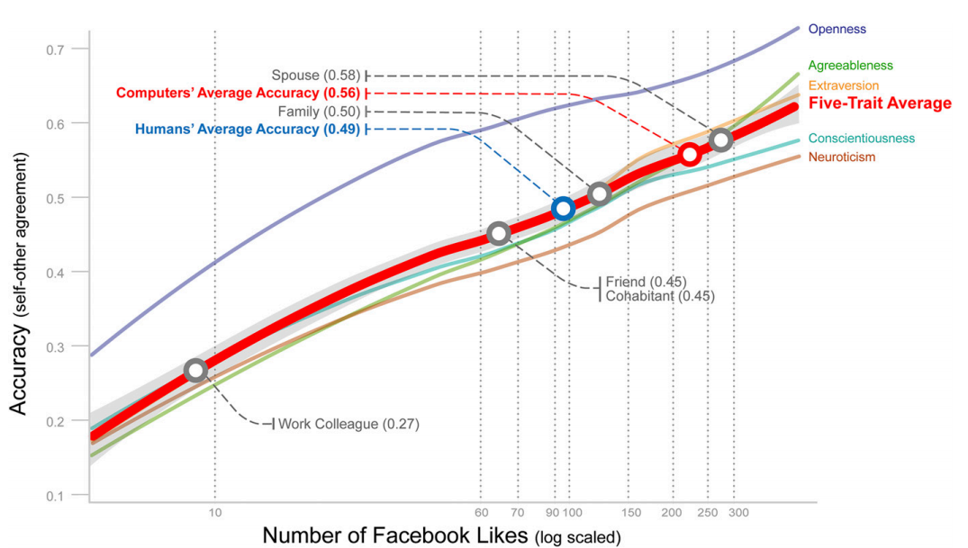
Predict Personality
(Youyou et al, 2013, PNAS)

Slide 11
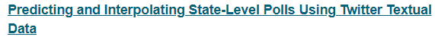

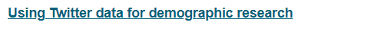

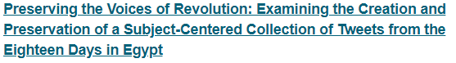
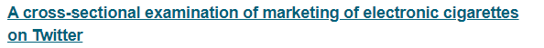

Social Science Uses
https://doi.org/10.1093/pan/mpu010
https://doi.org/10.1111/ajps.12274
https://doi.org/10.4054/DemRes.2017.37.46
https://doi.org/10.4054/DemRes.2018.39.22
https://doi.org/10.17723/aarc.77.2.794404552m67024n
http://dx.doi.org/10.1136/tobaccocontrol-2014-051551
https://doi.org/10.1007/s10579-012-9185-0

Slide 12
Predict Depression?
Prediction Accuracy
from Facebook
(Eichstaedt et al, 2018, PNAS; see also Thorstad & Wolff, 2019; De Choudhury et al, 2013; Guntuku et al, 2017)
Months Before Depression Diagnosis
Notes:
Note to myself. This slidef is not clear at all. Consdier replotitting their data and a better titile.

Slide 13
We’ll focus on twitter,
but think broadly
…

Slide 14
Twitter as Data

Slide 15
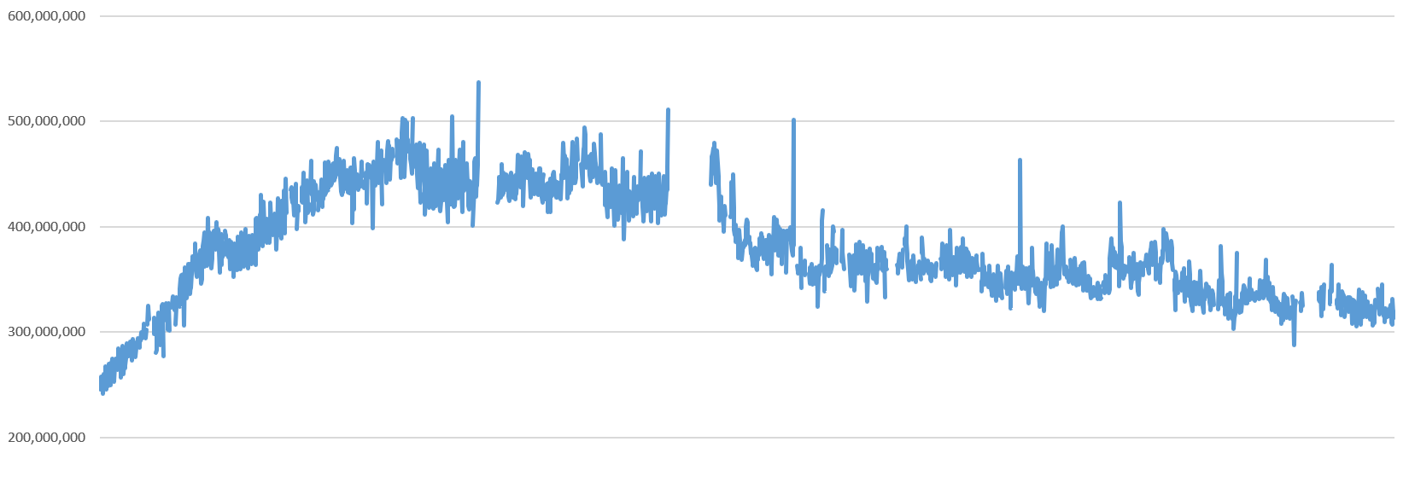
~200 Billion Tweets/Year
Tweets per day
600 million
500 million
400 million
300 million
200 million
2012
2014
2016
2018
Estimated from 1% twitter firehose by Kalev Leetaru: https://bit.ly/2mvwGXi
Notes:
NOTE; tell them what the “firehose” is.

Slide 16


Demographics
Not as skewed as you may think!
>$75k/year
% Male
College
% White
< 50 years
2012
2014
2016
2018
PEW, 2018

Slide 17

What kind of data is this?
Notes:
These are data of multiple types and formats. Twitter is “RAW MATERIALS FOR DATA…. Not data itself.”

Slide 18
Language
Components:
Hashtags
Mentions
URLs
Images
Emoticons
…

Slide 19
Social

Slide 20


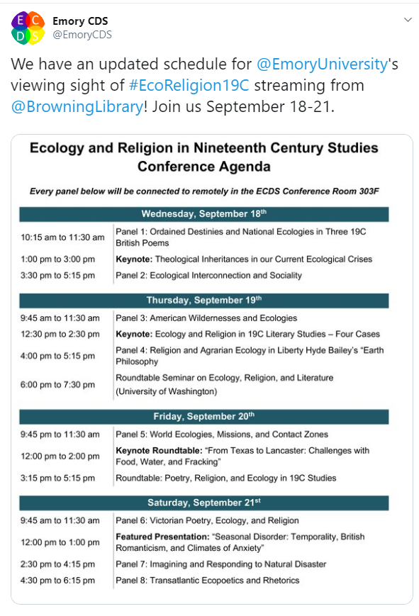
Time Series

Slide 21
Getting Tweets

Slide 22

Option #1: Pre-Curated Dataset
Good for:
Historical tweets about public interest topics
Easier to get started!

Slide 23
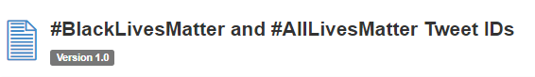

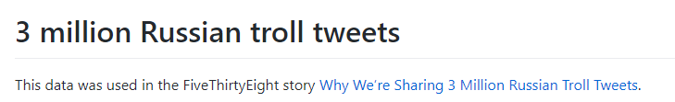
Some pre-curated datasets
https://doi.org/10.7910/DVN/IQ525U
https://doi.org/10.7910/DVN/UIVHQR
https://github.com/fivethirtyeight/russian-troll-tweets
http://doi.org/10.3886/E100202V3
10.5255/UKDA-SN-852731

Slide 24
May need to “hydrate”
Usually, just get an ID
Want to recover this:
1033084146103402497

Slide 25
Ethics Note
Can only share or publish
tweet ID, not text of tweet
Ok to store full tweets
https://developer.twitter.com/en/developer-terms/agreement-and-policy.html

Slide 26
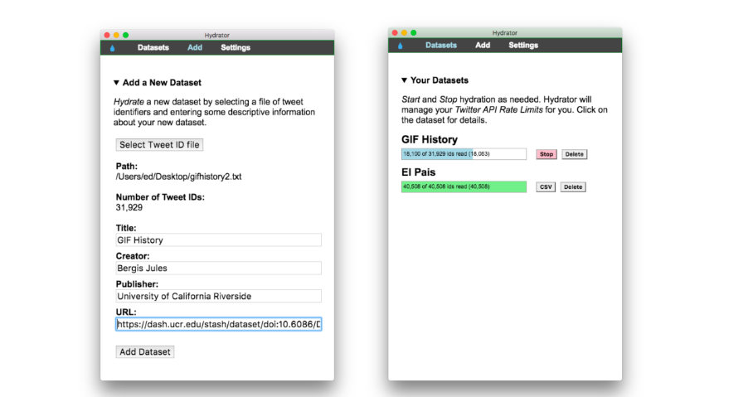
There’s an app for that!
Hydrator: https://github.com/DocNow/hydrator

Slide 27
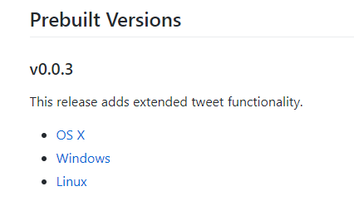
Install

Slide 28
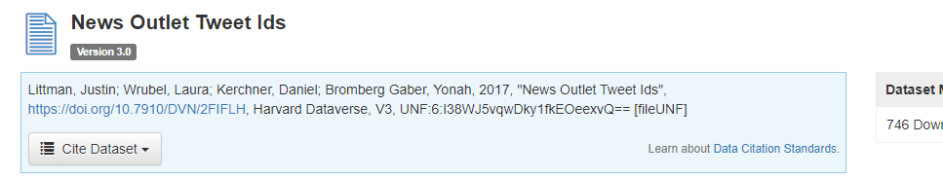
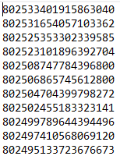
Example Dataset
Input is a list of IDs, 1 per line:
news_outlets.txt

Slide 29
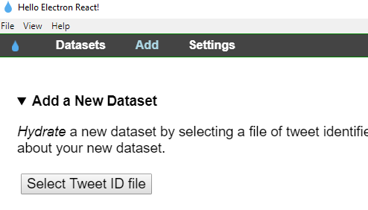
Add Dataset to Hydrator

Slide 30
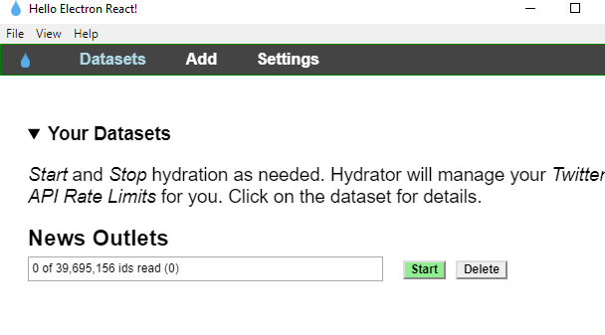
Start Hydrating
Output: text file of tweets
JSON format… see Python portion of tutorial!

Slide 31

Option #2: Mine your Own
Good for:
Get exactly the tweets you want!
But, more effort

Slide 32
Options:
Keyword [tutorial]
Timeline [of a single user]
Decahose [real-time stream]
Others [some cost $$$]: https://developer.twitter.com/en/docs/tweets/search/api-reference

Slide 33
Tutorial
https://colab.research.google.com/drive/1jhWs6bt5UdHNdfh22hloWuTPKvCd93I0

Slide 34
Careful with rate limits:
Cheat sheet
Programming concepts
tweepy.api(wait_on_rate_limit=True)
API (+ rate limits)
JSON (and JSONL)
https://developer.twitter.com/en/docs/basics/rate-limits
Types of searches:
Twitter API Credentials
Keywords. User timeline. Decahose. And others
https://developer.twitter.com/en/docs/basics/authentication/guides/access-tokens
https://developer.twitter.com/en/docs/tweets/search/api-reference
https://developer.twitter.com/en/apply-for-access
Tools for mining tweets
Tweepy (python). Hydrator (graphical program)

