Slide 1
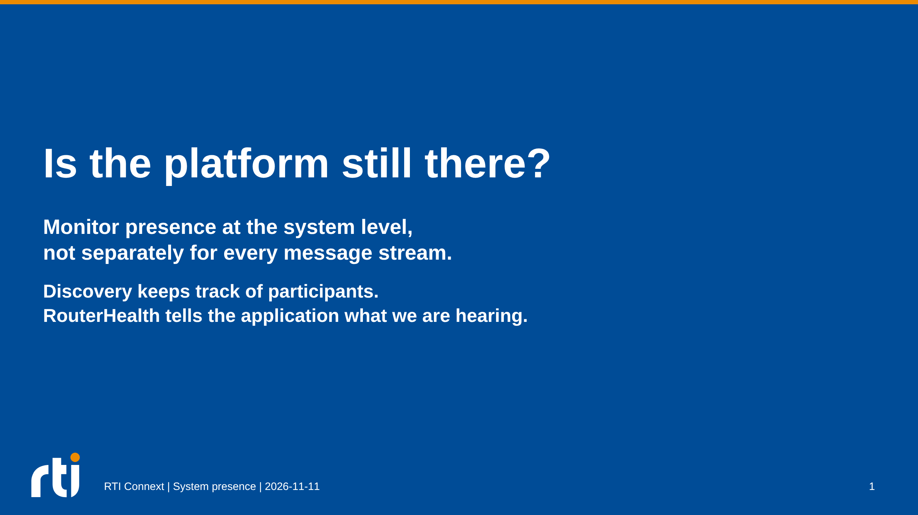
Notes:
The operational question is whether the platform is alive or has gone down.
A receiver can establish reachability by its policy, not prove physical death:
a crashed platform, failed radio path, or severe congestion can look alike.
Router health is a system-presence signal, not proof every onboard task works.
Scope: Connext DDS Professional 7.7.0. No new runtime qualification is claimed.

Slide 2
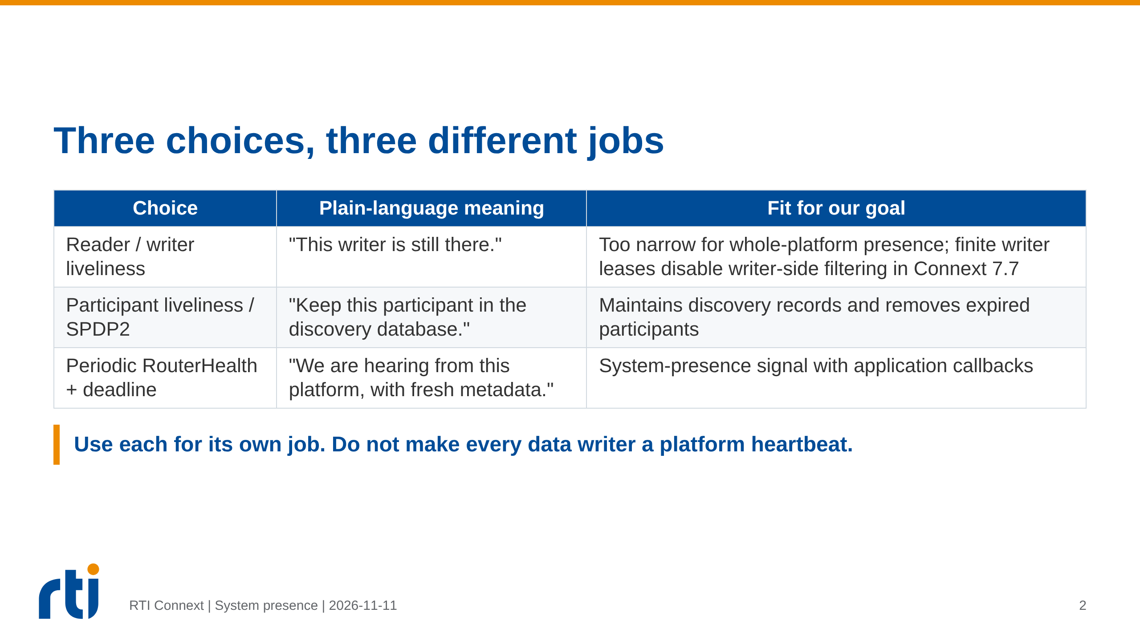
Notes:
Writer LIVELINESS is asserted by a DataWriter and observed by matched readers;
there is no symmetric DataReader LIVELINESS contract.
The finite-writer-lease filtering restriction is documented for 7.7 and does
not mean reader-side filtering stops working. Unwanted data may cross the WAN.
AUTOMATIC writer liveliness may continue while application work is stalled.
MANUAL_BY_PARTICIPANT writer liveliness is not the participant discovery lease.
Infinite application-writer leases remove this particular filtering blocker,
but other prerequisites for writer-side filtering still apply.
Source: 7.7 Users Manual, LIVELINESS QosPolicy:
https://community.rti.com/static/documentation/connext-dds/7.7.0/doc/manuals/connext_dds_professional/users_manual/users_manual/LIVELINESS_QosPolicy.htm

Slide 3
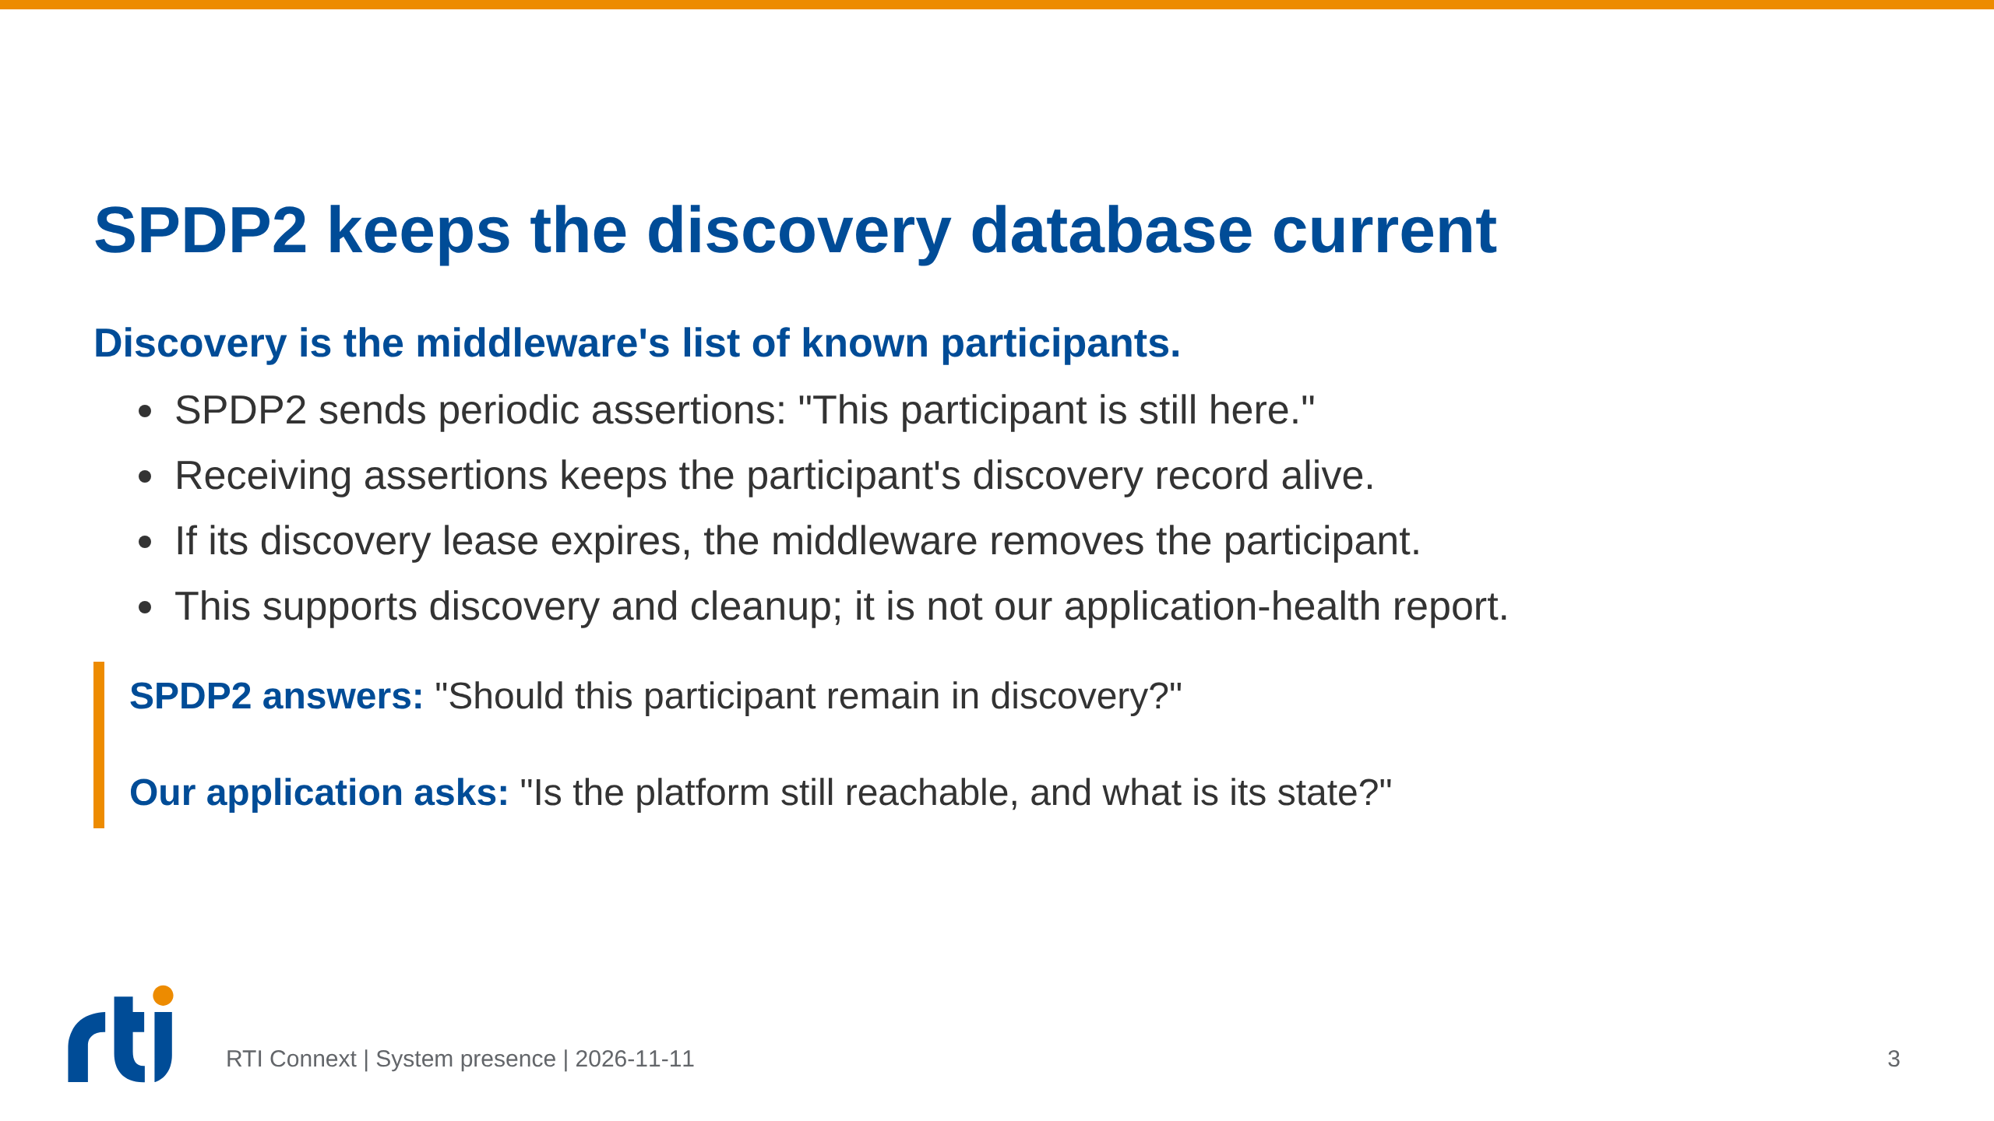
Notes:
SPDP2 means Simple Participant Discovery Protocol 2.0.
Its small periodic liveliness messages are separate from full discovery
announcements. The assertion period and discovery lease are distinct settings.
Participant expiry also affects associated endpoint discovery.
Discovery can expose status notifications, but it does not carry RouterHealth
application metadata or prove progress of the platform's business tasks.
This slide explains SPDP2's role; it does not claim it is enabled in the live mesh.
Sources: 7.7 Users Manual, Simple Participant Discovery 2.0 and DISCOVERY_CONFIG:
https://community.rti.com/static/documentation/connext-dds/7.7.0/doc/manuals/connext_dds_professional/users_manual/users_manual/Simple_Participant_Discovery_2.htm
https://community.rti.com/static/documentation/connext-dds/7.7.0/doc/manuals/connext_dds_professional/users_manual/users_manual/DISCOVERY_CONFIG_Qos.htm

Slide 4
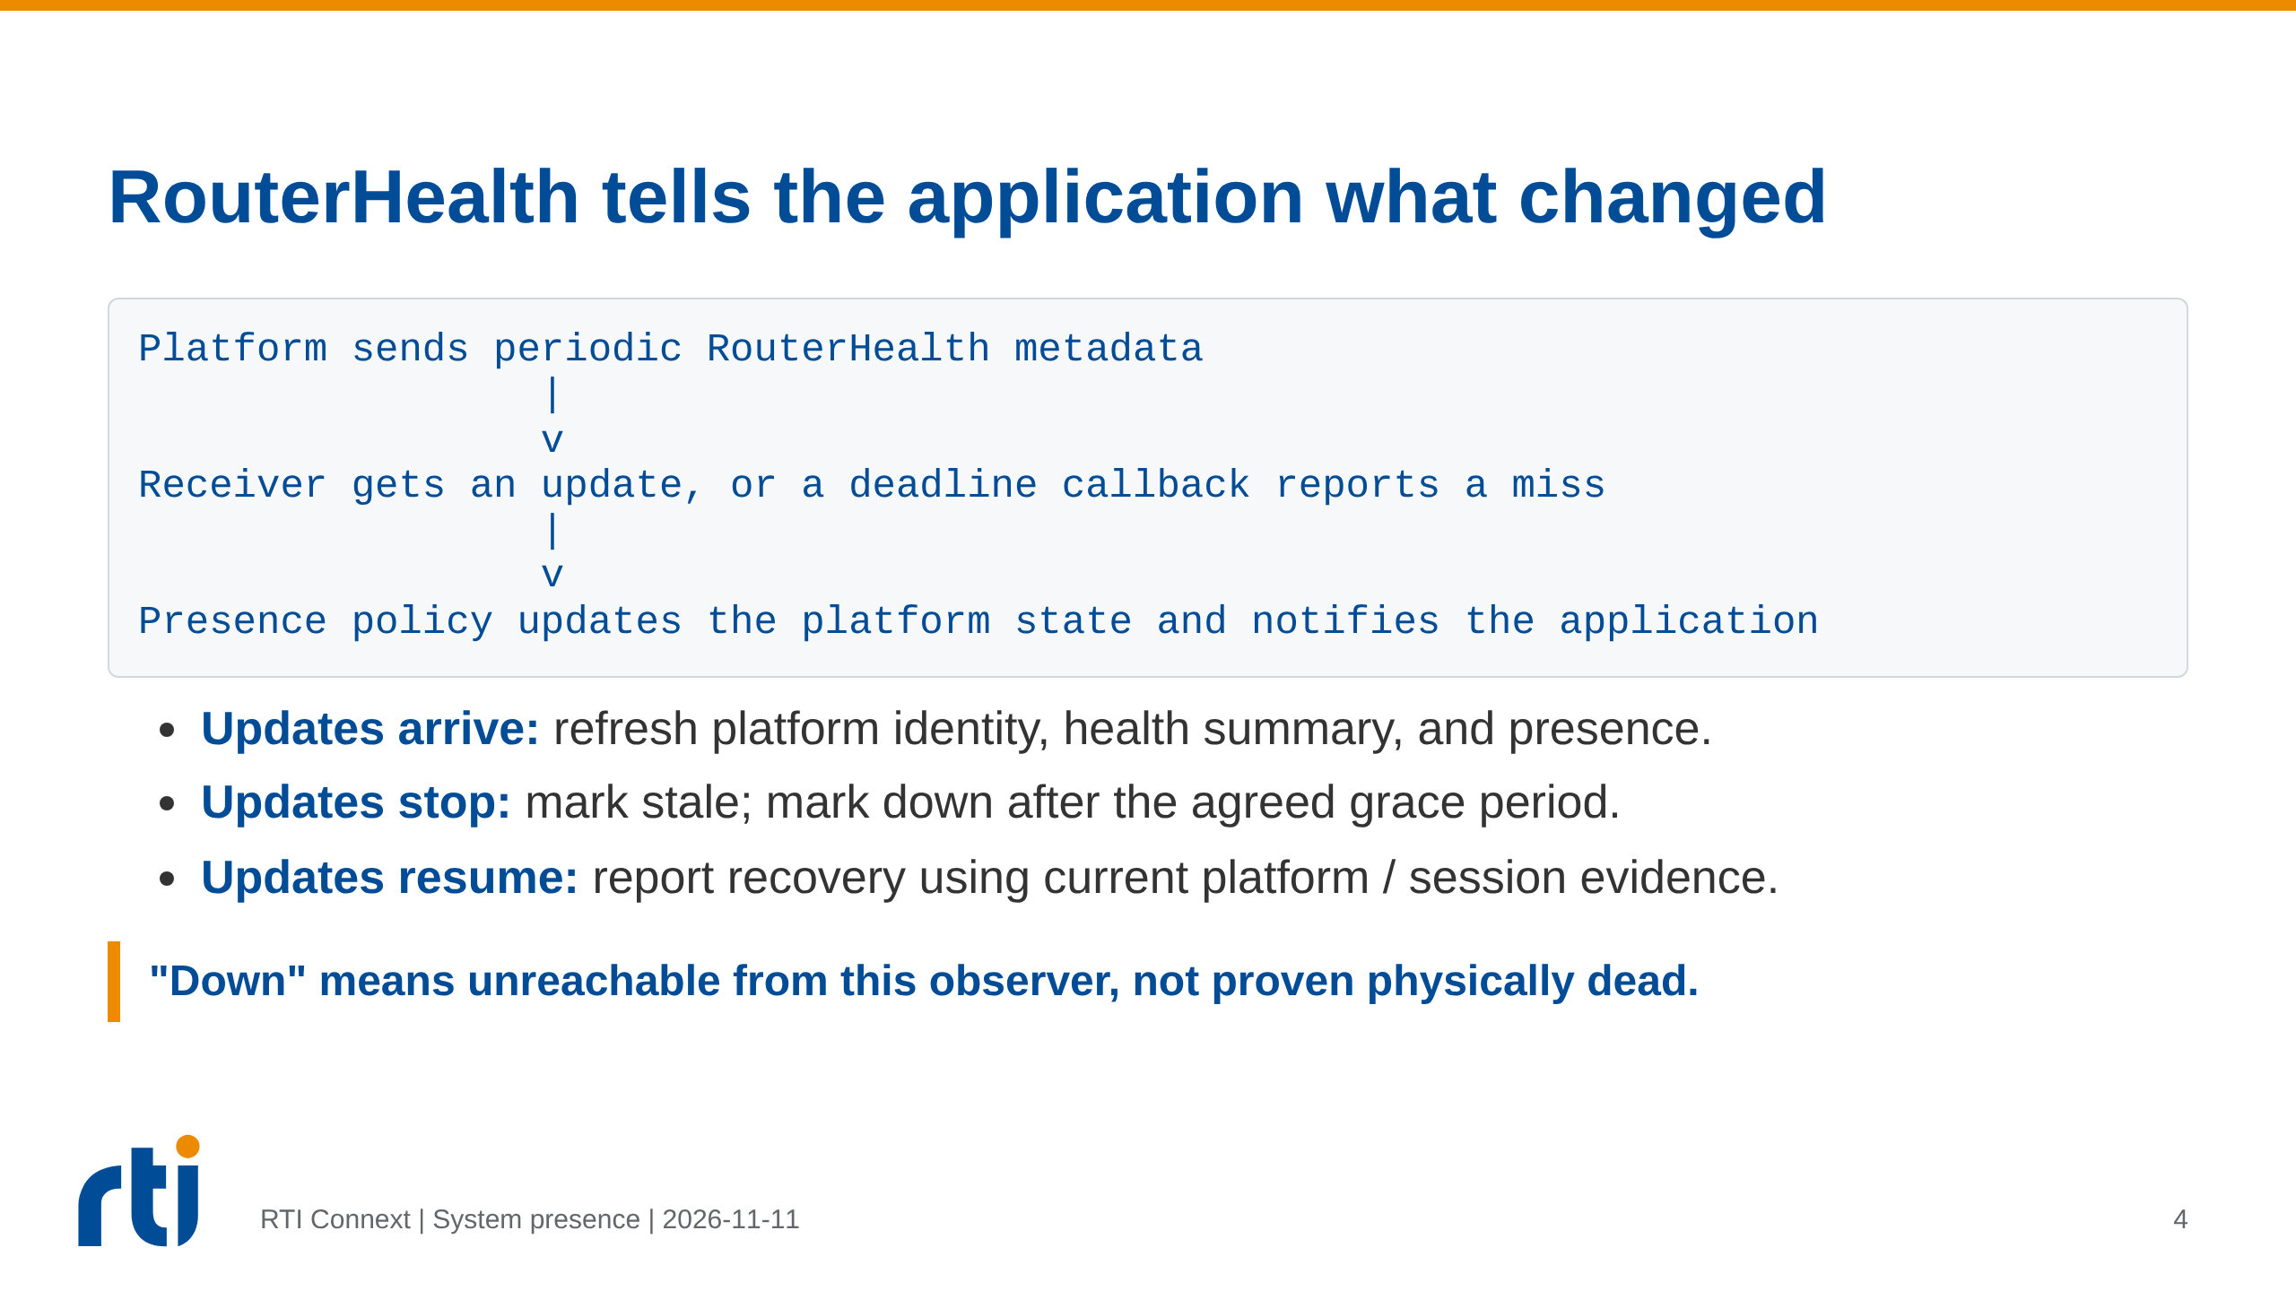
Notes:
RouterHealth is the logical application health stream. In the two-topic design
it is a case inside the shared Status topic, not a third permanent WAN topic.
DDS DEADLINE provides a missed-update callback for a known instance; the
application policy decides how this becomes a presence notification.
An incoming-data callback/condition handles new metadata; DEADLINE does not
itself carry the metadata or publish a dashboard update.
Reader DEADLINE begins after first receipt. Expected platforms never seen need
a separate startup/expected-roster check. Allow for scheduling and network jitter.
Current two-topic source uses a 2 s deadline and 30 s grace after STALE;
only health-instance deadline misses drive presence. Any valid received Status
can restore ALIVE, so current ALIVE denotes source reachability, not necessarily
resumption of the health stream. This slide is the plain-language flow, not
a replacement specification for those details.
Sources:
https://community.rti.com/static/documentation/connext-dds/7.7.0/doc/manuals/connext_dds_professional/users_manual/users_manual/DEADLINE_QosPolicy.htm
Repository: harness_v2/qos/act_qos_profiles.xml,
router/src/core/PresenceMonitor.cxx, router/src/core/WanAdapterFactory.cxx.

Slide 5
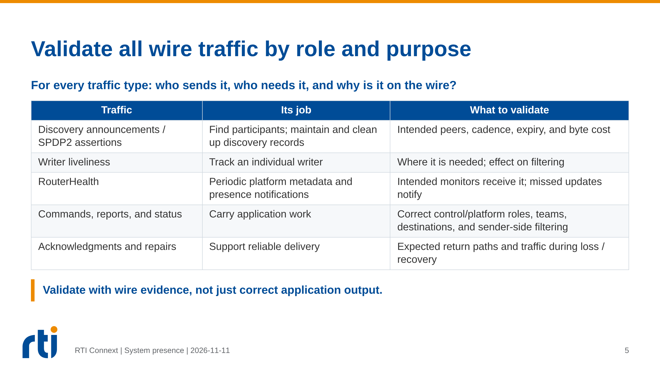
Notes:
"Role" covers both the message's function and the sender/receiver system role:
control versus platform, addressed recipients, and team membership where relevant.
This is a traffic-validation requirement, not a claim that DDS filters provide
authentication, authorization, or complete security enforcement.
Every observed traffic type must be accounted for, including middleware control
traffic, retries, and startup/restart bursts, not only user-topic payloads.
Check appropriate control-to-platform and platform-to-control health flows;
do not assume all platform-to-platform health visibility without a requirement.
Writer-side suppression requires sender counters or scoped packet capture:
receiving only desired values also happens with filtering at the receiver.
This deck defines what to validate; it does not claim those captures were run.

Slide 6
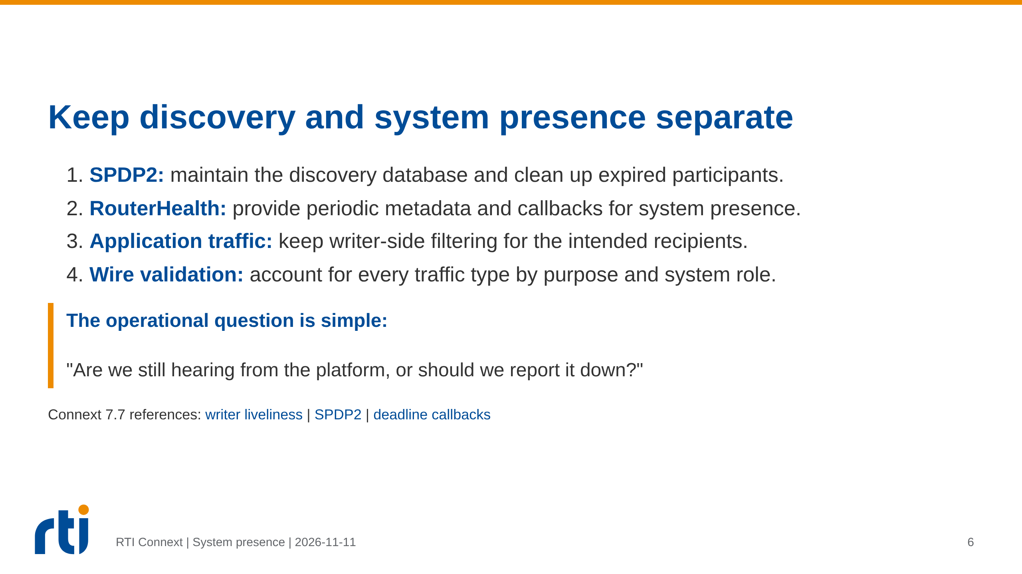
Notes:
Do not silently enable finite writer liveliness on shared application endpoints.
This is a communication/design deck; no QoS, application, or live-mesh behavior
was changed. System presence and detailed task health remain different claims.
The same absence can result from platform failure, a broken path, or congestion.
Validate timeout behavior, recovery, restarts, never-seen expected platforms,
audience filtering, and wire traffic before claiming system acceptance.

