Slide 1


EternalBlue One of the most potent exploits ever seen!
IST 623 – Introduction to Information Security
Case Study Presentation
2/25/2020
Team: Group 2
Samantha Brennen-Lisko
Assadour Derderian
Rose Ochoa
Nicolas Reyes
Ryan Timbrook

Slide 2
Case Summary
Per NY Times: “Since 2017, when the N.S.A. lost control of the tool, EternalBlue.
It has been picked up by state hackers in North Korea, Russia and, more recently, China, to cut a path of destruction around the world, leaving billions of dollars in damage.”
Ransomware is a type of malicious software designed to block access to a computer system until a sum of money is paid.
Although ransomware aims at individuals, it also caters to Institutions for financial profit.
Notes:
- Assadour

Slide 3
Origination
The National Security Agency discovered vulnerabilities in Microsoft’s system that could be used as an exploitation device but did not notify Microsoft until a breach had occurred.
Microsoft then created a patch to fix the vulnerabilities but not in enough time for widespread affect before attack was carried out.
A group of hackers known as Shadow Brokers were able to obtain information from the NSA regarding the vulnerabilities.
The Shadow Brokers group then released the secrets on the internet which were then picked up by such groups who created the WannaCry ransomware attack which targeted systems across the globe.
Notes:
- Nicolas

Slide 4
Victims
Governments
Businesses
Constituents
Possibly Critical Information
Notes:
- Assadour

Slide 5
Question & Answer
EternalBlue – Case Summary - Victims

Slide 6
Mechanism of attack
EternalBlue exploited “vulnerabilities in the windows implementation of Windows Server Message Block protocol.”
Three bugs were exploited
Once the attacker takes control of the system, they can use a multi-layered encryption approach to encrypt a victim’s files and hold them for ransom.
Unpatched systems are still vulnerable to this day.
Notes:
- Nicolas Server Message Block (SMB) is a network communication protocol which allows computers on a network, or within a domain, to share files (3). The bugs essentially allow an attacker to overwrite client data within packets and address it to the attacker’s specifications through a modified packet to the server. The first bug creates a situation where less memory is allocated during packet generation.
The second bug exploits code that can trigger a buffer overflow.
The third bug exploits code that can take advantage of this overflow by deploying a heap spraying technique which in turn allows the attacker to direct code.

Slide 7
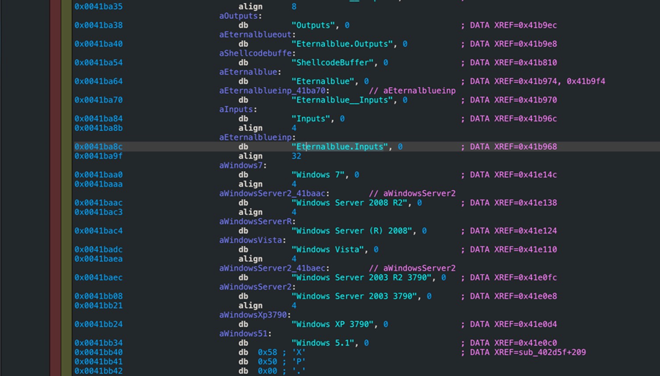
¹Vulnerable Windows Systems:
Notes:
Not just Windows PCs are vulnerable, essentially any system that implements the SMB protocol

Slide 8
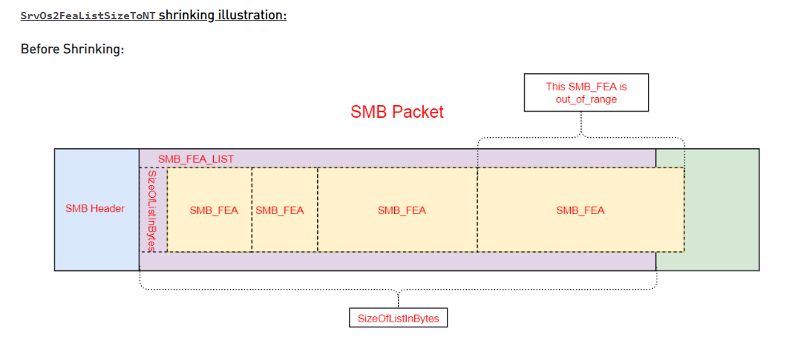
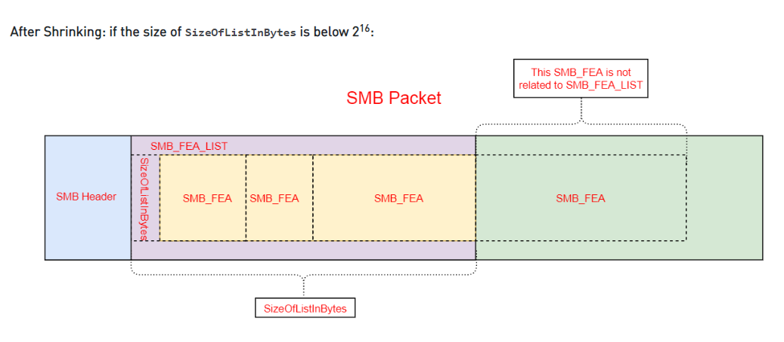
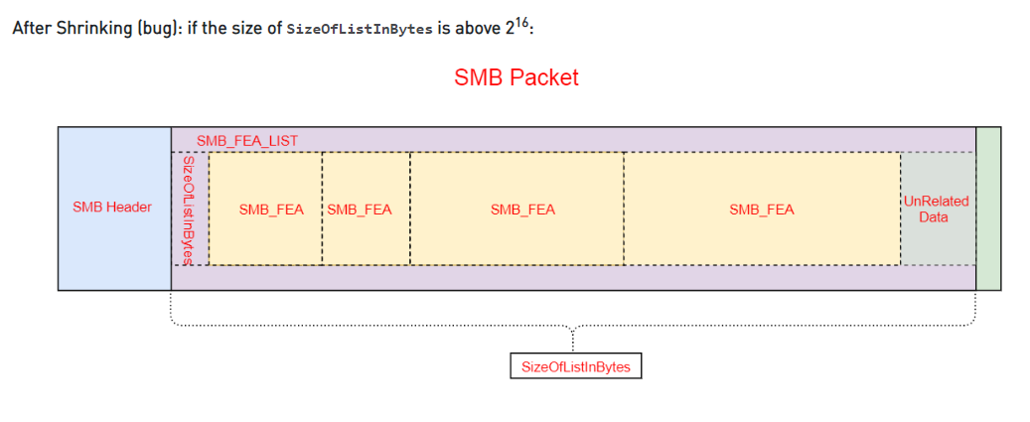
1st Bug Illustration
From checkpoint.com Research By: Nadav Grossman
https://research.checkpoint.com/2017/eternalblue-everything-know/

Slide 9
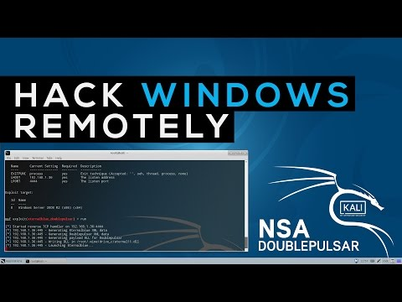
Hack Windows 7 Remotely Using DOUBLEPULSAR — NSA Hacking Tool
Video by: ArcaneHacks

Slide 10
Question & Answer
EternalBlue – Mechanism of Attack

Slide 11
Fallout
Affected over an estimated 500,000 computers across 150 countries in 2017.
Estimated damage range from hundreds of millions to billions of dollars for businesses and governments
Cybercriminals asked for 13 bitcoins ($113,000) from Balitmore authorities
Governments had to pay to get data back
Baltimore decided not to pay Wannacry – had to pay $18 million
Citizens now pose the question, "should the government be responsible and liable to cover the costs of damages just like any other war/military or state-created weapon?"
No such thing as a safe cyber weapon
Active war – not an act for profit, but more of resent
Buy/replace new IT equipment
Even after purchasing data back, they need to cover the software damages to take care of virus in devices
Users had to update their programs and system for patch updates
Public fear that their data is not safe/secure anymore
Notes:
- Rose Mary

Slide 12
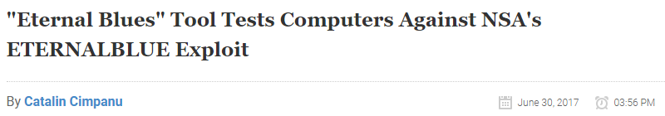
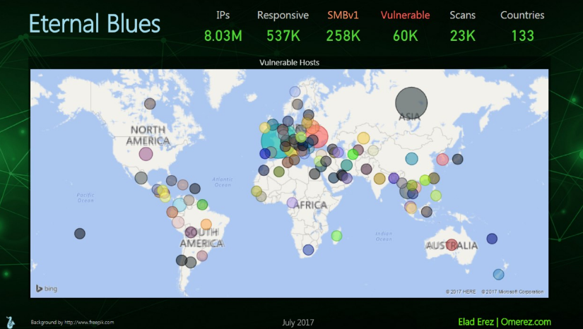
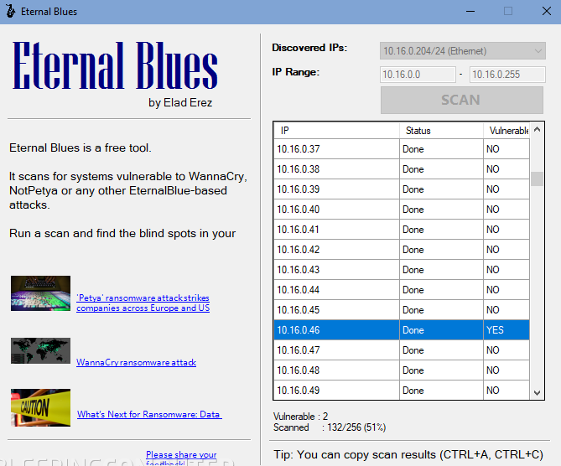
Eternal Blues Scan Statistics
- Eternal Blues app found more than 50,000 vulnerable computers around the world in the past two weeks, since official release date
Users scanned over eight million IPs
53.8% of scanned hosts still had the SMBv1 protocol enabled
Most had applied MS17-010 patch, leaving 50,000 still vulnerable
“Security researcher Elad Erez has created a tool named Eternal Blues that system administrators can use to test if computers on their network are vulnerable to exploitation via NSA’s ETERNALBLUE exploit. Erez released his tool on Wednesday, a dafter the NotPetya ransomware caused damages to thousands of computers across the globe.” – BleepingComputer.com
Notes:
The developer of a tool named Eternal Blues that scans for computers vulnerable to the NSA's ETERNALBLUE exploit has published statistics gathered from the app's usage.
According to Elad Erez, the tool's developer, the Eternal Blues app found more than 50,000 vulnerable computers around the world in the past two weeks, since the tool's official release.
Eternal Blues works by pinging computers in a network range and attempting to identify if they are vulnerable to specially crafted SMB packets, as the ones used by the ETERNALBLUE exploit. Eternal Blues only checks for specific responses, without exploiting the actual SMB flaw, and does not run any code on the scanned computers.
Users scanned over eight million IPs
After Erez published Eternal Blues on June 28, he says that countless of users downloaded the tool and scanned local networks or Internet ranges for vulnerable systems.
The developer says that users employed Eternal Blues to scan over eight million IP addresses. Most of the scanned IPs were assigned to countries such as France, Russia, Germany, the US, and Ukraine.
Of these, 53.82% of scanned hosts still had the SMBv1 protocol enabled, even if Microsoft has recommended that users move to v2 or v3, newer and more secure versions of the protocol.
The good news is that even if so many users had SMBv1 enabled, most had applied the MS17-010 patch that protects systems against ETERNALBLUE.
Only one in nine scanned hosts was vulnerable to ETERNALBLUE
According to Erez, only one in nine of the scanned hosts were vulnerable to ETERNALBLUE, which was about 50,000 PCs, or 11% of the scanned hosts. The top 3 most vulnerable countries were France, Russia, and Ukraine.
While some Eternal Blues statistics came from bad actors looking for vulnerable systems, the good guys also used this tool, meaning that at least some part of these computers have been patched.
You can download Eternal Blues from Erez's homepage, and you can also see a visual representation of his findings in this presentation here.
Security researcher Elad Erez has created a tool named Eternal Blues that system administrators can use to test if computers on their network are vulnerable to exploitation via NSA's ETERNALBLUE exploit.
Erez released his tool on Wednesday, a day after the NotPetya ransomware caused damages to thousands of computers across the globe.
Just like WannaCry did in last month's outbreak, NotPetya also used ETERNALBLUE as a means to spread from one computer to the next.
Eternal Blues was created for simple folks
Technically, an attacker could hack Windows computers with one SMB packet. This is also how Erez's tool works.
Eternal Blues will ping computers in a network range and detect if they are vulnerable to those specially crafted packets, but without exploiting the flaw to run any code on the scanned computers.
When users launch Eternal Blues, the tool allows users to scan their local LAN, but Erez says the tool can be used to scan any network range on the Internet, not just local networks.
The researcher admits that his tool is nowhere near as advanced as NMap, Metasploit, or others, but he says he intentionally created a simpler tool because he wanted a one-click solution to detect computers vulnerable to
ETERNALBLUE that less technical users can utilize, and not just infosec professionals.
The target audience for Eternal Blues is ordinary sysadmins who have seen WannaCry and NotPetya ransomware wreak havoc in other companies and want to see if their networks are vulnerable, in order to install the necessary updates.

Slide 13
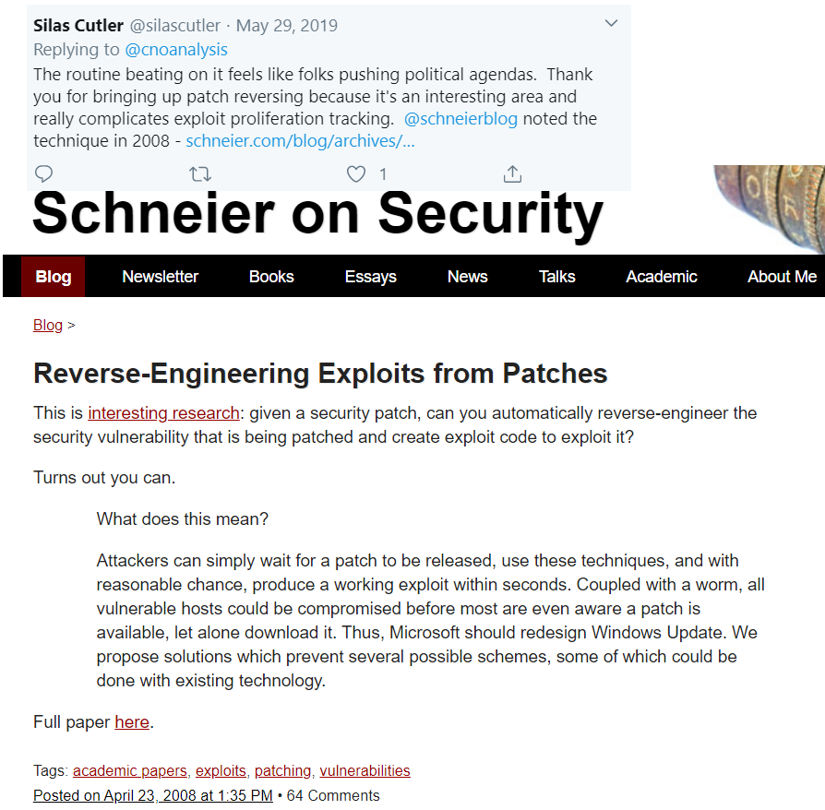
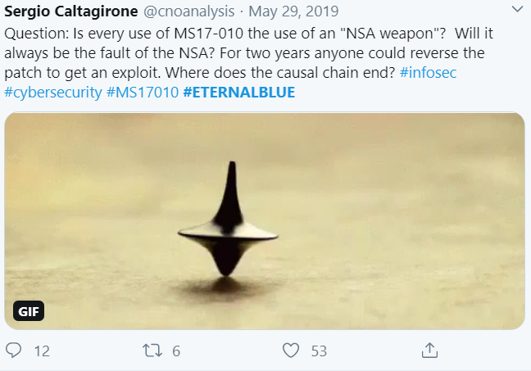
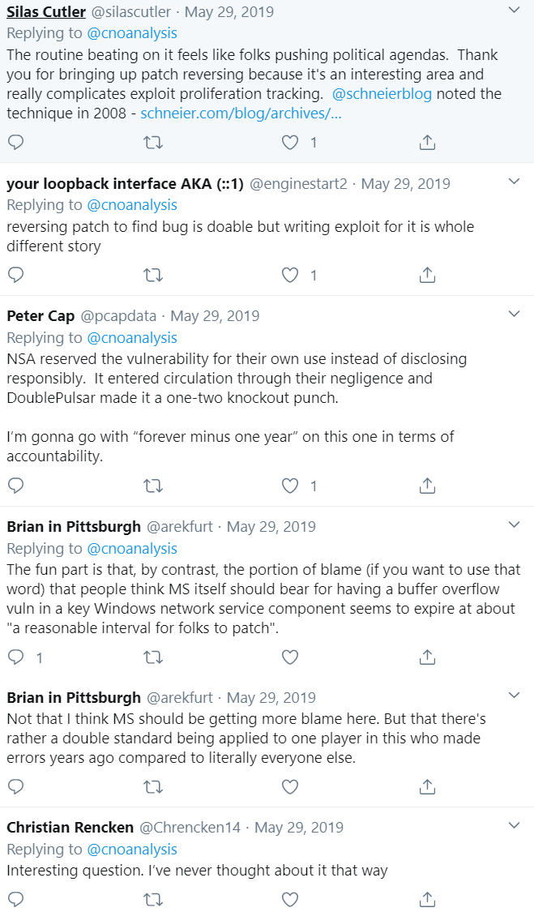
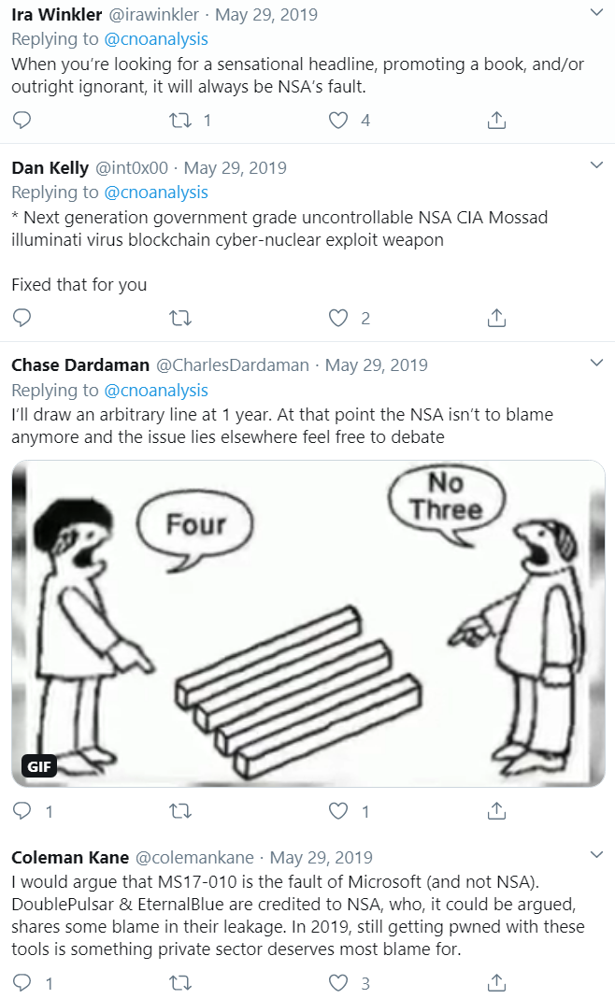
Social Media Clippings

Slide 14
Question & Answer
EternalBlue - Fallout

Slide 15
Texas
22 cities or counties hit in single attack, Federal Investigation ^{4,5}
Keene, TX ^{4,5}
No Credit Card payments
No Utility payments
Analog
Ransom demand $2.5 million
State IT Dept. Restoring
Lubbock County, TX ⁵
Lubbock's IT department isolate the ransomware before it spread
Infected computer, not network

Slide 16
Florida
Lake City, FL ⁶
Paid $485,000 in bitcoin (Insurance paid all but $10,000)
Hackers: control phone and email system
Emergency system not effected
Phone calls rerouted through emegency system: no delays to emergency calls
Key received: some emails restored, many inoperable
Adding training
Marion County, FL ⁶
2 computers infected
No important information was jeopardized
Increased cyber security and
Developed counter measures.

Slide 17
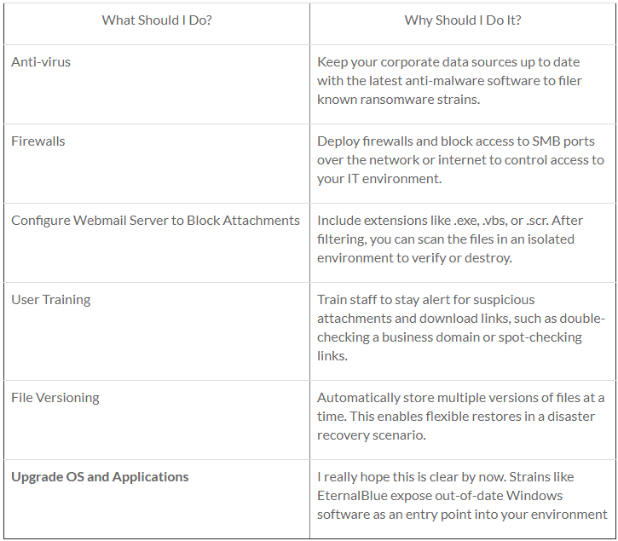
How to Protect Against EternalBlue
EternalBlue exploits a vulnerability in outdated versions of Microsoft Server Message Block.
Only known mechanism to protect against EternalBlue is to download the latest Windows software update and install the patch.
Additionally, ensure that the following safeguards are in place:
Anti-virus software
Secure offsite backup with “attack-loop” prevention
Filter for .exe attachments in emails
Encrypt sensitive data
https://www.keepitsafe.com/blog/post/eternalblue-whats-going-on-and-how-to-protect-your-data/
Notes:
Also consider the following tactics to proactively prevent an attack from infiltrating your network:

Slide 18
Question & Answer
EternalBlue - Mitigations

Slide 19
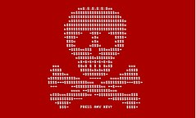
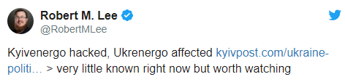
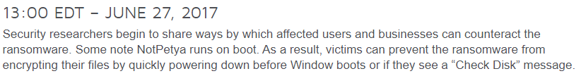
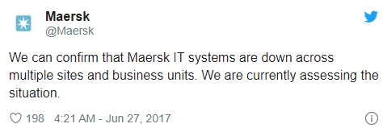
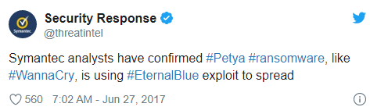
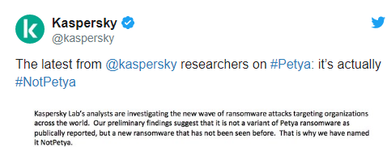
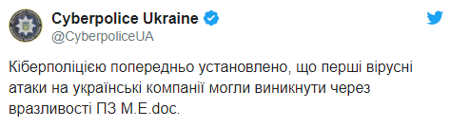
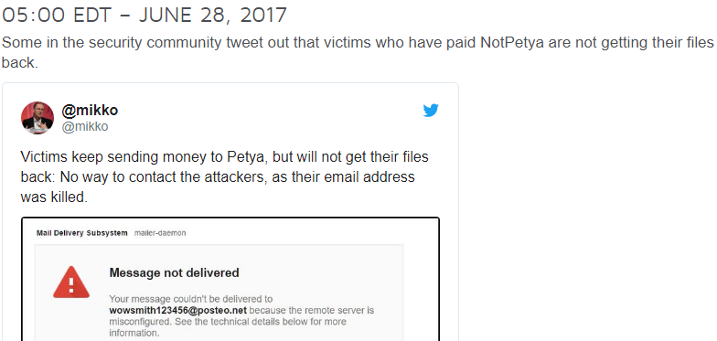
NotPetya - Variants of EternalBlue
JUNE 27, 2017
At the end of 2018, millions of systems were still vulnerable to EternalBlue
They aren’t just viruses. They are worms…
On June 27, 2017, a digital attack campaign struck banks, airports and power companies in Ukraine, Russia and parts of Europe.
- Combined, caused over $1 billion worth of damages over 65 countries
05:00 – 06:00 EDT
08:00 EDT
10:00 EDT
12:00 EDT
13:00 EDT
05:00 EDT
Ukraine’s police confirm MeDoc, an accounting software package that many Ukrainians use to pay their taxes, as a NotPetya infection vector.
The first signs of a digital attack
Symantec Security Response confirms that Petya ransomware is responsible for the digital attacks.
Other affected organizations coming forward:
Kaspersky Lab tweets out a statement clarifying that the ransomworm is not a variant of Petya but is actually a new ransomware they named “NotPetya.”
Security researchers’ belief that an update released by MeDoc at 10:30 GMT on June 27, 2017, allegedly installed the malware on the “victim zero” system.
Notes:
Place Holder – Slide – Ryan Timbrook – Topic
The modern ransomware attack was born from two innovations in the early part of this decade: encryption and bitcoin.
WannaCry was the first “ransomworm” the world had ever seen.
A “worm”, in computing parlance, is a piece of malware able to spread itself to be far more damaging than your typical computer virus. They self-replicate, bouncing from host to host, and obeying all the epidemiological rules that real diseases do, growing exponentially and taking off when they infect well-connected nodes.
The Shadow Brokers released details of a weakness in Microsoft’s Windows operating systems that could be used to automatically run programs on other computers on the same network.
At the end of 2018, millions of systems were still vulnerable to EternalBlue. This has led to millions of dollars in damages due primarily to ransomware worms. Following the massive impact of WannaCry, both NotPetya and BadRabbit caused over $1 billion worth of damages in over 65 countries, using EternalBlue as either an initial compromise vector or as a method of lateral movement.
The “unpatched Windows exploit” was how WannaCry was able to affect over 200,000 computers across 150 countries in 2017. Damage estimates range from hundreds of millions to billions of dollars
NotPetya Variant
- The new variant propagates via the EternalBlue exploit.
Kaspersky Lab referred to this new version as NotPetya to distinguish it from the 2016 variants, due to these differences in operation. In addition, although it purports to be ransomware, this variant was modified so that it is unable to actually revert its own changes.
The malware harvests passwords (using tweaked build of open-source Mimikatz) and uses other techniques to spread to other computers on the same network, and uses those passwords in conjunction with PSExec to run code on other local computers.
Additionally, although it still purports to be ransomware, the encryption routine was modified so that the malware could not technically revert its changes. This characteristic, along with other unusual signs in comparison to WannaCry (including the relatively low unlock fee of US$300, and using a single, fixed Bitcoin wallet to collect ransom payments rather than generating a unique ID for each specific infection for tracking purposes), prompted researchers to speculate that this attack was not intended to be a profit-generating venture, but to damage devices quickly, and ride off the media attention WannaCry
As explained by information security researcher “the grugq,” researchers’ struggle to correctly identify the ransomware stems from some code shared between Petya and the new threat:

Slide 20
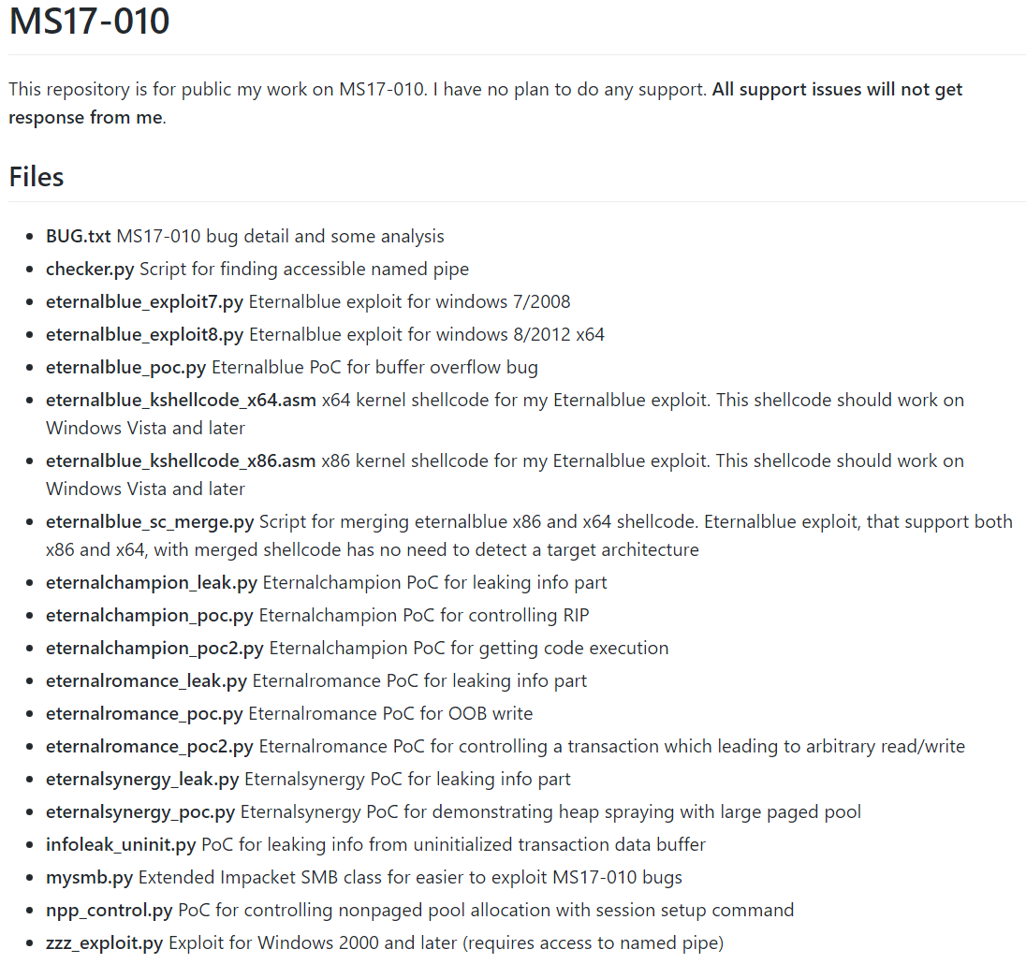
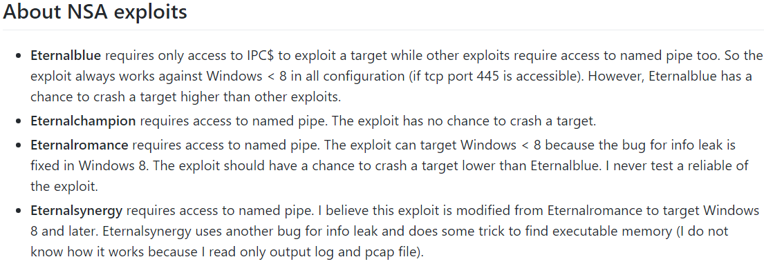
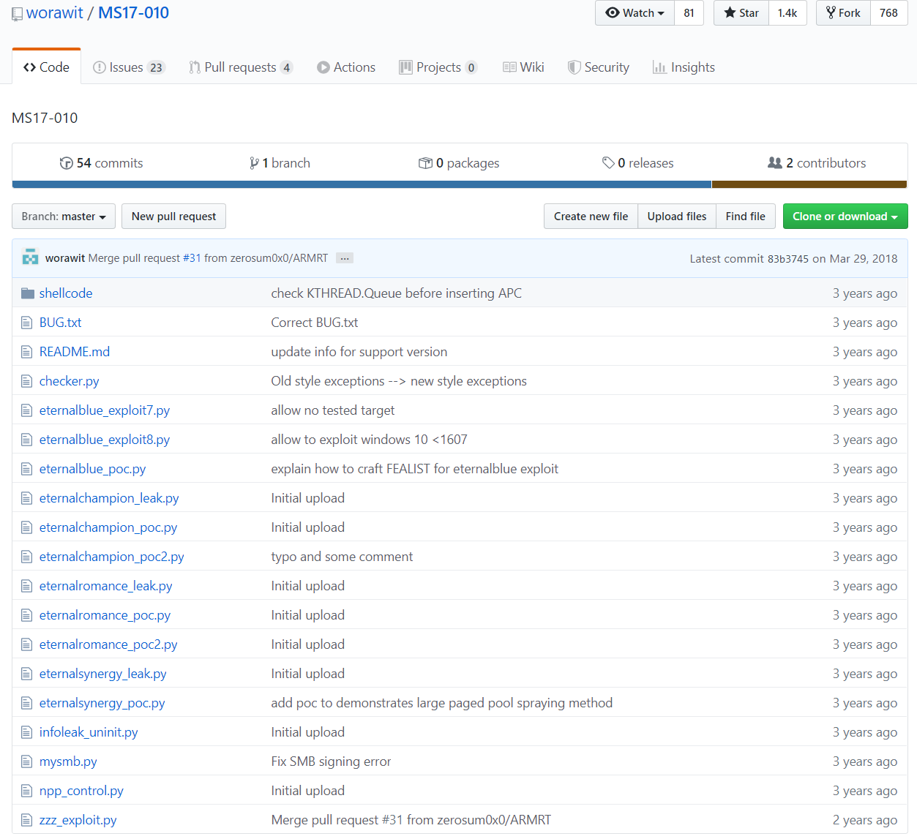
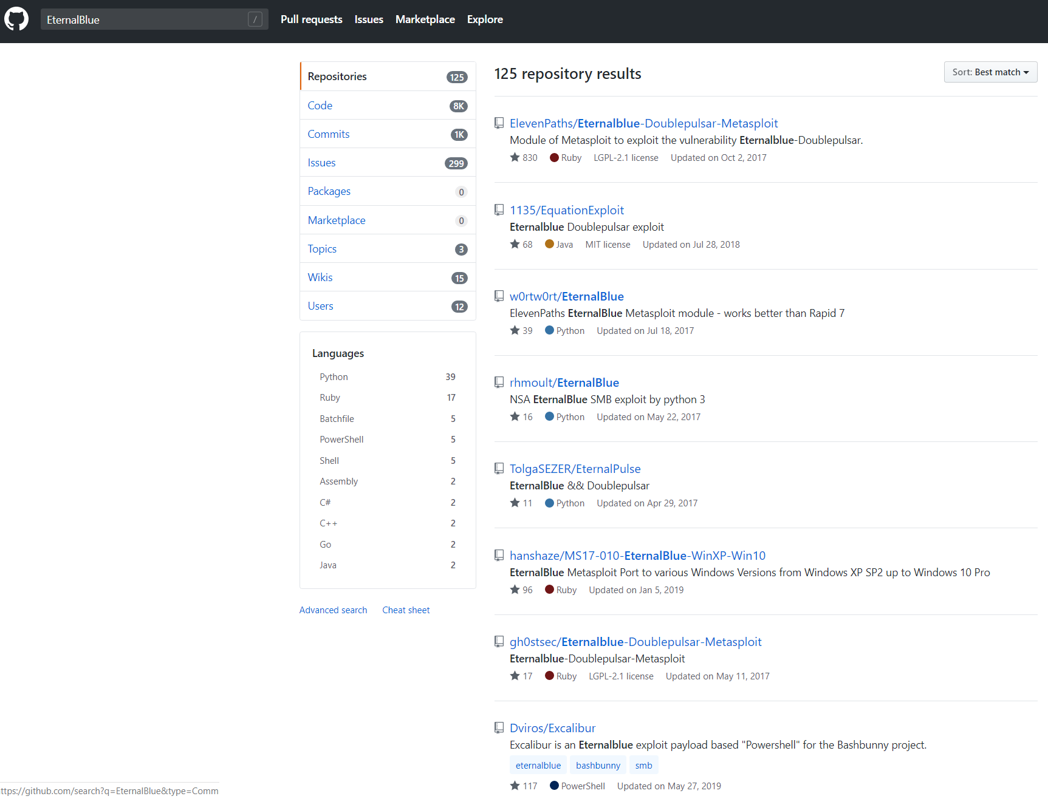
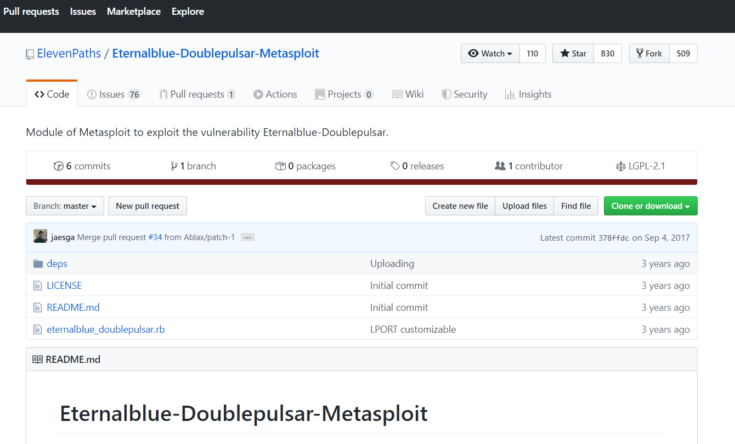
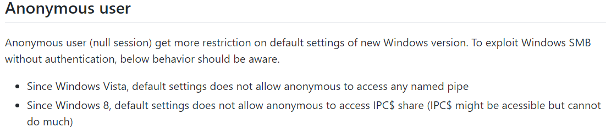
EternalBlue OpenSource Code…
Following the massive impact of WannaCry, both NotPetya and BadRabbit caused over $1 billion worth of damages in over 65 countries, using EternalBlue as either an initial compromise vector or as a method of lateral movement.
Notes:
Following the massive impact of WannaCry, both NotPetya and BadRabbit caused over $1 billion worth of damages in over 65 countries, using EternalBlue as either an initial compromise vector or as a method of lateral movement.
Petya is a family of encrypting ransomware that was first discovered in 2016. The malware targets Microsoft Windows–based systems, infecting the master boot record to execute a payload that encrypts a hard drive's file system table and prevents Windows from booting. It subsequently demands that the user make a payment in Bitcoin in order to regain access to the system.
it contained notable differences in operation that caused it to be "immediately flagged as the next step in ransomware evolution“
Another variant of Petya discovered in May 2016 contained a secondary payload used if the malware cannot achieve administrator-level access.
The name "Petya" is a reference to the 1995 James Bond film GoldenEye, wherein Petya is one of the two Soviet weapon satellites which carry a "Goldeneye"—an atomic bomb detonated in low Earth orbit to produce an electromagnetic pulse.
Petya's payload infects the computer's master boot record (MBR), overwrites the Windows bootloader, and triggers a restart. Upon startup, the payload encrypts the Master File Table of the NTFS file system, and then displays the ransom message demanding a payment made in Bitcoin.
The original payload required the user to grant it administrative privileges; one variant of Petya was bundled with a second payload, Mischa, which activated if Petya failed to install. Mischa is a more conventional ransomware payload that encrypts user documents, as well as executable files, and does not require administrative privileges to execute. The earlier versions of Petya disguised its payload as a PDF file, attached to an e-mail.

Slide 21

NotPetya -Variants of EternalBlue
Operation -
Encryption routine was modified so that the malware could not revert its changes
Low unlock fee of $300
Single, fixed Bitcoin wallet to collect ransom payments
Due to the above, Researchers speculate that this attack was not intended to be a profit-generating venture
Rather, to damage devices quickly, and ride off the media attention WannaCry received by claiming to be ransomware.
Researchers at Kaspersky Lab reveal that the ransomware does use EternalBlue, as well as EternalRomance, another exploit targeting some Windows machines as infection vectors.
Kaspersky also discloses NotPetya’s ability to use Mimikatz to extract administrative credentials from an infected system using the lsass.exe process. The threat can then use other tools, such as Windows Management Instrumentation (WMI) or PsExec, to infect other computers on a network.
Notes:
Place Holder – Slide – Ryan Timbrook – Topic
In hacking and cyber-security circles, ETERNALBLUE is considered one of the most potent exploits ever seen. A testament to its efficiency and ability to create virulent threats stand the two ransomware outbreaks that took place just two months after its release.
NotPetya
- Petya's payload infects the computer's master boot record (MBR), overwrites the Windows bootloader, and triggers a restart.
Upon startup, the payload encrypts the Master File Table of the NTFS file system, and then displays the ransom message demanding a payment made in Bitcoin.
Meanwhile, the computer's screen displays text purportedly output by chkdsk, Windows' file system scanner, suggesting that the hard drive's sectors are being repaired.
The original payload required the user to grant it administrative privileges; one variant of Petya was bundled with a second payload, Mischa, which activated if Petya failed to install. - Mischa is a more conventional ransomware payload that encrypts user documents, as well as executable files, and does not require administrative privileges to execute.
The earlier versions of Petya disguised its payload as a PDF file, attached to an e-mail.
The "NotPetya" variant used in the 2017 attack uses EternalBlue, an exploit that takes advantage of a vulnerability in Windows' Server Message Block (SMB) protocol.
it was leaked in April 2017 and was also used by WannaCry.
The malware harvests passwords (using tweaked build of open-source Mimikatz) and uses other techniques to spread to other computers on the same network, and uses those passwords in conjunction with PSExec to run code on other local computers.
Additionally, although it still purports to be ransomware, the encryption routine was modified so that the malware could not technically revert its changes.
This characteristic, along with other unusual signs in comparison to WannaCry (including the relatively low unlock fee of US$300, and using a single, fixed Bitcoin wallet to collect ransom payments rather than generating a unique ID for each specific infection for tracking purposes),
prompted researchers to speculate that this attack was not intended to be a profit-generating venture,
but to damage devices quickly, and ride off the media attention WannaCry received by claiming to be ransomware.

Slide 22
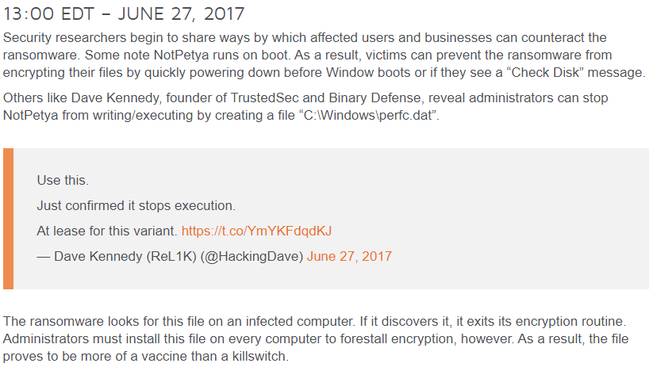
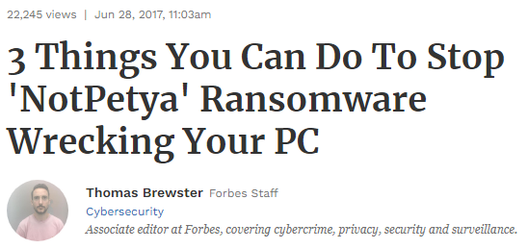
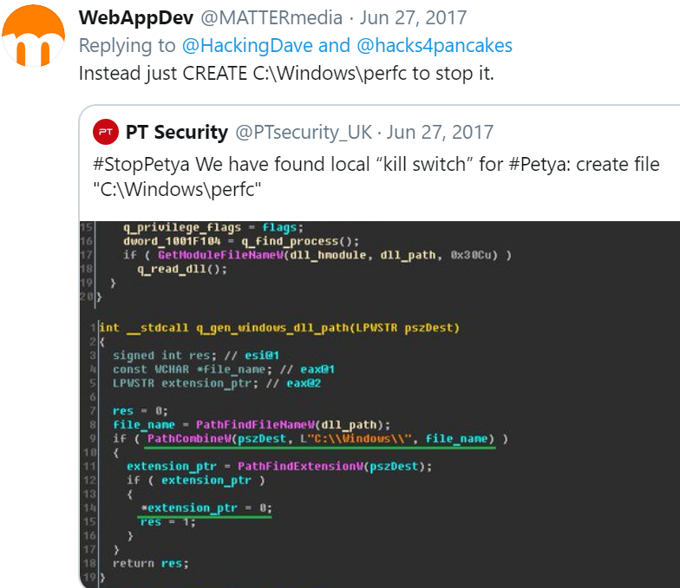
NotPetya - Variants of EternalBlue
Mitigation -
Trick the malware into thinking it’s already on the computer
%WINDIR%perfc – kill switch
Check whether computer is already infected, look for two “rundll32.exe” files running in Windows Task Manager
If found, power off PC and reinstall windows.
Employ sensible digital hygiene.
Make sure your running latest version of your Windows OS
Ensure Windows firewall is turned on
Check antivirus is up-to-date
Ensure all third-party software has been patched
To protect against ransomware campaigns such as NotPetya, users and businesses alike must update their operating system software regularly, don’t click on suspicious attachments, and back up their critical data on a regular basis.
Notes:
Place Holder – Slide – Ryan Timbrook – Topic
NotPetya
Under the hood, ETERNALBLUE leverages a vulnerability (CVE-2017-0144) in the SMBv1 file sharing protocol. Windows computers — where SMBv1 comes enabled by default — mishandles specially crafted SMB packets and allows an attacker to execute arbitrary code on the user's computer.
One way of preventing a PC getting infected is by tricking the malware into thinking it's already on the computer. This can be done by heading to the Windows directory folder (C:Windows) and creating a file named perfc (it'll end up looking something like this: %WINDIR%perfc. Set that to "read only" permissions, says Hacker House CEO Matthew Hickey. This protects PCs because when the malware first runs, it searches for that filename in that folder and if it's found, it'll kill itself, noted Cybereason, one of two cybersecurity firms along with Positive Technologies to find the "vaccine."
Second, Hickey recommends that concerned users check whether their computer is already infected, a and if so, if the ransomware is not yet running. To do this, look for two "rundll32.exe" files running in the Windows Task Manager. If they're present, power off the PC and do not turn it back on again. If it is turned back on, the ransomware will then run, encrypt the files and demand $300 in Bitcoin for payment (don't pay: the hackers' email account used to handle payment and provide encryption keys has been closed).
Reinstalling Windows will then remove NotPetya. With luck, you've got backups to return files to the PC, whether on a device or in the cloud. If not, it's possible to retrieve unencrypted data by downloading a free operating system like Kali Linux and using it to access the PC hard drive before re-installing Windows, Hickey noted.
Finally, employ some sensible digital hygiene. In particular, make sure you're running the latest version of whatever Windows system you're running, as this will patch the flaws that both the NotPetya and WannaCry ransomware exploited (i.e. the vulnerabilities leaked by Shadow Brokers, who claimed the bugs were originally used by the NSA). Ensure Windows firewall is turned on, check antivirus is up-to-date and that all third-party software has been patched too.

Slide 23
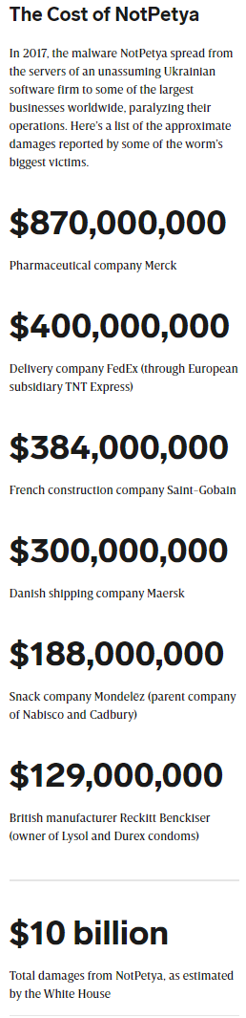
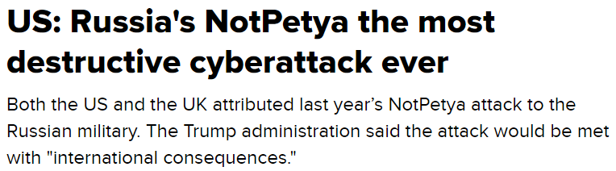
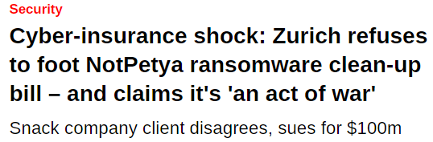
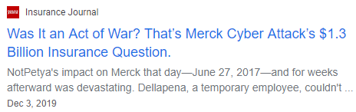
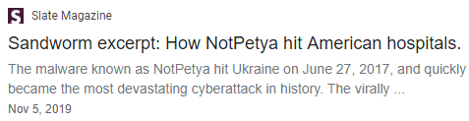
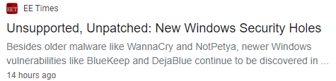
Variants of EternalBlue
Impact -
“While there was no loss of life, it was equivalent of using a nuclear bomb to achieve a small tactical victory,” Bossert says.
NotPetya
Maersk
Merck – Pharmaceutical giant
TNT Express - FedEx’s European subsidiary
Saint-Gobian - French construction company
Mondelez – Food producer
Reckitt Benckiser – Manufacturing
Rosneft – Russian oil company
Chernobyl - Nuclear Power Plant
Several Ukrainian Ministries
WPP – British advertising company
Etc…
Notes:
Place Holder – Slide – Ryan Timbrook – Topic
NotPetya
-- In a report published by Wired, a White House assessment pegged the total damages brought about by NotPetya to more than $10 billion. This was confirmed by former Homeland Security adviser Tom Bossert, who at the time of the attack was the most senior cybersecurity focused official in the US government.
A single machine at Maersk started the global meltdown that resulted in an estimated $10 billion in losses when all was said and done. Describing the NotPetya attack, the Wired article observes, “It crippled multinational companies including Maersk, pharmaceutical giant Merck, FedEx’s European subsidiary TNT Express, French construction company Saint-Gobain, food producer Mondelēz, and manufacturer Reckitt Benckiser. In each case, it inflicted nine-figure costs. It even spread back to Russia, striking the state oil company Rosneft.”
-- During the attack initiated on 27 June 2017, the radiation monitoring system at Ukraine's Chernobyl Nuclear Power Plant went offline. Several Ukrainian ministries, banks and metro systems were also affected. It is said to have been the most destructive cyberattack ever.
-- Among those affected elsewhere included British advertising company WPP, Maersk Line, American pharmaceutical company Merck & Co., Russian oil company Rosneft (its oil production was unaffected), multinational law firm DLA Piper, French construction company Saint-Gobain and its retail and subsidiary outlets in Estonia, British consumer goods company Reckitt Benckiser, German personal care company Beiersdorf, German logistics company DHL, United States food company Mondelez International, and American hospital operator Heritage Valley Health System. The Cadbury's Chocolate Factory in Hobart, Tasmania, is the first company in Australia to be affected by Petya. On 28 June 2017, JNPT, India's largest container port, had reportedly been affected, with all operations coming to a standstill. Princeton Community Hospital in rural West Virginia will scrap and replace its entire computer network on its path to recovery.
-- The business interruption to Maersk, the world's largest container ship and supply vessel operator, was estimated between $200m and $300m in lost revenues
-- Jens Stoltenberg, NATO Secretary-General, pressed the alliance to strengthen its cyber defenses, saying that a cyberattack could trigger the Article 5 principle of collective defense
-- Mondelez International's insurance carrier, Zurich American Insurance Company, has refused to pay out a claim for cleaning up damage from a Notpetya infection, on the grounds that Notpetya is an "act of war" that is not covered by the policy. Mondelez is suing Zurich American for $100 million
-- Europol said it was aware of and urgently responding to reports of a cyber attack in member states of the European Union. The United States Department of Homeland Security was involved and coordinating with its international and local partners. In a letter to the NSA, Democratic Congressman Ted Lieu asked the agency to collaborate more actively with technology companies to notify them of software vulnerabilities and help them prevent future attacks based on malware created by the NSA. On 15 February 2018, the Trump administration blamed Russia for the attack and warned that there would be "international consequences". The United Kingdom and the Australian government also issued similar statements
BadRabbit

Slide 24
Question & Answer
Variants of EternalBlue

Slide 25
Works Cited:
1 https://www.sentinelone.com/blog/eternalblue-nsa-developed-exploit-just-wont-die/
2 https://research.checkpoint.com/2017/eternalblue-everything-know/
3 https://techterms.com/definition/smb
4 https://www.govtech.com/security/How-Texas-Cities-Are-Handling-Recent-Ransomware-Attacks.html
5 https://www.npr.org/2019/08/20/752695554/23-texas-towns-hit-with-ransomware-attack-in-new-front-of-cyberassault
6 https://www.govtech.com/security/Lake-City-Fla-Authorizes-Nearly-500K-Ransomware-Payment.html
7 https://www.forbes.com/sites/thomasbrewster/2017/06/28/three-things-you-can-do-to-stop-notpetya-ransomware-wrecking-your-pc/#4280effe77b0
8 https://twitter.com/PTsecurity_UK/status/879779707075665922
9 https://www.tripwire.com/state-of-security/security-data-protection/cyber-security/notpetya-timeline-of-a-ransomworm/
10 https://www.bleepingcomputer.com/news/software/-eternal-blues-tool-tests-computers-against-nsas-eternalblue-exploit/
11 https://www.bleepingcomputer.com/news/security/app-finds-more-than-50-000-computers-vulnerable-to-eternalblue-exploit/
12 https://www.schneier.com/blog/archives/2008/04/reverseengineer.html
13 https://www.wired.com/story/notpetya-cyberattack-ukraine-russia-code-crashed-the-world/

Slide 26
Appendix

Slide 27
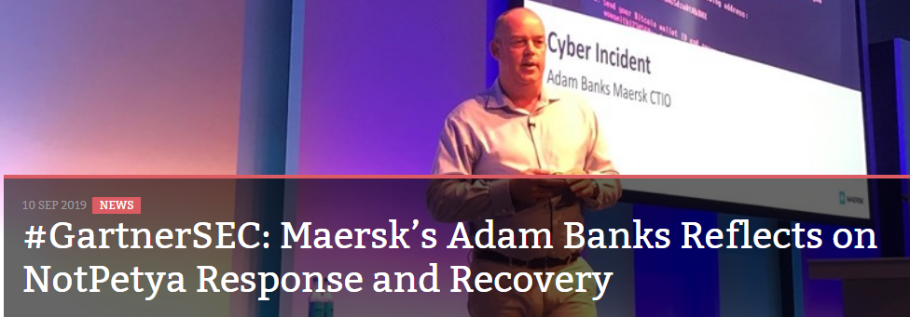
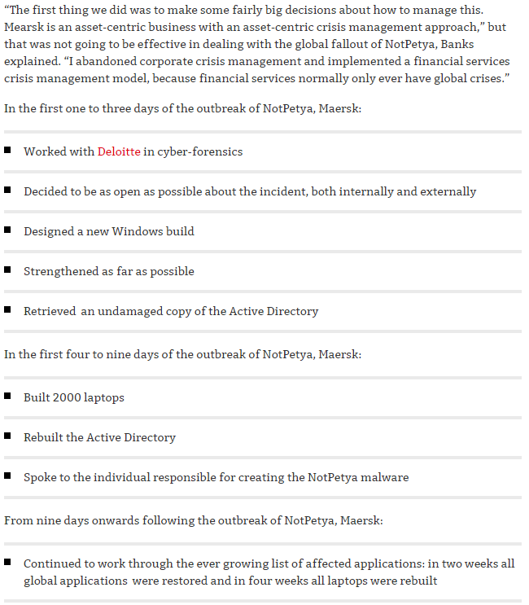
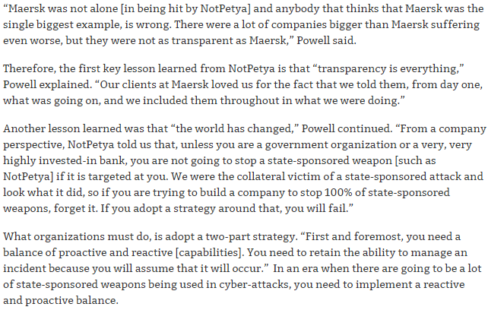
Maersk – Response / Recovery to NotPetya

