Slide 1
IST 707 Data Analytics Project Proposal
Team: Seattle
Ryan Timbrook

Slide 2

Buy-Rent-Sell, Real-Estate Property Investments Overall Summary
Introduction
Targeting low risk property investment opportunities for property management firms or individual investors who buy-rent-sell single family homes throughout the United States.
Given a base set of investment criteria, provide a predicted N-best list of US geolocation regions by zip code that offer the best ROI.
Motivation
As a home-owner, a land-lord, and an investor, this is an area of interest that has financial impacts.
Recent survey’s, one from Millennium Trust Company, found an increasing preference for ‘alternative investments’, including real estate. Among those surveyed who held real estate, 73 percent favored single-family rentals.
Problem Statement
How to predict a low risk / high yield return on property investment in a volatile market.
Buy low, rent fair, sell high…
Where and when to buy and sell that maximizes investment profits.
Forecast future growth and decline of a region that yields Net Present Value (NPE) measurements significant enough to act on.
About the Data
Base datasets are provided by Zillow research data:
Home Values
Home Listings and Sales
Rental Values
Additional data will be mined from:
Bureau of Labor Statistics and Census
Capital markets and economics
Notes:
Research question / Motivation
Target Domain:
Real-estate Investment
Target Audience:
Individual Property Management Firms and or Sol Proprietors who buy and rent single family homes as an investment

Slide 3
Initial Data Cleaning
Zillow Single-Family Home, Median Price Averages:
Dataset Shape: (15605, 286)
15,000+ zip codes
Data covers 1997 to present
Initial Cleaning Steps:
Remove columns dates prior to 1997
Remove any possible white space in the column's values
Renamed RegionName to ZipCode for clarity
Removed non-necessary categorical variables
'RegionID','City','Metro','CountyName','SizeRank’,’State’
Narrow attributes during modeling, combine by ZipCode as key
Data transformation to support Facebook Prophet Timeseries modeling package:
The input to Prophet is always a dataframe with two columns: ds and y.
ds (datestamp) : YYYY-MM-DD for a date or YYYY-MM-DD HH:MM:SS for a timestamp.
y column must be numeric and represents the median home value to forecast.
Notes:
Notes: 1) You must have at least two different vis types that support each method. 2) Each method above will have its own subsection(s) in the Analysis and in the Results. 3) Place the visualizations where they belong in the your project – not at the end.

Slide 4
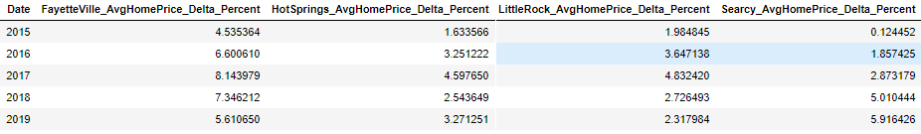
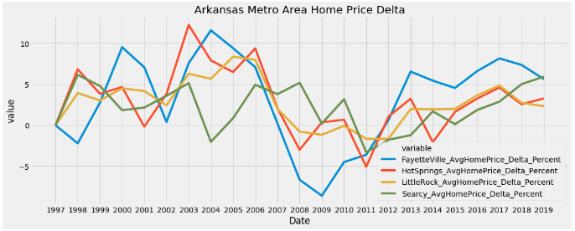
Data Eval: Sub Region US
Annual Net Home Price Delta: Arkansas – (Purchased property here 2 years back)
Average Median Home Price Value by Metro Region and Year were generated to create a net value annual change region matrix:
Average Median Home Price
Annual Median Home Price Net Change Year over Year
Annual Median Home Price as a percent Net Change Year over Year
Notes:
Notes: 1) You must have at least two different vis types that support each method. 2) Each method above will have its own subsection(s) in the Analysis and in the Results. 3) Place the visualizations where they belong in the your project – not at the end.

Slide 5
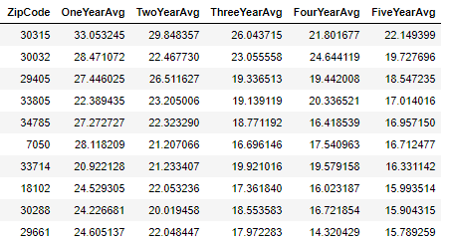
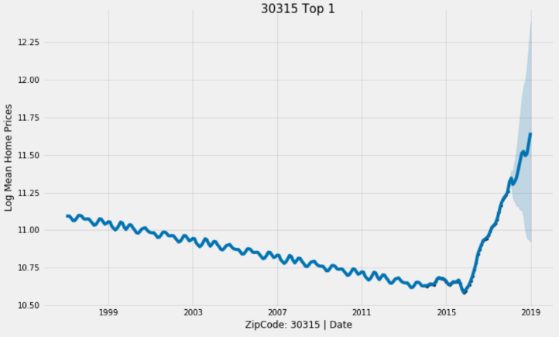
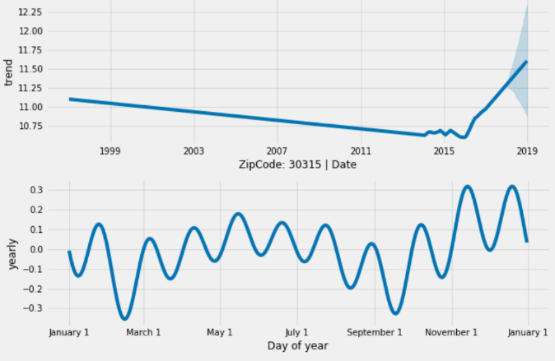
Data Eval: Picking and Timeseries Forcasts
Simple Picking for Eval:
Methodology taken was to select the top performing zip codes based on their prior five-year average net percent home median value change year-over-year. (PCHV)
Next, NPV scoring will be added to the picking algorithms
Top 1 Performing Zip Code - Last Five Years
Notes:
Notes: 1) You must have at least two different vis types that support each method. 2) Each method above will have its own subsection(s) in the Analysis and in the Results. 3) Place the visualizations where they belong in the your project – not at the end.

Slide 6
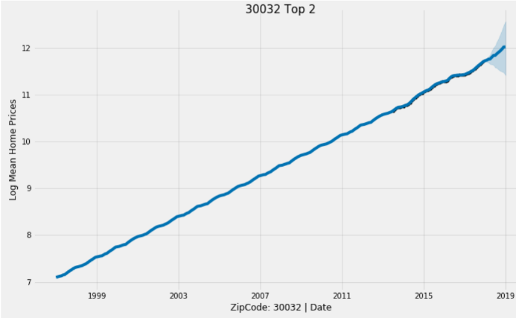
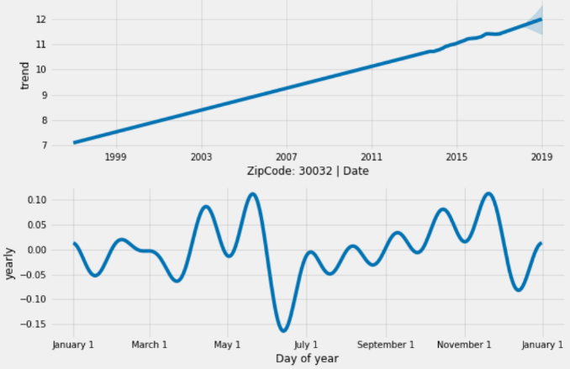
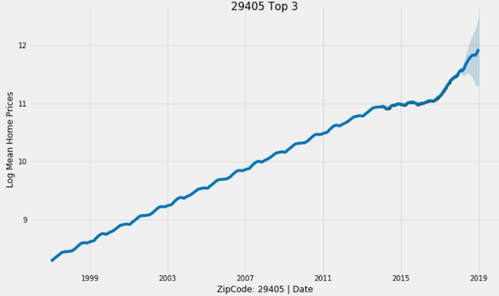
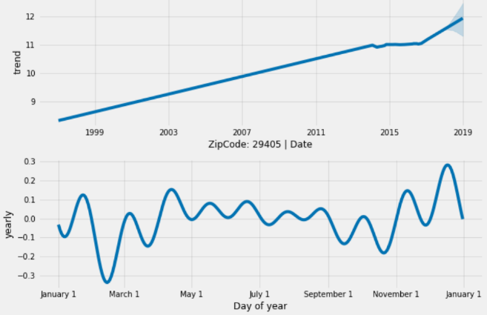
Data Eval: Examples Top Zips
Top 2 Performing Zip Code - Last Five Years
Top 3 Performing Zip Code - Last Five Years
Notes:
Notes: 1) You must have at least two different vis types that support each method. 2) Each method above will have its own subsection(s) in the Analysis and in the Results. 3) Place the visualizations where they belong in the your project – not at the end.

Slide 7
More About the Data
Home Values
Zillow Home Value Index (ZHVI): A smoothed, seasonally adjusted measure of the median estimated home value across a given region and housing type. It is a dollar-denominated alternative to repeat-sales indices. Zillow also publishes home value and other housing data for local markets, as well as a more detailed methodology and a comparison of ZHVI to the S&P CoreLogic Case-Shiller Home Price Indices.
Home Listings and Sales
Zillow provides data on sold homes, including median sale price for various housing types, sale counts (for which there’s detailed methodology), and foreclosures provided as a share of all sales in which the home was previously foreclosed upon. There is also current and historical for-sale listings data, ranging from median list prices and inventory counts to share of listings with a price cut, median price cut size, age of inventory, and the days a listing spent on Zillow before the sale was final. Inventory and other housing data also are available for local markets.
Notes:
Notes: 1) You must have at least two different vis types that support each method. 2) Each method above will have its own subsection(s) in the Analysis and in the Results. 3) Place the visualizations where they belong in the your project – not at the end.

Slide 8
Net Present Value
Definition of Net Present Value
It is a real estate measure to calculate the present value of your NET future cash flows from real estate property investing. It is widely used in investment real estate analysis as a base to determine if the future cash flows expected to be generated from a rental property have a present value larger than the amount of cash required to invest in the rental property.
In simpler words, the net present value informs the real estate investor whether his or her target rate of return will be achieved, and thus, whether the investor should invest in that property.
Calculating Net Present Value of Cash Flows
To arrive at a present value of future cash flows, NPV discounts all future cash flows by the desired rate of return and then deducts that amount from the initial cash (capital) invested. The formula for calculating the net present value of cash flows is as follows:
NPV= ∑_(t=1)^N (C_t/(1+r)^t) -NCF_0
Where:
N = The total number of years (holding period)
t = Time
Ct = Cash Flow generated at a specific time
r: Discount rate of return
NCF0 = Initial Cash invested
How Net Present Value Works
The net present value calculation is centered on a rule which states: if the present value of future benefits is greater than or equal to the cost of those benefits, then the real estate investor should consider the investment opportunity to be a profitable one. Alternatively, if the present value of the future benefits is less than the cost for those benefits, then it’s best for the investor to consider another investment opportunity because the desired rate of return will not be achieved.
Notes:
Notes: 1) You must have at least two different vis types that support each method. 2) Each method above will have its own subsection(s) in the Analysis and in the Results. 3) Place the visualizations where they belong in the your project – not at the end.

Slide 9
Initial Results & Findings

Slide 10
Timeline

Slide 11
Requirements
Required Methods:
Full cleaning, prep, EDA and visual EDA
Association Rule Mining (unsupervised) Offer the top 10 rules for the highest sup, the top 10 for conf, and the top 10 for lift. All rules must have at least one element on the left and one on the right. Also choose to set the left as a given value and show the top 10 (based on your dataset and determinations).
Clustering (k means and one other – your choice) (unsupervised) Include visualization. Run k means for three choices for k and choose the best.
Decision Tree (supervised). Include at least three different trees and their visualizations.
Naïve Bayes
SVM – use at least three different kernels, and for each kernel, look at and discussion 3 different costs.
Text Mining – it is your choice how to apply this.
Notes:
Notes: 1) You must have at least two different vis types that support each method. 2) Each method above will have its own subsection(s) in the Analysis and in the Results. 3) Place the visualizations where they belong in the your project – not at the end.

Slide 12
Live Presentation
Live Presentations:
Introduce - what is your area (briefly!) and what are your goals.
Discuss 5 key analyses, their results and their visualizations. You will have more than 5 analyses in your report, but will choose the most interesting 5 to present.
Offer clear and anyone-can-understand conclusions. - Include nothing about the data cleaning, etc.
Be precise and succinct.
Your Project should be written professionally. You may use RMarkdown, ppt, pdf, Word, or a more advanced option.
Whether you use RMarkdown or not, you must have all the written areas (paper submission).

