Slide 1
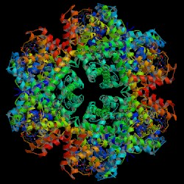
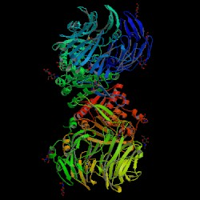
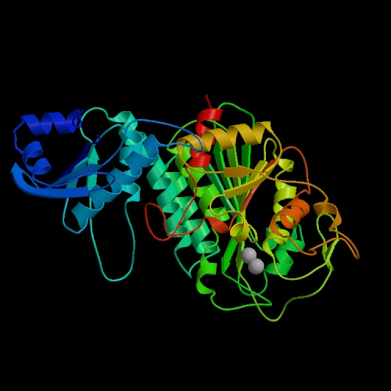
Understanding SVMs
Professor Ami M. Gates
Georgetown University

Slide 2
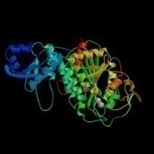

A Review of Vector Math
Any line in dimension D can be represented as w^{T}x + b = 0.
w is a vector of coefficients, x is the vector of variables, b is the translation (can be thought of in 2D as the y intercept).
x2
Suppose we are in 2D. (the common Cartesian coordinate system).
Then, a line can be written as
w0x0 + w1x1 + b = 0
x1 = - b/w1 - (w0/w1 )(x0)
The “slope” is –w0/w1
Given any vector w (in 2D, [w0,w1], from the origin, a line parallel to w has slope w1/w0
The line perpendicular to that vector has slope –w0/w1
slope = w1/w0
Class 2
m
Class 1
x1
slope = -w0/w1

Slide 3
A Review of Vector Math, cont.
The goal of an SVM is to determine (via training) the “best” line in 2D (or hyperplane in higher D) that separates two classes.
There are an infinite number of possible lines (hyperplanes) that may work.
x1
A general linear equation in two variables is:
w0x0 + w1x1 + b = 0
→ w^{T}x + b = 0
An SVM algorithm must determine the weight vector w that will result in a line (hyperplane) that best separates the two classes.
?
Class 2
?
Class 1
m
m
x0

Slide 4
Setting Up the SVM Problem
w
everything on this
side classifies as “1”
support vector
w^{T}x + b ≥ + 1
GOAL: Maximize the margin m between the +1 and -1 classes
margin m
everything on this
side classifies as “-1”
w^{T}x + b =0
w^{T}x + b ≤ - 1

Slide 5
Important Concepts
The margin m can be created such that
w0x0+ w1x1 + b ≥ 1
→ w^{T}x + b ≥ 1
w0x0 + w1x1 + b ≤ -1
→ w^{T}x + b ≤ -1
Remember that w will have to be determined (using the training data) so that the classes are “best” separated.
The value of “b” is a constant that affects the location (but not slope) of the line (in 2D).
These concepts are the same in higher D.

Slide 6
The margin m between the two classes should be maximized.
w
everything on this
side classifies as “1”
w^{T}x + b ≥ + 1
margin m
everything on this
side classifies as “-1”
w^{T}x + b =0
w^{T}x + b ≤ - 1

Slide 7
Key Math Concepts
Any line in 2D or hyperplane in higher D can be represented as:
w0x0 + w1x1 + w2x2 + … +wnxn + b = 0
→ same as: w^{T}x + b = 0
2) This linear equation can be represented with vector w, with vector x, and with b.
If vector w is plotted, it will be perpendicular to the linear equation above.
The distance between any hyperplane w^{T}x = k and the origin is k/||w||
If vector w is altered, the “slope” (in 2D) or “rotation” (in higher D) is affected. If “b” is altered the “y intercept (in 2D) or the “translation” (in high D) is affected.
3) We can use w^{T}x + b = 0 to try different lines. To do this, we need w and b and a measure of “best”.

Slide 8
The SVM Margin m
Assume that in some dimension that we have two classes that can be linearly separated.
Then, there must be a line (hyperplane) that separates the classes.
This line is defined by w^{T}x + b = 0.
This line can be contained within two parallel lines that create a “margin” between the two classes.
The two parallel lines can initially be defined as:
w^{T}x + b = 1 and w^{T}x + b = -1
(Note that b is a constant that can be altered as needed)
margin m:
Distance between two parallel lines (hyperplanes)
w^{T}x + b= 1 and w^{T}x + b= -1 is…
|b -1| - |b + 1| / ||w|| = 2/||w||

Slide 9
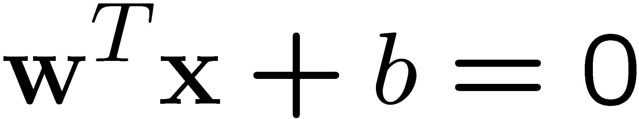
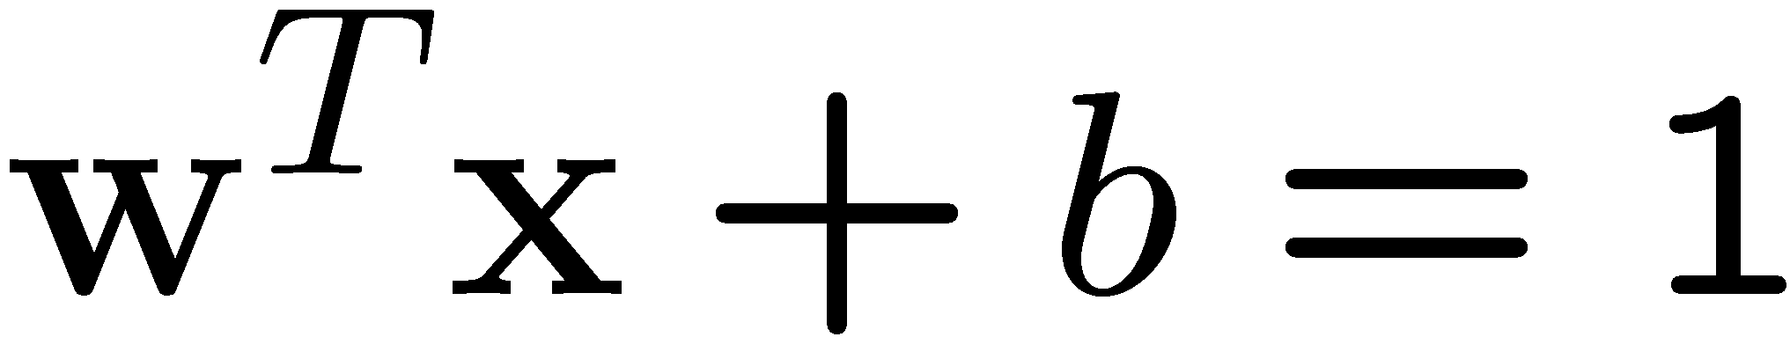
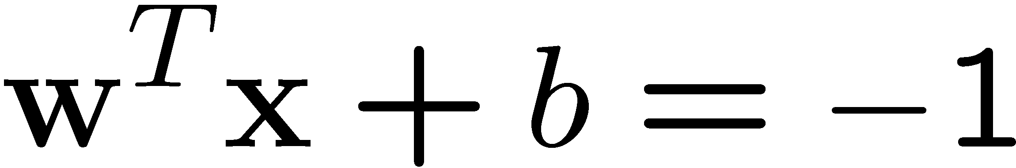
Maximizing margin m will create the “best” separation between the Classes.
margin m is the distance between the two parallel boundary lines (or two parallel hyperplanes)
Distance between a line
w^{T}x + b= 0 (hyperplane)
and the origin is
b/||w||
Margin m:
Distance between two parallel lines (hyperplanes)
w^{T}x + b= 1 and w^{T}x + b= -1
|b -1| - |b + 1| / ||w|| = 2/||w||
Class 2
m
Class 1
Image: Martin Law Michigan State university

Slide 10
Maximizing margin m
To maximize the margin m = 2/||w||
We need to minimize ||w|| which is same as min ½||w||²
which makes the math easier.
Note that ||w|| is sqrt(w0^2 + w1^2).
We can say that margin m =
2/ sqrt(w0^2 + w1^2)
as we do in scikit-learn example
Class 2
m
Class 1
Image: Martin Law Michigan State university

Slide 11
The Optimization Problem
1) Find the min of ||w|| and b
This is the same min ½||w||² and b
2) Such that this constraint holds:
yi (w^{T}xi + b ) ≥ 1 for all input vectors xi
Recall that yi will be +1 or -1 (depending on the class)
This is a quadratic optimization problem.

Slide 12
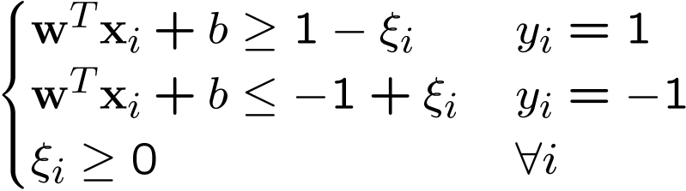
A Soft Margin Hyperplane SVM
If we minimize ∑_{i}ξ_{i},
ξ_{i} can be computed by
ξ_{i} are “slack variables” in optimization
Note that ξ_{i}=0 if there is no error for x_{i}
ξ_{i} is an upper bound of the number of errors
We want to minimize: ½||w||² + C ∑_{i}ξ_{i}
C : tradeoff parameter between error and margin
The optimization problem becomes
½||w||² + C ∑_{i}ξ_{i}
Image: Martin Law Michigan State university

Slide 13








Soft Margin Example
Allow “error” ξ_{i} in classification
ξ_{i} approximates the number of misclassified samples
Class 2
Class 1

Slide 14
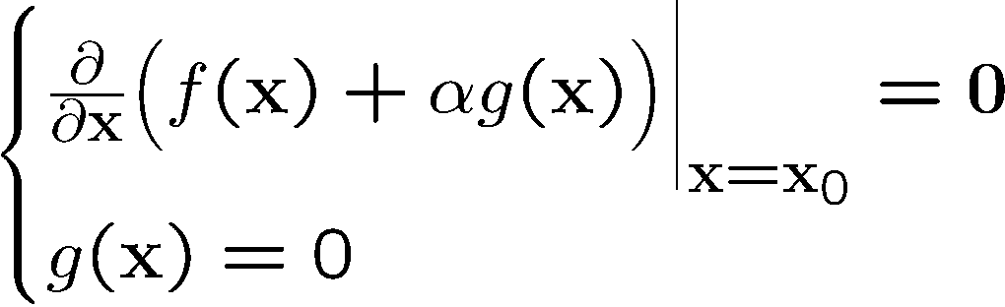
Constrained Optimization Quick Review
Suppose you want to minimize some function f(x) subject to the constraint of g(x).
Then, for any x to be a solution, the following must be true.
Note that the “α” is a Lagrange multiplier

Slide 15
Using Lagrange in SVM Solving
Goal: Minimize ½ ||w||²
subject to constraint:
1 – yi(w^{T}xi + b)≤ 0, i = 1, 2..,n
The Lagrangian L is
L = ½ w^{T}w + ∑(i=1 to n) αi(1 – yi(w^{T}xi + b))
Them, setting the gradient of L w.r.t. w and b to 0, gives:
w + ∑(i=1 to n) αi(– yi)xi = 0 →
w = ∑(i=1 to n) αiyixi and ∑(i=1 to n) αiyi = 0
Finally, if we substitute w into L we get (after a bit of math): -1/2 ∑(i=1 to n) ∑(j=1 to n) αiαjyiyjxi^{T}xj + ∑(i=1 to n) αi

Slide 16
The Dual Problem in SVM
The new objective function is called the dual problem in SVM math.
W(α) = -1/2 ∑(i=1 to n) ∑(j=1 to n) αiαjyiyjxi^{T}xj + ∑(i=1 to n) αi
It is a function of alpha.
The goal is now to maximize W(α) subject to alphas all being positive and ∑(i=1 to n) αiyi = 0
This is a quadratic programming problem with
w = ∑(i=1 to n) αiyixi

Slide 17




A Visual Interpretation of α
Class 2
α₁₀=0
α₈=0.6
α₇=0
α₂=0
α₅=0
α₁=0.8
α₄=0
α₆=1.4
α₉=0
α₃=0
Class 1

Slide 18
SVM kernel Transformation: φ(x)
φ( )
φ( )
φ( )
φ( )
φ( )
φ(.)
φ( )
φ( )
φ( )
φ( )
φ( )
φ( )
φ( )
φ( )
φ( )
φ( )
φ( )
φ( )
φ( )
Input space
Feature space
Recall that the SVM optimization problem solved is:
W(α) = -1/2 ∑(i=1 to n) ∑(j=1 to n) αiαjyiyjxi^{T}xj + ∑(i=1 to n) αi
Here, only the inner product of the x values is needed.
Therefore, if a kernel transformation is used, the updated optimization problem becomes
W(α) = -1/2 ∑(i=1 to n) ∑(j=1 to n) αiαjyiyj φ(xi)^{T} φ(xj) + ∑(i=1 to n) αi
where kernel k(xi, xj) = φ(xi)^{T} φ(xj)
We only need the inner product of the feature space – not an explicit mapping.

Slide 19
Common Kernels
Polynomial with degree d
K(x, y) = (xTy + 1)d
Radial
K(x,y) = exp(-||x – y||² / 2σ²))
Sigmoid:
K(x,y) = tanh(cx^{T}y + d)
Gaussian:
K(x, y) = exp(-a||x – y||²), a>0

Slide 20
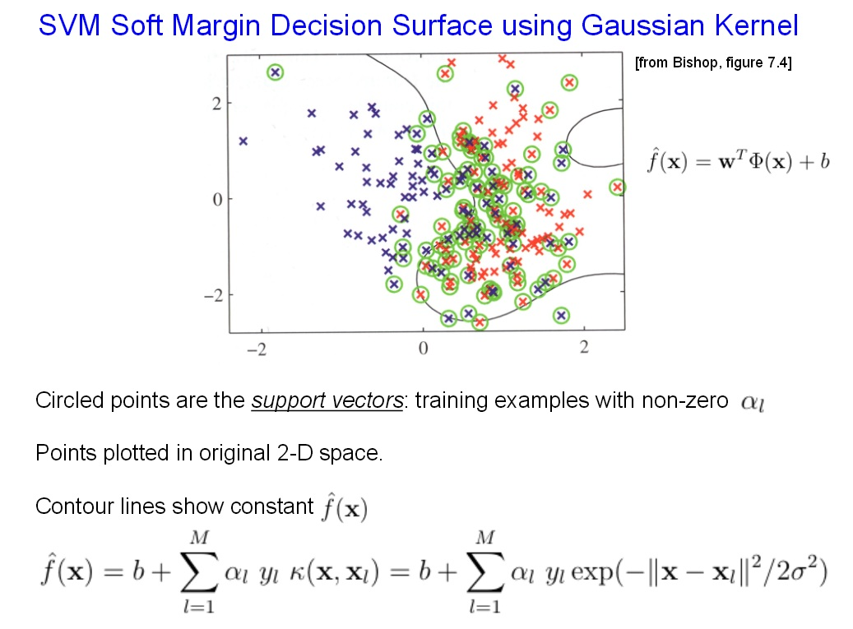
Compliments of: https://www.cs.cmu.edu/~tom/10701_sp11/slides/Kernels_SVM2_04_12_2011-ann.pdf

Slide 21
Example non-linear
Value of discriminant function
class 1
class 2
class 1
1
2
4
5
6
Image: Martin Law Michigan State university

Slide 22
Using Python 3 scikit-learn: SVM
http://scikit-learn.org/stable/modules/svm.html
SVM:
supervised learning method
for classification, regression, outlier detection
Advantages:
Effective in high D space
Effective when dimension > # samples
Uses “subset” of training data – just the “support vectors”
Allows or the use of kernel functions
Disadvantages:
If features >> samples → poor performance
No prob estimates – these must be “done by hand” using at least 5-fold cross validation

Slide 23

SVM Classification with scikit-learn: Example 1
from sklearn.svm import SVC
import numpy as np
#Train
#SVC takes in two arrays [n_samples, n_features]
#This holds the training samples
X = np.array([[-1, -1], [-2, -1], [-3, -4], [3,3], [1, 1], [2, 1]])
#The classes of the training data
y = np.array([1, 1, 1, 2, 2, 2])
#TRAIN
#Define the model with SVC
# Fit SVM with training data
clf = SVC(C=1, kernel="rbf", verbose=False)
clf.fit(X, y)
#PREDICT - perform classification
print(clf.predict([[-.8, -1]]))
print(clf.predict([[.8, 1]]))
print(clf.predict([[0, 0]]))

Slide 24
More scikit-learn Examples
from sklearn.svm import SVC
from sklearn import datasets
import numpy as np
import matplotlib.pyplot as plt
iris = datasets.load_iris()
#Place first two columns into X
X=np.array(iris.data[:,:2])
#Place the targets/classes into y
y = np.array(iris.target)
#Set up the SVM - linear kernel
clf = SVC(C=1, kernel="linear")
clf.fit(X, y)
#Margin is 2/ ||w||
margin = 2 / np.sqrt(np.sum(clf.coef_ ** 2))
#Predict a new data points
print(clf.predict([[6, 3]]))
# get the separating hyperplane
#The weights vector w
w = clf.coef_[0]
#The slope of the SVM sep line
a = -w[0] / w[1]
#Create a variable xx that are values between 4 and 8
xx = np.linspace(4, 8)
## This is the y values for the main sep line
yy = a * xx - (clf.intercept_[0]) / w[1]
# adding or subtracting ½ of the margin
yy_down = yy + .5*margin
yy_up = yy - .5*margin

Slide 25
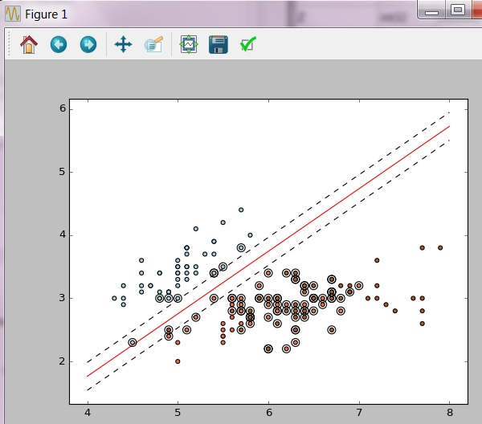
continued…
# plot the line, the points, and the nearest vectors to the plane
plt.clf()
plt.plot(xx, yy, 'r-')
plt.plot(xx, yy_down, 'k--')
plt.plot(xx, yy_up, 'k--')
plt.scatter(clf.support_vectors_[:, 0], clf.support_vectors_[:, 1], s=80,
facecolors='none', zorder=5)
#cmap is the color map
plt.scatter(X[:, 0], X[:, 1], c=y, zorder=5, cmap=plt.cm.Paired)
plt.axis('tight')

Slide 26
The SVM Math - FYI
The perpendicular distance from a point to hyperplane y(x)=0, where y(x) = w^{T}φ(x)+b, is defined as t_{n}(w^{T} φ(x_{n})+b) / ||w||, since only correctly predicted points are of interest.
The margin is given by the perpendicular distance to the closest point x_{n}, and w and b can be optimized to maximize the distance.
The max margin solution can be found by solving:
arg max w, b { 1/||w|| min n [t_{n}(w^{T}φ(x_{n})+b)]}
Note: rescaling w and b by the same constant does not affect the distance between x_{n} and the decision boundary.
Therefore, set t_{n}(w^{T}φ(x_{n})+b) = 1 for the closest point and
t_{n}(w^{T}φ(x_{n})+b) ≥ 1 for all other points.

Slide 27
Extra slides…

Slide 28
The SVM Math - FYI
t_{n}(w^{T}φ(x_{n})+b) ≥ 1 is the canonical representation of the hyperplane.
To maximize the margin, minimize w^{T}w
Therefore, the Quadratic Programming problem can be stated as:
arg min w, b : w^{T}w
such that t_{n}(w^{T}φ(x_{n})+b) ≥ 1
Lagrangian to solve:
L(w,b,a)=w^{T}w – Ʃ_{n=1 to N} a_{n}{t_{n}(w^{T}φ(x_{n})+b) - 1}
Take derivatives of L(w,b,a) w.r.t. w and b to get:
w = Ʃ_{n=1 to N} a_{n}t_{n}φ(x_{n}) and Ʃ_{n=1 to N} a_{n}t_{n} = 0

Slide 29
The SVM: The kernel
Substituting:
w = Ʃ_{n=1 to N} a_{n}t_{n}φ(x_{n}) and Ʃ_{n=1 to N} a_{n}t_{n} = 0
into
L(w,b,a)=w^{T}w – Ʃ_{n=1 to N} a_{n}{t_{n}(w^{T}φ(x_{n})+b) - 1}
The Dual Representation:
L’(a) = Ʃ_{n=1 to N} a_{n} – ½ Ʃ_{n=1 to N} Ʃ_{m=1 to N} a_{n}a_{m}t_{n}t_{m}φ(x_{n})^{T} φ(x_{m})
Kernel:
K(x_{n,}x_{m}) = φ(x_{n})^{T} φ(x_{m})
NOTE: This portion of the math allows for the use of a kernel to represent the inner product of data points.

Slide 30
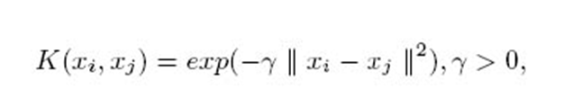
Kernels
Because the solution to the SVM optimization problem (the Dual Form) involves only inner products, the data values can be “transformed” to a different dimension using a kernel.
The Dual Representation:
L’(a) = Ʃ_{n=1 to N} a_{n} – ½ Ʃ_{n=1 to N} Ʃ_{m=1 to N} a_{n}a_{m}t_{n}t_{m}φ(x_{n})^{T} φ(x_{m})
Kernel: K(x_{n,}x_{m}) = φ(x_{n})^{T} φ(x_{m})
This can be thought of as a virtual transformation as the points themselves do not have to be projected.
This is the Gaussian Kernel for example.

