Slide 1
Text Mining
When the Words Become the Variables

Slide 2
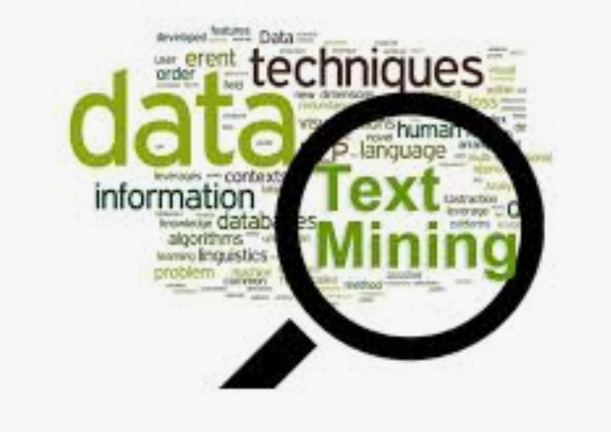
Divider slide
What is Text Mining?
How is Text Mining Different from Data Analytics?

Slide 3
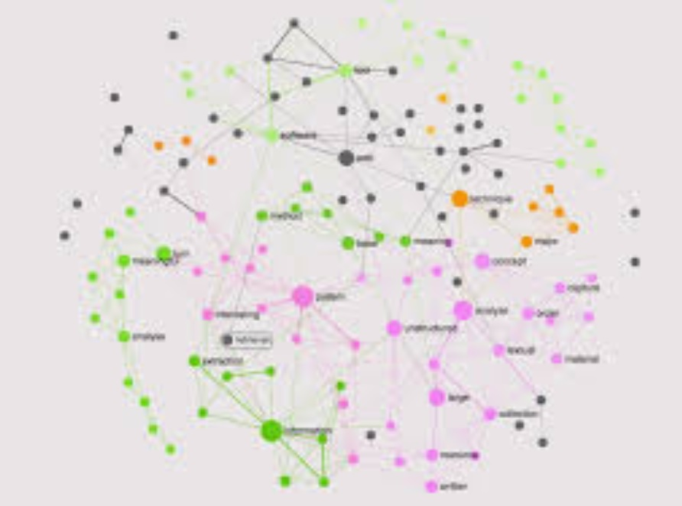
What is Data? What is Text Data?

Slide 4
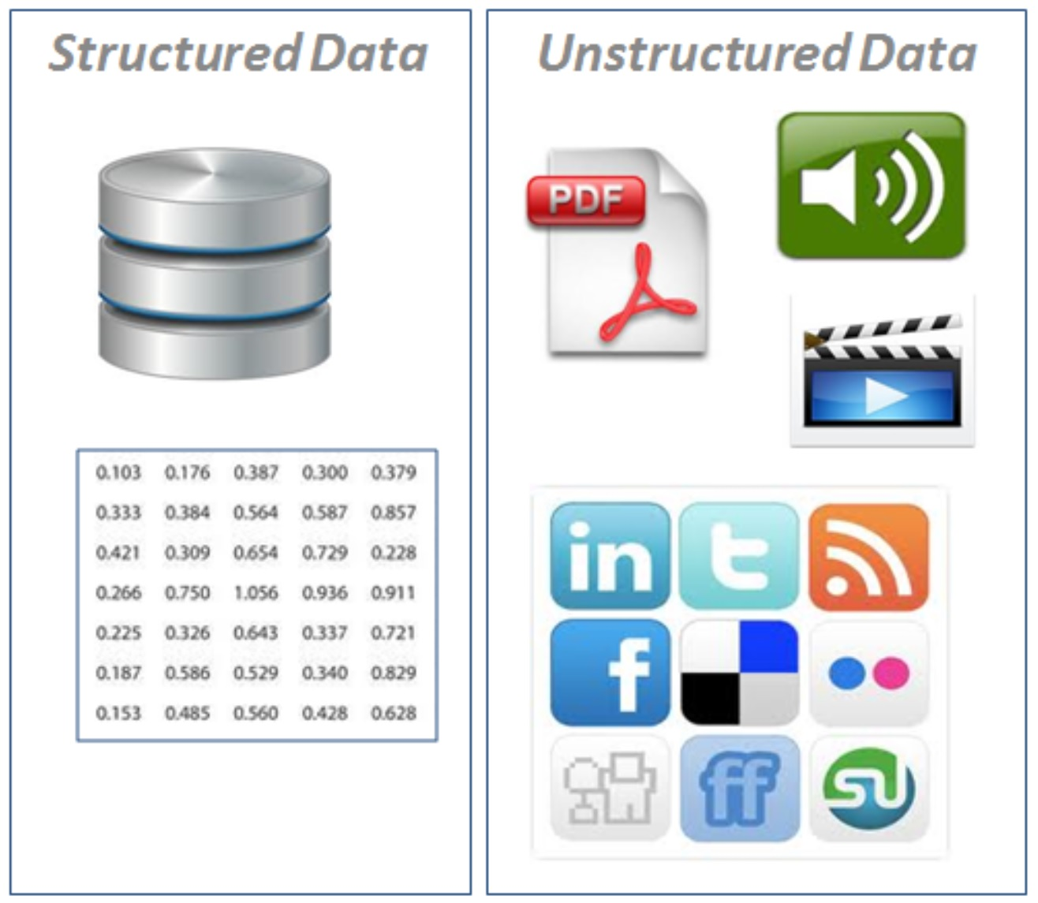
Types of Data
4
Record
HTML/Web
JSON
Network
Tweets
6) etc. etc. …
Is text data “different” from number data?
Can text data be represented as numerical data?

Slide 5
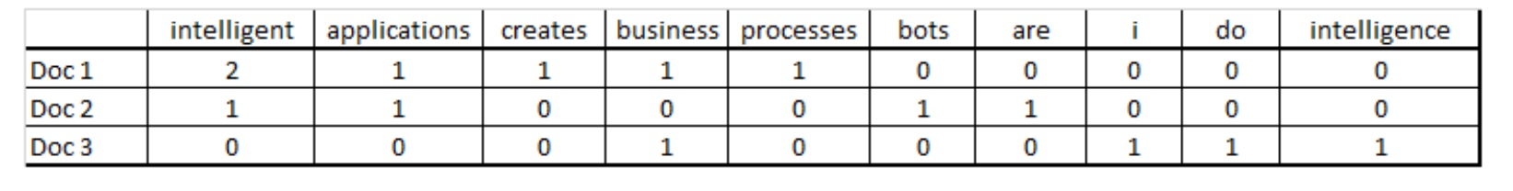
Converting Documents to Matrices (DTM)
5
Can text be represented with numbers? Yes
What is a DTM? (What is a TDM?)
What is “frequency”, vs. “TF-IDF”, vs. “binary”?

Slide 6
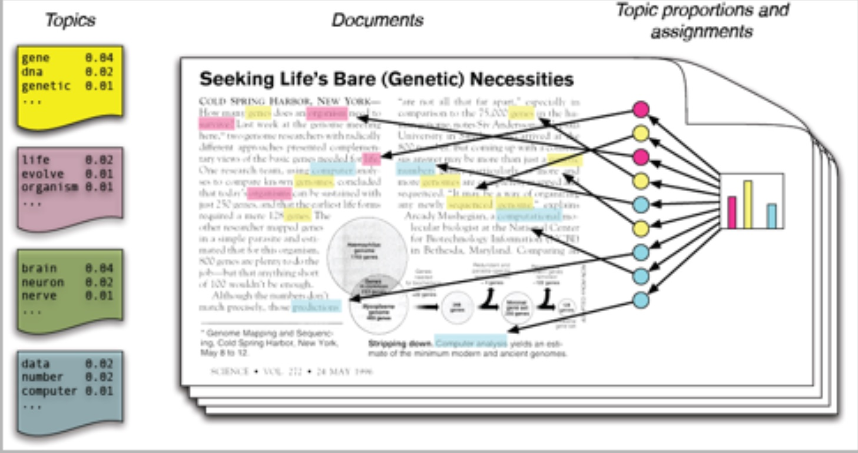

What is Topic Modeling?
What is a document?
What is a Corpus?
Do documents have “topics”?
What is a topic distribution?
How can you determine the topic(s) of a document?

Slide 7
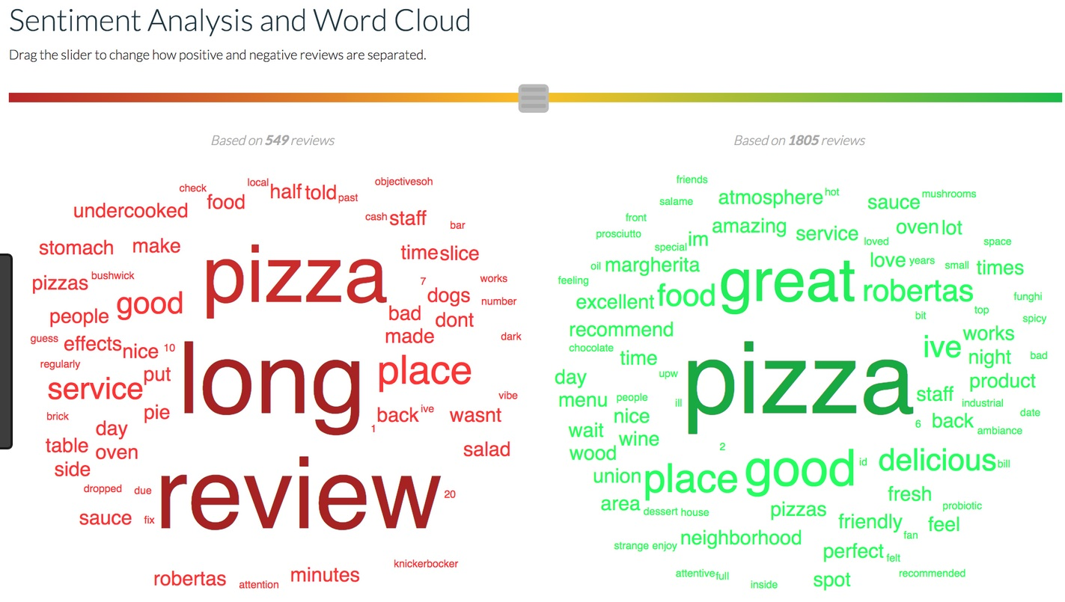

Sentiment Analysis
Can Data Analytics be used to understand sentiment?
Can models be created (trained) to predict sentiment?
What are some “supervised” methods that can be used?
Can unsupervised methods be used?
- How?

Slide 8
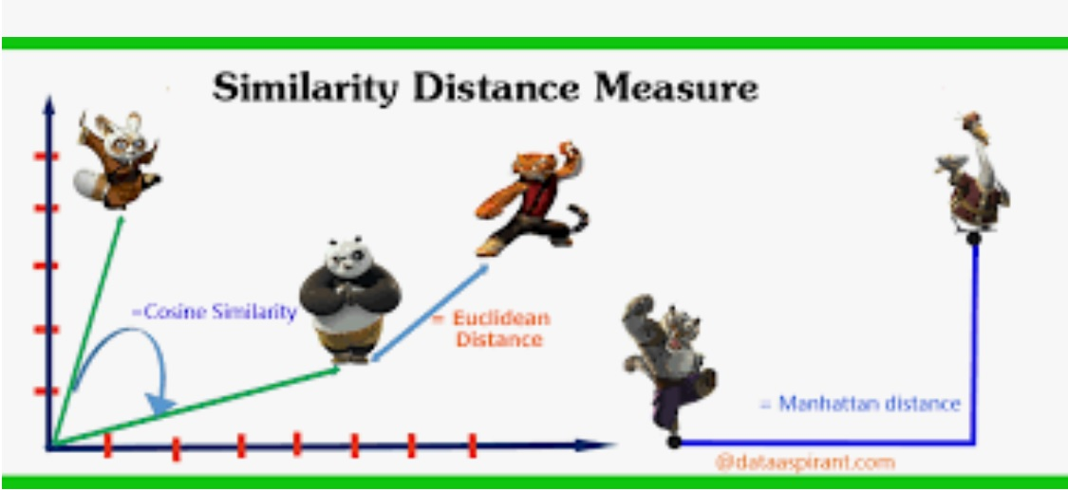
What are Distance Measures?
Why do we need to measure distance?
Is this the same as “similarity”?
What does it mean for two documents to be “similar”?

Slide 9
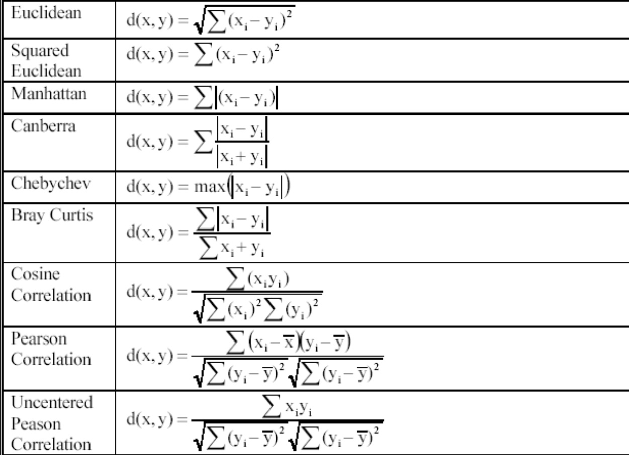
Types of Distance Measures
9
Are there others?
What is “edit distance”?
How about Jaccard?

Slide 10
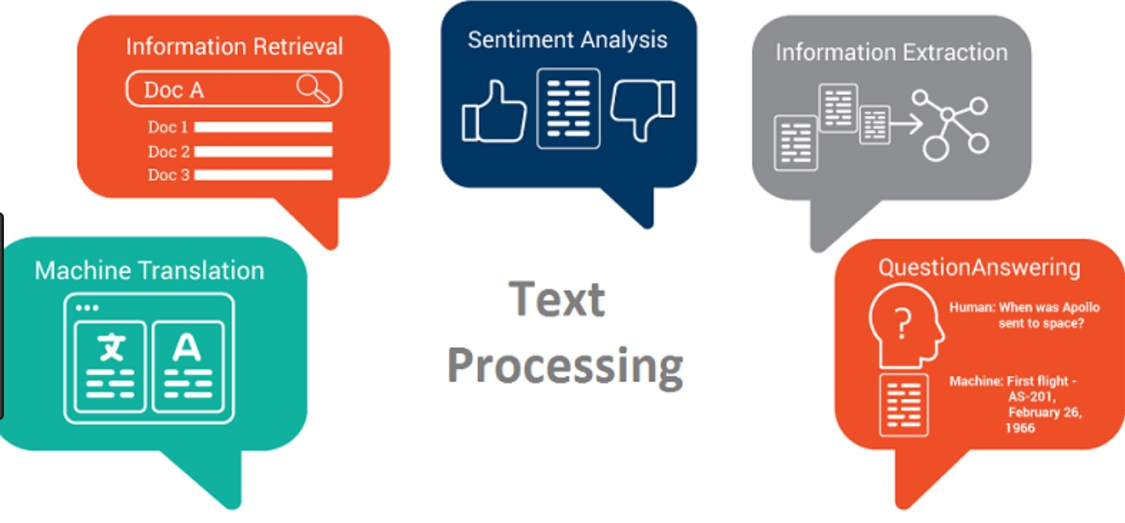
10

