Slide 1
Naïve Bayes
Dr. Ami Gates
Reference: Kumar et. Al 2005,2015

Slide 2
Reminder: A Classification Task

Slide 3
Naïve Bayes:

Slide 4
Bayes Theorem
Assume that attributes are independent
Let c be any class or label, Let x be a data vector
Bayes:
P(c|x) = P(x|c) P(c) / P(x)
= P(x1|c) * P(x2|c) *…*P(xn|c)*P(c) / P(x1) * P(x2) *…*P(xn)
Why? Because we assume independence.
P(c|x) is the posterior probability of the class given the predictor attribute vector x
P(x|c) is the Likelihood – the prob of the attribute vector given the class.
P(c) is the Class Prior Probability – the prob of the class
P(x) is the Predictor Prior Probability – the prob of the attribute vector

Slide 5
Reminder of Conditional Prob Rules and Basic Bayes: FYI
A probabilistic framework for solving classification problems
Conditional Probability:
Bayes theorem:

Slide 6
Example 1: Basic Bayes
Given:
A doctor knows that meningitis (M) causes stiff neck, S, is 50%. P(S|M)=.5
Prior probability of any patient having meningitis is 1/50000. P(M) = 1/50000
Prior probability of any patient having stiff neck is 1/20: P(S) = 1/20
Question: If a patient has stiff neck, what’s the probability he/she has meningitis?

Slide 7
Bayesian Classifiers Overview
Consider each attribute and class label as random and independent variables
Given a record (data row) with attributes (A₁, A₂,…,A_{n})
Goal is to predict class C
Specifically, we want to find the value of C that maximizes P(C| A₁, A₂,…,A_{n} )
Can we estimate P(C| A₁, A₂,…,A_{n} ) directly from data?

Slide 8
Bayesian Classifiers
Approach:
Compute the posterior probability
P(C | A₁, A₂, …, A_{n}) for all values of C using Bayes
Choose value of C that maximizes P(C | A₁, A₂, …, A_{n})
Equivalent to choosing value of C that maximizes
P(A₁, A₂, …, A_{n}|C) P(C)
How to estimate P(A₁, A₂, …, A_{n} | C )?

Slide 9
Naïve Bayes Classifier
Assume independence among attributes A_{i} when class is given:
P(A₁, A₂, …, A_{n} |C_{j}) =
P(A₁| C_{j}) P(A₂| C_{j})… P(A_{n}| C_{j})
Can estimate P(A_{i}| C_{j}) for all A_{i} and C_{j}.
New point is classified to C_{j} if
P(A_{i}| C_{j}) * P(C_{j}) is maximal.

Slide 10
Example of Naïve Bayes Classifier
Given a Test Record X, classify as Evade E =Yes or No:
Let record X = {Refund R=No, Married M=Yes, Income I =120K}
P(X|E=No) = P(R=No|E=No) * P(M=Yes| E=No) * P(I=120|E=No)
= 4/7 * 4/7 * 0.0072 = .0024 (see slides 12&13)
P(X|E=Yes) = P(R=No|E=Yes) * P(M=Yes| E=Yes) * P(I=120|E=Yes)
= 1 * 0 * 0.0 = 0.0
Since P(X|E=No)P(E=No) > P(X|E=Yes)P(E=Yes)
Therefore P(E=No|X) > P(E=Yes|X) → Class = No

Slide 11
Estimating Discrete Prob from Data
Class: P(C) = N_{c}/N
P(No) = 7/10
P(Yes) = 3/10
For discrete attributes: P(A_{i}|C_{k}) = |A_{ik}|/ N_{c}
where |A_{ik}| is number of instances having attribute A_{i} and belongs to class C_{k}
Examples:
P(Married=Yes|E=No) = 4/7 P(Refund=Yes|E=Yes) = 0
k

Slide 12
Normal distribution:
One for each (X_{i},Y_{i}) pair
For (Income, Class=No):
If Class=No
sample mean = 110
sample variance = 2975

Slide 13
The Normal Prob Dist
The Normal Prob Distribution
mu is the mean and sigma is the std dev

Slide 14
How to Estimate Probabilities from Data?
For continuous attributes:
Discretize the range into bins
one ordinal attribute per bin
Two-way split: (A < v) or (A > v)
choose only one of the two splits as new attribute
Probability density estimation:
Assume attribute follows a normal distribution
Use data to estimate parameters of distribution (e.g., mean and standard deviation)
Once probability distribution is known, can use it to estimate the conditional probability P(A_{i}|c)

Slide 15
Naïve Bayes Classifier
If one of the conditional probability is zero, then the entire expression becomes zero
Probability estimation:
c: number of classes
p: prior probability
m: parameter

Slide 16
Example: Naïve Bayes Classifier
A: attributes
M: mammals
N: non-mammals
P(A|M)P(M) > P(A|N)P(N)
→ Mammals

Slide 17
Naïve Bayes Summary
Robust to isolated noise points
Handle missing values by ignoring the instance during probability estimate calculations
Robust to irrelevant attributes
Independence assumption may not hold for some attributes
Use other techniques such as Bayesian Belief Networks (BBN)

Slide 18
Naïve Bayes in R
Gates

Slide 19
Link to the Code:
The follow is a specific example of Naïve Bayes in R.
https://drive.google.com/drive/folders/1rXm4jTHMTTjFvHfJ3daCCWNmOdF9tNPl?usp=sharing
You can find my code and data in the above link.
The following slides show examples, but it is best to read about these options and then write your own code.

Slide 20
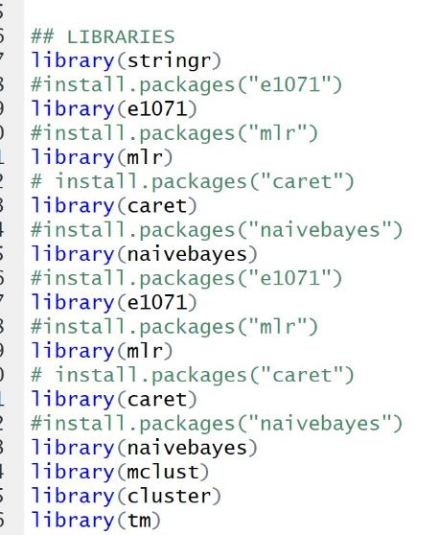
Libraries: at least these

Slide 21
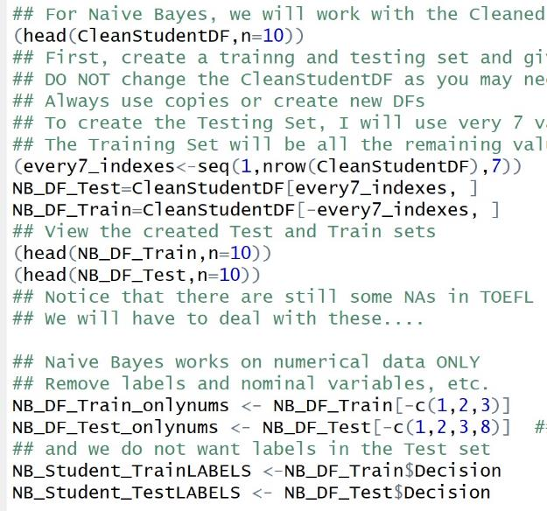
Naïve Bayes
Create a Test Set
Create a Training Set
*** My example to the right is a specific example for my Student App dataset.
Alterations/changes will depend on the data you use.

Slide 22
Issues with Naïve Bayes
NA values or blanks. You can na.pass. This means you lose those rows in the analysis.
You can try to fill in the values with a measure, such as mean or median.
Naïve Bayes can *only* run on numerical data – so you must remove all nominal/qual/categorical data first.

Slide 23
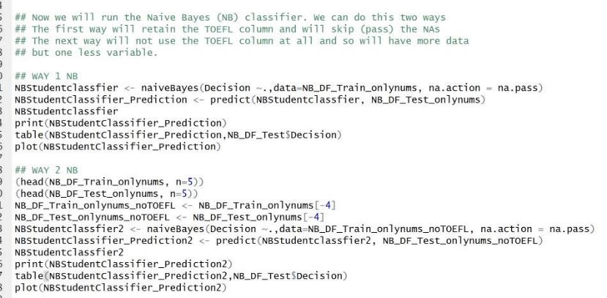
Just an example: Bayes in R

Slide 24
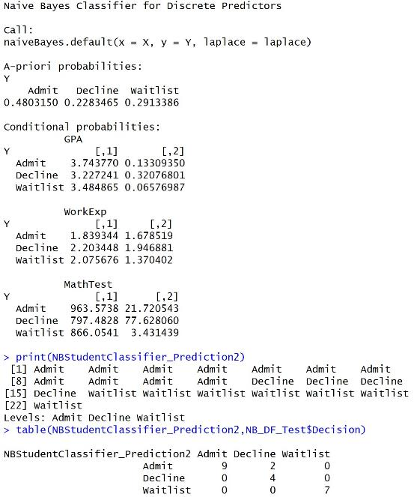
Results from the classifier

Slide 25
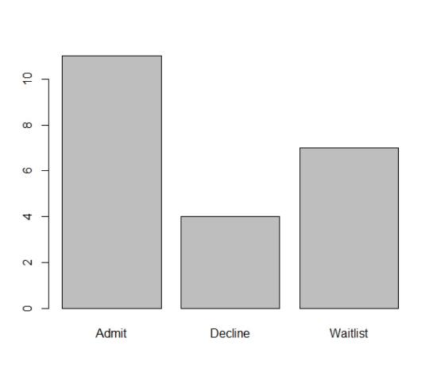
Quick plot for naïve Bayes

Slide 26
Example 2 in R
The following example is taken directly from:
https://www.r-bloggers.com/understanding-naive-bayes-classifier-using-r/
R supports a package called ‘e1071’ which provides the naive bayes training function. For this demonstration, we will use the classic titanic dataset and find out the cases which naive bayes can identify as survived.
The Titanic dataset in R (not Kaggle) is a table for about 2200 passengers summarised according to four factors – economic status ranging from 1st class, 2nd class, 3rd class and crew; gender which is either male or female; Age category which is either Child or Adult and whether the type of passenger survived. For each combination of Age, Gender, Class and Survived status, the table gives the number of passengers who fall into the combination.

Slide 27
What is Naïve Bayes?
Naive Bayes – a Not so Naive Algorithm
The reason that Naive Bayes algorithm is called Naive … is because the algorithm makes a very strong assumption about the data having features independent of each other while in reality, they may be dependent in some way.
In other words, it assumes that the presence of one feature in a class is completely unrelated to the presence of all other features. If this assumption of independence holds, Naive Bayes performs extremely well and often better than other models.
Naive Bayes can also be used with continuous features but is more suited to categorical variables. If all the input features are categorical, Naive Bayes is recommended. However, in case of numeric features, it makes another strong assumption which is that the numerical variable is normally distributed.
https://www.r-bloggers.com/understanding-naive-bayes-classifier-using-r/

Slide 28
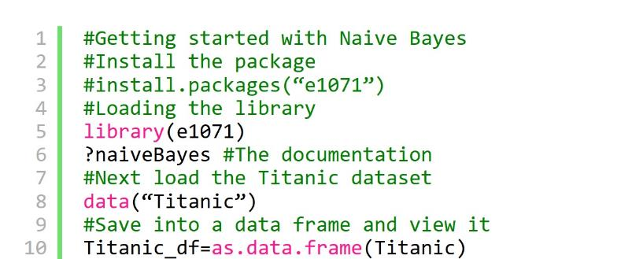
Naïve Bayes Example with R Titanic Data Part 1

Slide 29
Naïve Bayes Example with R Titanic Data Part 2
#Creating data from table
repeating_sequence=rep.int(seq_len(nrow(Titanic_df)), Titanic_df$Freq)
#This will repeat each combination equal to the
#frequency of each combination
#Create the dataset by row repetition created
Titanic_dataset=Titanic_df[repeating_sequence,]
#We no longer need the frequency, drop the feature
Titanic_dataset$Freq=NULL

Slide 30
Naïve Bayes Example with R Titanic Data Part 3
#Fitting the Naive Bayes model
Naive_Bayes_Model=naiveBayes(Survived ~., data=Titanic_dataset)
#What does the model say?
#Print the model summary
Naive_Bayes_Model

Slide 31
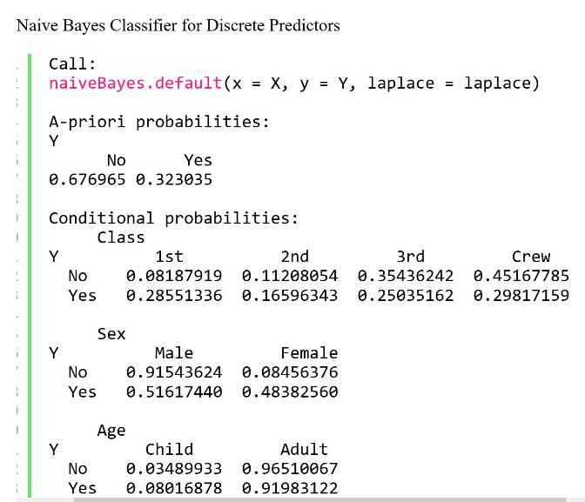
results

Slide 32
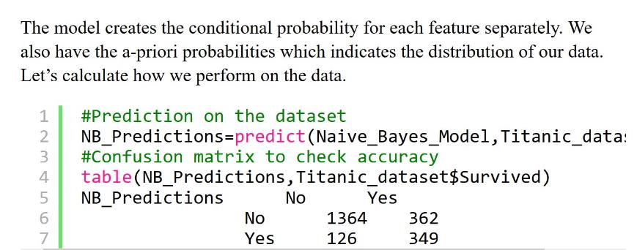
Results Part 2

Slide 33
Conclusions and Can You DO Better? *Always* ask this question.
We have the results! We are able to classify 1364 out of 1490 “No” cases correctly and 349 out of 711 “Yes” cases correctly. This means the ability of Naive Bayes algorithm to predict “No” cases is about 91.5% but it falls down to only 49% of the “Yes” cases resulting in an overall accuracy of 77.8%
Naive Bayes is a parametric algorithm which implies that you cannot perform differently in different runs as long as the data remains the same.
We will, however, learn another implementation of Naive Bayes algorithm using the ‘mlr’ package. Assuming the same session is going on for the readers, I will install and load the package and start fitting a model

Slide 34
Example 3: Using the mlr package
This full example is taken directly from:
https://www.r-bloggers.com/understanding-naive-bayes-classifier-using-r/
Author info is here too as well as all of the code that they used.

Slide 35
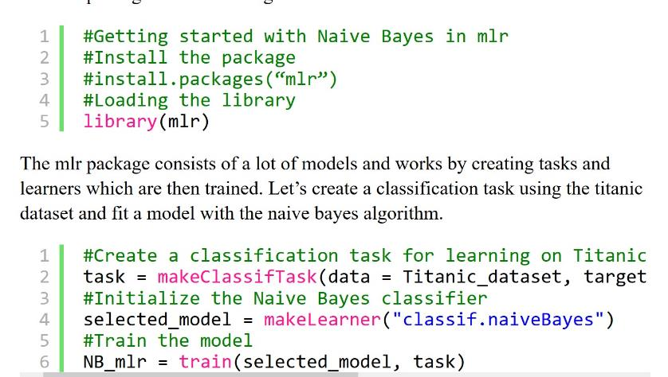
Step 1: using mlr

Slide 36
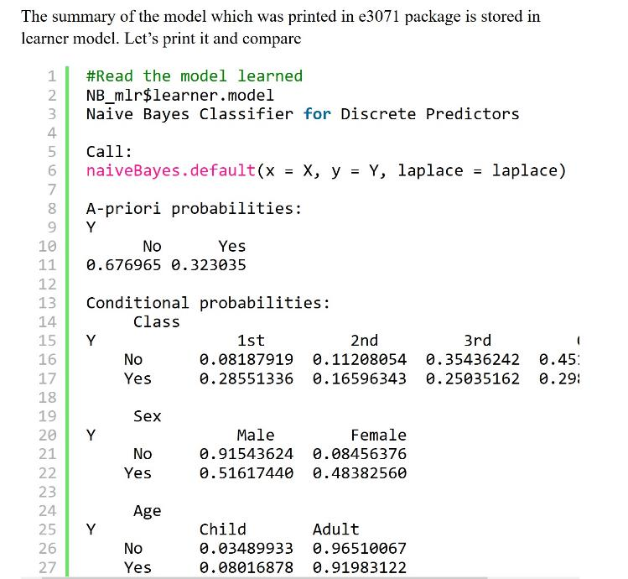

Slide 37
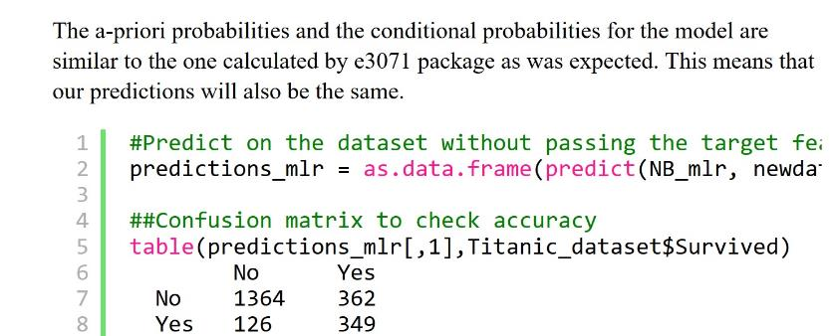
Table of results

Slide 38
R: Example 4
## libraries
library(naivebayes)
library(psych)
library(dplyr)
library(ggplot2)
## data
data(iris)
str(iris)
# Species is the label
table(iris$Species)
(head(iris))
(summary(iris))
MyIrisDF <- iris
## Create Train and Test Set
(n <- round(nrow(MyIrisDF)/5))
(s <- sample(1:nrow(MyIrisDF), n))
## The test set is the sample
IrisTest<- MyIrisDF[s,]
## The trainng set is the not sample
IrisTrain <- MyIrisDF[-s,]
## Have a look...
(head(IrisTest,n=5))
(head(IrisTrain,n=5))

Slide 39
Visual EDA
pairs.panels(iris)
iris %>%
ggplot(aes(x=Species, y=Sepal.Width, fill=Species)) +
geom_boxplot() +
ggtitle("Box plot")
iris %>%
ggplot(aes(x=Sepal.Width, fill=Species)) +
geom_density(alpha=.6, color="black") +
ggtitle("Density plot")
plot(iris)
plot(iris$Petal.Length,iris$Petal.Width,col=iris$Species)

Slide 40
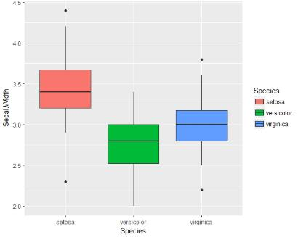
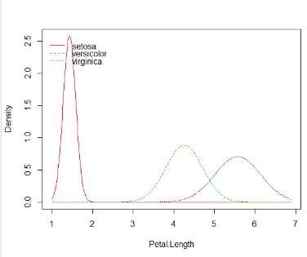
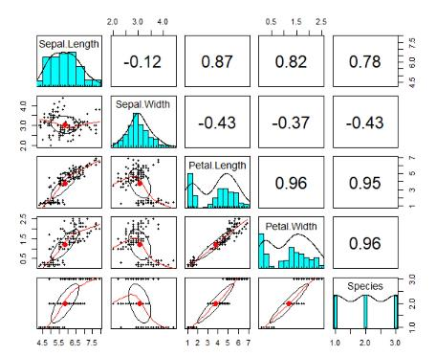
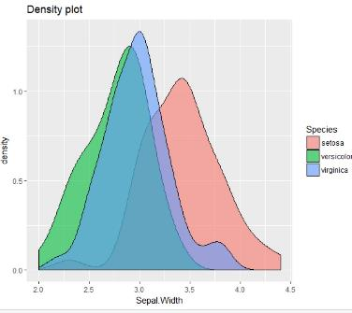

Slide 41
Naïve Bayes
## Naive Bayes
NBModel <- naive_bayes(IrisTrain$Species ~., data=IrisTrain)
print(NBModel)
plot(NBModel)
## predict
NB_p <- predict(NBModel, IrisTest, type="prob")
(head(round(NB_p)))
## classify/predict
NB_p2 <- predict(NBModel, IrisTest, type="class")
(Pred_TABLE <-table(NB_p2, IrisTest$Species))
## accuracy
(sum(diag(Pred_TABLE)/sum(Pred_TABLE)))

Slide 42
Suggestions and references
Kumar 2005, 2015
As with all new things – create a small toy example and do it by hand and with R to see that you get the same results.
https://www.r-bloggers.com/understanding-naive-bayes-classifier-using-r/
There is always more! Each time you use a model or technique, you will always find new ideas, new improvements, new packages, and new methods to visualize.
Ask the question – Can I make this better?

