Slide 1
Lecture 11

Slide 2
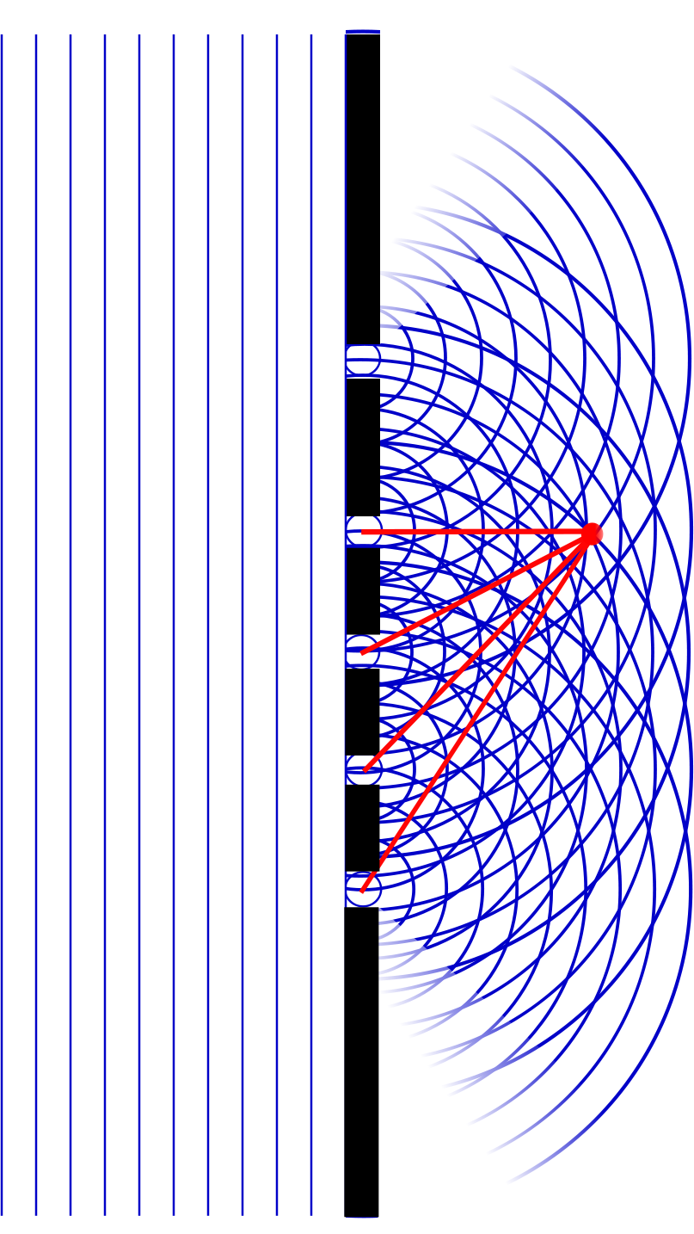
Question
At point A, there will be
Constructive interference
Destructive interference
Partial constructive interference
Partial destructive interference
A

Slide 4
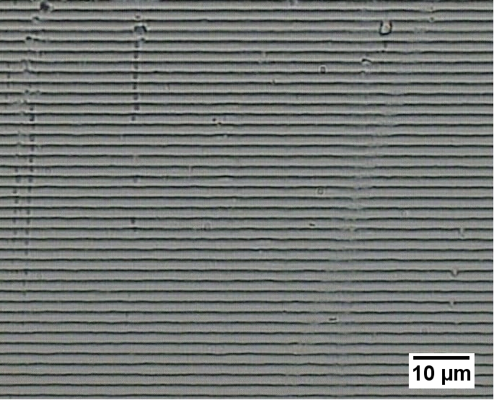

Slide 5
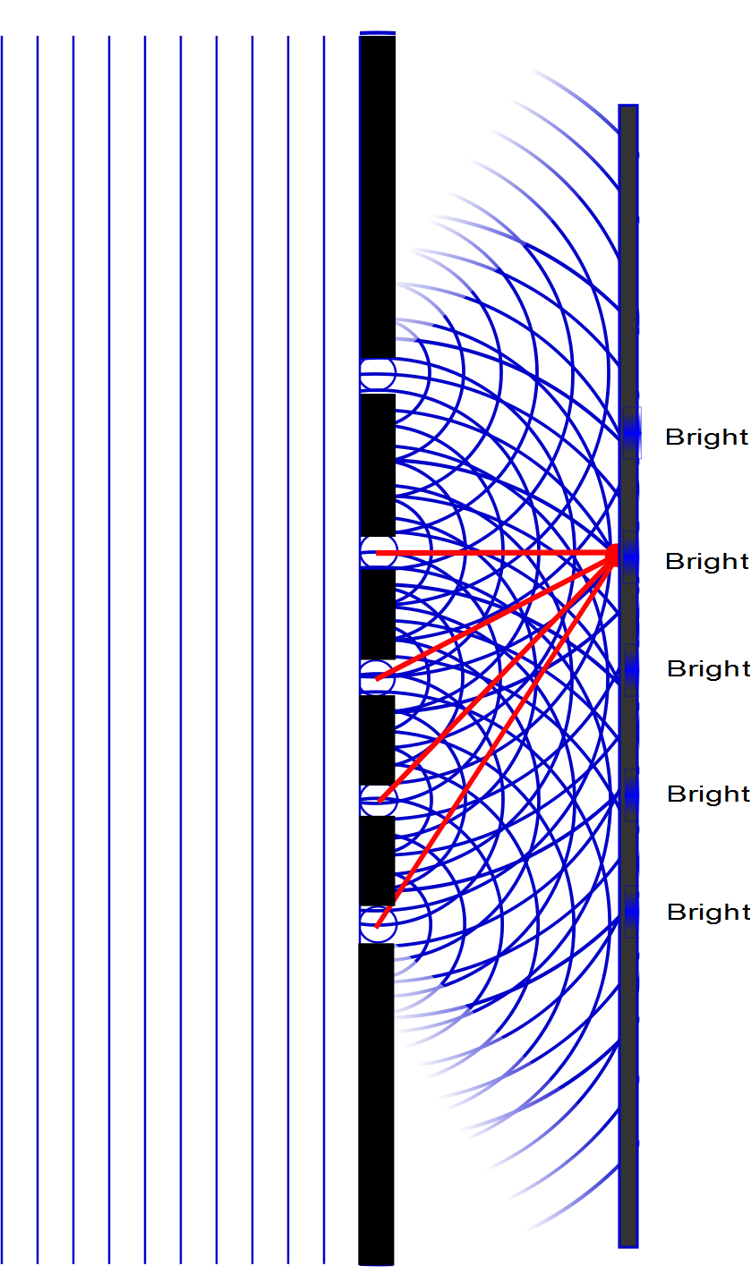

Slide 6
Question
Which will be a brighter spot, pint A or point B?
A
B
They will be the same
A
B

Slide 7
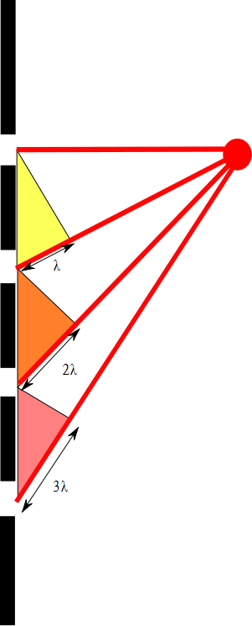

Slide 8
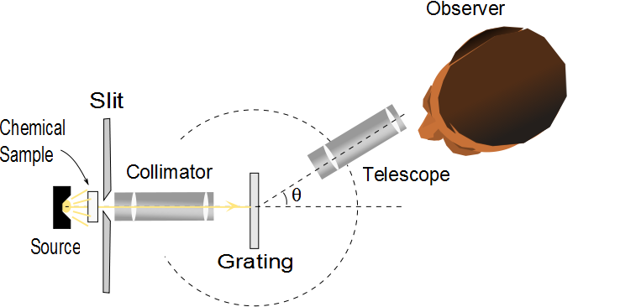
Diffraction Grating Spectrometer
The collimated beam is incident on the grating
The diffracted light leaves the gratings and the telescope is used to view the image
The wavelength can be determined by measuring the precise angles at which the images of the slit appear for the various orders

Slide 9
Details

Slide 10
Diffraction Grating, Intensity, cont.
Characteristics of the intensity pattern
The sharp peaks are in contrast to the broad, bright fringes characteristic of the two-slit interference pattern
Because the principle maxima are so sharp, they are much brighter than two-slit interference patterns

Slide 11
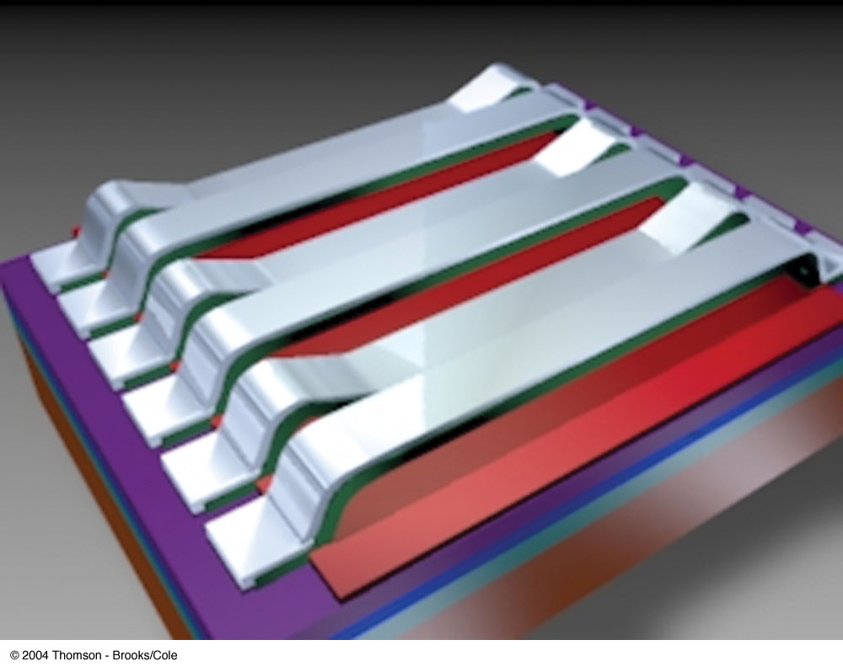
Grating Light Valve
A grating light valve consists of a silicon microchip fitted with an array of parallel silicon nitride ribbons coated with a thin layer of aluminum
When a voltage is applied between a ribbon and the electrode on the silicon substrate, an electric force pulls the ribbon down
The array of ribbons acts as a diffraction grating

Slide 12
Resolving Power of a Diffraction Grating
For two nearly equal wavelengths, λ₁ and λ₂, between which a diffraction grating can just barely distinguish, the resolving power, R, of the grating is defined as
Therefore, a grating with a high resolution can distinguish between small differences in wavelength

Slide 13
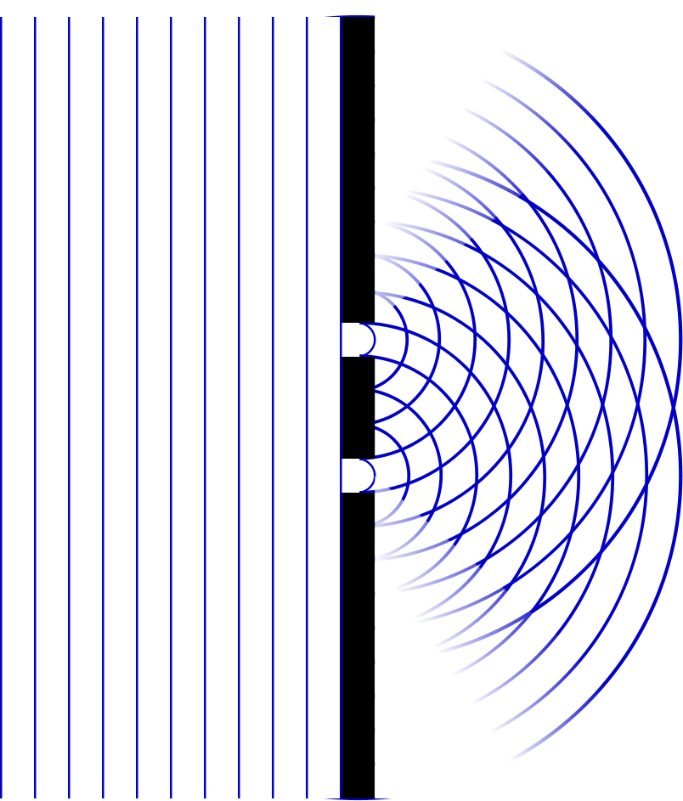
Question
Which will be a narrower, pint A or point B?
A
B
They will be the same
A
B

Slide 14
Single Slit Envelope
2 slits
Intensity pattern
3 slits
4 slits
5 slits
10 slits
100 slits

Slide 15
Resolving Power of a Diffraction Grating, cont
The resolving power in the mth-order diffraction is R = Nm
N is the number of slits
m is the order number
Resolving power increases with increasing order number and with increasing number of illuminated slits

Slide 16
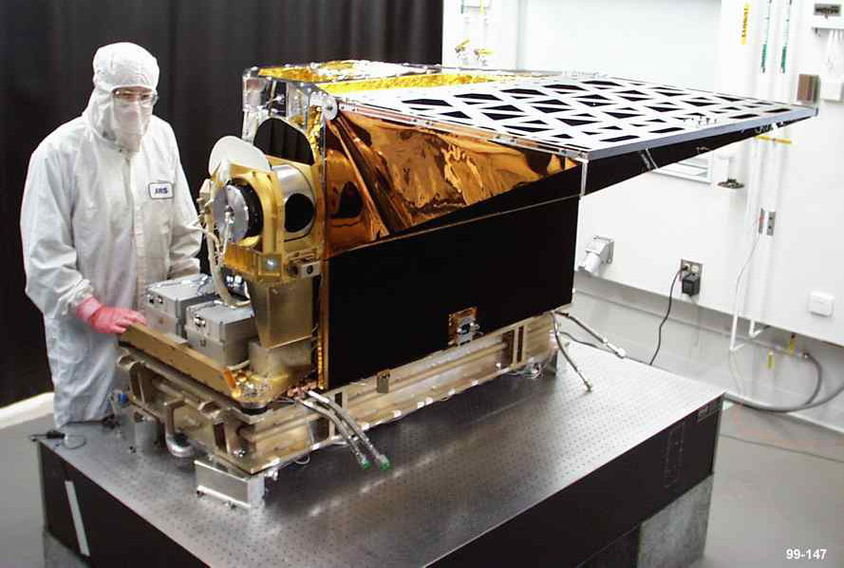
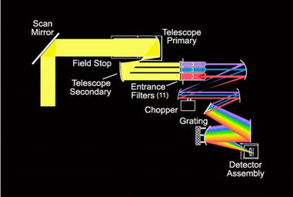
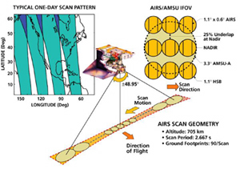

AIRS

Slide 17
Question
Light goes through just one slit. Will there be spots of destructive interference?
Yes
No
How could that work with just one light source?

Slide 18
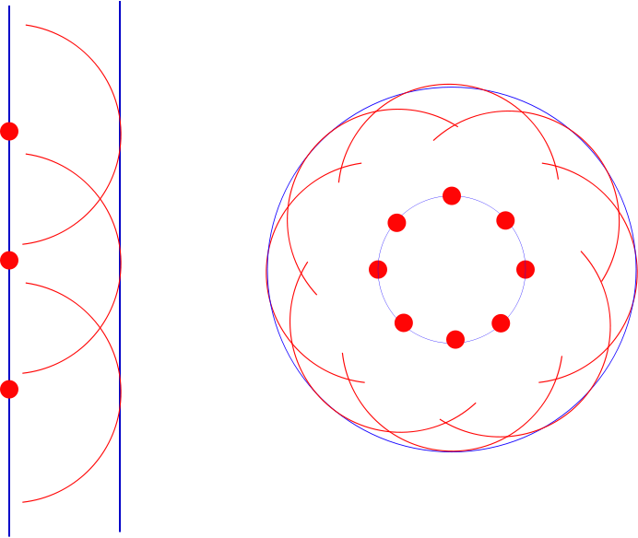

Slide 19
Question 223.11.0.1
1
What is the path difference between ray 1 and ray 2?
a)
b)
c)
d)
2
3
a/2
θ
a

Slide 20
Single-Slit Diffraction
a/2
θ
a

Slide 21
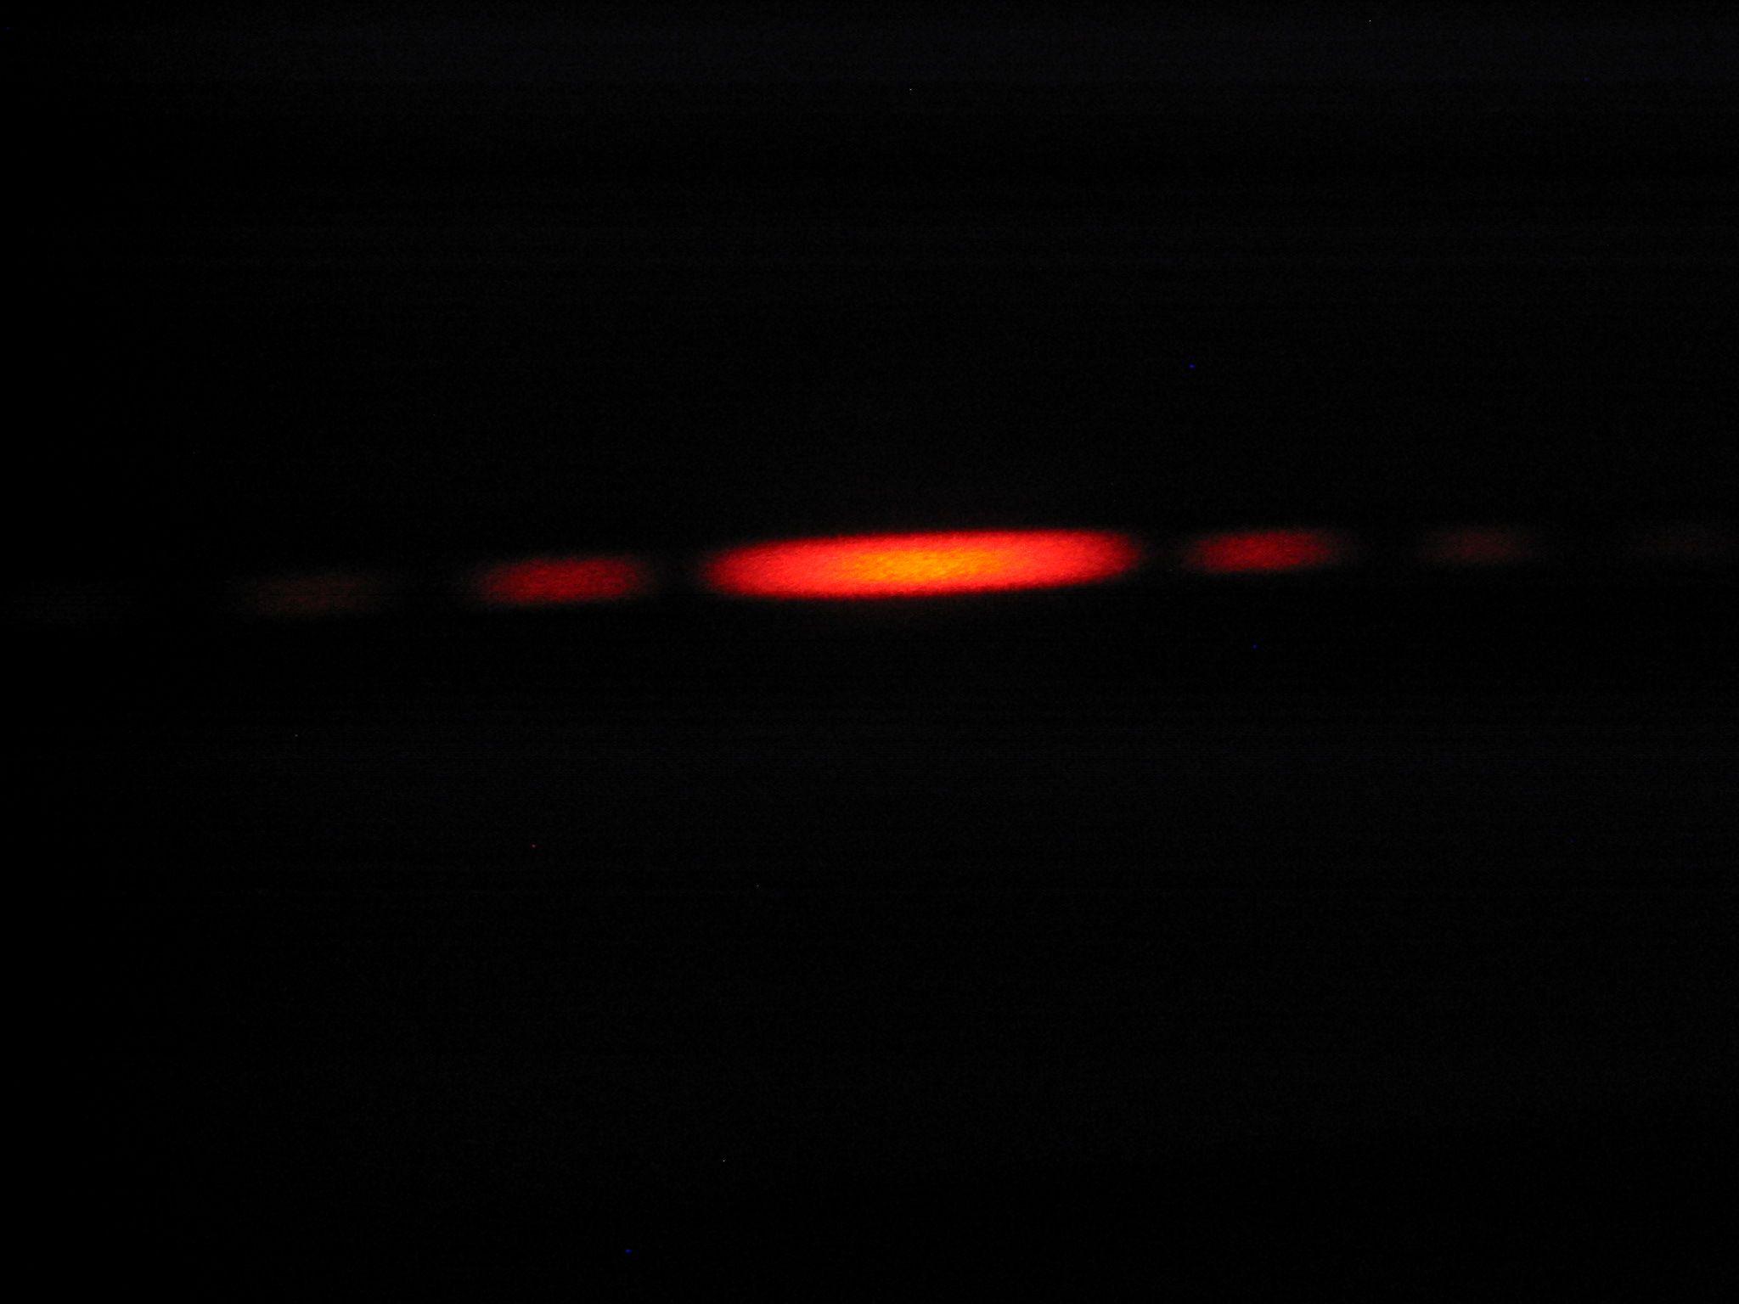
Diffraction Pattern, Single Slit
The diffraction pattern consists of the central maximum and a series of secondary maxima and minima
The pattern is similar to an interference pattern

Slide 22
Single-Slit Diffraction
5
4
3
2
1
a/2
a
θ

Slide 23
Single-Slit Diffraction
a/6
a
θ

Slide 24
Intensity
The intensity can also be expressed as
Minima occur at

Slide 25
sinc(x)

Slide 26
(sinc(x))²

Slide 27

I
Interference fringes:
due to having a single slit
-2π
-π
π
2π
φ/2

Slide 28
Intensity Equation
To determine the maximum intensity:
The factor in the square brackets represents the single-slit diffraction pattern
This acts as the envelope
The two-slit interference term is the cos² term

Slide 29
Missing Maxima
To find which interference maximum coincides with the first diffraction minimum
The conditions for the first interference maximum
d sin θ = mλ
The conditions for the first diffraction minimum
a sin θ = λ

Slide 30
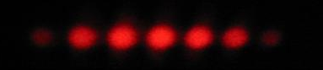
I
Interference fringes:
due to having two slits.
φ/2
-5π
-3π
-π
π
3π
5π

Slide 31
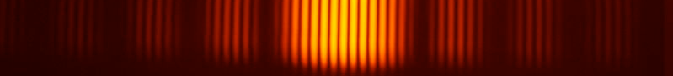
Diffraction envelope:
The single slit pattern due to shape of the individual slits.
I
Interference fringes:
due to having two slits.
φ/2
-3π
-2π
-π
π
2π
3π

