Slide 1
Question 223.3.1
What is a crest?
A toothpaste
The place a wave crosses the x-axis
The peak of a wave
The lowest point in the wave

Slide 2
Sinusoidal Waves
A continuous wave can be created by shaking the end of the string in simple harmonic motion
The shape of the wave is called sinusoidal since the waveform is that of a sine curve
The shape remains the same but moves
Toward the right in the text diagrams

Slide 3
Question 223.3.2
Does a longitudinal wave, have an amplitude ?
a) yes
b) no
c) it depends on the medium the wave is in

Slide 4
Question 223.3.2.5
What do we mean when we say “amplitude” for a sound wave?
The maximum displacement from equilibrium of the molecule perpendicular to the wave direction.
The maximum displacement of one air molecule from its equilibrium point
The maximum distance an air particle travels

Slide 5
Amplitude and Wavelength
The crest of the wave is the location of the maximum displacement of the element from its normal position
This distance is called the amplitude, A
The point at the negative amplitude is called the trough
The wavelength, λ, is the distance from one crest to the next

Slide 6
Wavelength and Period
More generally, the wavelength is the minimum distance between any two identical points on adjacent waves
The period, T , is the time interval required for two identical points of adjacent waves to pass by a point
The period of the wave is the same as the period of the simple harmonic oscillation of one element of the medium

Slide 7
x
t

Slide 8
Frequency
The frequency, ƒ, is the number of crests (or any point on the wave) that pass a given point in a unit time interval
The time interval is most commonly the second
The frequency of the wave is the same as the frequency of the simple harmonic motion of one element of the medium

Slide 9
Question 223.3.3
I have a sinusoidal wave traveling with a wave speed of 10m/s. The wavelength is 5m. What is the frequency?
5m
2 sec
2 Hz
50 1/sec

Slide 10
Question 223.3.4
We know that frequency and period are inversely related. If the frequency is 0.2Hz what is the period?
20 sec
5 sec
2 sec
1 sec

Slide 11
Question 223.3.5
When we talk about the period of a sinusoidal wave, what do we mean?
Considering the snapshot view, it is the distance between wave crests
Considering the history graph view (video camera view), it is the period of oscillation of a single medium element.
Considering the snapshot view, it is the distance in maximum displacement between to medium points
Considering the history graph view, it is the distance between two wave crests.

Slide 12
Question 223.3.6
When we talk about the wavelength of a sinusoidal wave, what do we mean?
Considering the snapshot view, it is the distance between wave crests
Considering the history graph view (video camera view), it is the period of oscillation of a single medium element.
Considering the snapshot view, it is the distance in maximum displacement between to medium points
Considering the history graph view, it is the distance between two wave crests.

Slide 13
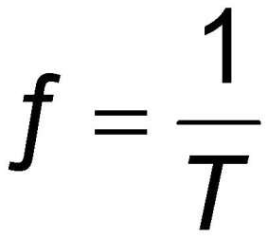
Frequency, cont
The frequency and the period are related
When the time interval is the second, the units of frequency are s⁻¹ = Hz
Hz is a hertz

Slide 14
Wavenumber
consider again a sinusoidal wave
A is the amplitude (x_{max}).
We need to find a (like for SHM we found ω).
Use initial conditions

Slide 15
Wavenumber
The next time y=0 will be when x=λ/2
This is true when
So
We have a special name for a, it is the wavenumber, and we give it the symbol k

Slide 16
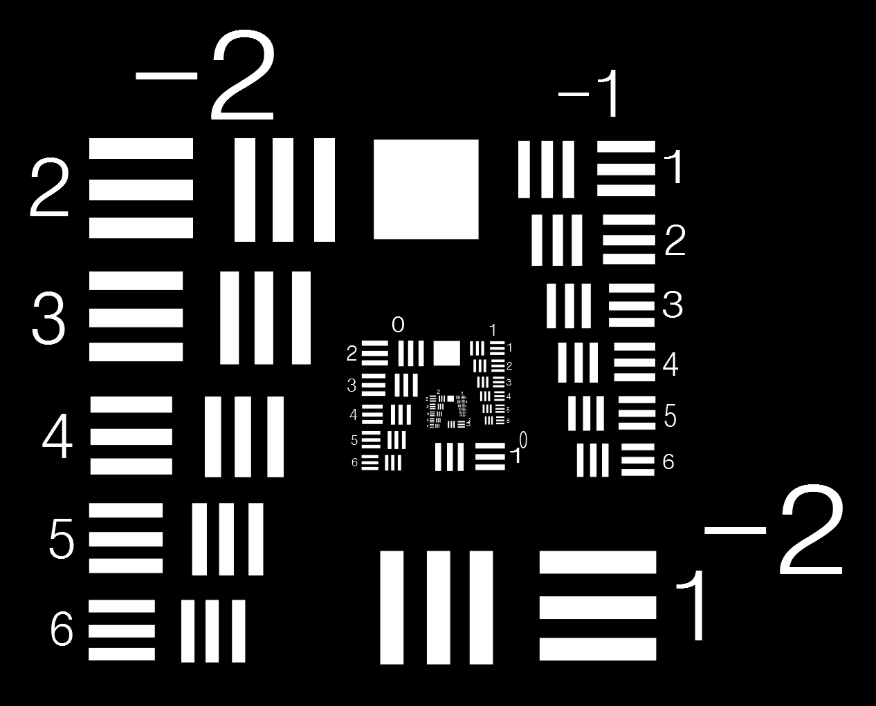

Slide 19
Question 223.3.8
What does k tell us?
How far apart wave crests are in distance
How often we get a wave crest in distance
How far apart wave crests are in time
How often we get a wave crest in time
Nothing

Slide 20
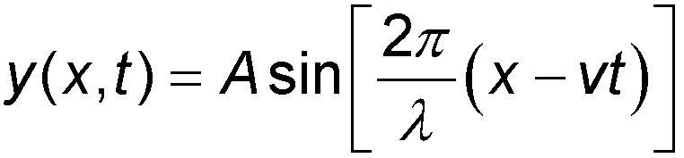
Speed of Waves
Waves travel with a specific speed
The speed depends on the properties of the medium being disturbed
The wave function is given by
This is for a wave moving to the right
For a wave moving to the left, replace x – vt with x + vt

Slide 21
Speed of Waves on Strings

Slide 22
θ
θ
T
T
θ

Slide 23
Forces on a Segment of String
Tension on the RHS of the element from the rest of the string on the right,
Tension on the LHS of the element from the rest of the string on the left
Force due to gravity
θ
θ
T
T
θ

Slide 24
Forces on a Segment of String
Assume that Δs an arc of a circle with radius R.
There is a force pulling left on the left end of the element that is tangent to the arc,
there is a force pulling right at the right end of the element which is tangent to the arc.
These forces produce centripetal accelerations
θ
θ
T
T
θ

Slide 25
Forces on a Segment of String
The horizontal components of the forces cancel
The vertical component, is directed toward the center of the arc
If the rope is not moving in the x direction, then
Then the force is
θ
θ
θ
θ
T
T
T
T
θ
θ

Slide 26
Forces on a Segment of String
Small Angle Aprox.
Define
so
θ
θ
T
T
θ

Slide 27
Forces on a Segment of String
Use Newton’ Second in Radial Direction
θ
θ
T
T
θ

Slide 28

Water Drop and wave From Julian Evil: Attribution-Share Alike 2.0 Generic

Slide 30

Portion of a Spherical Wave: Wave becomes more flat as it expands

