Slide 1
Lecture 6
Superposition and Standing Waves

Slide 2
Example

Slide 3
Amplitude

Slide 4
Effect of φ
Same example, but with different values of φ

Slide 5
Question 223.6.1
A pulse is traveling on a rope. If one end of the rope is fixed to a pole, the reflected wave on this end is inverted because…
The rope dissipates energy so the returning pulse must be lower to account for the lower potential energy
The pole exerts an equal but opposite force on the end of the rope. The pulse makes the pulse pull upward on the poll, so the pole pushes downward. So the rope is forced downward
The pull of gravity increases for the end of ropes
Can’t tell

Slide 6
0s
4s
1s
5s
2s
6s
3s
7s

Slide 7
Forces on the End of the Rope
T_{y}
T_{y}
T
T_{y}
T_{x}
F_{g}
T_{x}
F_{wall}
F_{g}
T
F_{wall}

Slide 8
Reasonable?
Remember back in PH 121 (or statics) the book on the table?
Book has a force due to gravity
Table exerts a force equal to m_{book}g on the book

Slide 9
Demo
See if you can feel that you must provide the force

Slide 10
Question 223.6.1.5
A pulse is traveling on a rope. If one end of the rope is not tied to anything, will the pulse reflect off of this end of the rope?
Yes
No
Maybe
Can’t tell

Slide 11
Question 223.6.1.6
A pulse is traveling on a rope. If one end of the rope is not tied to anything, a pulse will still reflect off of this “free end.” Will the reflected pulse be inverted?
Yes
No
Maybe
Can’t tell

Slide 12
0s
4s
1s
5s
2s
6s
3s
7s

Slide 13
Forces on the End of the Rope
T_{y}
T_{y}
T
T_{y}
T_{x}
F_{g}
T_{x}
F_{g}
T

Slide 14
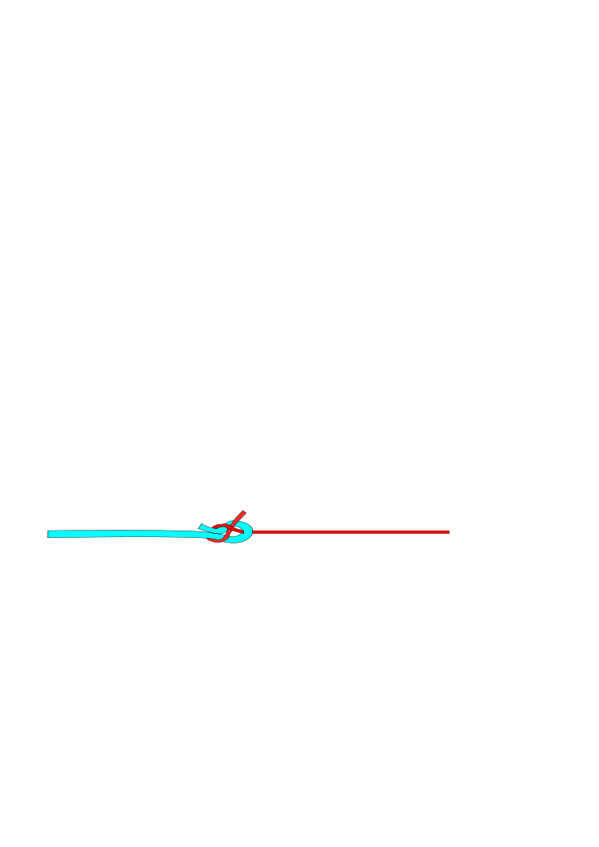
Question 223.6.3 Question 123.23.2
A wave travels across a boundary between two different weight ropes. If it goes from the heavier to the lighter rope, the wave speed
Increases
Decreases
Stays the same
Can’t tell

Slide 15
Question 223.6.2
A wave travels across a boundary between two different weight ropes. If it goes from the lighter to the heavier rope, the reflected wave
Is inverted
Is not inverted
Can’t tell

Slide 16
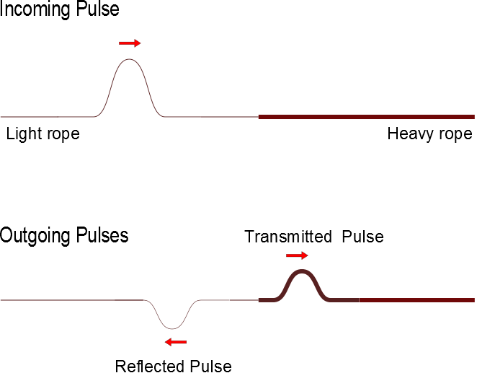
Case 3: Semi-loose End
Now the pulse is partially reflected
RHS rope sees a semi-fixed end point
LHS receives part of the pulse energy
New pulse has been “transmitted”

Slide 17
Forces on the End of the Rope
T_{y}
T_{y}
T
T_{y}
T_{x}
F_{g}
T_{x}
F_{RHS}
F_{g}
F_{RHSl}
T

Slide 18
Consider momentum
When we move from a less dense medium to a more dense medium
Reflected pulse is inverted
Pulse slows down
Which piece is harder to move?

Slide 19
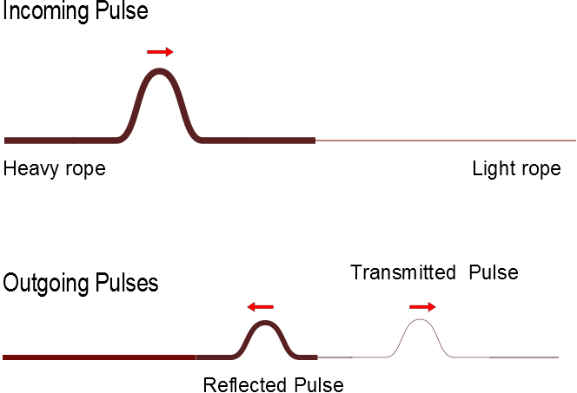

Slide 20
Question 223.6.4 Question 123.23.1
Two identical waves travel in opposite directions in a medium. If each wave has amplitude, A, the maximum amplitude of the resultant wave would be
A
2A
4A
A/2

Slide 21
Standing Waves

Slide 22
Question 223.6.5 Question 123.23.3
Does the node of a standing wave move in the x direction?
Yes
No
Neither

Slide 23
Question 223.6.6 Question 123.23.4
The nodes of a standing wave occur at
And the antinodes occur at
Wait… none of these is technically correct! (if you choose this answer, be ready to explain why)

Slide 24
Anti-Nodes
Nodes

Slide 26
Question 223.6.7 Question 123.23.5
I have my trusty ukulele and I have a string experiencing a standing wave. Which frequency corresponds to this wave shown?
The fundamental
The second harmonic
The third harmonic
The fourth harmonic

Slide 27
L

Slide 28

Question 223.6.8 Question 123.23.5
A string is clamped at both ends and plucked so it vibrates in a standing mode between two extreme positions a and b. Let upward motion correspond to positive velocities. When the string is in position c, the instantaneous velocity of points along the string:
1 is zero everywhere.
2 is positive everywhere.
3 is negative everywhere.
4 depends on location.
a
c
b

Slide 29

Answer
D).
P
R
Q

Slide 30
Question 223.6.9 Question 123.23.6
A string is clamped at both ends and plucked so it vibrates in a standing mode between two extreme positions a and b. Let upward motion correspond to positive velocities. When the string is in position b, the instantaneous velocity of points along the string
is zero everywhere.
is positive everywhere.
is negative everywhere.
depends on location
a
c
b

Slide 31

Answer
A)
R
Q
P

Slide 32
Summary
Superposition
Standing Waves

Slide 33
Summary
Standing Waves in Strings

