Slide 1

Question 223.6.8 Question 123.23.5
A string is clamped at both ends and plucked so it vibrates in a standing mode between two extreme positions a and b. Let upward motion correspond to positive velocities. When the string is in position c, the instantaneous velocity of points along the string:
1 is zero everywhere.
2 is positive everywhere.
3 is negative everywhere.
4 depends on location.
a
c
b

Slide 2

Answer
D).
P
R
Q

Slide 3
Question 223.6.9 Question 123.23.6
A string is clamped at both ends and plucked so it vibrates in a standing mode between two extreme positions a and b. Let upward motion correspond to positive velocities. When the string is in position b, the instantaneous velocity of points along the string
is zero everywhere.
is positive everywhere.
is negative everywhere.
depends on location
a
c
b

Slide 4

Answer
A)
R
Q
P

Slide 5
L
Displacement from Equilibrium
Pressure Change

Slide 6
Question 223.7.2
A pipe that is open at both ends has a standing sound wave generated in it. The pipe will have a pressure ____________ at both ends.
Node
Antinode
Neither

Slide 7
Question
L
How much of a wavelength is there in the displacement curve s(x) inside the pipe?
1 wavelength
2 wavelength
½ wavelength
¼ wavelength
s

Slide 8
L

Slide 9
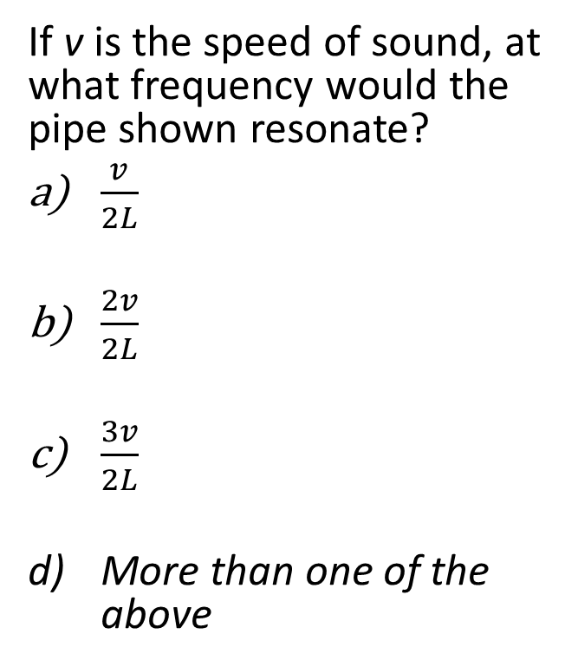
Question
L
If v is the speed of sound, at what frequency would the pipe shown resonate?
$\frac{v}{2L}$
$\frac{2v}{2L}$
$\frac{3v}{2L}$
More than one of the above
s

Slide 10
Question 223.7.2.5
A pipe, open on both ends has a tuning fork next to it which is oscillating at the pipe’s second harmonic frequency, How big is the wavelength compared to the pipe length?
λ = L/2
λ = L
λ = 2L
λ = (3/2)L

Slide 11
Question 223.7.2.6
A pipe, open on both ends has a tuning fork next to it which is oscillating at the pipe’s second harmonic frequency. The pipe is 30cm long? The speed of sound is 343m/s. What is the frequency we will hear?
286Hz
572Hz
1143Hz
1715Hz
2287Hz

Slide 12
Question
L
If I put a cap on one end of my pipe, how will the resonant frequency change?
It won’t change the frequency
It will double the frequency
It will half the frequency
It will change the frequency in an unpredictable way
Cap blocking one end

Slide 13
Question 223.7.1
A pipe, closed at one end, has a displacement node at one end. Why?
The pressure there must match atmospheric pressure
There is no pressure there so the molecules are free to move. This creates a node.
The wave molecules collide with the air molecules in the room
The end prevents the molecules from moving in a longitudinal direction

Slide 14
L
Displacement from Equilibrium
Pressure Change

Slide 15
L

Slide 16
Question 223.7.2.7
A pipe, closed on one end has a tuning fork next to it which is oscillating at the pipe’s second harmonic frequency, How big is the wavelength compared to the pipe length?
286Hz
572Hz
1143Hz
1715Hz
2287Hz

Slide 17
Question 223.7.3
Sound that produces standing wave frequencies that are not related by integer multiples is called
Atonal
Noise
Circle of 5ths
Guns n Roses
Can’t tell

Slide 18
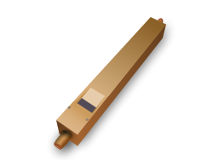

Slide 19
138.591Hz
155.563Hz
184.997Hz
207.652Hz
233.082Hz
277.183Hz
311.127Hz
369.994Hz
415.305Hz
D 146.832Hz
E 164.814Hz
F 174.614Hz
G 195.998Hz
A 220.000Hz
B 246.942Hz
C 261.626Hz
D 293.665Hz
E 329.628Hz
F 349.228Hz
G 391.995Hz
A 440.000Hz

Slide 20
A flash from a light bulb gets the wave started
Reflected wave is inverted and forms a standing wave
Mirrors

Slide 21
Partial mirror that lets some light out
Amplifier
Mirrors

Slide 22
Clamped Rod
The clamp prevents movement here
Atoms can move longitudinally here
Atoms can move longitudinally here

Slide 23
Clamped Rod: Center Clamp

Slide 24
Clamped Rod
The clamp prevents movement here
Atoms can move longitudinally here
Atoms can move longitudinally here

Slide 25
Clamped Rod: L/4 Clamp

Slide 26
Question 223.7.4
You have designed a support structure, but you find you have a device placed on the structure that excites a longitudinal natural frequency of a support strut. To dampen this effect you could
Clamp the strut at a non resonant point
Apply glue to the end where the struts fastens
Add a device that superposes another frequency on the strut
Can’t tell

Slide 27
Question 223.7.5
Suppose you have designed a large telescope with a whopping 6m diameter primary mirror. The telescope will be mounted on a motorized platform. Should you be concerned about vibration ruining your imagery?
No, the curved circular shape of the mirror precludes any longitudinal or transverse waves.
Yes there are normal modes of oscillation in any structure
No. the motor will produce longitudinal waves, such as a long thin structure like a rod can support.

Slide 28
Drum Head

