Slide 1
Question
There was a lot of math in this reading. Do we have to know it all for the test?
Yes
No
Please No

Slide 2
Question
How do I know what from this lecture will be on the test?
Wild guessing
Just memorize it all
Look at what is in the next homework assignment and in the concept questions in the lecture slides.

Slide 3
Question 223.8.4
I have two waves coming from speakers in my room. I am sitting 3 wavelengths away from one speaker and 6 wavelengths away from the other speaker. I hear..
Twice the normal loudness
4 times the normal loudness
8 times the normal loudness
Practically nothing

Slide 4
Question 223.9.1
Two graphs are shown below. Each graph represents the result of adding two waves together. For which graph is the frequency difference greater between the two original waves?.
A
B

Slide 5
Example of Beats

Slide 7
Question 223.9.2
You are tuning a guitar by comparing the sound of the string with that of a standard tuning fork. You notice a beat frequency of 5Hz. You tighten the guitar string and the beat frequency rises to 8Hz. In order to tune the string exactly to the tuning fork, you should
Continue to tighten the string
Loosen the string
Impossible to determine

Slide 8
Question 223.9.3
A trumpet player plays a note on her trumpet. You hear
Just one frequency
Two frequencies
Three frequencies
Ten frequencies
Hundreds of freqencies

Slide 9

Flour
Sugar
Eggs
Chocolate Chip Cookies
Chocolate Chips
Baking Powder
Margarine
vanilla

Slide 10
Flour
Sugar
vinegar
Chocolate cake
cocoa
Baking Soda
oil
vanilla

Slide 11
Chocolate Chip Cookies
Mass of ingredient
Flour
Sugar
Eggs
Margarine
Vanilla
Chocolate Chips
Baking Powder

Slide 12
440Hz
880Hz
1320Hz
Trumpet A
1760Hz
2200Hz
2640Hz
3080Hz

Slide 13
440Hz
1320Hz
Clarinet A
2200Hz
3080Hz

Slide 14
Trumpet A
Amplitude of Partial
440Hz
880Hz
1320Hz
2640
3080
1760Hz
2200Hz

Slide 15
Clarinet A
Amplitude of Partial
440Hz
880Hz
1320Hz
2640
3080
1760Hz
2200Hz

Slide 18
Question 223.9.3
If a trumpet sound is made of many frequencies, which frequency gives the sound it’s musical note?
The fundamental
The second harmonic
The third harmonic
The fourth harmonic

Slide 19
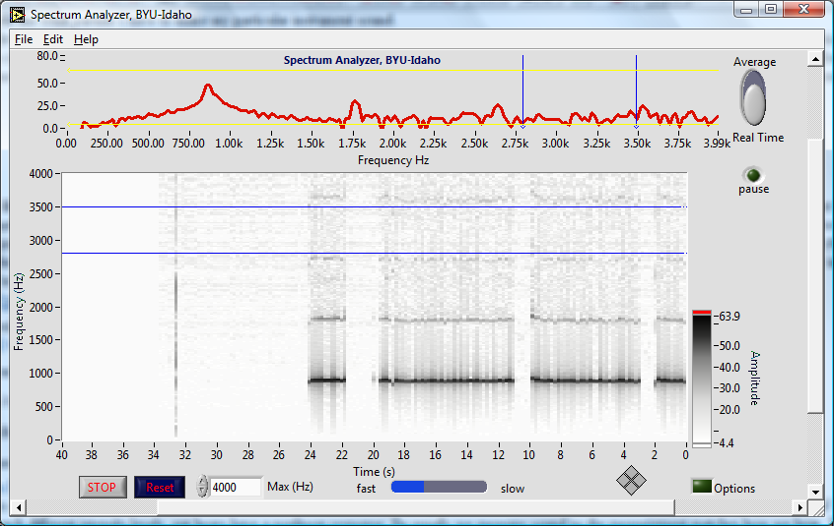
Peaks show partials

Slide 20
Strip chart also shows partials, darker black means higher peak
It is like looking at the graph above, but from above, and repeated for each second of playing

Slide 21
Notice that there are non-harmonic partials in this instrument too!

Slide 22
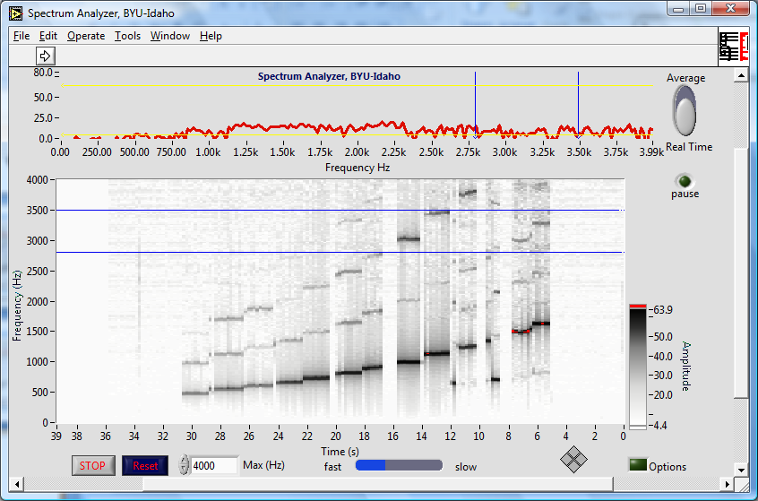
Bamboo six holed flute

Slide 23
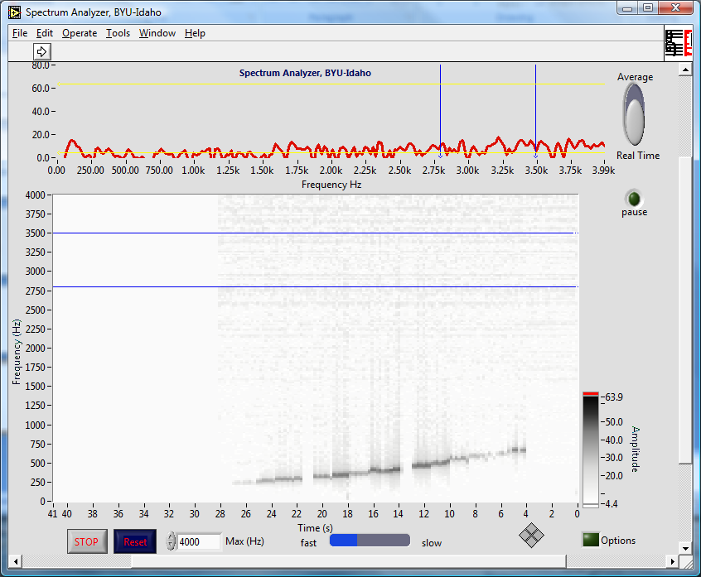
Ocarina

Slide 24
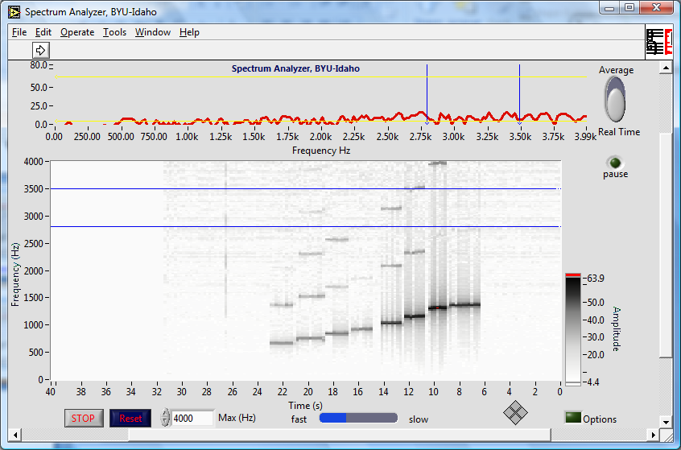
Recorder

Slide 25
Recorder

Slide 26
Question 223.9.3.1
We can make a sound spectrum to see what frequencies are in a complex sound. Are light signals also made of multiple frequencies?
Yes
No
This is all crazy

Slide 27
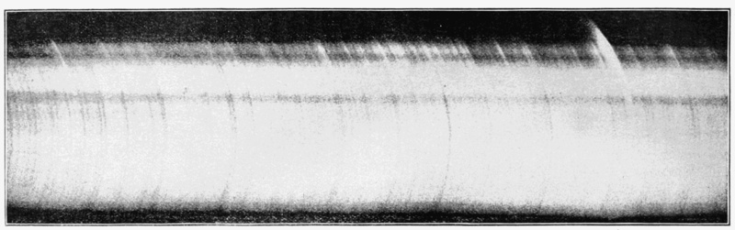
Application: Light Spectra

Slide 28


Slide 29
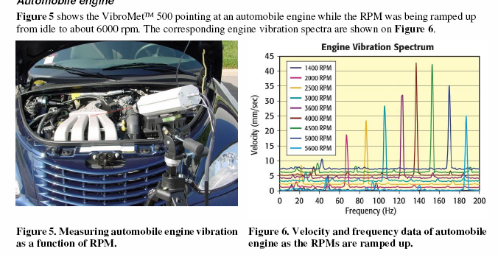
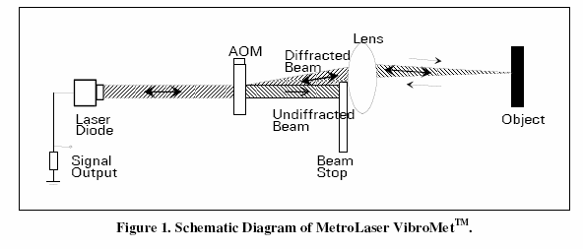
Application: Industrial Monitoring

Slide 30
Application, Vibrometry Target ID

Slide 31
Example: Square Wave

Slide 32
Example: Square Wave

Slide 33
Example: Square Wave, More Terms

Slide 34
Example: Square Wave

Slide 35
Question 223.9.3.2
If I make a wave signal last for less time, this will cause its frequency uncertainty to
Increase
Decrease
Stay the same
Explode

Slide 36
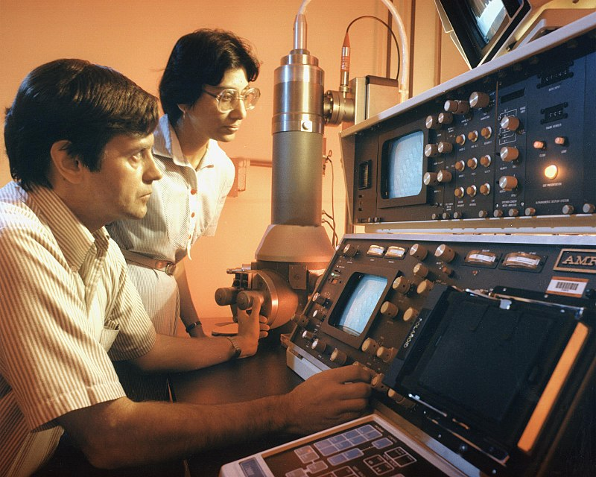
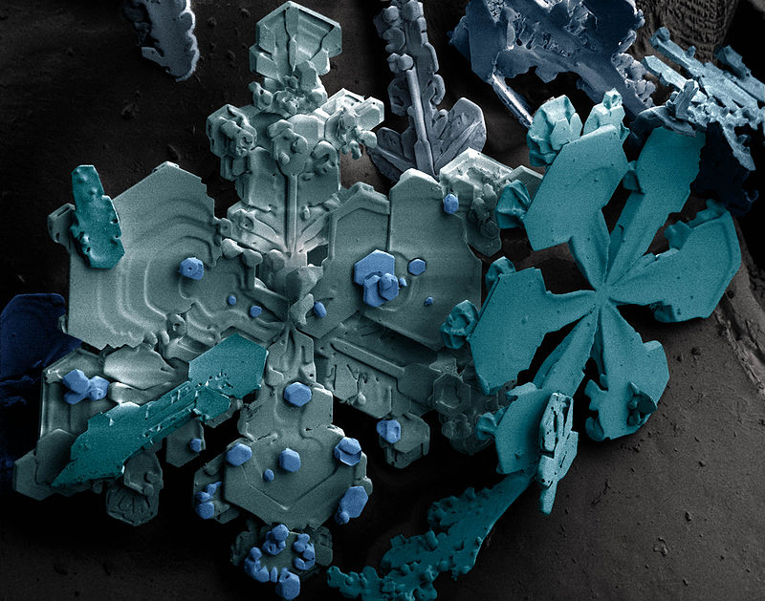
Electron Source
Condenser Lenses
Aperture
Sample
Objective Lens
Aperture
Projective Lens

Slide 38
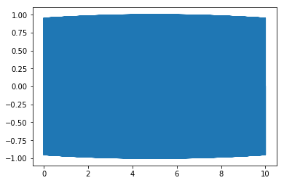
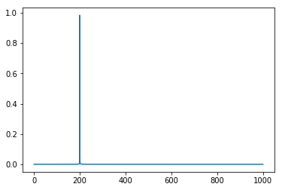
Time in seconds
Frequency in Hz
10s, 200Hz

Slide 39

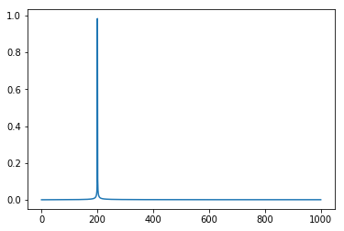
Time in seconds
Frequency in Hz
1sec, 200hz

Slide 40
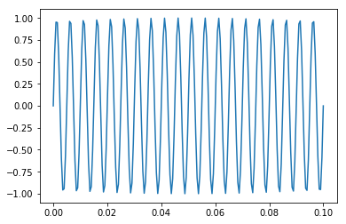
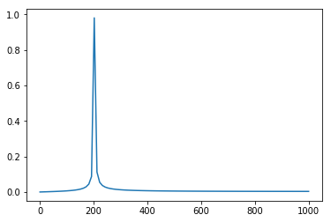
Time in seconds
Frequency in Hz
0.1 sec, 200hz

Slide 41
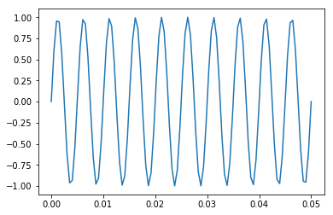
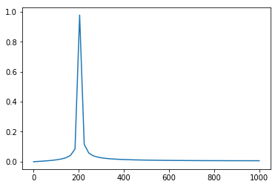
Time in seconds
Frequency in Hz
0.05 sec, 200hz

Slide 42
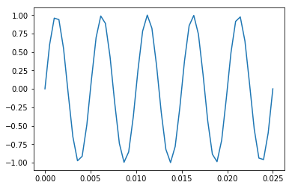
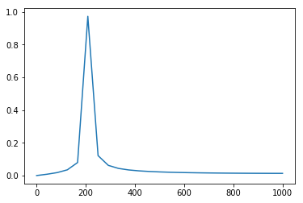
0.025 sec, 200hz

Slide 43
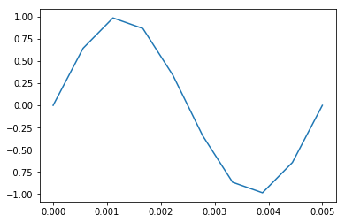
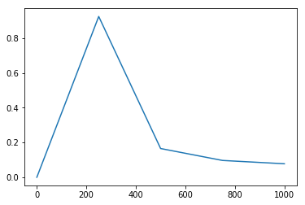
￼
Time in seconds
Frequency in Hz
0.005 sec, 200hz

