Slide 1
Lecture 11

Slide 2
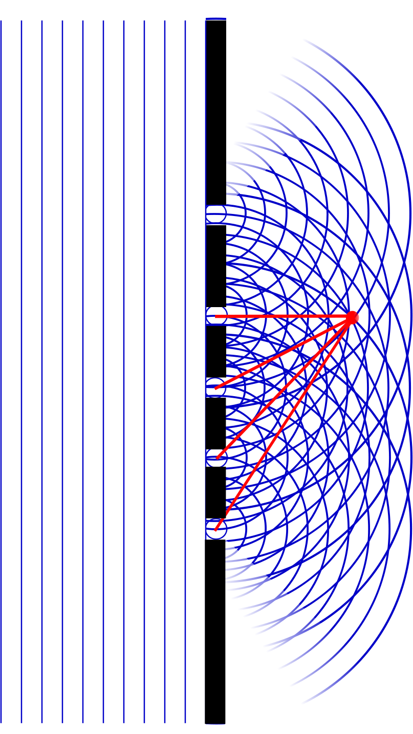
Question
At point A, there will be
Constructive interference
Destructive interference
Partial constructive interference
Partial destructive interference
A

Slide 4
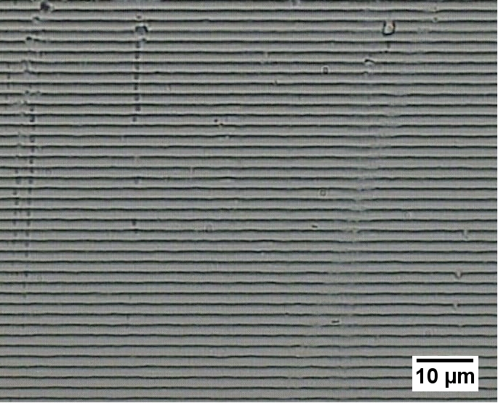

Slide 5
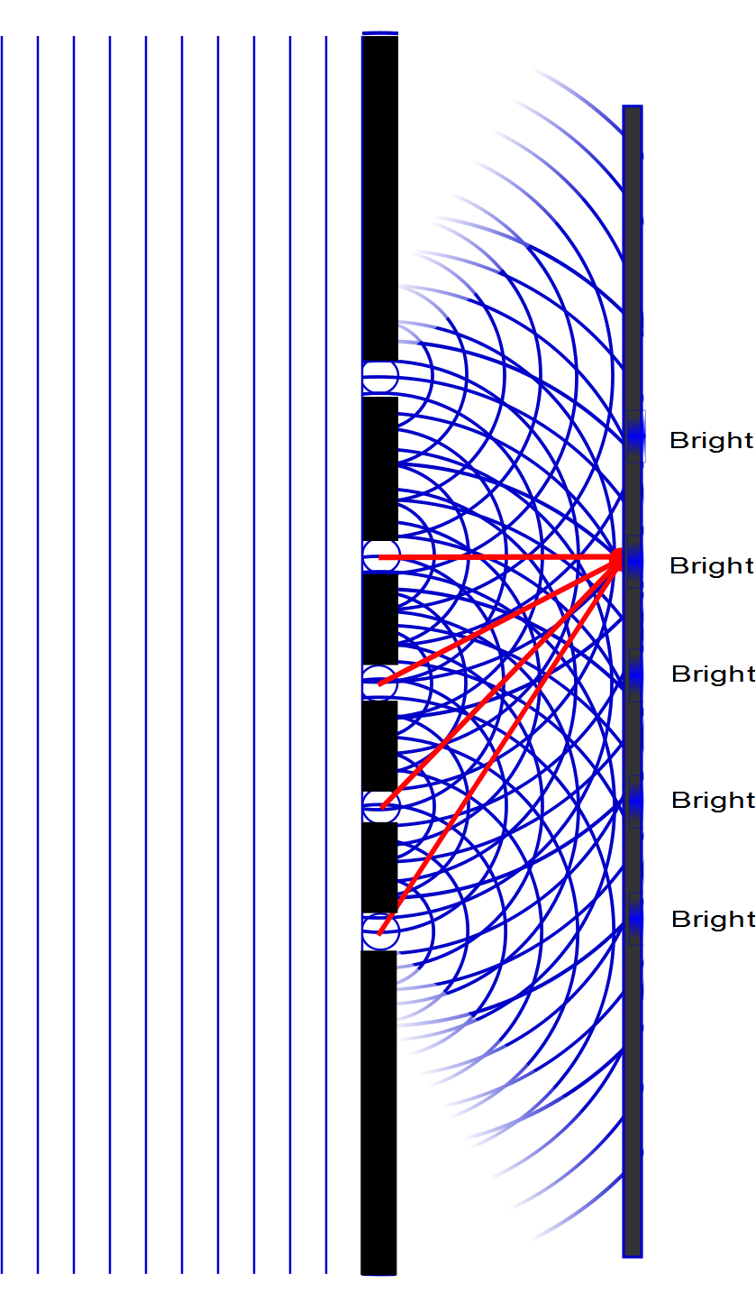

Slide 6
Question
Which will be a brighter spot, pint A or point B?
A
B
They will be the same
A
B

Slide 7
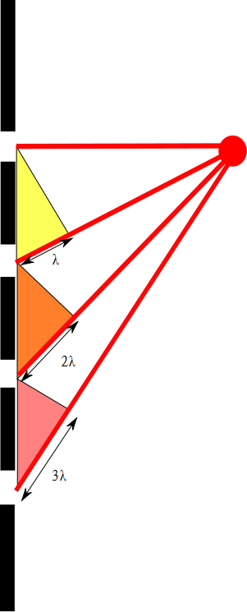

Slide 8
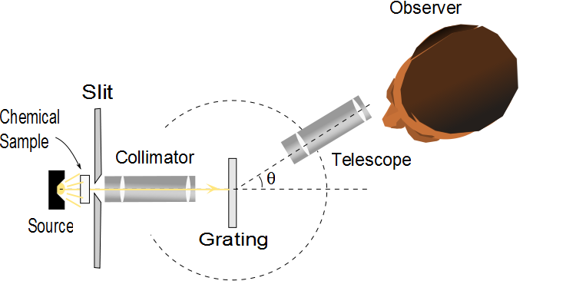
Diffraction Grating Spectrometer
The collimated beam is incident on the grating
The diffracted light leaves the gratings and the telescope is used to view the image
The wavelength can be determined by measuring the precise angles at which the images of the slit appear for the various orders

Slide 9
Details

Slide 10
Diffraction Grating, Intensity, cont.
Characteristics of the intensity pattern
The sharp peaks are in contrast to the broad, bright fringes characteristic of the two-slit interference pattern
Because the principle maxima are so sharp, they are much brighter than two-slit interference patterns

Slide 11
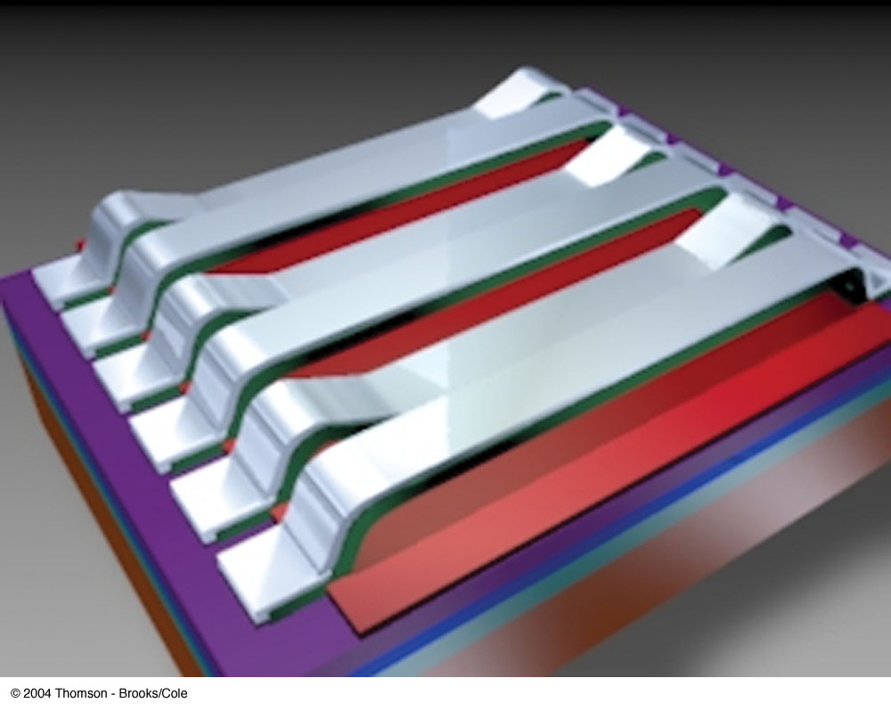
Grating Light Valve
A grating light valve consists of a silicon microchip fitted with an array of parallel silicon nitride ribbons coated with a thin layer of aluminum
When a voltage is applied between a ribbon and the electrode on the silicon substrate, an electric force pulls the ribbon down
The array of ribbons acts as a diffraction grating

Slide 12
Resolving Power of a Diffraction Grating
For two nearly equal wavelengths, λ₁ and λ₂, between which a diffraction grating can just barely distinguish, the resolving power, R, of the grating is defined as
Therefore, a grating with a high resolution can distinguish between small differences in wavelength

Slide 13
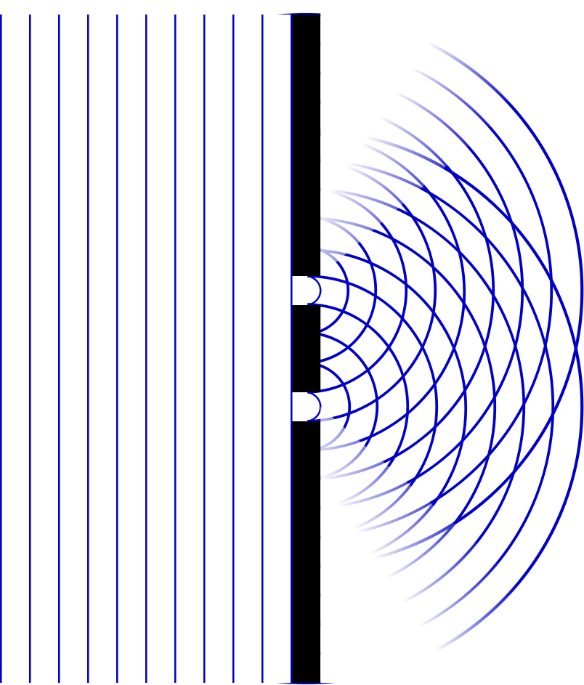
Question
Which will be a narrower, pint A or point B?
A
B
They will be the same
A
B

Slide 14
Single Slit Envelope
2 slits
Intensity pattern
3 slits
4 slits
5 slits
10 slits
100 slits

Slide 15
Resolving Power of a Diffraction Grating, cont
The resolving power in the mth-order diffraction is R = Nm
N is the number of slits
m is the order number
Resolving power increases with increasing order number and with increasing number of illuminated slits

Slide 16
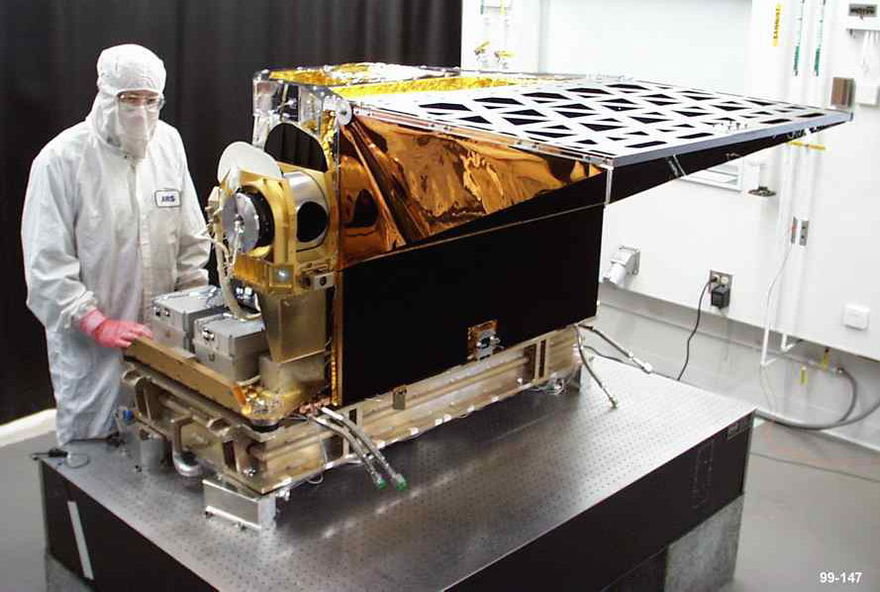
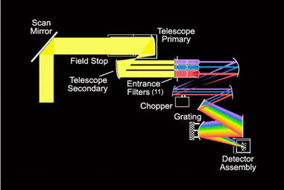
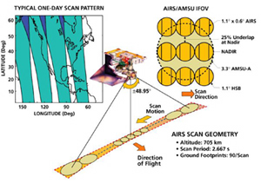

AIRS

Slide 17
Question
Light goes through just one slit. Will there be spots of destructive interference?
Yes
No
How could that work with just one light source?

Slide 18
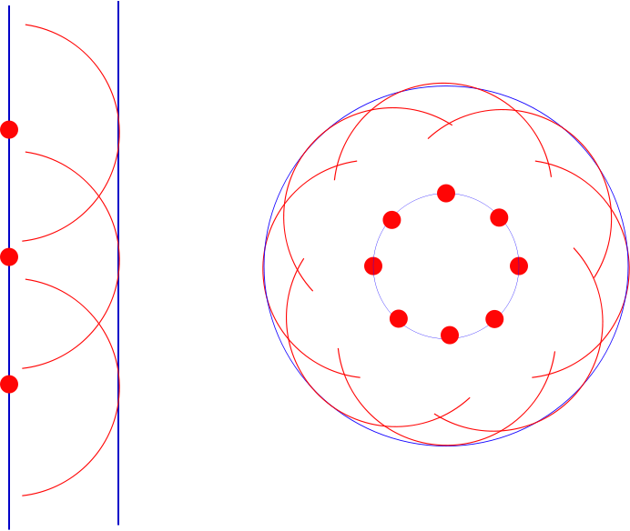

Slide 19
Question 223.11.0.1
1
What is the path difference between ray 1 and ray 2?
a)
b)
c)
d)
2
3
a/2
θ
a

Slide 20
Single-Slit Diffraction
a/2
θ
a

Slide 21
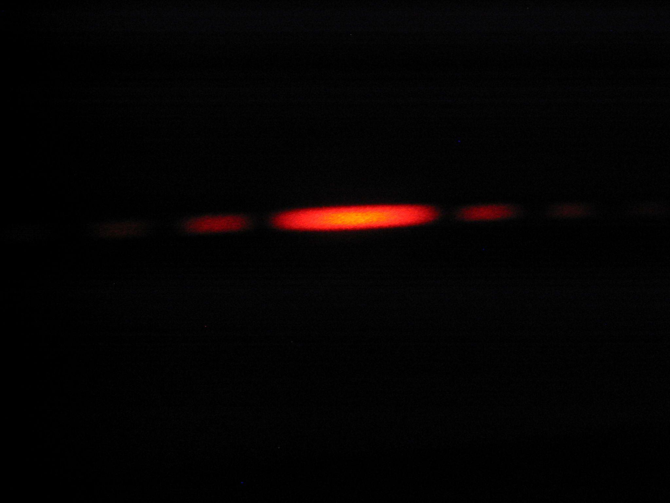
Diffraction Pattern, Single Slit
The diffraction pattern consists of the central maximum and a series of secondary maxima and minima
The pattern is similar to an interference pattern

Slide 22
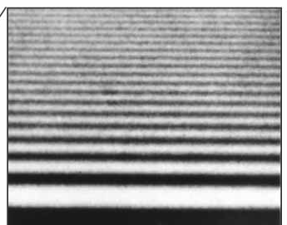
Diffraction Pattern, Object Edge
This shows the upper half of the diffraction pattern formed by light from a single source passing by the edge of an opaque object
The diffraction pattern is vertical with the central maximum at the bottom

Slide 23
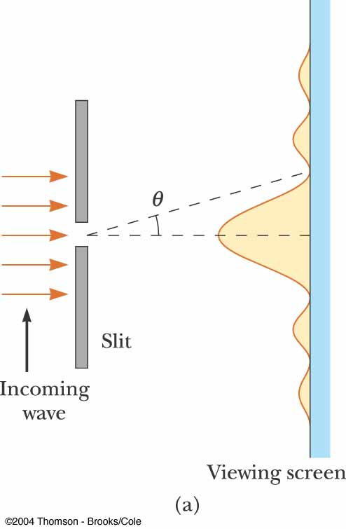
Fraunhofer Diffraction Pattern
A Fraunhofer diffraction pattern occurs when the rays leave the diffracting object in parallel directions
Screen very far from the slit
Could be accomplished by a converging lens

Slide 24
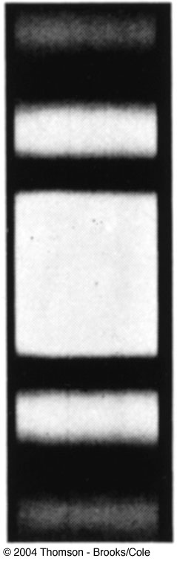
Fraunhofer Diffraction Pattern Photo
A bright fringe is seen along the axis (θ = 0)
Alternating bright and dark fringes are seen on each side

Slide 25
Diffraction vs. Diffraction Pattern
Diffraction refers to the general behavior of waves spreading out as they pass through a slit
A diffraction pattern is actually a misnomer that is deeply entrenched
The pattern seen on the screen is actually another interference pattern
The interference is between parts of the incident light illuminating different regions of the slit

Slide 26
Single-Slit Diffraction
5
4
3
2
1
a/2
a
θ

Slide 27
Single-Slit Diffraction
a/6
a
θ

Slide 28
Single-Slit Diffraction, 2
The resultant light intensity on a viewing screen depends on the direction θ
The diffraction pattern is actually an interference pattern
The different sources of light are different portions of the single slit

Slide 29
Single-Slit Diffraction, Analysis
All the waves that originate at the slit are in phase
Wave 1 travels farther than wave 3 by an amount equal to the path difference
(a/2) sin θ
If this path difference is exactly half of a wavelength, the two waves cancel each other and destructive interference results
In general, destructive interference occurs for a single slit of width a when sin θ_{dark} = mλ / a
m = ±1, ±2, ±3, …

Slide 30
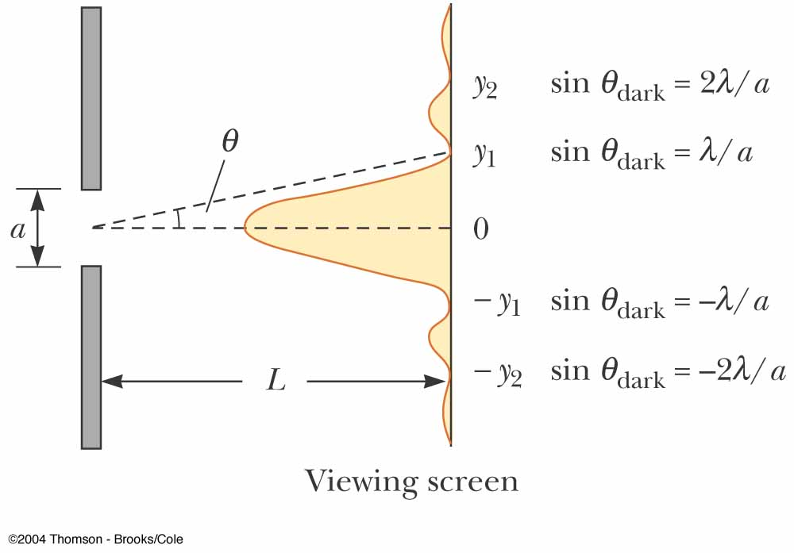
Question 223.11.1
Suppose you have a single slit diffraction pattern. If you increase the size of the slit, the size of the central maximum
Becomes wider
Becomes narrower
Stays the same
Fades to non-existent

Slide 31
Diffraction from Narrow Slits

Slide 32
Single-Slit Diffraction, Intensity
The general features of the intensity distribution are shown
A broad central bright fringe is flanked by much weaker bright fringes alternating with dark fringes
Each bright fringe peak lies approximately halfway between the dark fringes
The central bright maximum is twice as wide as the secondary maxima

Slide 33
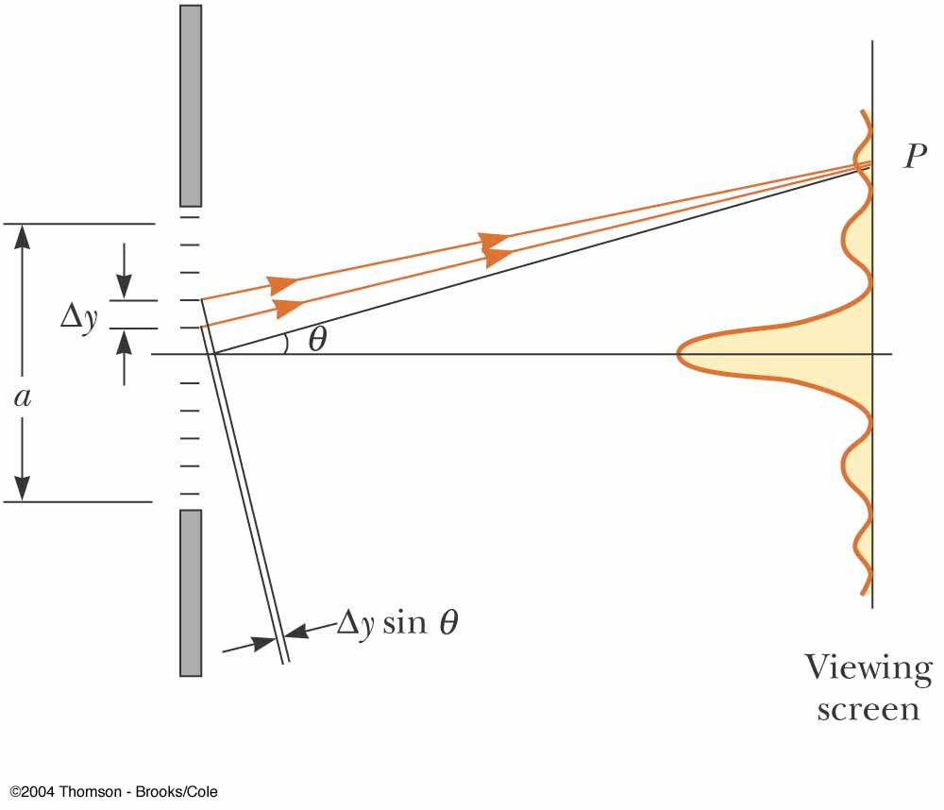
Intensity of Single-Slit Diffraction Patterns
Phasors can be used to determine the light intensity distribution for a single-slit diffraction pattern
Slit width a can be thought of as being divided into zones
The zones have a width of Δy
Each zone acts as a source of coherent radiation

Slide 34
Intensity
The intensity can also be expressed as
Minima occur at

Slide 35
sinc(x)

Slide 36
(sinc(x))²

Slide 37

I
Interference fringes:
due to having a single slit
-2π
-π
π
2π
φ/2

Slide 38
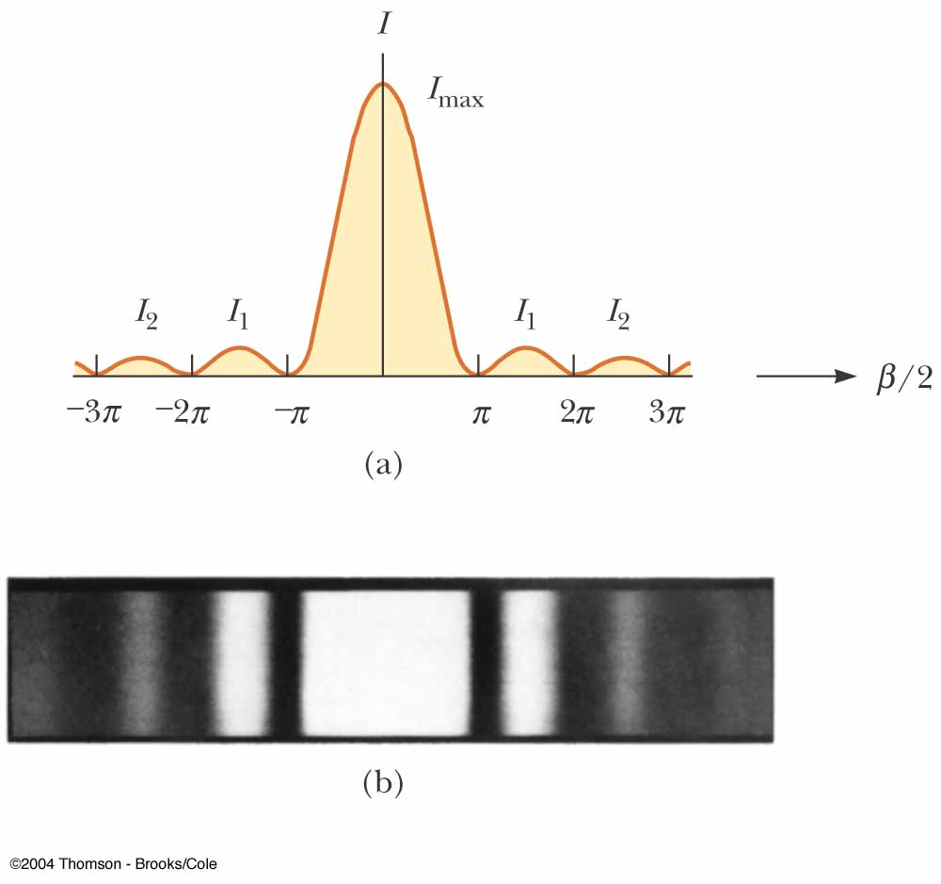
Intensity, final
Most of the light intensity is concentrated in the central maximum
The graph shows a plot of light intensity vs. β/2

Slide 39
Intensity of Two-Slit Diffraction Patterns
When more than one slit is present, consideration must be made of
The diffraction patterns due to individual slits
The interference due to the wave coming from different slits
The single-slit diffraction pattern will act as an “envelope” for a two-slit interference pattern

Slide 40
Intensity Equation
To determine the maximum intensity:
The factor in the square brackets represents the single-slit diffraction pattern
This acts as the envelope
The two-slit interference term is the cos² term

Slide 41
Missing Maxima
To find which interference maximum coincides with the first diffraction minimum
The conditions for the first interference maximum
d sin θ = mλ
The conditions for the first diffraction minimum
a sin θ = λ

Slide 42
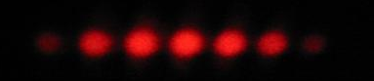
I
Interference fringes:
due to having two slits.
φ/2
-5π
-3π
-π
π
3π
5π

Slide 43
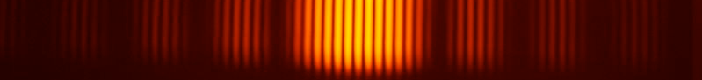
Diffraction envelope:
The single slit pattern due to shape of the individual slits.
I
Interference fringes:
due to having two slits.
φ/2
-3π
-2π
-π
π
2π
3π

