Slide 1
Lecture 12

Slide 2
Question 223.12.1
I have a single slit illuminated by a laser. The slit width is a and the light that passes through the slit lands on the screen, a distance L away. If the screen is moved farther away, the size of the central spot will
Increase
Decrease
Stay the same
Impossible to tell

Slide 3
Question 223.12.3
I have a circular aperture illuminated by a laser. The aperture Diameter is D and the light that passes through the slit lands on the screen, a distance L away. If the aperture size increases, the size of the central spot will
Increase
Decrease
Stay the same
Impossible to tell

Slide 4
First Minimum
Circular Aperture
θ
D
w
Central Maximum
Intensity Pattern
L

Slide 8
Question 223.12.4
I have a laser pointer with a wavelength of 632nm and a beam profile that is about half a millimeter across. I shine it through a circular aperture with a diameter of 1m. About how big is the central spot on a screen 10m away?
6.1683 x 10⁻⁶m
A few millimeters
Maybe a centimeter or two
About a meter

Slide 9
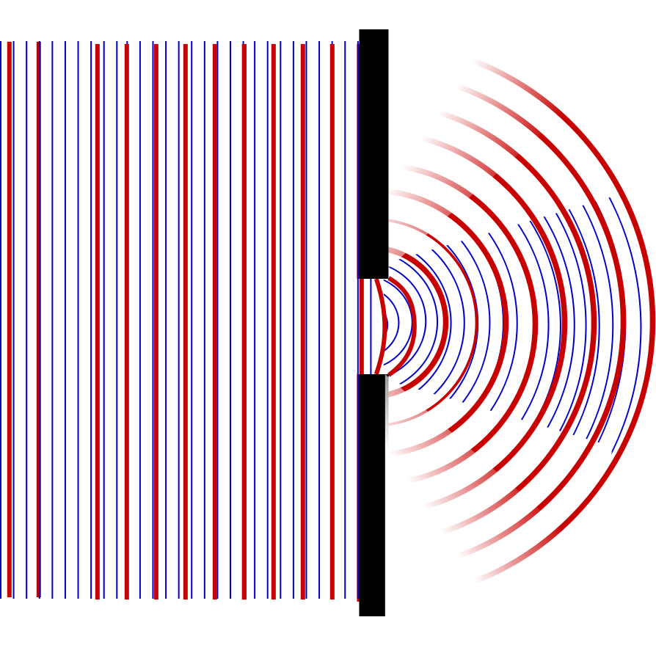

Slide 10
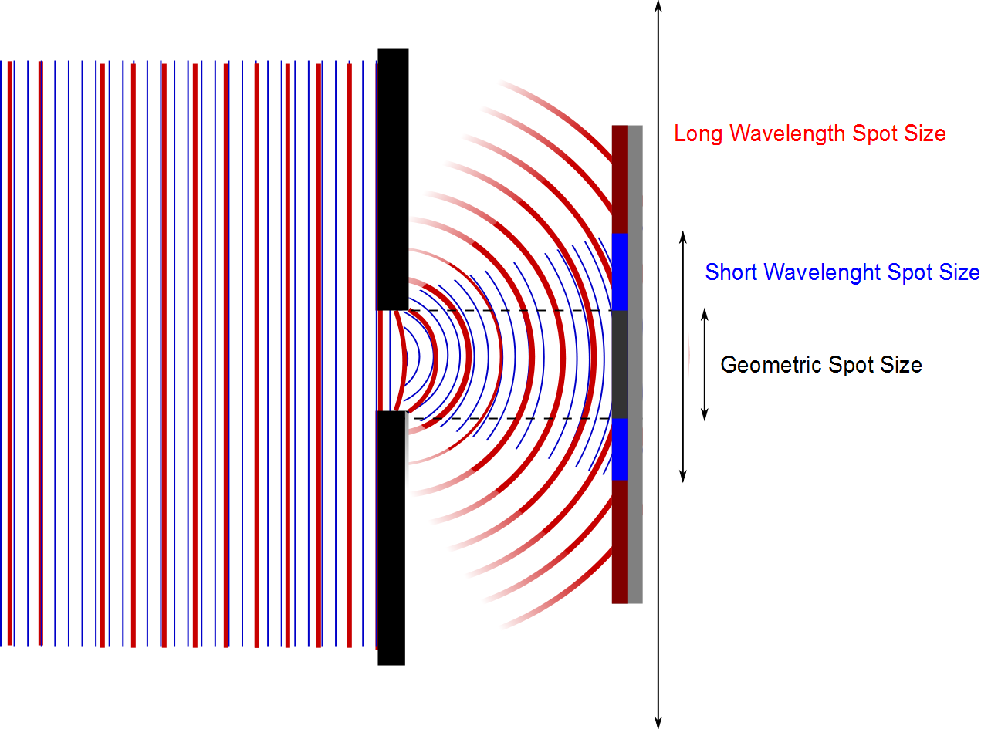

Slide 11
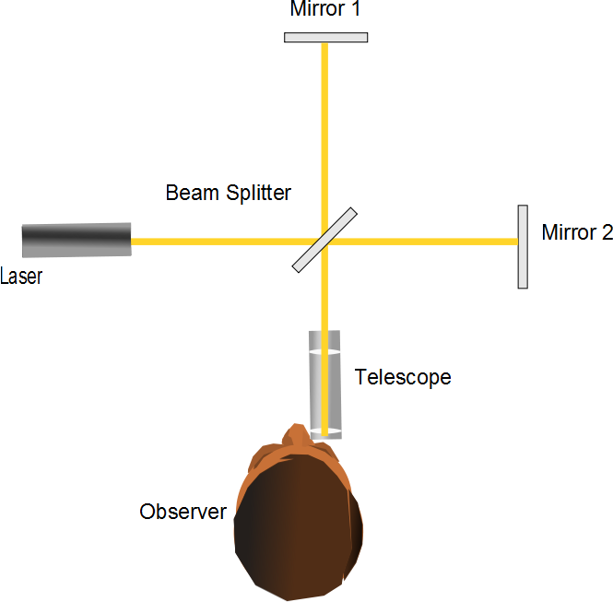
L₁
L₂

Slide 12
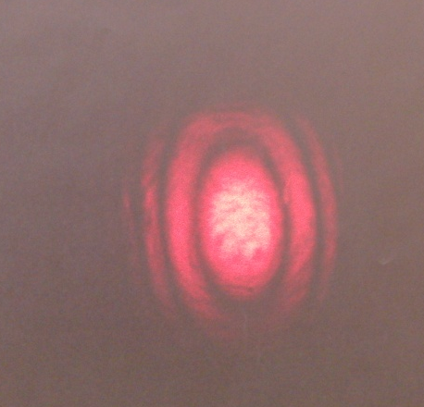
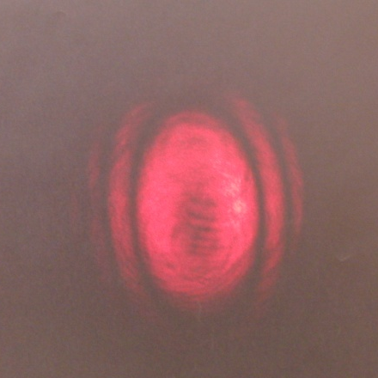
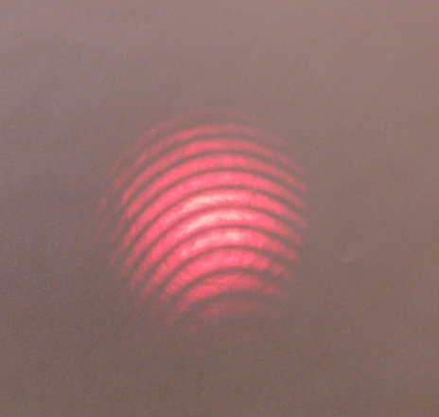
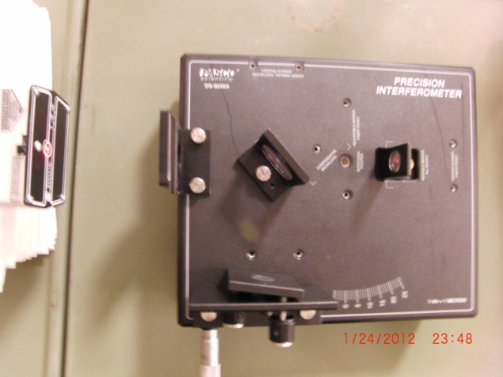
Bright Center
Dark Center
Small Off-Center Fringes
To Screen
Laser
Movable Mirror
Beam Splitter
Fixed Mirror

Slide 13
Holography
Beam Splitter
Mirror)
Light from laser expanded with beam expander
Interference Pattern
(Hologram)
Object

Slide 14
Holography Reconstruction
Mirror)
Light from laser expanded with beam expander
Interference Pattern
(Hologram)
Reconstructed Image of Object

Slide 15
Diffraction of X-Rays by Crystals
X-rays are electromagnetic waves of very short wavelength
Max von Laue suggested that the regular array of atoms in a crystal could act as a three-dimensional diffraction grating for x-rays

Slide 16
Incident Beam
Reflected Beam
θ
θ
First Row of Atoms
d
θ
Second Row of Atoms

Slide 17
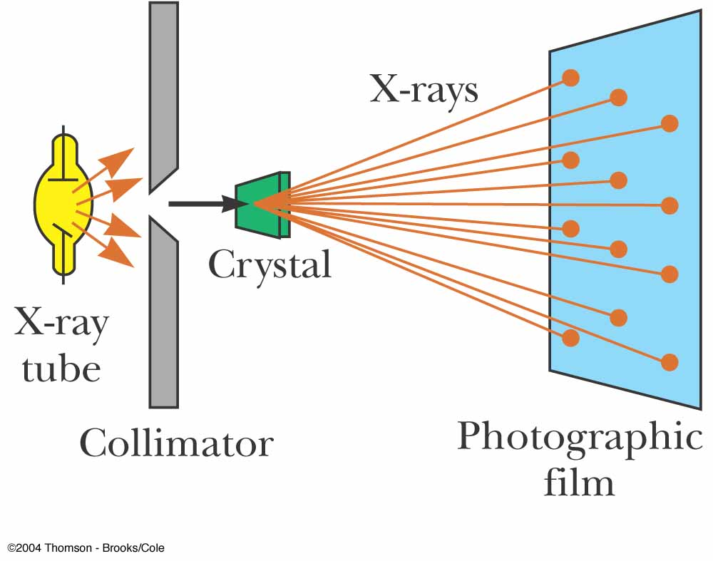
Diffraction of X-Rays by Crystals, Set-Up
A collimated beam of monochromatic x-rays is incident on a crystal
The diffracted beams are very intense in certain directions
This corresponds to constructive interference from waves reflected from layers of atoms in the crystal
The diffracted beams form an array of spots known as a Laue pattern

Slide 18
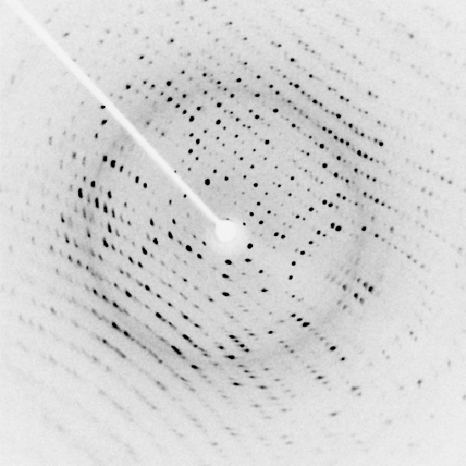

Slide 19
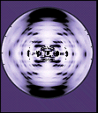

Slide 20
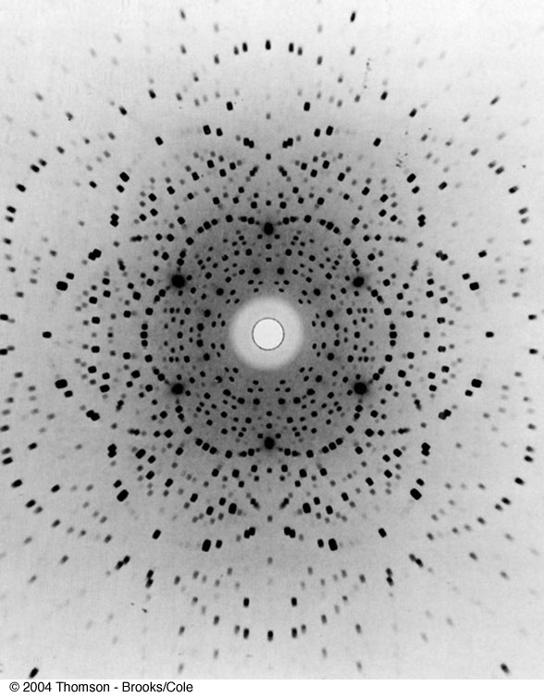
Laue Pattern for Beryl

Slide 21
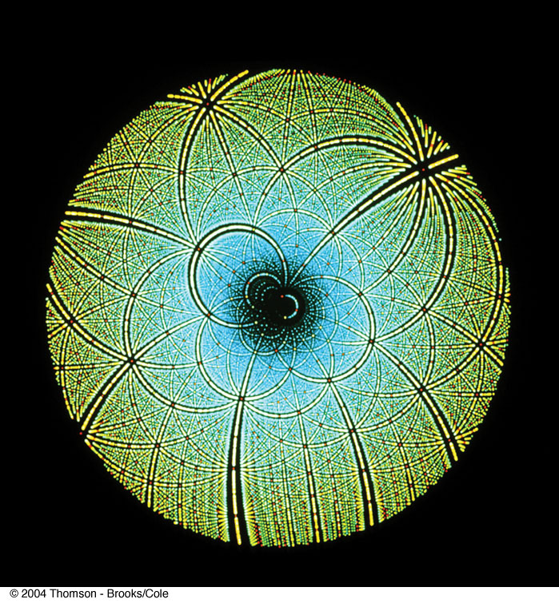
Laue Pattern for Rubisco

Slide 22
Question 223.13.0.6
I have radar waves (λ = 3.2cm) that illuminate a circular aperture with diameter of 2mm. Will the wave nature of light be important?
Yes
No
Maybe

