Slide 1
Question 223.13.0.6
I have radar waves (λ = 3.2cm) that illuminate a circular aperture with diameter of 2mm. Will the wave nature of light be important?
Yes
No
Maybe

Slide 2
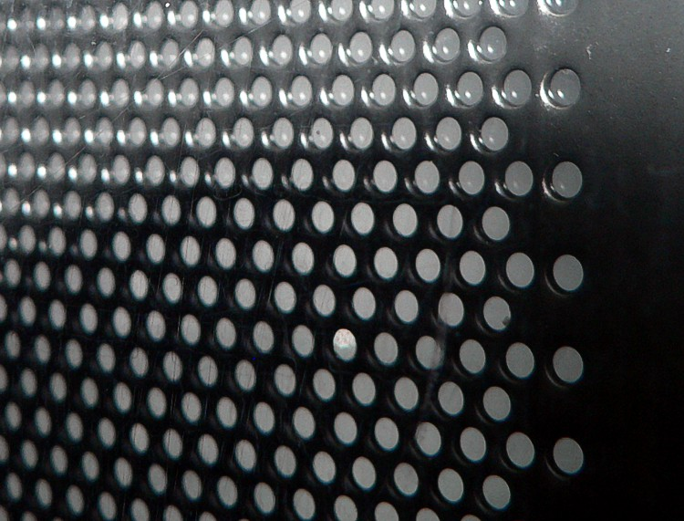

Slide 3
Question 223.13.0.5
I have radar waves (λ = 3.2cm) that illuminate a circular aperture with diameter of 2m. Will the wave nature of light be important?
Yes
No
Maybe

Slide 4
Question 223.13.0.7
I have radar waves (λ = 3.2cm) that illuminate a circular aperture with diameter of 3.2cm. Will the wave nature of light be important?
Yes
No
Take another physics class to find out

Slide 5
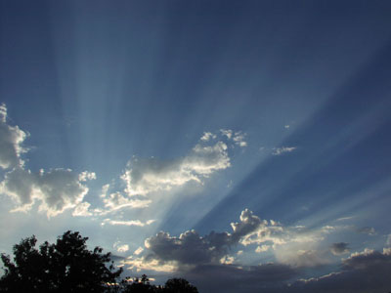
Question 223.13.1
You are in the western US and you observe a dramatic sunset. The Sun is descending through a bank of clouds and you see light and dark bands . What is causing these?
Constructive and Destructive Interference from the light traveling through small slits in the mountains
Constructive and Destructive Interference from the light traveling through small openings in the clouds
The dark bands are cloud or mountain shadows
Crepuscular rays: Image public domain http://commons.wikimedia.org/wiki/File:Crepuscular_rays.jpg

Slide 6


Slide 7
Question 223.13.1.5
If I take two light bulbs near each other, will I observe interference where the light from the bulbs meet?
Yes
No

Slide 8
Question 223.13.2
Will light from two sources that starts in phase necessarily stay in phase?
Yes, if the initial phase is the same, the light will stay in phase
No, the light might have different wavelengths, which will cause the phase to diverge
No, The light might take different paths, which would cause a relative phase

Slide 13
Question 123.13.3
Which of the following would likely be a coherent source?
Laser
Light bulb
Glow stick
Radio transmission
Black body emission

Slide 14
Question 223.13.4
I have a ray of light traveling from left to right across the room near the front. Can you see the ray?
No
Yes
I can see only part of the ray

Slide 15
Wave Crests
Rays

Slide 16
Question 9.1
A specular reflector is ……..
A reflector that is spectacular!
One that can cook a hot dog
Like a mirror
A rough surface

Slide 17
Rays

Slide 18
Question 223.13.5
A laser beam is incident on a glass sheet. There is no apparent reflected ray. We might conclude that…
The glass has a high index of refraction
The glass surface is rough
The glass has a low index of refraction
The glass is opaque

Slide 20
Question 35.3.6
I have a neat demo on the board where light goes from left to right. You can see the path the light takes. How can this be?
The light ray is a different color than the laser, so I can see it.
The light ray must follow the law of reflection, so it must be bouncing back along it’s original path
The light ray must be hitting dust in the air as it travels, so we see the scattered light from the dust.
The light is not a single ray, and part of the light beam it hits the board, sending rays to my eyes

Slide 21
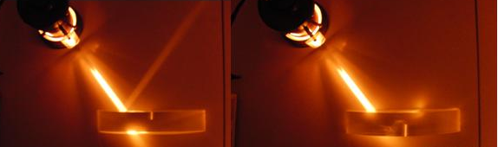

Slide 22
Question 9.2
A diffuse reflector is ……..
A reflector that is spectacular!
One that can cook a hot dog
Like a mirror
A rough surface

Slide 23
Question 223.13.6
Are most natural surfaces diffuse or specular reflectors?
Diffuse
Specular

Slide 24
θ_{i}
θ_{r}

Slide 25
Law of Reflection, cont.
The angle of reflection is equal to the angle of incidence
θ₁’= θ₁
This relationship is called the Law of Reflection
The incident ray, the reflected ray and the normal are all in the same plane

Slide 26
Retroreflection
Assume the angle between two mirrors is 90º
The reflected beam returns to the source parallel to its original path
This phenomenon is called retroreflection
M₂
Incident Light
40.0°
1.25m
M₁

Slide 27
Retroreflection
Assume the angle between two mirrors is 90º
The reflected beam returns to the source parallel to its original path
This phenomenon is called retroreflection
θ₄
θ₃
θ₁
θ₂
α

Slide 28
Question 223.13.7
An observer at point O is facing a mirror and observes a light source S. Where does the observer perceive the mirror image of the source to be located?
mirror
O
3
1
S
2
4

Slide 29
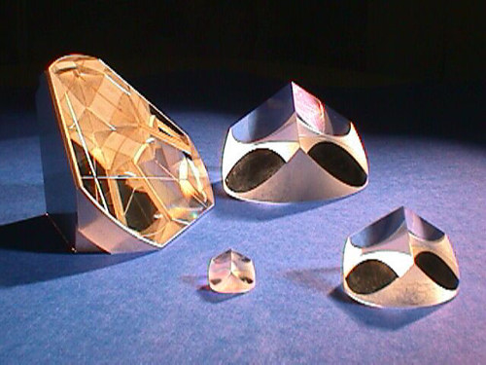

Slide 30
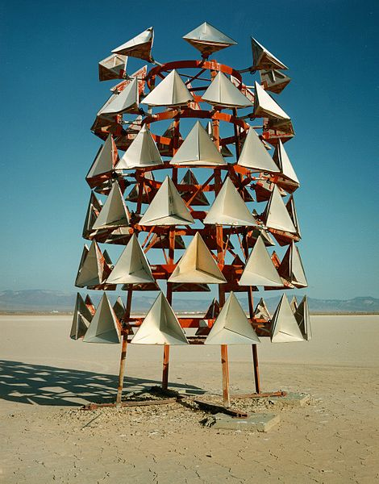
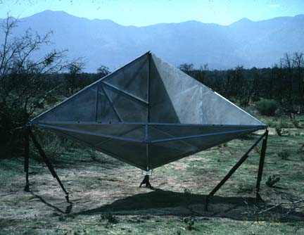
Retroreflectors

Slide 31
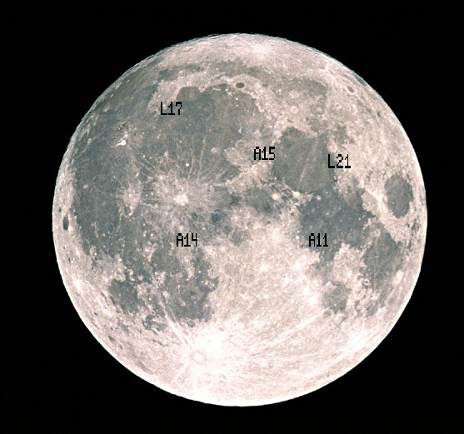
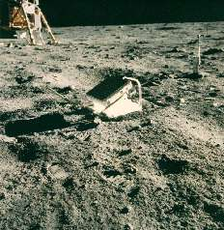
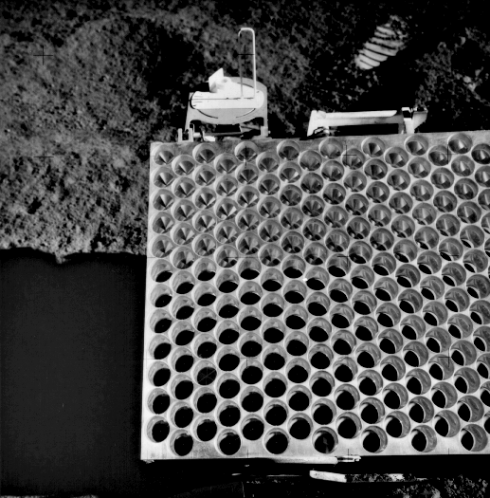
Apollo Retro-reflectors

Slide 32
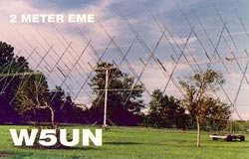
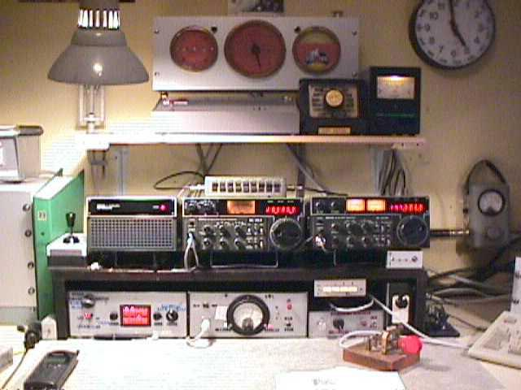
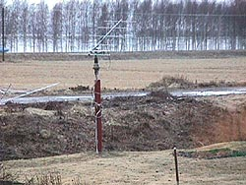
Try it at Home
Amateur Radio Moonbounce Communication
http://www.arrl.org/news/features/2002/01/21/1/

Slide 33
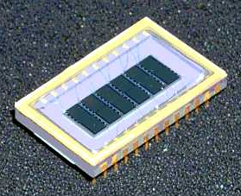
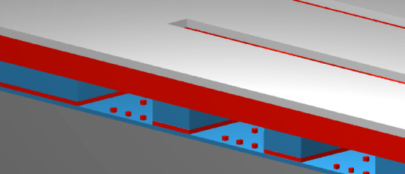
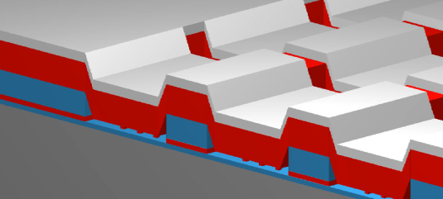
Micro Mirror Arrays
A high-tech example is the new micro-mirror arrays
ITT version
Metal “Mirror”
+-
GEMS Device Off-State
GEMS Device On-State
6 channel GEMS Device
(50 Channel Device is in Development)

Slide 34
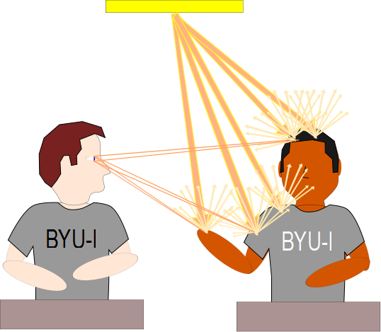

Slide 35
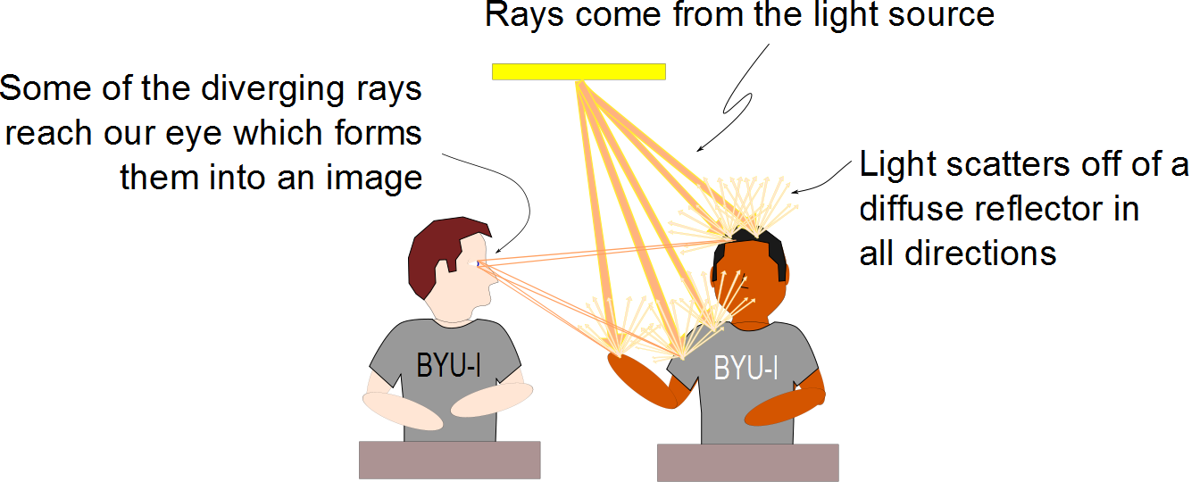

Slide 36
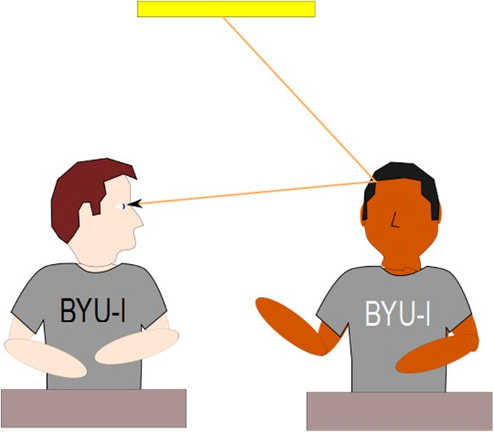
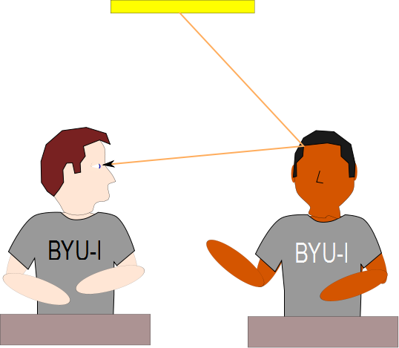

Slide 37
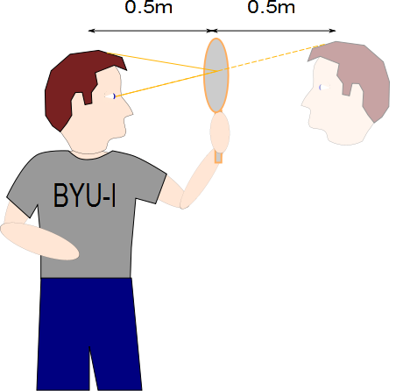

Slide 38
Question 223.13.8
In the movies, you sometimes see an actor looking in a mirror and you can see his face in the mirror. During the filming of this scene, what does the actor see in the mirror?
his face
your face
the director’s face
the movie camera
impossible to determine

Slide 39
Question 223.13.9
When watching the Moon over the ocean, you often see a long streak of light on the surface of the water. This occurs because:
the Moon is very large
atmospheric conditions are just right
the ocean is calm
the ocean is wavy
motion of the Moon
G

Slide 40
Question 223.13.10
You hold a hand mirror 0.5 m in front of you and look at your reflection in a full-length mirror 1 m behind you. How far in back of the big mirror do you see the image of your face?
0.5 m
1.0 m
1.5 m
2.0 m
2.5 m
G

Slide 41
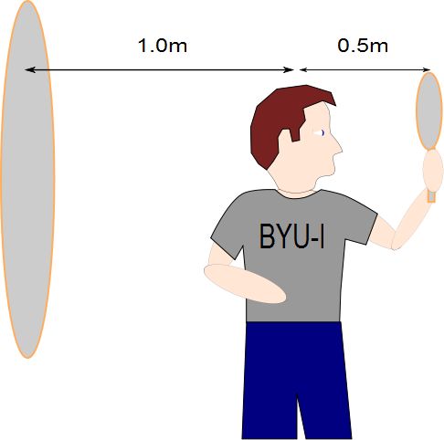
Question 223.13.11
The image of the man’s face in the small mirror will be half a meter away. How far away from the large mirror will the image of this image be?
Half a meter
A meter
1.5 meters
2 meters
What are you talking about?

Slide 42
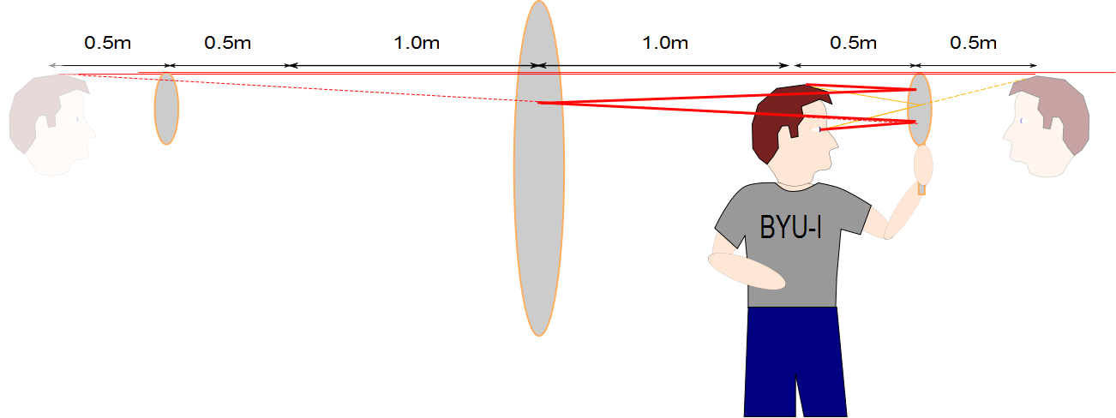

Slide 43
Question 35.3.8
I have light emitted from a point source as shown. What would the wave front’s look like?
Lines converging on the point source
Lines leaving the point source
Concentric circles centered on the point source
Concentric spheres centered on the point source

