Slide 1
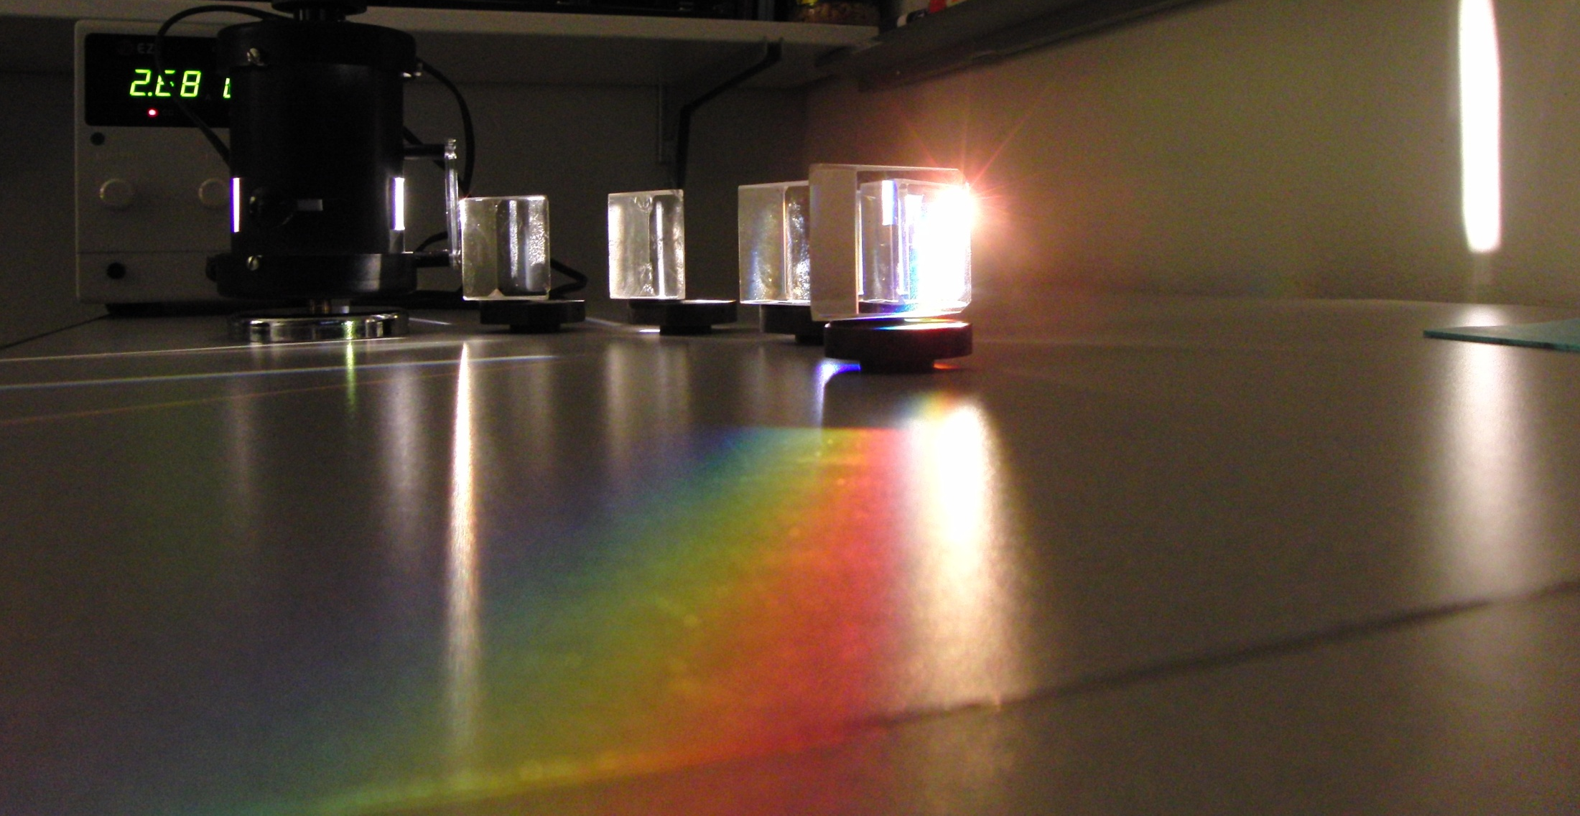
Lecture 15

Slide 2
Question 223.15.1
Consider the prism to your right. If we illuminate it with white light, which color will be at the top of the rainbow?
Red
Yellow
Green
Blue
Violet
White Light

Slide 3
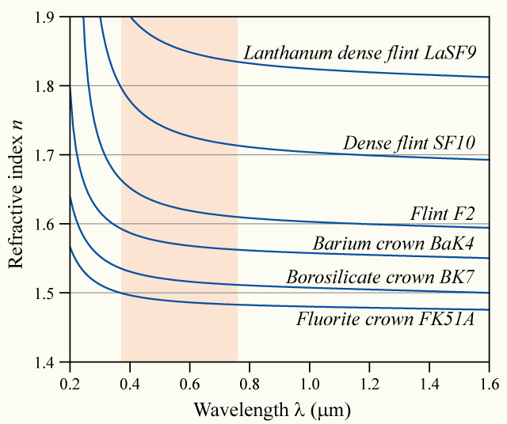

Slide 4
δ_{R}
White Light
δ_{B}
Red
Blue

Slide 5
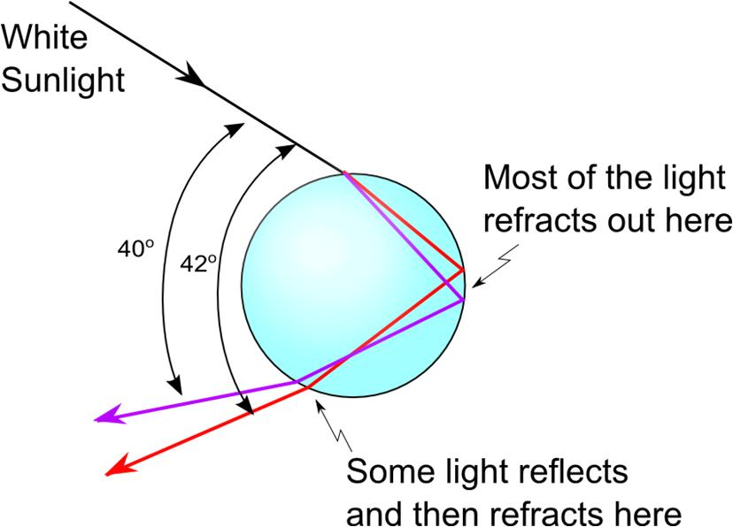

Slide 6
Light of wavelength 700nm is incident on the face of a fused quartz prism at an angle of 75.0℃ (with respect to the normal to the surface). The apex angle of the prism is 60.0℃ . Use the value of n=1.458 and calculate the angle
of refraction at this first surface,
of incidence at the second surface,
of refraction at the second surface, and
between the incident and emerging rays.

Slide 7
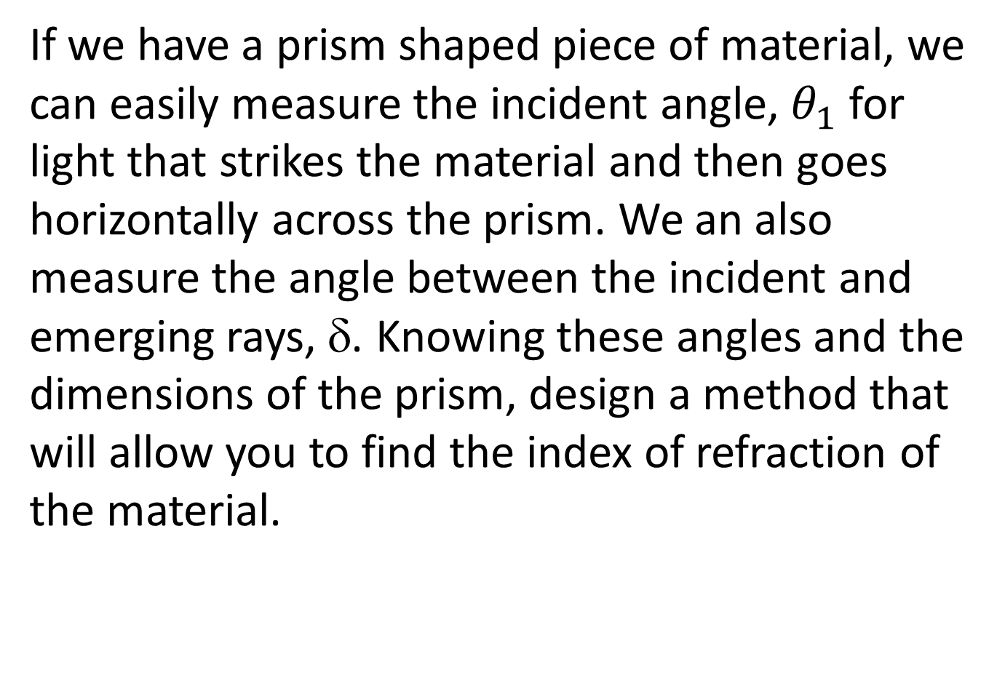
If we have a prism shaped piece of material, we can easily measure the incident angle, $θ_{1}$ for light that strikes the material and then goes horizontally across the prism. We an also measure the angle between the incident and emerging rays, δ. Knowing these angles and the dimensions of the prism, design a method that will allow you to find the index of refraction of the material.

Slide 8
Finding δ
Φ/2
δ
η
φ
φ
φ
β
θ₁
α
α
θ₁
θ₂
θ₂
n

Slide 9
Question 223.15.2
You build a prism out of a thin walled container filled with water. If the water prism is immersed in a tank of water, does it still make a rainbow?
Yes
No
Can’t tell

Slide 10
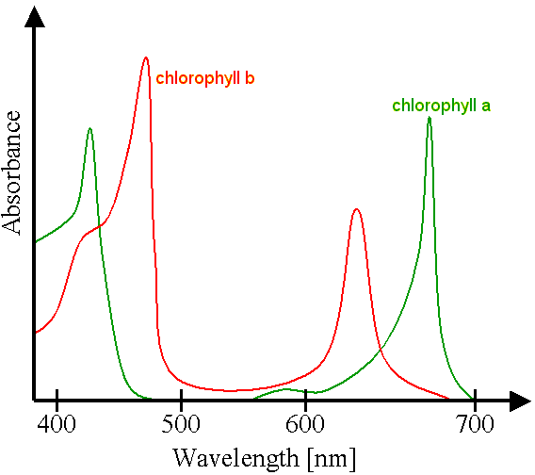

Slide 11


Image courtesy NASA (http://www.nasa.gov/centers/goddard/news/topstory/2004/0510westdrought.html)

Slide 12
Question 223.15.4
What type of lens is a simple magnifier?
Convex
Concave
Diverging
Converging
More than one of the above

Slide 13
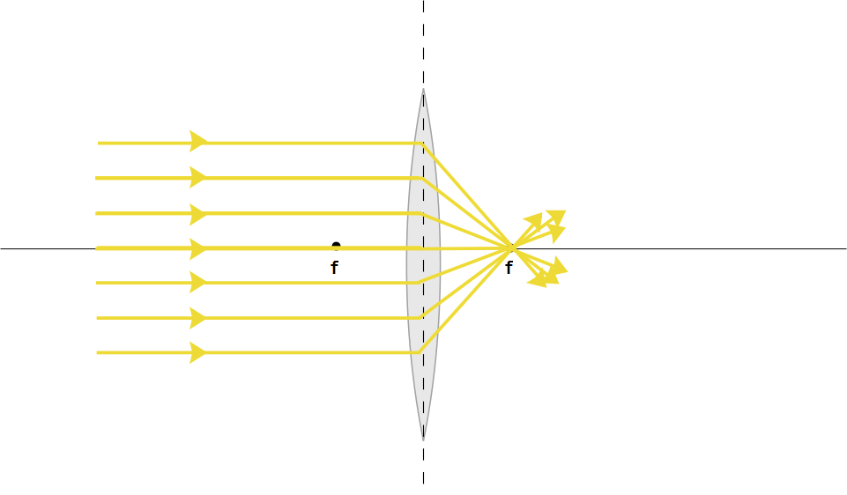

Slide 14
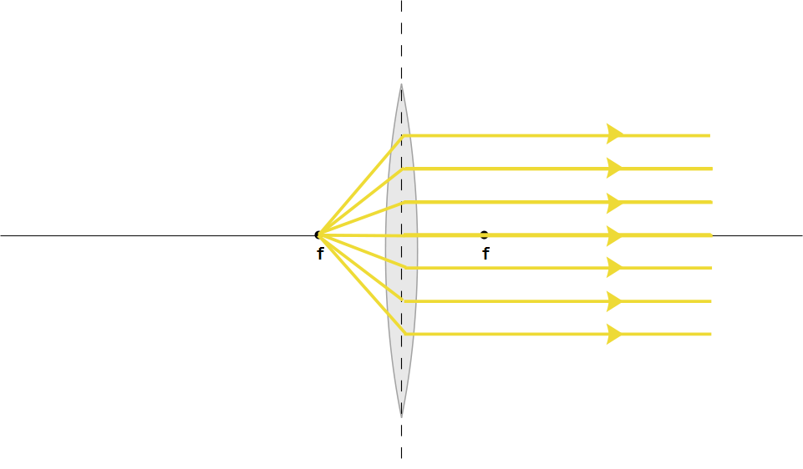

Slide 16
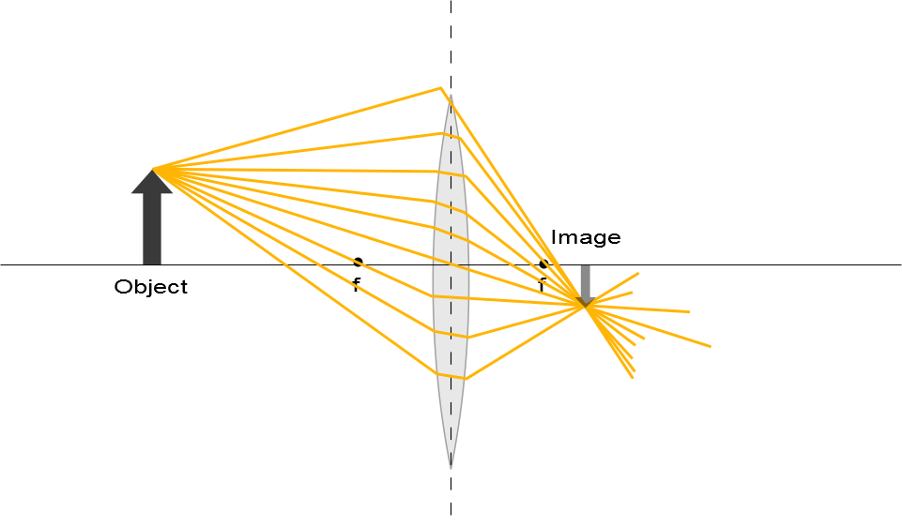

Slide 17
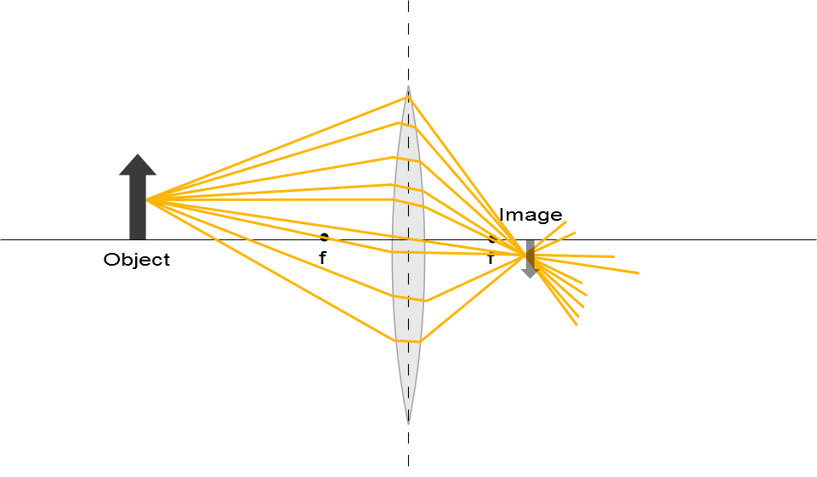

Slide 19
Question 223.15.6
A
f
f
f
f
B
f
f
A ray enters a lens as shown above. Which of the choices to the right shows how the ray will exit the lens?
C
f
f

Slide 20
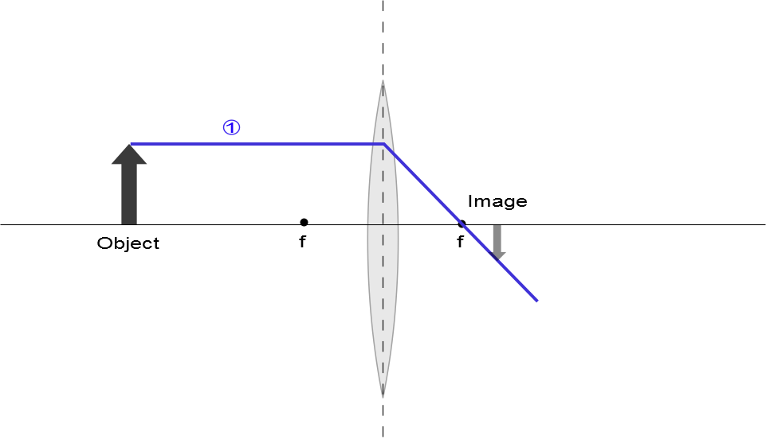

Slide 21
Question 223.15.8
A
f
f
f
f
B
f
f
A ray enters a lens as shown above. Which of the choices to the right shows how the ray will exit the lens?
C
f
f

Slide 22
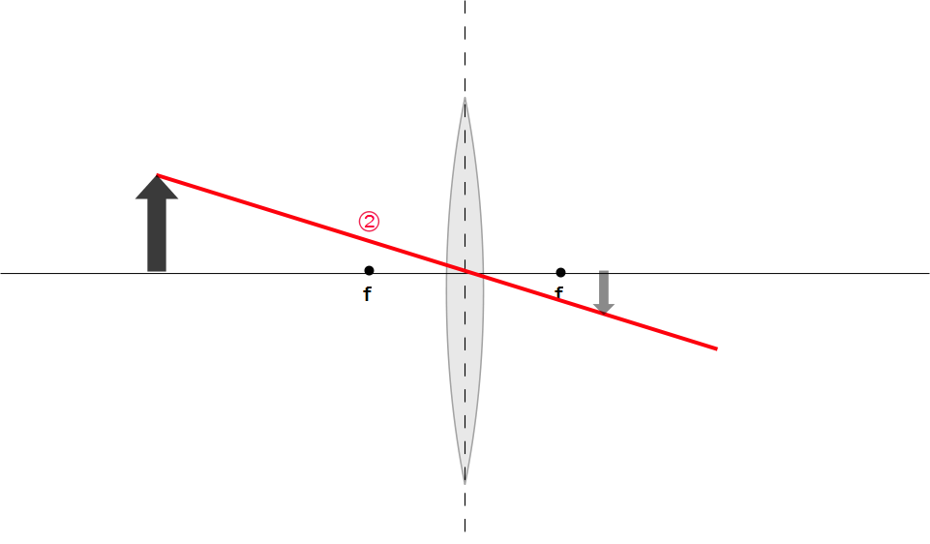
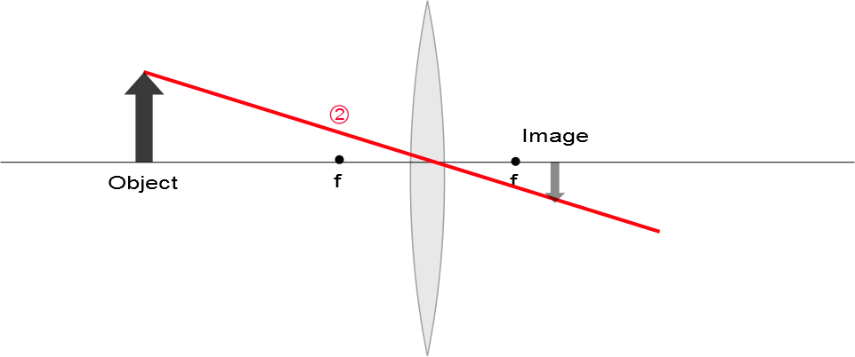

Slide 23
Question 223.15.7
A
f
f
f
f
B
f
f
A ray enters a lens as shown above. Which of the choices to the right shows how the ray will exit the lens?
C
f
f

Slide 24
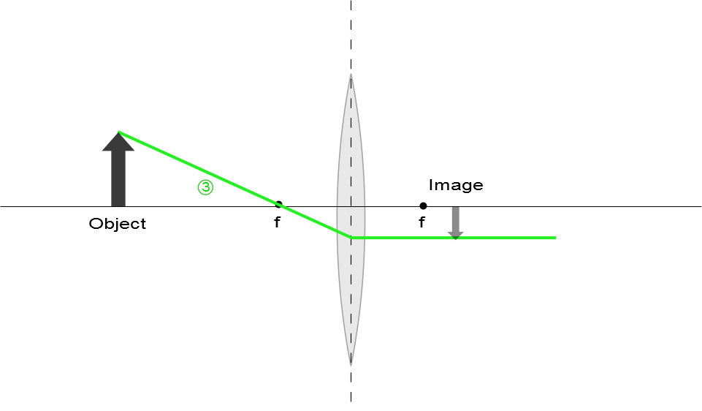

Slide 25
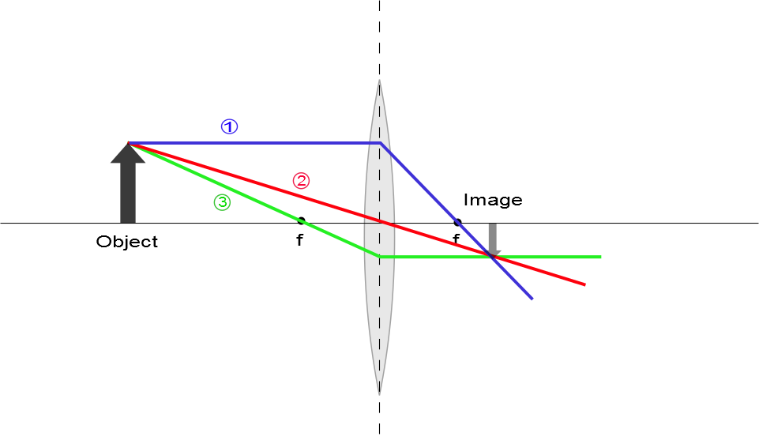
Ray Diagram for Converging Lens, s > f
The image is real
The image is inverted
The image is on the back side of the lens

Slide 26
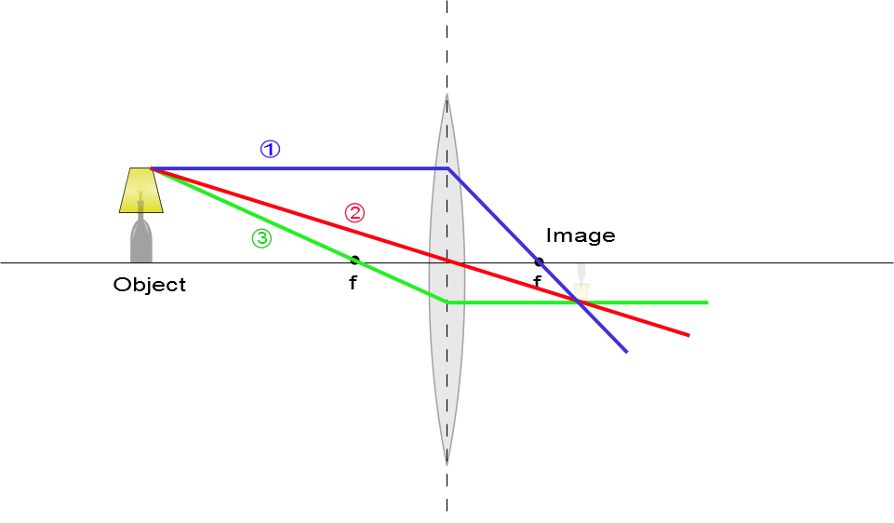
Ray Diagram for Converging Lens, s > f
The image is real
The image is inverted
The image is on the back side of the lens

Slide 27
Question 223.15.3
You are building a camera with refractive lenses. Would you expect all colors of light to focus at the same point?
Yes
No
Can’t tell

Slide 28
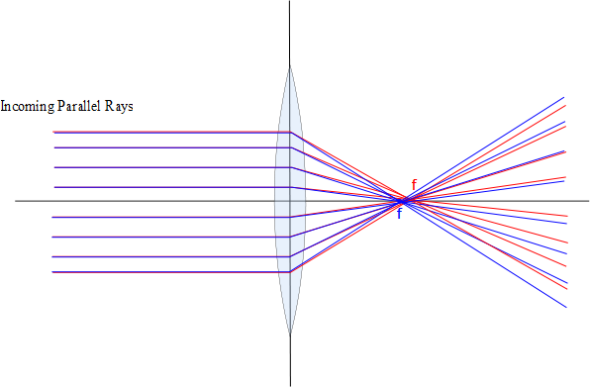

Slide 29
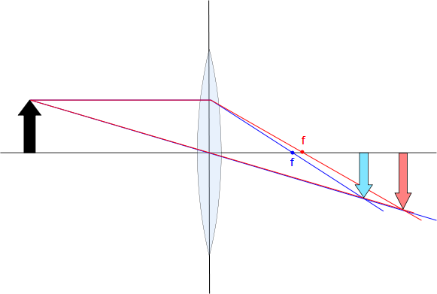

Slide 30



Slide 31
Question 223.15.12
A
f
f
f
f
B
f
f
A ray enters a lens as shown above. Which of the choices to the right shows how the ray will exit the lens?
C
f
f

Slide 32
Question 223.15.13
A
f
f
f
f
B
f
f
A ray enters a lens as shown above. Which of the choices to the right shows how the ray will exit the lens?
C
f
f

Slide 33
Question 223.15.13
A
f
f
f
f
B
f
f
A ray enters a lens as shown above. Which of the choices to the right shows how the ray will exit the lens?
C
f
f

Slide 34
Question 223.15.14
Three rays leave a glowing object and pass through a lens as shown. After passing through the lens, where do they meet?
At f
At the center of the lens
This is silly, they don’t meet anywhere
f
f

Slide 35
Question 223.15.15
Three rays leave a glowing object and pass through a lens as shown. After passing through the lens, where does our brain think they meet?
At f
At the center of the lens
Somewhere behind the lens off to the left
f
f

Slide 36
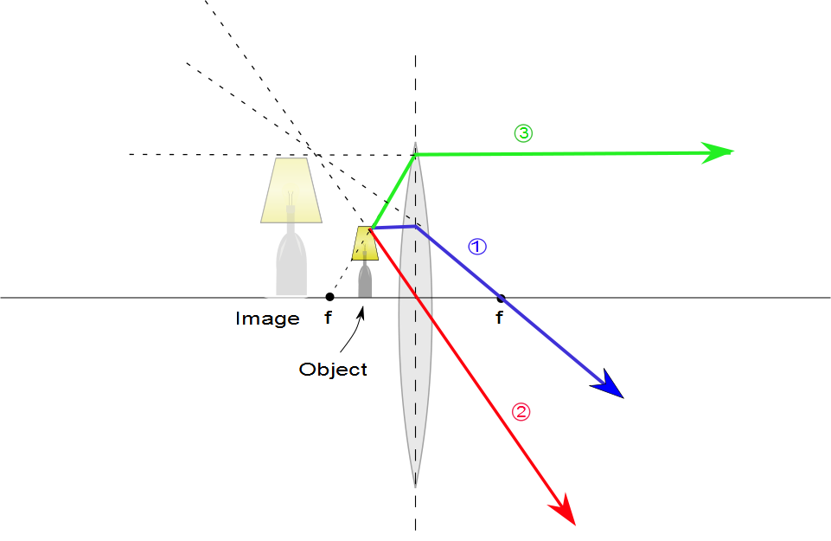
Ray Diagram for Converging Lens, p < f
The image is virtual
The image is upright
The image is larger than the object
The image is on the front side of the lens

Slide 37
Ray Diagrams for Thin Lenses – Diverging
For a diverging lens, the following three rays are drawn:
Ray 1 is drawn parallel to the principal axis and emerges directed away from the focal point on the front side of the lens
Ray 2 is drawn through the center of the lens and continues in a straight line
Ray 3 is drawn in the direction toward the focal point on the back side of the lens and emerges from the lens parallel to the principal axis

Slide 38
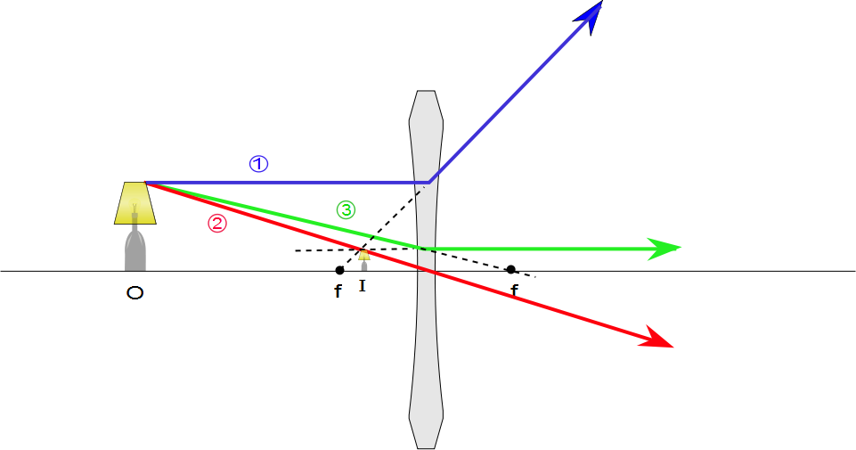
Ray Diagram for Diverging Lens
The image is virtual
The image is upright
The image is smaller
The image is on the front side of the lens

Slide 39
Question 223.15.9
A
f
f
f
f
B
f
f
A ray enters a lens as shown above. Which of the choices to the right shows how the ray will exit the lens?
C
f
f

Slide 40
Question 223.15.10
A
f
f
f
f
B
f
f
A ray enters a lens as shown above. Which of the choices to the right shows how the ray will exit the lens?
C
f
f

Slide 41
Question 223.15.11
A
f
f
f
f
B
f
f
A ray enters a lens as shown above. Which of the choices to the right shows how the ray will exit the lens?
C
f
f

