Slide 1
Standard Configurations of Charge
Point charge
Several point charges
Line of Charge
Semi-infinate sheet of charge
Charged sphere
Charged spherical shell
Ring of Charge

Slide 2
Question 223.22.1 Field and Force I
Between the red and the blue charge, which of them experiences the greater electric field due to the green charge?
a)
b)
c) the same for both
+1
+2
+1
+2
d
+1
+1
d

Slide 3
Question 223.22.1 Field and Force I
Between the red and the blue charge, which of them experiences the greater electric field due to the green charge?
a)
b)
c) the same for both
+1
+2
+1
+2
+1
+1
d
d
Both charges feel the same electric field due to the green charge because they are at the same point in space!

Slide 4
Question 223.22.2 Field and Force II
Between the red and the blue charge, which of them experiences the greater electric force due to the green charge?
a)
b)
c) the same for both
+1
+2
+1
+2
+1
+1
d
d

Slide 5
Question 223.22.2 Field and Force II
Between the red and the blue charge, which of them experiences the greater electric force due to the green charge?
a)
b)
c) the same for both
+1
+2
+1
+2
+1
+1
d
d
The electric field is the same for both charges, but the force on a given charge also depends on the magnitude of that specific charge.

Slide 7
Question 223.22.3
What is the direction of the electric field at the center of the square?
-2 C
b
a
c
d
-2 C
e) E = 0

Slide 8
Question 223.22.3
What is the direction of the electric field at the center of the square?
-2 C
b
a
c
d
-2 C
e) E = 0
For the upper charge, the E field vector at the center of the square points towards that charge. For the lower charge, the same thing is true. Then the vector sum of these two E field vectors points to the left.

Slide 9
Question 223.22.4
Two charges are fixed along the x-axis. They produce an electric field E directed along the negative y-axis at the indicated point. Which of the following is true?
a) charges are equal and positive
b) charges are equal and negative
c) charges are equal and opposite
d) charges are equal, but sign is undetermined
e) charges cannot be equal
y
E
Q₁
Q₂
x
Notes:
[CORRECT 5 ANSWER]

Slide 10
Question 223.22.4
Two charges are fixed along the x-axis. They produce an electric field E directed along the negative y-axis at the indicated point. Which of the following is true?
a) charges are equal and positive
b) charges are equal and negative
c) charges are equal and opposite
d) charges are equal, but sign is undetermined
e) charges cannot be equal
y
The way to get the resultant PINK vector is to use the GREEN and BLUE vectors. These E vectors correspond to equal charges (because the lengths are equal) that are both negative (because their directions are toward the charges).
E
Q₁
Q₂
x

Slide 11
y
q₁
Two charges are separated by a distance d. What is the field a distance L from the center of the two charges?
r
θ
d
L
θ
P
z
r
q₂

Slide 12
y
q₁
r
E₁
E₂
θ
d
L
θ
z
r
q₂

Slide 13
y
q₁
r
E
E₁
E₂
θ
d
L
θ
z
r
q₂

Slide 14
E₁
E
E₂
q₁
r
θ
d
L
θ
q₂
r

Slide 15
Question
We have studied the field due to a dipole. If we pick a location a distance r away from the dipole, would the dipole field be stronger or weaker than the field the same distance away from a single charge of the same magnitude as the dipole charges?
Dipole field is stronger
Single field is stronger
Both are the same

Slide 17
q₁
Dipole Moment
q₂

Slide 18
Question 223.22.5
-Q
+Q
What is the direction of the electric field at the position of the X ?
b
c
+Q
a
d
e

Slide 19
Question 223.22.5
-Q
+Q
What is the direction of the electric field at the position of the X ?
b
c
+Q
a
d
e
The two +Q charges give a resultant E field that is down and to the right. The –Q charge has an E field up and to the left, but smaller in magnitude. Therefore, the total electric field is down and to the right.

Slide 20
q₁
y
Three charges are separated by a distance d as shown. What is the field a distance L from the center of the two charges?
d
q₂
E₃
θ
L
θ
E₂
z
E₁
d
q₃

Slide 21
q₁
y
d
q₂
E₃
θ
E
L
θ
E₂
z
E₁
d
q₃

Slide 22
Question 223.22.6
What is the direction of the electric field at the center of the square?
-2 C
-2 C
b
a
c
d
e) E = 0
-2 C
-2 C

Slide 23
Question 223.22.6
What is the direction of the electric field at the center of the square?
-2 C
-2 C
b
a
c
d
e) E = 0
-2 C
-2 C
The four E field vectors all point outwards from the center of the square toward their respective charges. Because they are all equal, the net E field is zero at the center!!

Slide 24
- - - - - - - - - - - - - - - - - - - - - - - - - -
- - - - - -- - - - - -

Slide 26
- - - -
- - - - - -
- - - - - - -
- - - - - - - -
- - - - - - -
- - - - - -
- - - -

Slide 27
+
+
+
+
+
+
+
+
+
+
+
+
+
+
+
+

Slide 29
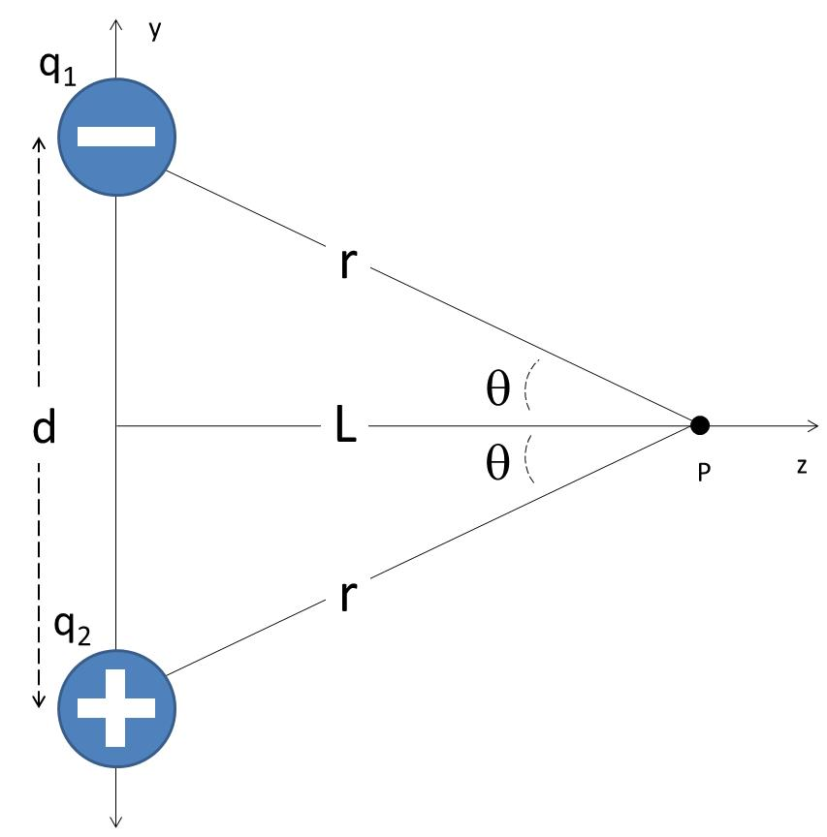
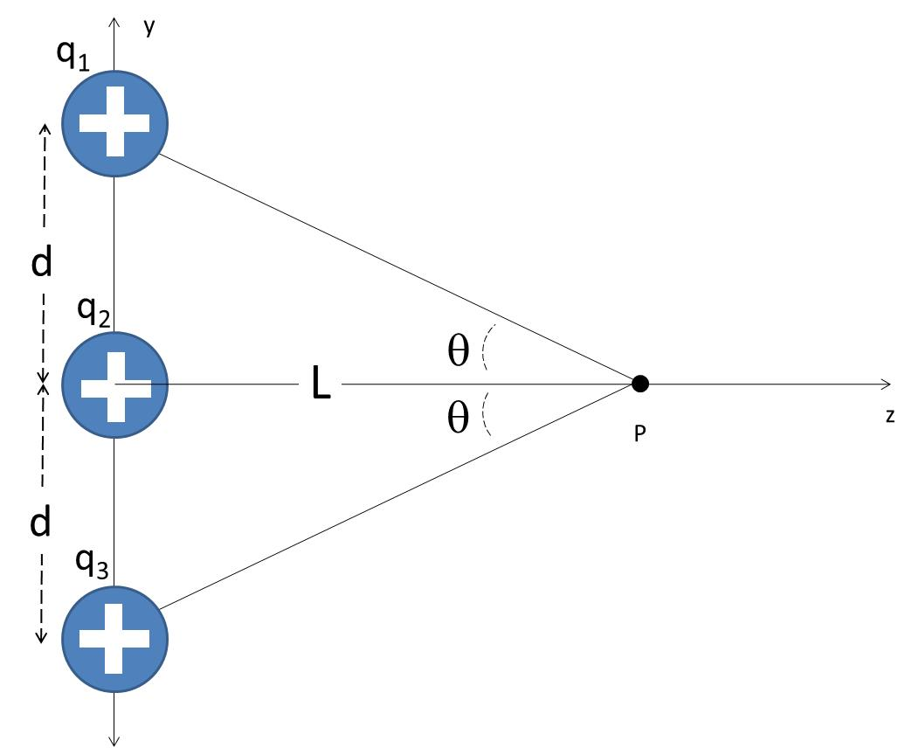
Find the field find due to two charges, one positive and one negative, at a point, P, along the axis between the two charges as shown to the right.
What is the field if L is very large?
Find the field find due to two three positive charges at a point, P, along the axis shown to the right
What is the field if L is very large?

Slide 30
q₁
y
d
q₂
θ
L
θ
z
P
d
q₃

