Slide 1
Question 223.15.12
A
f
f
f
f
B
f
f
A ray enters a lens as shown above. Which of the choices to the right shows how the ray will exit the lens?
C
f
f

Slide 2
Question 223.15.13
A
f
f
f
f
B
f
f
A ray enters a lens as shown above. Which of the choices to the right shows how the ray will exit the lens?
C
f
f

Slide 3
Question 223.15.13
A
f
f
f
f
B
f
f
A ray enters a lens as shown above. Which of the choices to the right shows how the ray will exit the lens?
C
f
f

Slide 4
Question 223.15.14
Three rays leave a glowing object and pass through a lens as shown. After passing through the lens, where do they meet?
At f
At the center of the lens
This is silly, they don’t meet anywhere
f
f

Slide 5
Question 223.15.15
Three rays leave a glowing object and pass through a lens as shown. After passing through the lens, where does our brain think they meet?
At f
At the center of the lens
Somewhere behind the lens off to the left
f
f

Slide 6
Question 223.15.9
A
f
f
f
f
B
f
f
A ray enters a lens as shown above. Which of the choices to the right shows how the ray will exit the lens?
C
f
f

Slide 7
Question 223.15.10
A
f
f
f
f
B
f
f
A ray enters a lens as shown above. Which of the choices to the right shows how the ray will exit the lens?
C
f
f

Slide 8
Question 223.15.11
A
f
f
f
f
B
f
f
A ray enters a lens as shown above. Which of the choices to the right shows how the ray will exit the lens?
C
f
f

Slide 9
Question 223.16.1
What is the focal length of a pane of window glass?
zero
infinity
the thickness of the glass
impossible to determine

Slide 10
Object
[Figure]
Convergence Point

Slide 11
A
θ₂
θ₁
η
S
d
α
β
σ
γ
P
V
C
R
s
s’

Slide 12
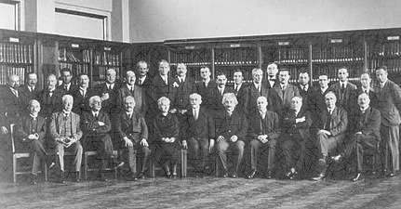
Sign Convention

Slide 13
Front
Back
Object
[Figure]
Convergence Point

Slide 14
Front
Back
Object
S’
[Figure]
S
R
C
Convergence Point

Slide 15
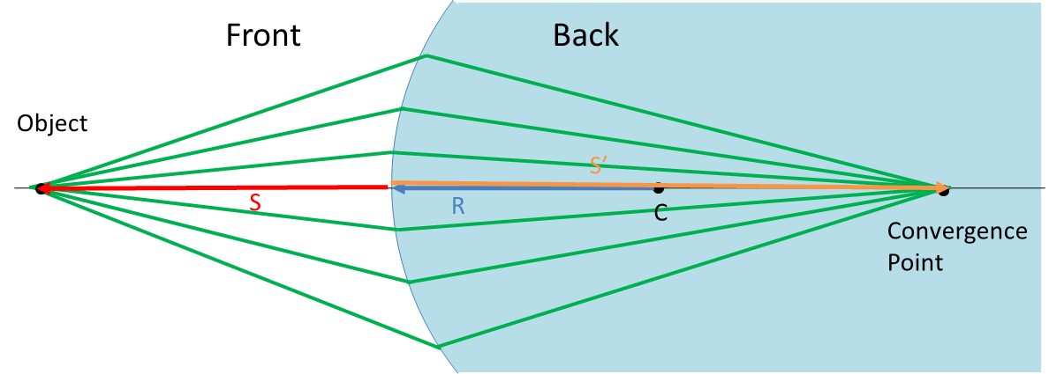
Sign Convention

Slide 16
Question 223.16.2
If the image is on the same side of the air-glass interface as the object, we call this a virtual image. What would be the sign of the image distance, s’?
Positive
Negative
Neutral

Slide 17
Question 223.16.3
If the image inverted, what is the sign of the image height?
Positive
Negative
Neutral

Slide 18
Question 223.16.4
If the image is inverted, what is the sign of the magnification?
Positive
Negative
Neutral

Slide 19
s
s’
Rays from fish
Fish in water
ℓ
Image of Fish
θ₂
θ₁
ℓ
θ₁
θ₂
Rays appear to come from here
n₁ (Large)
n₂ (Small)

Slide 20
Question 223.16.5
What would
Be for a thin lens?
The radius ratio
The lens thickness
The lens width
The focal length

Slide 21
Derivation of the Lens Equ.
B
A
C₁
C₂
P
S
n
t
R₂
s₁
s’₂
R₁

Slide 22
Question 223.16.6
The professor tells us that we will find the thin lens formula by making the image of a dot of light. This is OK because…
No one takes pictures of anything but dots of light
He is lazy and does not want to do anything bigger than a dot
A dot of light images into a complete picture, like the Mona Lisa
We can think about any extended body as consisting of emitting or reflecting dots.

Slide 23
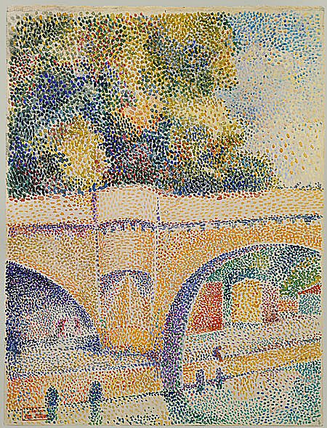

Slide 24
Derivation of the Lens Equ.
B
A
C₁
C₂
P
S
n
t
R₂
s₁
s’₂
R₁

Slide 25
Derivation of the Lens Equ.
A
P₁
C₁
S
n
S’₁
s₁
R₁

Slide 26
Derivation of the Lens Equ.
B
A
A
C₁
P₁
C₁
C₂
P₂
S
n
R₂
S’₁
s’₂
t
s₂

Slide 27
Derivation of the Lens Equ.
B
A
C₁
C₂
P
S
n
t
R₂
s₁
S’₂
R₁

Slide 28
Derivation of the Lens Equ.
R₁
S
C₂
n
C₁
P
R₂
s
s’

Slide 29
P₃
P₂
P₁
S₁
S₂
S₃
S
S’

Slide 30
Question 223.16.7
Diving masks often have a lens built into the glass for divers who do not have perfect vision. This allows the individual to dive without the necessity for glasses, because the lenses in the faceplate perform the necessary refraction to provide clear vision. The proper design allows the diver to see clearly with the mask on both under water and in the open air. Normal eyeglasses have lenses that are curved on both the front and rear surfaces. The lenses in a diving mask should be curved
only on the front surface
only on the rear surface
on both the front and rear surfaces

Slide 31
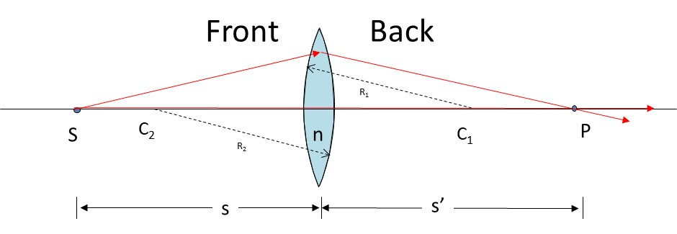

Slide 32
Derivation of the Lens Equ.
Front
Back
R₁
S
C₂
n
C₁
P
R₂
s
s’

Slide 33
h
θ
I
O
n
θ
h’
s
s’

Slide 34
Question 223.16.8
Consider a flat mirror. Which of the following is true?
The image is as far behind the mirror as the object is in front
The image is twice as far away as the object is from the mirror
The image is farther away, but you would need to know the particular circumstances to know how far.
The image is in the same place as the object.

Slide 35
Question 223.16.9
What is the magnification of a flat mirror
1
2
-1
½
The image is unmagnified

Slide 36
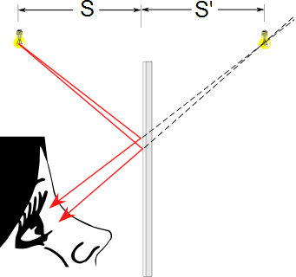
Flat Mirrors
Simplest possible mirror
Light rays leave the source and are reflected from the mirror
Point I is called the image of the object at point O
The image is virtual
O
I

Slide 37
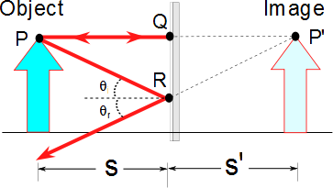
Flat Mirrors
One ray starts at point P, travels to Q and reflects back on itself
Another ray follows the path PR and reflects according to the law of reflection

Slide 38
Question 223.16.10
When you look in a flat mirror you observe
Left right reversal
Top bottom reversal
Front back reversal
No reversal

Slide 39
Images Formed by Flat Mirrors, 4
To observe the image, the observer would trace back the two reflected rays to P’
Point P’ is the point where the rays appear to have originated
The image formed by an object placed in front of a flat mirror is as far behind the mirror as the object is in front of the mirror
|s| = |s’|

Slide 40
Lateral Magnification
Lateral magnification, M, is defined as
This is the general magnification for any type of mirror
It is also valid for images formed by lenses
Magnification does not always mean bigger, the size can either increase or decrease
M can be less than or greater than 1

Slide 41
Lateral Magnification of a Flat Mirror
The lateral magnification of a flat mirror is 1
This means that h’ = h for all images

Slide 42
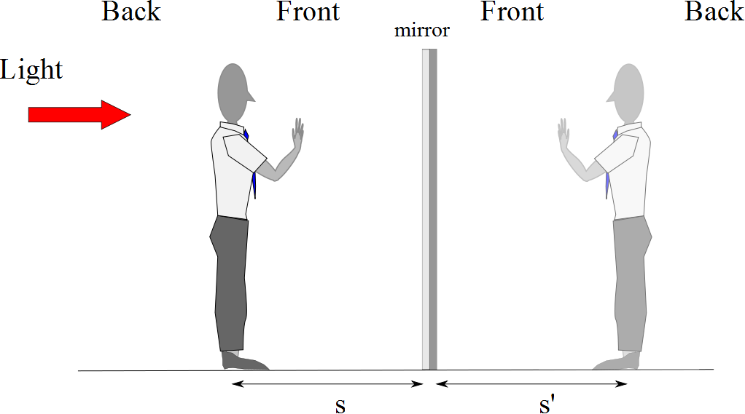
Reversals in a Flat Mirror

Slide 43
Question 223.16.11
I have a concave mirror. If I place an object closer than the focal distance, the image is
Inverted and has a magnification greater than 1
Not inverted and has a magnification greater than 1
Inverted and has a magnification smaller than 1
Not inverted and has a magnification smaller than 1

Slide 47
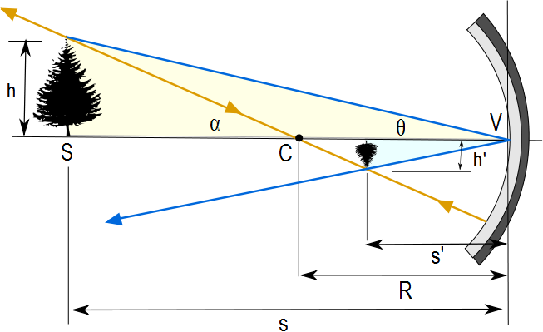
Image Formed by a Concave Mirror
Geometry can be used to determine the magnification of the image
h_{i} is negative when the image is inverted with respect to the object

Slide 48
Concave Mirror, Notation
The mirror has a radius of curvature of R
Its center of curvature is the point C
Point V is the center of the spherical segment
A line drawn from C to V is called the principal axis of the mirror

Slide 50
Paraxial Rays
We use only rays that diverge from the object and make a small angle with the principal axis
Such rays are called paraxial rays
All paraxial rays reflect through the image point

Slide 51
Spherical Aberration
Rays that are far from the principal axis converge to other points on the principal axis
This produces a blurred image
The effect is called spherical aberration

Slide 52
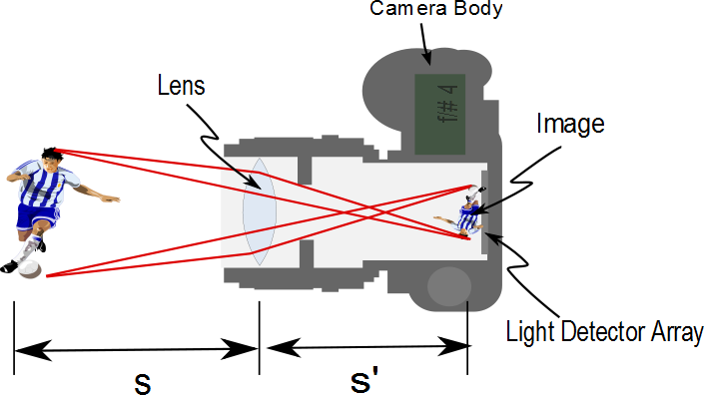

Slide 53
Image Formed by a Concave Mirror
Geometry also shows the relationship between the image and object distances
This is called the mirror equation
If p is much greater than R, then the image point is half-way between the center of curvature and the center point of the mirror
s → ∞ , then 1/ s ≈ 0 and s’ ≈ R/2

Slide 54
Focal Length
When the object is very far away, then s→ ∞ and the incoming rays are essentially parallel
In this special case, the image point is called the focal point
The distance from the mirror to the focal point is called the focal length
The focal length is ½ the radius of curvature

Slide 55
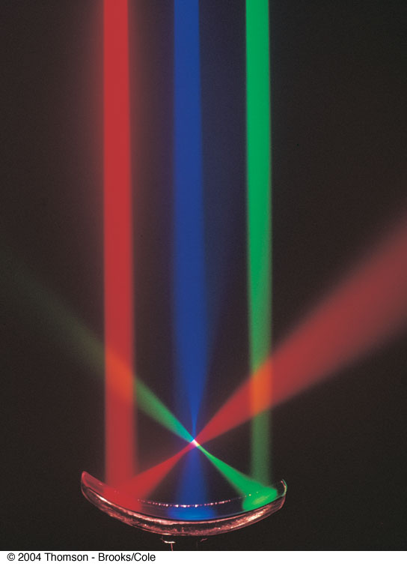
Focal Point, cont.
The colored beams are traveling parallel to the principal axis
The mirror reflects all three beams to the focal point
The focal point is where all the beams intersect
It is the white point

Slide 56
Focal Point and Focal Length, cont.
The focal point is dependent solely on the curvature of the mirror, not on the location of the object
It also does not depend on the material from which the mirror is made
ƒ = R / 2
The mirror equation can be expressed as

Slide 57
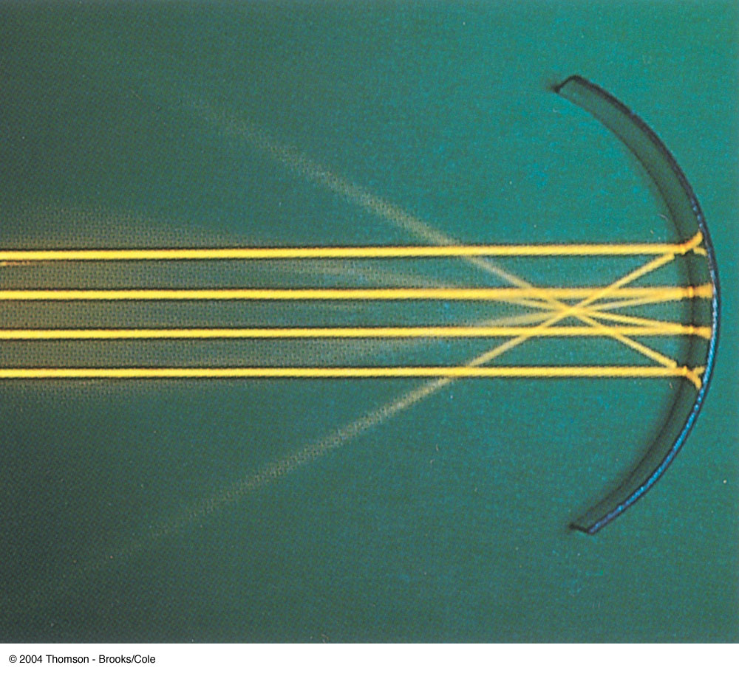
Focal Length Shown by Parallel Rays

Slide 58
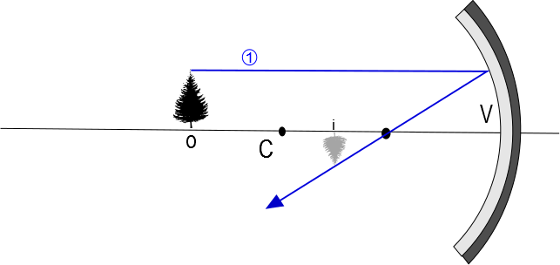

Slide 59
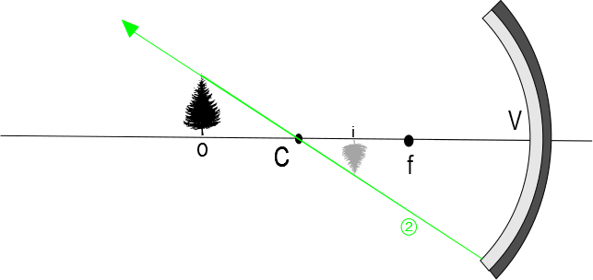

Slide 60
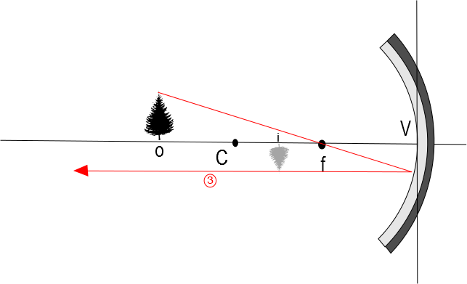

Slide 61
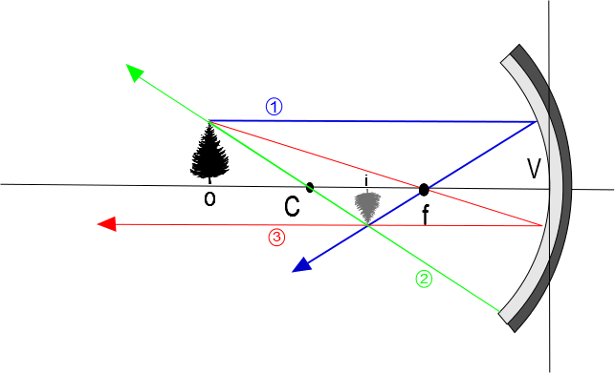

Slide 62
Convex Mirrors
A convex mirror is sometimes called a diverging mirror
The light reflects from the outer, convex side
The rays from any point on the object diverge after reflection as though they were coming from some point behind the mirror
The image is virtual because the reflected rays only appear to originate at the image point

Slide 63
Image Formed by a Convex Mirror
In general, the image formed by a convex mirror is upright, virtual, and smaller than the object

Slide 64
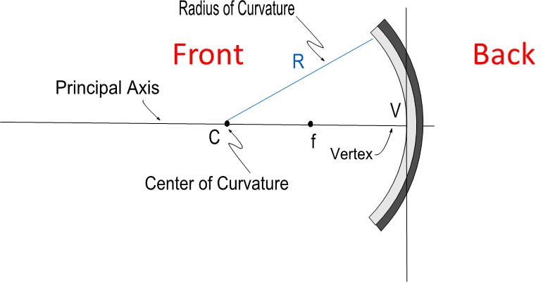

Slide 65
Front
Back

Slide 66
Ray Diagrams
A ray diagram can be used to determine the position and size of an image
They are graphical constructions which reveal the nature of the image
They can also be used to check the parameters calculated from the mirror and magnification equations

Slide 67
Drawing a Ray Diagram
To draw a ray diagram, you need to know:
The position of the object
The locations of the focal point and the center of curvature
Three rays are drawn
They all start from the same position on the object
The intersection of any two of the rays at a point locates the image
The third ray serves as a check of the construction

Slide 68
Ray Diagram – Concave Mirrors
Ray 1 is drawn from the top of the object parallel to the principal axis and is reflected through the focal point, F
Ray 2 is drawn from the top of the object through the focal point and is reflected parallel to the principal axis
Ray 3 is drawn through the center of curvature, C, and is reflected back on itself

Slide 69
Notes About the Rays
The rays actually go in all directions from the object
The three rays were chosen for their ease of construction
The image point obtained by the ray diagram must agree with the value of q calculated from the mirror equation

Slide 70
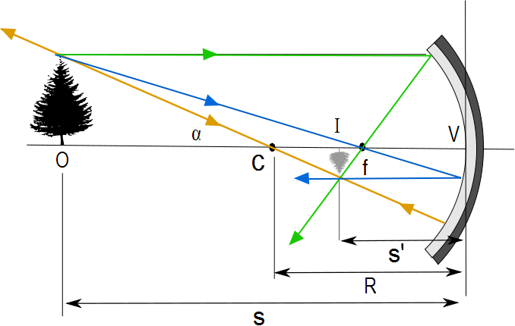
Ray Diagram for a Concave Mirror, s > R
The center of curvature is between the object and the concave mirror surface
The image is real
The image is inverted
The image is smaller than the object (reduced)

Slide 71
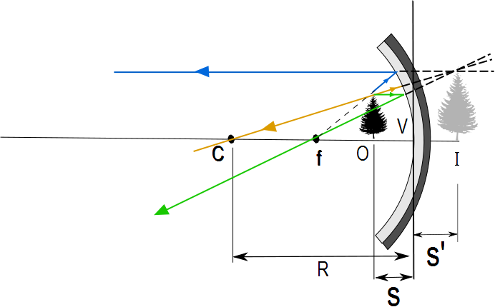
Ray Diagram for a Concave Mirror, s < f
The object is between the mirror surface and the focal point
The image is virtual
The image is upright
The image is larger than the object (enlarged)

Slide 72
The Rays in a Ray Diagram – Convex Mirrors
Ray 1 is drawn from the top of the object parallel to the principal axis and is reflected away from the focal point, F
Ray 2 is drawn from the top of the object toward the focal point and is reflected parallel to the principal axis
Ray 3 is drawn through the center of curvature, C, on the back side of the mirror and is reflected back on itself

Slide 73
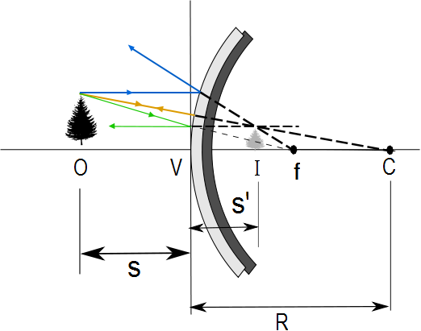
Ray Diagram for a Convex Mirror
The object is in front of a convex mirror
The image is virtual
The image is upright
The image is smaller than the object (reduced)

Slide 74
Notes on Images
With a concave mirror, the image may be either real or virtual
When the object is outside the focal point, the image is real
When the object is at the focal point, the image is infinitely far away
When the object is between the mirror and the focal point, the image is virtual
With a convex mirror, the image is always virtual and upright
As the object distance decreases, the virtual image increases in size

Slide 75
Question 223.16.12
Will a refractive spherical optic display spherical aberration?
Yes
No
Sometimes yes, sometimes no

Slide 76
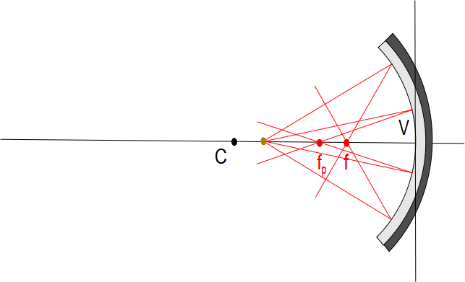

Slide 77
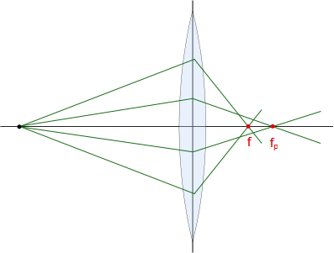

Slide 78
Question 223.26.4.6
Suppose I have a spherical mirror and I tell you that s is positive and s’ is negative. What type of mirror might I have
Concave
Convex
Can’t tell

