Slide 1
Question
If a magnetic field causes a force on a moving charge, will it cause a force on lots of moving charge?
Yes
No
Maybe

Slide 2
Question 223.41.1
A horizontal wire carries a current and is in a vertical magnetic field. What is the direction of the force on the wire?
1) left
2) right
3) zero
4) into the page
5) out of the page
I
B

Slide 3
Question 223.41.1
A horizontal wire carries a current and is in a vertical magnetic field. What is the direction of the force on the wire?
1) left
2) right
3) zero
4) into the page
5) out of the page
Using the right-hand rule, we see that the magnetic force must point out of the page. Since F must be perpendicular to both I and B, you should realize that F cannot be in the plane of the page at all.
I
B

Slide 4
Question 223.41.2
A vertical wire carries a current and is in a vertical magnetic field. What is the direction of the force on the wire?
1) left
2) right
3) zero
4) into the page
5) out of the page
I
B

Slide 5
Question 223.41.2
A horizontal wire carries a current and is in a vertical magnetic field. What is the direction of the force on the wire?
1) left
2) right
3) zero
4) into the page
5) out of the page
I
When the current is parallel to the magnetic field lines, the force on the wire is zero.
B

Slide 6
Question
Currents in wires cause magnetic fields. Magnetic fields exert forces on current carrying wires. Does this mean that currents in one wire exert forces on other wires?
Yes
No
maybe

Slide 7
1
L
B₁₂
I₁
2
F₁₂
d
I₂

Slide 8
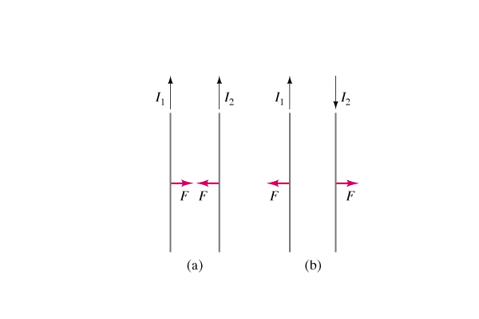
Question 223.41.2.3
Two straight wires run parallel to each other, each carrying a current in the direction shown below. The two wires experience a force in which direction?
1) toward each other
2) away from each other
3) there is no force
Notes:
[CORRECT 5 ANSWER]

Slide 9
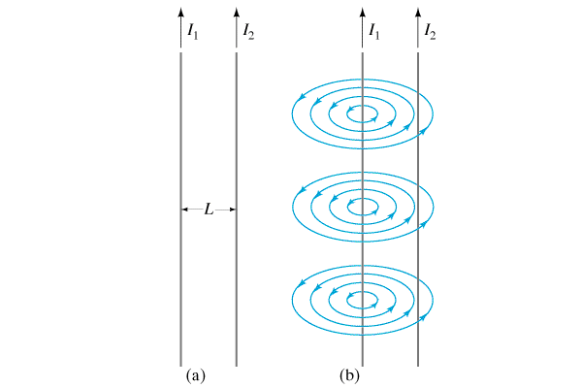
Question 223.41.2.3
Two straight wires run parallel to each other, each carrying a current in the direction shown below. The two wires experience a force in which direction?
1) toward each other
2) away from each other
3) there is no force
The current in each wire produces a magnetic field that is felt by the current of the other wire. Using the right-hand rule, we find that each wire experiences a force toward the other wire (i.e., an attractive force) when the currents are parallel (as shown).
Follow-up: What happens when one of the currents is turned off?

Slide 10
Question 223.41.4
A rectangular current loop is in a uniform magnetic field. What is the direction of the net force on the loop?
1) + x
2) + y
3) zero
4) - x
5) - y
z
B
y
x

Slide 11
Question 223.41.4
A rectangular current loop is in a uniform magnetic field. What is the direction of the net force on the loop?
1) + x
2) + y
3) zero
4) - x
5) - y
Using the right-hand rule, we find that each of the four wire segments will experience a force outwards from the center of the loop. Thus, the forces of the opposing segments cancel, so the net force is zero.
z
B
y
x

Slide 12
Question 223.41.5
I have a uniform magnetic field. Each loop shown has an identical current. Which has highest potential energy?
B
I
I
I
A B C

Slide 13
Current Loop
I
b
a

Slide 14
Current Loop
I
B
b
a

Slide 15
B
I
B
F₁
a/2
b
I
F₂
a
Side View
Bottom View

Slide 16
Current Loop
I
B
b
a

Slide 17
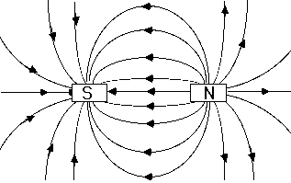
Question 223.41.6
If there is a current in the loop in the direction shown, the loop will:
1) move up
2) move down
3) rotate clockwise
4) rotate counterclockwise
5) both rotate and move
B field out of North
B field into South
N
S
S
N
Notes:
[CORRECT 5 ANSWER]

Slide 18
Question 223.41.6
If there is a current in the loop in the direction shown, the loop will:
1) move up
2) move down
3) rotate clockwise
4) rotate counterclockwise
5) both rotate and move
Look at the North Pole: here the magnetic field points to the right and the current points out of the page. The right-hand rule says that the force must point up. At the south pole, the same logic leads to a downward force. Thus the loop rotates clockwise.
F
N
S
F

Slide 19

Brushes
Commutator
N
S

Slide 20


Slide 21
Brushes
Commutator
N
S

Slide 22

Positive Brush
Commutator
Negative Brush
Reversal of current Direction

Slide 23
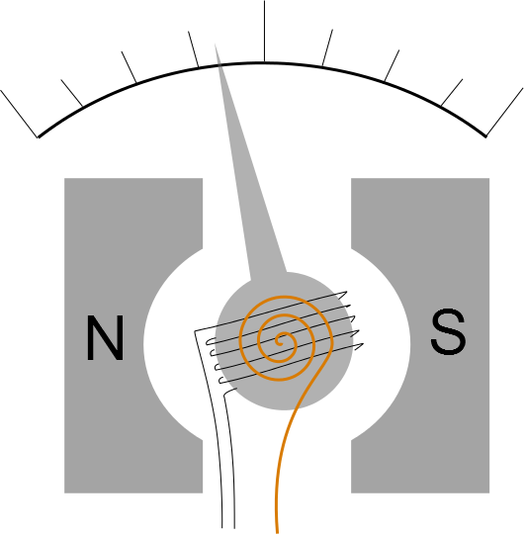

Slide 24
ConcepTest 20.8a Magnetic Field of a Wire I
If the currents in these wires have the same magnitude, but opposite directions, what is the direction of the magnetic field at point P?
1) direction 1
2) direction 2
3) direction 3
4) direction 4
5) the B field is zero
1
P
4
2
3
Notes:
[CORRECT 5 ANSWER]

Slide 25
ConcepTest 20.8a Magnetic Field of a Wire I
If the currents in these wires have the same magnitude, but opposite directions, what is the direction of the magnetic field at point P?
1) direction 1
2) direction 2
3) direction 3
4) direction 4
5) the B field is zero
1
P
Using the right-hand rule, we can sketch the B fields due to the two currents. Adding them up as vectors gives a total magnetic field pointing downward.
4
2
3

Slide 26
ConcepTest 20.8b Magnetic Field of a Wire II
Each of the wires in the figures below carry the same current, either into or out of the page. In which case is the magnetic field at the center of the square greatest?
1) arrangement 1
2) arrangement 2
3) arrangement 3
4) same for all
1
B=?
2
B=?
3
B=?
Notes:
[CORRECT 5 ANSWER]

Slide 27
ConcepTest 20.8b Magnetic Field of a Wire II
Each of the wires in the figures below carry the same current, either into or out of the page. In which case is the magnetic field at the center of the square greatest?
1) arrangement 1
2) arrangement 2
3) arrangement 3
4) same for all
1
2
3

Slide 28
ConcepTest 20.10 Current Loop
What is the direction of the magnetic field at the center (point P) of the square loop of current?
1) left
2) right
3) zero
4) into the page
5) out of the page
I
P

Slide 29
ConcepTest 20.10 Current Loop
What is the direction of the magnetic field at the center (point P) of the square loop of current?
1) left
2) right
3) zero
4) into the page
5) out of the page
Use the right-hand rule for each wire segment to find that each segment has its B field pointing out of the page at point P.
I
P

Slide 30
ConcepTest 20.9a Field and Force I
A positive charge moves parallel to a wire. If a current is suddenly turned on, which direction will the force act?
1) + z (out of page)
2) - z (into page)
3) + x
4) - x
5) - y
y
+q
I
x
z

Slide 31
ConcepTest 20.9a Field and Force I
A positive charge moves parallel to a wire. If a current is suddenly turned on, which direction will the force act?
1) + z (out of page)
2) - z (into page)
3) + x
4) - x
5) - y
Using the right-hand rule to determine the magnetic field produced by the wire, we find that at the position of the charge +q (to the left of the wire) the B field points out of the page. Applying the right-hand rule again for the magnetic force on the charge, we find that +q experiences a force in the +x direction.
y
+q
I
x
z

