Slide 1
Question 223.32.0.1
Where does gravitational potential energy come from?
Mass
The gravitational field
Hills and mountains

Slide 2
Question 223.32.0.2
How do we gain gravitational potential energy?
Do work against the gravitational field
Allow the mass to fall
Hook the mass to a battery
Put the mass in a nuclear reactor

Slide 3
Question 223.32.0.3
Are the gravitational field and the gravitational potential energy different physical things?
Yes
No
Maybe

Slide 4
Question 223.32.1
What do we call the electrical potential energy for one unit of charge?
Electric potential energy
Electric field
Electric field gradient
Electric potential

Slide 5
Question 223.32.2
What do we call the amount of electrical work done for one unit of charge?
Electric potential energy
Electric field
Electric field gradient
Electric potential

Slide 6
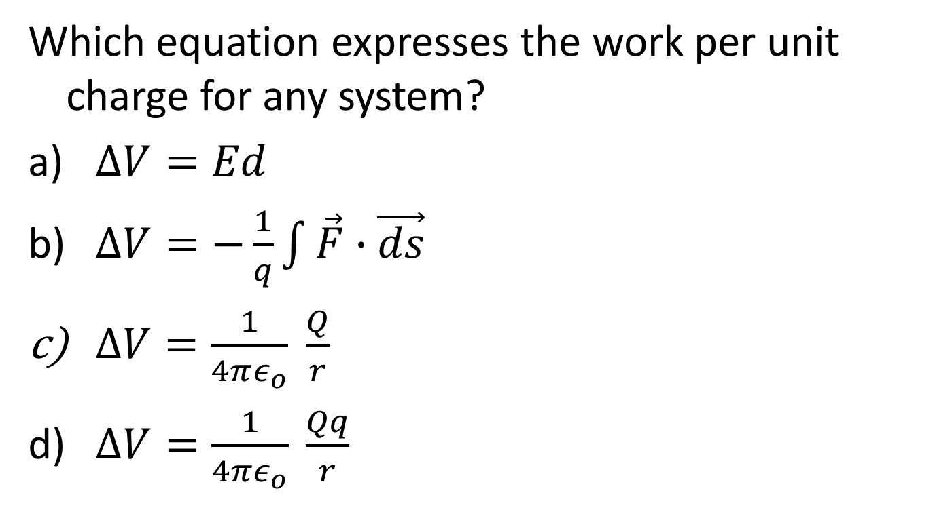
Question 223.32.2
Which equation expresses the work per unit charge for any system?
$∆V=Ed$
$∆V=−\frac{1}{q}\int{\vec{F}∙\vec{ds}}$
$∆V=\frac{1}{4πε_{o}} \frac{Q}{r}$
$∆V=\frac{1}{4πε_{o}} \frac{Qq}{r}$

Slide 7
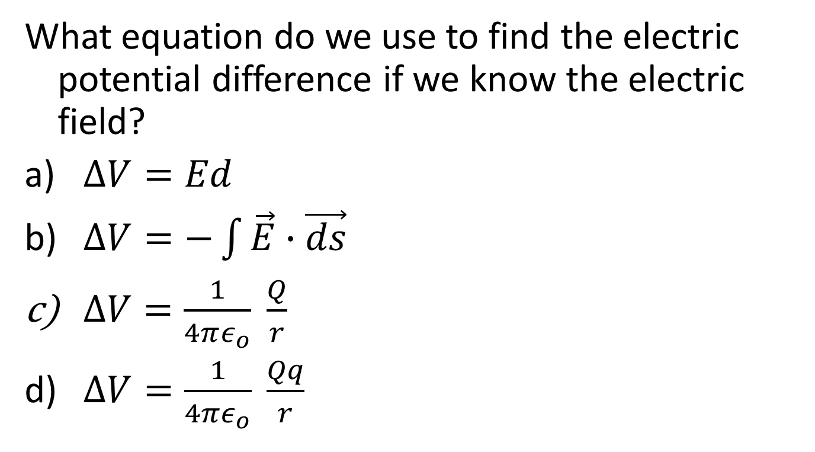
Question 223.32.2
What equation do we use to find the electric potential difference if we know the electric field?
$∆V=Ed$
$∆V=−\int{\vec{E}∙\vec{ds}}$
$∆V=\frac{1}{4πε_{o}} \frac{Q}{r}$
$∆V=\frac{1}{4πε_{o}} \frac{Qq}{r}$

Slide 8
A
B

Slide 9
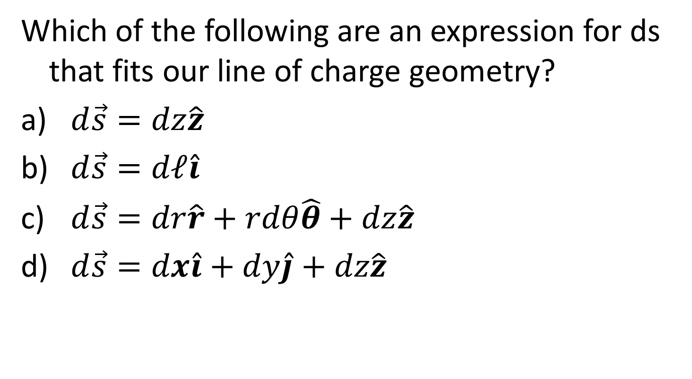
Question 223.32.2.1
Which of the following are an expression for ds that fits our line of charge geometry?
$d\vec{s}=dz\hat{z}$
$d\vec{s}=dℓ\hat{i}$
$d\vec{s}=dr\hat{r}+rdθ\hat{θ}+dz\hat{z}$
$d\vec{s}=dx\hat{i}+dy\hat{j}+dz\hat{z}$
A
B

Slide 10
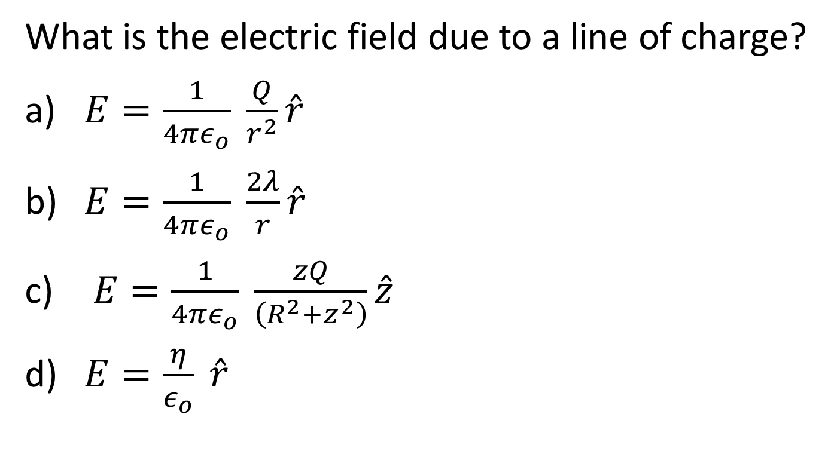
Question 223.32.2.2
What is the electric field due to a line of charge?
$E=\frac{1}{4πε_{o}} \frac{Q}{r^{2}}\hat{r}$
$E=\frac{1}{4πε_{o}} \frac{2λ}{r}\hat{r}$
$E=\frac{1}{4πε_{o}} \frac{zQ}{\left(R^{2}+z^{2}\right)}\hat{z}$
$E=\frac{η}{ε_{o}} \hat{r}$
A
B

Slide 11
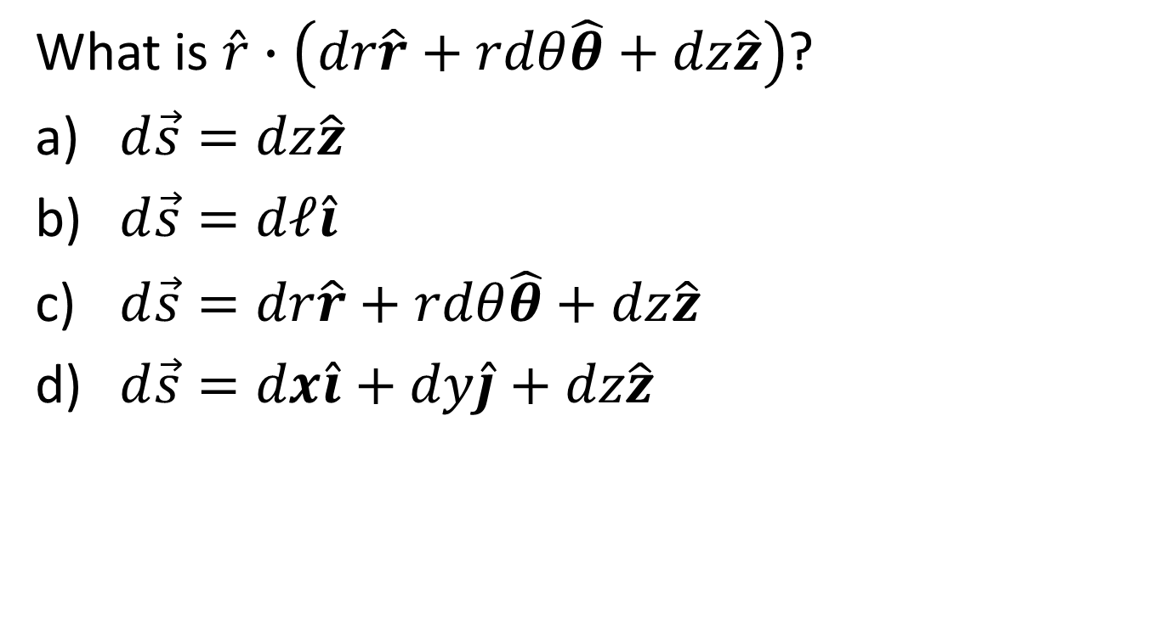
Question 223.32.2.3
What is $\hat{r}∙\left(dr\hat{r}+rdθ\hat{θ}+dz\hat{z}\right)$?
$d\vec{s}=dz\hat{z}$
$d\vec{s}=dℓ\hat{i}$
$d\vec{s}=dr\hat{r}+rdθ\hat{θ}+dz\hat{z}$
$d\vec{s}=dx\hat{i}+dy\hat{j}+dz\hat{z}$
A
B

Slide 13

Question 223.32.2.4
What is $\lim_{r→∞}{−\frac{1}{2π}}\frac{λ}{ε_{o}}ln\left(r\right)$?
$\frac{1}{4πε_{o}} \frac{Q}{r^{2}}$
$∞$
$0$
A
B

Slide 14
Question 223.32.3
Are the electric field and the electric potential different physical things?
Yes
No
Maybe

Slide 15
High Potential
Low Potential
E
+ + + + + + + + + + + + + + + + + + + + + + + + + +
+ + + + + + + + + + + + + + + + + + + + + + + + + +
+
A
B
- - - - - - - - - - - - - - - - - - - - - - - - - - - - - -
- - - - - - - - - - - - - - - - - - - - - - - - - - - - - -
d

Slide 16
Question 223.32.4
How do we create electric potential?
Mechanical work
Chemical work
Separate charge
Maybe more than one of the above, but one is the best answer

Slide 17
Question
How does a van de Graaf generator separate charge?
It mechanically transports charge on it’s belt
It has a large capacitor that shoots the charge to the metal ball on the top
It uses magnets to deflect the charge to the top
Magic

Slide 18
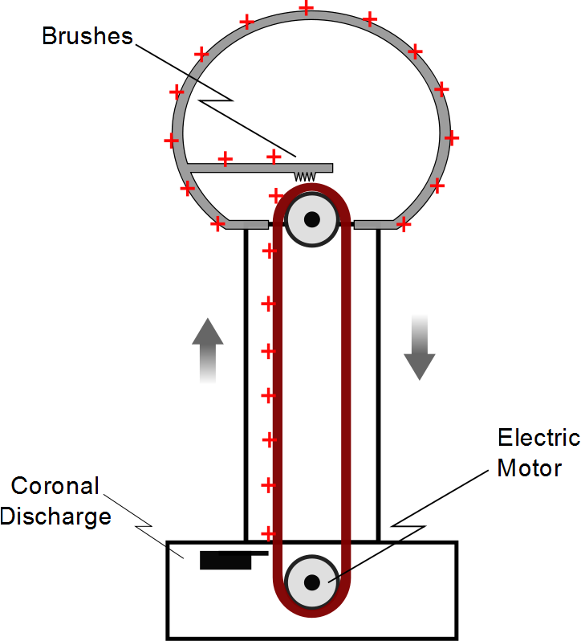

Slide 19
Question 223.32.5
How does a battery separate charge?
There is a small charge pump that separates the charge
There is a strong static charge that attracts the moving charge in the wires
There is an electro-chemical reaction that separates charge
Batteries don’t separate charge, they create voltage

Slide 20
Negative Electrode made of porous lead
Positive Electrode made of lead dioxide
Pb
PbO₂
H₂O
H₂SO₄

Slide 21
Negative Electrode made of porous lead
Positive Electrode made of lead dioxide
Pb
PbO₂
H₂O
H₂SO₄
H₂SO₄
H₂O

Slide 22
Negative Electrode made of porous lead
Positive Electrode made of lead dioxide
H⁺
SO₄⁻²
Pb
PbO₂
H₂O
H⁺
H⁺
SO₄⁻²
H⁺
H₂O

Slide 23
Pb⁰
Pb⁰
SO₄⁻²
Pb⁰
H⁺
H⁺
Pb⁰
H₂O
Pb⁰
H⁺
SO₄⁻²
Pb⁰
Pb⁰
H₂O
H⁺
Pb⁰
H⁺
Pb⁰
SO₄⁻²
Pb⁰
H⁺
H₂O
Pb⁰
Pb⁰

Slide 24
Pb⁰
Pb⁰
Pb⁰
Pb⁰
Pb⁰
H⁺
SO₄⁻²
Pb⁰
Pb⁰
H₂O
-
H⁺
Pb⁰
H⁺
-
Pb⁺²
SO₄⁻²
Pb⁰
H⁺
H₂O
Pb⁰
Pb⁰

Slide 25
O⁻²
Pb⁺⁴
O⁻²
H⁺
O⁻²
SO₄⁻²
Pb⁺⁴
H₂O
H⁺
O⁻²
O⁻²
-
H⁺
SO₄⁻²
Pb⁺⁴
O⁻²
-
H⁺
H₂O
O⁻²
Pb⁺⁴
O⁻²

Slide 26
O⁻²
Pb⁺⁴
O⁻²
O⁻²
SO₄⁻²
Pb⁺⁴
O⁻²
H₂O
₋₂
SO₄⁻²
Pb⁺²
H₂O
H₂O
O⁻²
Pb⁺⁴
O⁻²

Slide 27
Pb⁰
O⁻²
Pb⁰
Pb⁺⁴
Pb⁰
O⁻²
Pb⁰
O⁻²
SO₄⁻²
Pb⁰
Pb⁺⁴
H⁺
SO₄⁻²
Pb⁰
O⁻²
H₂O
Pb⁰
H₂O
-
H⁺
₋₂
Pb⁰
SO₄⁻²
Pb⁺²
H⁺
-
Pb⁺²
SO₄⁻²
H₂O
Pb⁰
H₂O
O⁻²
H⁺
H₂O
Pb⁰
Pb⁺⁴
Pb⁰
O⁻²

Slide 28
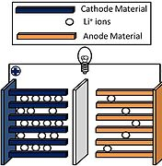
Lithium-ion Batteries
CoO₂ + Li⁺ + e⁻ → LiCoO₂
LiC₆ → C₆ + Li⁺ + e⁻
https://commons.wikimedia.org/wiki/File:Schematic_of_a_Li-ion_battery.jpg

Slide 29
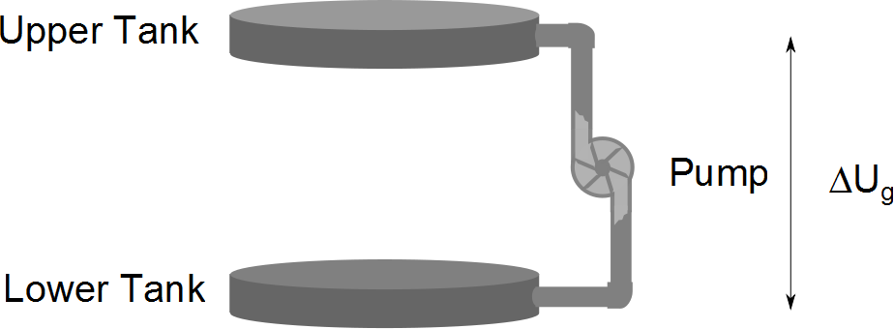

Slide 30
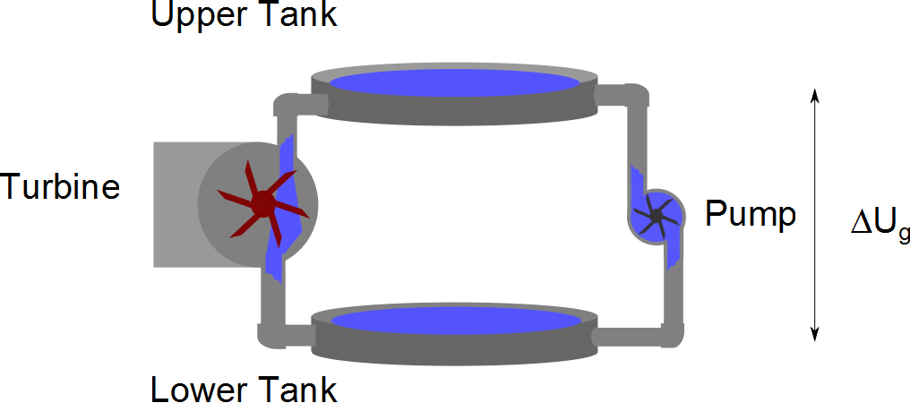

Slide 31
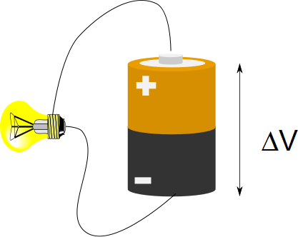

Slide 32
Question
If water travels up through the pump from the lower tank to the upper tank and then travels through the turbine from the upper tank to the lower tank, what is the change in potential energy of the water?
400J
Mgh where M is the mass of the water
2Mgh
0

Slide 33
Question
If electrons travel up through the battery from the lower terminal to the upper terminal and then travel through the lightbulb from the upper terminal to the lower terminal, what is the change in potential energy of the electrons?
400J
Mgh where M is the mass of the electrons
2Mgh
0

Slide 34
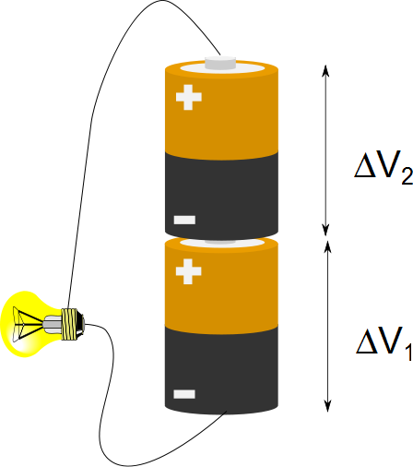
Question
Suppose a particular type of batter has a voltage of 1.5V. If I put two batteries together what is the electric potential difference from the bottom of the first battery to the top of the second battery?
1.5V
3V
6V
9V

Slide 35
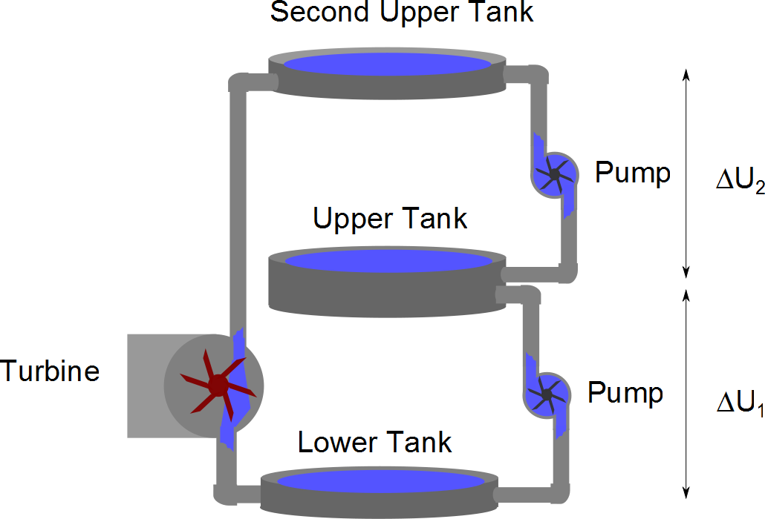

Slide 37
High Potential
Low Potential
E
+ + + + + + + + + + + + + + + + + + + + + + + + + +
+ + + + + + + + + + + + + + + + + + + + + + + + + +
+
A
B
- - - - - - - - - - - - - - - - - - - - - - - - - - - - - -
- - - - - - - - - - - - - - - - - - - - - - - - - - - - - -
d

Slide 38
High Potential
Low Potential
E
- - - - - - - - - - - - - - - - - - - - - - - - - - - - - -
- - - - - - - - - - - - - - - - - - - - - - - - - - - - - -
+ + + + + + + + + + + + + + + + + + + + + + + + + +
+ + + + + + + + + + + + + + + + + + + + + + + + + +
Equipotential Lines

Slide 39
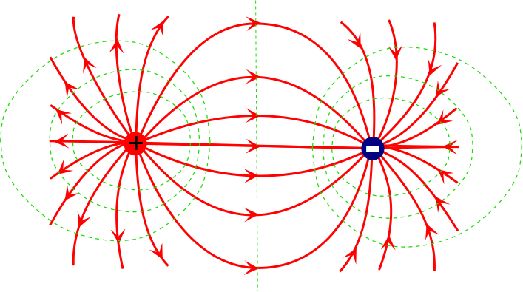

Slide 40
Question 223.32.6
Your nervous system needs sodium ions to work as charge carriers. How do you get sodium atoms in the body?
You eat salt, and the water molecules in your body split up the sodium and the chlorine.
You have an internal electrolysis system that splits up molecules using high voltages
You are born with a large positive charge

Slide 41
Question 223.32.7
We reasoned that a battery is like a charge pump, and that the charge must flow back ‘down’ to the pump after traveling through the wire. The battery gives us a voltage by separating charge. The moving charge looses potential energy as it returns to the battery. This is an example of
Kirchhoff's loop law
conservation of energy
Wheatstone's law
Planck’s law

