Slide 1
Physics 223

Slide 2
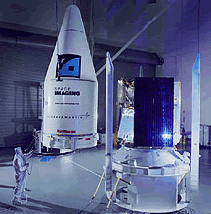
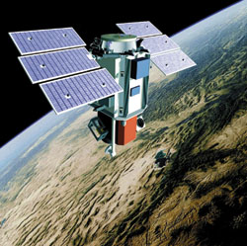

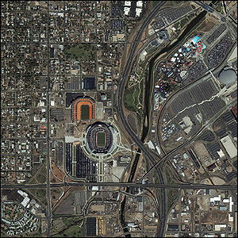

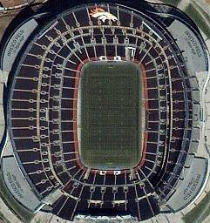
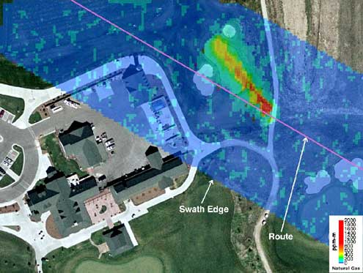
Instructor Introduction
R. Todd Lines
Education
BS Physics – BYU
MS, PhD Physics – NMSU
Recent Experience
18 years at BYUI
6 years with ITT (Eastman Kodak)
Laser radar
Atmospheric physics
Remote sensing
4 years experience with Raytheon
Weather satellite design
6 years experience with the US Army Research Laboratory
Atmospheric physics
Remote sensing

Slide 3
Survey Results:
What type of engineer/chemist do you plan to be?
Mechanical was very popular (but not very specific)
Mechatronics
Electrical
Pharmaceutical
A chemist that passes P-Chem

Slide 4
Survey Results:
What do you hope to learn from this course?
Things that apply to my future classes
Things that apply to my future jobs
What do you hope to do with this new knowledge?
Pass P-Chem
Have a great future job

Slide 5
Survey Results
What do you expect the lectures to do for you?
Answers varied
Some want their primary learning to be from the lecture
Sometimes this will be true, but sometimes it will not
Learning to read is important—no professors in industry

Slide 6
Survey Results
What do you expect the book to do for you?
Answers varied
Most said the book would be a source for learning the concepts we will study.
“I have done readings in physics textbooks in past classes, but they have never been helpful for me.”
“Be a reference to relearn something I didn't learn in class while working on my homework”
I hope this is true. I am taking a risk this semester. Our department text book is very wordy – reading assignments are loooong.
You all don’t have a huge time to read. I have tried to provide shorter readings.
If this is not working, let me know and we can go back to the wordy new book.

Slide 7
Reading
Some Studies show reading can be important
Studies in 1990’s showed that in introductory physics courses…”
30% of students read the book
30% of students pass the course
The studies showed that the book is most helpful if read in advance of lecture and homework
Think of an English class, could you discuss and understand Hamlet without reading it?
I wanted to capitalize on this gain.
I want every advantage we can get!
Post graduate learning is mostly from books working on your own.
How to do this?
We start off behind with a free book, you will need to watch to make sure there are no errors. (sorry)
Quizzes will be given to help remind you to read – they will not be concept questions, just test whether or not you did the reading.

Slide 8
Survey Results
How many hours a week do you think it will take to learn all you need to know from this course?
Answers varied from 6 to 20.
Average was about 8
I hope that it will be no more than 15
We meet 5 days a week and you expect two hours out of class for every hour in class = 15 hours
This is a 4 credit hour class, so we all expect it to be more work than the average class
It takes time and effort to grow new neurological connections that support these new skills
I want you to tell me how we are doing.
If you feel the load is too heavy
If you feel the load is too light
It will take some cooperation to make sure we neither kill you off nor send you to your jobs unprepared.

Slide 9
Course Description
This course is a one semester class covering the second and third semesters of calculus-based physics.
The course is designed for students majoring in mechanical engineering.
The course covers topics in
waves,
electricity, magnetism, and
optics.
These areas of study are important in a wide variety of engineering applications.
For example, an understanding of wave properties is essential in the proper design of structures.
A knowledge of electric and magnetic fields is required for any system that involves transmission of electrons for either communication or power generation purposes.
Finally, principles of optics are involved in fiber-optic communication, instrument design, scanners, surveillance, etc.

Slide 10
Course Objectives
The primary objective of this course is to help you develop a conceptual understanding of the fundamental physical principles described above.
The second objective of this course is for you to develop the mathematical description of these principles that can then be used to develop devices, structures, and technologies that are useful for mankind.
The third objective of the course is to help you use the mathematical description of these principles to develop problem solving skills that will benefit your future career.

Slide 11
General Philosophy of the Course
Physics is a topic that must be learned by faith, that is, by action.
You will need to read the text and perform the homework assignments in order to succeed in this course.
Studies have indicated there is value of reading the text but principally if the text is read before the lecture
Makes the semester less frustrating, more enjoyable

Slide 12
Learning Model Implementation
Teach One Another
Class Discussion
Prepare
Reading Assignment
Ponder/Prove
Daily Quiz, homework

Slide 13
Learning Model Implementation
Discuss
Discuss
Discuss
Read
Read
Read
Exam
Quiz
Quiz
Quiz

Slide 14
Learning Model Implementation
Final

Slide 15

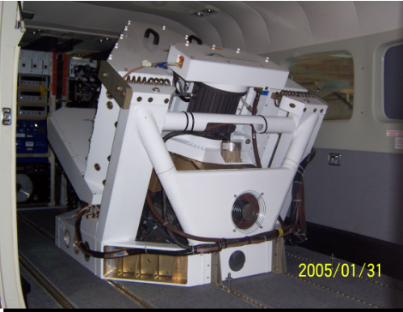
Physics and Engineers
Physics is the understanding that makes engineering design more efficient and, in some instances, possible.
Example: Tacoma Narrows Bridge
Personal Example: ITT ANGEL system wavelength design
Often, in my experience, an understanding of physics makes the difference that allows promotion within a discipline or advancement to system level engineering

Slide 16
Class Policies
We will follow the BYU-Idaho Honor Code in this class. In addition I would like to stress the following:
I expect professional behavior. Where I see unprofessional behavior, I will point it out so you get a good idea of what will be expected in your future jobs.
Plagiarism is a violation of the Honor code and will be grounds for a failing grade in this course. It may also cause other disciplinary action. If you use the work of another person (including a solution manual), you must give credit for that work. This is a rule that transcends college. It will be important in your future careers to establish intellectual property rights and to avoid law suits.
Cheating in any form, including claiming you made observations that you really didn't, is a gross violation of the honor code and most corporate values systems. Learning such behavior in school can lead to practices that would cause job termination, or even loss of life later in your career, so we will adhere to strict standards now.
Please do not discuss examinations administered in the testing center until the testing period has closed.
Please come to class on time
Complete the reading assignments before the lecture
Late assignments are highly discouraged. Late assignments are penalized 50% of their value for each class period past the due date
Learning the subject is the responsibility of each student. I will try in every way I can to facilitate the learning process. Please see me during my office hours or arrange a time with me to get extra help. I will assign you to work in groups and strongly recommend that you work together. (But be sure that the work you turn in is your own).
I will not post grades on Blackboard. Instead, I will periodically email your scores to your BYU-I account. You should check your grades to make sure I have recorded everything correctly.
Read the Syllabus

Slide 17
Procedures
Time in Class and Content: We will spend 60 minutes each day in class. Four days a week (MTWF) will be lecture days. Thursday is called a “recitation day.” We will use to do homework problems as groups.
We will not normally cover all the material in the chapter (derivations, example problems, etc.) You should come prepared to discuss this material. By “prepared” I mean that you should read the chapter sections assigned in the book before class starts. This is hard and takes some getting used to.

Slide 18
Procedures
Class attendance: It is very important that you attend class if you expect to keep up with assignments, examination preparation, etc. You will not see me taking roll, but I will always know from the clicker system if you are not attending class. I tend to “give the benefit of the doubt” (in terms of exam grading and final grades) to those students who faithfully attend class. If you must miss class for an interview or other BYU-I approved activity, please let me know in advance. You will be responsible for all information given as announcements in class whether you are there or not, so if you must miss, talk to me or to a trusted colleague to find out what happened in class.

Slide 19
Grading (1 of 2)
The class grade will consist of the following elements: daily reading quizzes, 13 homework assignments, 5 exams. The final grade will be based on the following (approximate) weighting.
Exam Prep Assignments | 20
Reading Assignments | 10
Exam 1 | 14
Exam 2 | 14
Exam 3 | 14
Exam 4 | 14
Final | 14
Notes:
Final will be comprehensive
The third test is to not make the final so long

Slide 20
Grading (2 of 2)
There is no pre-assigned quota of A’s and C’s that will be given in the class. My personal goal is to give each of you all you need to earn an A. But it would not be beneficial to you if I artificially gave high grades. Level of effort and understanding of course material are two important factors to me in assigning letter grades.
94-100 | A |  | 73-77 | C
90-94 | A- |  | 70-73 | C-
87-90 | B+ |  | 67-70 | D+
83-87 | B |  | 63-67 | D
80-83 | B- |  | 60-63 | D-
77-80 | C+ |  | 0-60 | F
Letter grades will be assigned to the percentages of the final total score as shown in the table

Slide 21
Homework
I will call these “Exam Prep” assignments because that is what they are!
Between 6 and 11 problems (sometimes more, sometimes less) will be assigned from each chapter. .
Homework will be due on Tuesdays. I will try to not assign a problem until we have had a chance to talk about the material in class. Because of the holiday schedule, this sometimes makes the problem load uneven from assignment to assignment. You will know in advance what problems are assigned, and should plan time for the larger assignments.
You will not always be able to finish the homework assignments in the hour a week of non-lecture time we have on Thursdays. To make best use of this time, I suggest you look at the problems before the class homework sessions, and come prepared with questions. If you will miss a Tuesday or Thursday class, please let me know in advance.
You will turn in all of the homework problems. Neatness, organization, and use of the homework problem solving process will be part of the grade.
The homework problems are posted on I-Learn

Slide 22
AI and Solution Manuals
I am aware that the four major AI LLM tools do a fair job of answering our homework problems.
I am aware that there are online businesses that will do your homework for you.

Slide 23
AI and Solution Manuals
I know that you are not so silly as to fall into this trap.
I have to talk about this anyway because I will feel negligent if I don’t
To copy a solution from someone else (even an AI) without noting that you have done so is to commit plagiarism. Since this is a violation of the Honor Code, please do not do this.
Also note that the homework process requires more than is provided in the solutions given by the AI or the commercial homework folks.
Most importantly: Consistently having someone or something els do your solutions will not prepare you for the exams, and will likely lead to a very poor understanding of the material and an unfortunate grade.

Slide 24
HI not AI
My objective is to teach you, the human, to have the insight that will keep you safe in your career.

Slide 25
Quizzes
There will be a quiz held every lecture period. They are in I-Learn
The quizzes are intended to encourage you to read and prepare for class. In past semesters, there has been some dismay on the part of those who neglect this preparation when they see the affect of quizzes on their final grade. The quizzes are small but they add up. Preparation is important!

Slide 26
Examinations
The exam questions will stress problem solving.
A typical exam will consist of ten problems Half of which will be conceptual, half like homework problems
As with the homework, the method used is as important as a correct answer.
Partial credit will be given based on the correctness of the method used.
The same problem solving process used for homework should be used on the exam questions.
Notes:
I reserve the right to adjust the value of the test to make up for extra hard tests
No extra penalty
I will not adjust the value of the test to make up for extra easy tests
Again, no extra penalty
Student has missed out on a fair assessment of their performance

Slide 27
Teaching Method
Active class
Mix of old-fashioned lecture and flipped classroom
Emphasis on concepts on lecture days
Emphasis on problem solving on Exam Prep days
Notes:
If you have trouble with this style of lecture, please let me know
This is in keeping with direction from President Clark

Slide 28
Disclaimer for Today’s Demonstrations
If the humidity is high, we will be in trouble
The fact that humidity is important is fascinating
If the humidity is high, we will consider why humidity is important as an extra credit problem! – so we will be OK either way.

Slide 29
Question
I rub a balloon on my hair. Now my hair is a mess and the balloon sticks to the wall. What makes this happen?
Hair gel, it’s sticky
Electric charge
The rubber was dissolved by whatever he used in his hair and now the rubber sticks to the wall
Magic
The professor has hair?

Slide 30
-
-
-
-
-
-
-
-
-
-
-
-
-
-
-
-
-
-
-
-
-
-
-
-
-
-
-
-
-
-
-
-
-
-
-
-
-
-
-
-
-
-
-
-

Slide 31
+
+
+
+
+
+
+
+
+
+
+
+
+
+
+
+
+
+
+
+
+
+
+
+
+
+
+
+
+
+
+
+
+
+
+
+
+
+
+
+

Slide 32
Question 223.19.4 Electric Charge I
Two charged balls are repelling each other as they hang from the ceiling. What can you say about their charges?
1) one is positive, the other is negative
2) both are positive
3) both are negative
4) both are positive or both are negative

Slide 33
ConcepTest 16.1a Electric Charge I
Two charged balls are repelling each other as they hang from the ceiling. What can you say about their charges?
1) one is positive, the other is negative
2) both are positive
3) both are negative
4) both are positive or both are negative
The fact that the balls repel each other only can tell you that they have the same charge, but you do not know the sign. So they can be either both positive or both negative.

Slide 34
-
-
-
-
-
-
-
-
-
+
+
+
+
+
-
-
-
-
-
+
+
+
+
+
-
-
-
-
-
-
-
-
+
+
+
+
+
+
+
+
+
+

Slide 35
Question 223.19.5 Electric Charge II
From the picture, what can you conclude about the charges?
1) have opposite charges
2) have the same charge
3) all have the same charge
4) one ball must be neutral (no charge)

Slide 36
ConcepTest 16.1b Electric Charge II
From the picture, what can you conclude about the charges?
1) have opposite charges
2) have the same charge
3) all have the same charge
4) one ball must be neutral (no charge)
The GREEN and PINK balls must have the same charge, since they repel each other. The YELLOW ball also repels the GREEN, so it must also have the same charge as the GREEN (and the PINK).

Slide 37
Question 223.19.6 Conductors I
A metal ball hangs from the ceiling by an insulating thread. The ball is attracted to a positive-charged rod held near the ball. The charge of the ball must be:
1) positive
2) negative
3) neutral
4) positive or neutral
5) negative or neutral
Notes:
[CORRECT 5 ANSWER]

Slide 38
ConcepTest 16.2a Conductors I
A metal ball hangs from the ceiling by an insulating thread. The ball is attracted to a positive-charged rod held near the ball. The charge of the ball must be:
1) positive
2) negative
3) neutral
4) positive or neutral
5) negative or neutral
Clearly, the ball will be attracted if its charge is negative. However, even if the ball is neutral, the charges in the ball can be separated by induction (polarization), leading to a net attraction.
remember the ball is a conductor!
Follow-up: What happens if the metal ball is replaced by a plastic ball?

Slide 39
Concept Question 16.01 Glass Rod Question
We picked up little bits of paper with a plastic rod or comb
Will a glass rod pick up the paper?
1) Yes, just like the plastic rod
2) No, the paper will fly away from the rod

Slide 40
Concept Question 16.01 Glass Rod Question
We picked up little bits of paper with a plastic rod or comb
Will a glass rod pick up the paper?
1) Yes, just like the plastic rod
2) No, the paper will fly away from the rod
By demonstration we see that the paper is attracted.

Slide 41
-
-
-
-
-
-
-
-
-
+
-
-
-
-
-
-
+
-
-
-
-
-
-
-
-
-
-
+
+
-

Slide 42
-
-
-
-
-
-
-
-
-
-
-
+
+
-
-
-
-
-
-
-
-
-
-
-
-
-
Nucleus
+
+
-
-

Slide 43
+
-

Slide 44
+
-
-
-
-
-
-
-
-
-
-
-
-
-
-
-
-
-
-
-
-
-
-
-
+
-
-
-
-
-
-
-
-
-
-
-
-
-
-
-
-
-
-
-
-
-
-
-

Slide 45
+
-
+
+
+
+
+
+
+
+
+
+
+
+
+
+
+
+
+
+
+
+

Slide 46
+
-
+
-
-
-
-
-
-
+
-
-
-
-
-
-
-
-
-
+
-
-
-
-
-
-
+
-
+
-
-
-
-
-
+
-
+
-
+
-
+
+
-
-
+
-
+
-

Slide 47
+
-
-
-
+
+
+
+
+
-
+
-
-
-
-
+
-
+
-
+
-
+
-
+
+
-
+
-
+
-
+
-
+
-
-
+
-
+
-
-
-
-
-
-
-
-
+
-
-
-
-
-
-
-
-
+
+
+
+
-
-
-
-
-
-
-
-
+
-
-
-
+
+
+
+
+
-
-
-
-
-
-
-
-
-
+
-
-
-
+
+
+
+
+
+
+
-
-
+
+
-
-
-
-
-
-
-
-
-
-
-
-
-
-
-
-
+
+
+
+
-
-
-
-
-
-
-
+
-
-
-
+
+
-
-
-
-
-
-
-
-
-
-
-
+
+
+
-
-
+
+
+
-
+
+
+
+
+
-
-
+
-
-
+
+
-
+
-
+
-
+
+
+
+
+
+
+
-
+
+
+
+
+
+
+
+
+

Slide 48
+
-
+
+
+
+
-
+
-
-
-
-
-
+
-
+
-
+
-
+
-
+
-
+
+
-
+
-
+
-
+
-
+
-
-
-
+
-
+
-
-
-
-
-
-
-
+
-
-
-
-
-
-
-
-
-
+
+
+
+
-
-
-
-
-
-
-
+
-
-
-
+
+
-
-
-
-
-
-
-
-
-
+
-
+
+
-
+
-
+
+
+
+
+
+
+
-
-
+
-
-
-
-
-
+
-
+
-
-
-
-
-
-
-
-
-
+
+
-
-
-
-
-
-
-
+
-
+
+
-
+
-
-
+
+
+
+
+
-
-
-
-
-
-
+
-
-
+
-
-
-
-
-
+
-
-
-
-
-
-
-
-
-

Slide 49
Question 223.19.7 Conductors II
Two neutral conductors are connected by a wire and a charged rod is brought near, but does not touch. The wire is taken away, and then the charged rod is removed. What are the charges on the conductors?
1) 0 0
2) + –
3) – +
4) + +
5) – –
0
0
?
?

Slide 50
ConcepTest 16.2b Conductors II
1) 0 0
2) + –
3) – +
4) + +
5) – –
Two neutral conductors are connected by a wire and a charged rod is brought near, but does not touch. The wire is taken away, and then the charged rod is removed. What are the charges on the conductors?
While the conductors are connected, positive charge will flow from the blue to the green ball due to polarization. Once disconnected, the charges will remain on the separate conductors even when the rod is removed.
0
0
Follow-up: What will happen when the conductors are reconnected with a wire?
?
?

Slide 51
Concept Question 16.05 Saltshaker and Charge
We rubbed the salt shaker just like we rubbed the glass and rubber rods, the salt shaker is made of glass, but the salt shaker remains uncharged because
1) It has a metal top
2) It contains salt
3) It is a combination of materials
4) It is magic, some sort of trick the professor is playing

Slide 52
Concept Question 16.0 Saltshaker and Charge
We rubbed the salt shaker just like we rubbed the glass and rubber rods, the salt shaker is made of glass, but the salt shaker remains uncharged because
1) It has a metal top
2) It contains salt
3) It is a combination of materials
4) It is magic, some sort of trick the professor is playing
The next demo will show this, there is something different about the structure of metals.

Slide 53
Question 223.20.7
I have two positive charges, they will
Attract each other
Repel each other
explode

Slide 54
Question 223.20.8
I have a positive and a negative charge they will
Attract each other
Repel each other
explode

Slide 55
Question 223.20.8.1
How many types of charge are there
1
2
3
4
5
6

Slide 56
Question 223.20.8.2
Some objects seem to be electrically neutral. How is this possible?
They are made of neutrons that don’t have electrical charge
They have the same number of positive charges and negative charges
They have had all the charge removed from them

Slide 57
Question 223.20.8.3
If we looked at the total amount of charge in the universe, how does it change over time?
We are slowly gaining more positive charge
We are slowly gaining more negative charge
The total amount of charge isn’t changing

Slide 58
Question 223.20.8.4
In physics, what word do we use to describe a quantity that doesn’t change?
Conserved
Equated
Equitated
Statified

Slide 60
Electrons
+
Electron
Nucleus with protons and neutrons
Particles not drawn to scale

Slide 61
Energy Levels in Atoms
2s
Energy
1s
(Schematic)

Slide 62
Energy Levels in Atoms
2s
Energy
1s
(Schematic)

Slide 63
Energy Levels in Atoms
2s
Energy
1s
(Schematic)

Slide 64
Question
If I bring two atoms together and force them to get close, what happens to their electron energy levels?
They stay the same, why would they change?
The split so the 1s and 2s levels are different energies for the two atoms
The combine so the two atoms have half the electrons
They explode

Slide 65
Bringing Two Atoms Together
2s
Energy
1s
Distance, r
(Schematic)

Slide 66
Bringing 5 Atoms Together
2s
Energy
1s
Distance, r
(Schematic)

Slide 67
Many Atoms Together (A Solid)
2s
Energy
1s
Distance, r
(Schematic)

Slide 68
Many Atoms Together (A Solid)
2s
Energy
1s
r_{o}
Distance, r
(Schematic)

Slide 69
Question
What is an energy band?
Guns and Roses
It is a group of closely spaced allowed states for the electrons in a material to occupy.
It is the group of frequencies that make up a laser beam

Slide 70
Energy Bands, Detail
Sodium example
Blue represents energy bands occupied by the sodium electrons when the atoms are in their ground states
Yellow represents energy bands that are empty
White represents energy gaps
Electrons can have any energy within the allowed bands
Electrons cannot have energies in the gaps
3p
3s
2p
2s
1s

Slide 71
Energy Level Definitions
The valence band is the highest filled band
The conduction band is the next higher empty band
The energy gap has an energy, E_{g}, equal to the difference in energy between the top of the valence band and the bottom of the conduction band

Slide 72
Question 223.20.11
What is a conductor
A person that tells you where to go on a train
Something that keeps you warm
Something that has fixed charge (charge that can’t move)
Something that has charge that is free to move from atom to atom within the whole sample.

Slide 73
Conductors
When a voltage is applied to a conductor, the electrons accelerate and gain energy
In quantum terms, electron energies increase if there are a high number of unoccupied energy levels for the electron to jump to
For example, it takes very little energy for electrons to jump from the partially filled to one of the nearby empty states

Slide 74
Question 223.20.10
What is an insulator
Something that absorbs sunlight
Something that keeps you warm
Something that has fixed charge (charge that can’t move)
An evil device invented by Dr. Doofenshmirtz.

Slide 75
Insulators
The valence band is completely full of electrons
A large band gap separates the valence and conduction bands
A large amount of energy is needed for an electron to be able to jump from the valence to the conduction band
The minimum required energy is E_{g}
Conduction Band
Energy Gap, E_{g}
Valance Band

Slide 76
Semiconductors
A semiconductor has a small energy gap
Thermally excited electrons have enough energy to cross the band gap
The resistivity of semiconductors decreases with increases in temperature
Conduction Band
Energy Gap, E_{g}
Valance Band

Slide 77
Question 223.20.6
Which of the following can add or remove charge from an object
Frictional forces
Gravitational forces
Momentum transfer
ElecTrochargeTM Solution

Slide 78
Insulator Conductor

Slide 79
Question 223.20.12
Suppose you have a conductor in electrostatic equilibrium, but further suppose we add extra charge to this conductor. Where will the excess charge be?
Uniformly distributed throughout the conductor volume
Mostly near the center of the conductor volume
It depends on the conductor
On the conductor surface

Slide 80
-
-

Slide 81
Question 223.20.13
What does it mean to be grounded?
To have your arguments based on fact
To be less imaginative
To have your freedom restricted for a period of time
To be wired to the Earth

Slide 82
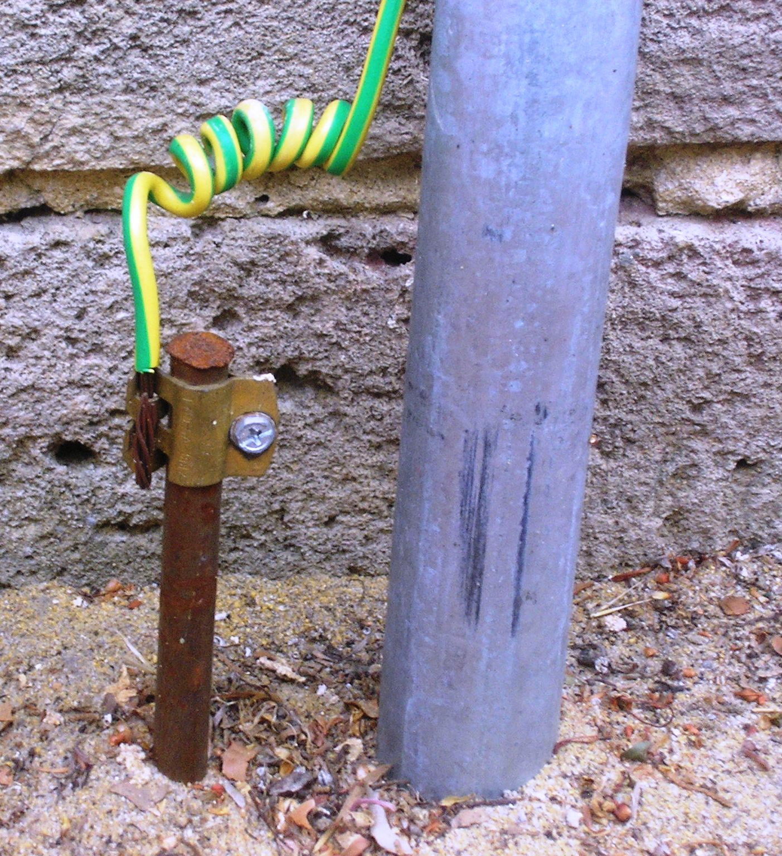
https://commons.wikimedia.org/wiki/File:HomeEarthRodAustralia1.jpg

Slide 83
TurboBlowTM
^{Blow Dryer}
The third wire in electrical devices is connect to the ground

Slide 84
Question 223.20.14
What is an electric dipole?
A charged conducting cylinder
Two charged conducting cylinders
Two dissimilar charges that are somehow bound together
A charged rod

Slide 85
+
-
+
-
-
-
-
-
-
+
-
-
-
-
-
-
-
-
-
+
-
-
-
-
-
-
+
-
+
-
-
-
-
-
+
-
+
-
+
-
+
+
-
-
+
-
+
-

Slide 86
-
-
-
-
-
-
-
-
-
-
-
+
+
-
-
-
-
-
-
-
-
-
-
-
-
-
Nucleus
+
+
-
-

Slide 87
Question 223.20.9
The force between charged objects
Has no effect at distances larger than a meter
Has no effect at distances larger than a kilometer
Has no effect at distances larger than a light year
Is long ranged, but is stronger near the charge

Slide 88
Center of Negative Charge
-
-
Center of Positive Charge
+
+ + +
+
-
-

Slide 89
Center of Negative Charge
Center of Positive Charge

Slide 90
Question
Are water molecules electric dipoles?
Yes
No
Maybe
What is a dipole again?

Slide 91
Center of Negative Charge
Center of Positive Charge

Slide 92
Question 223.20.15
Which charge diagram shows a conductor in electrostatic equilibrium?
+
+
+
+ + + +
+
+ + + + + +
+
+ + + + + + +
+
+
+ + + + + + + +
+
+ + + + + + +
+
+
+ + + + + +
+
+ + + +
+
A
B

Slide 94
+
+
-
-
+
-
+
-
+
-
+
+
-
-
+
+
-
-
+
-
+
-
+
-

Slide 95
+ + + +
- - - -
+ + + + + +
- - - - - -
+ + + + + + +
- - - - - - -
+ + + + + + + +
- - - - - - - -
+ + + + + + +
- - - - - - -
+ + + + + +
- - - - - -
+ + + +
- - - -

Slide 96
Comparison to Gravity

