Slide 2
Question 223.25.1
I have a dipole in a uniform E-field. Which direction will the angular acceleration point?
a) To the right
b) To the left
c) Into the page
d) Out of the page
q
F
p
-F
-q

Slide 3
Question 223.25.2
I have a dipole in a uniform E-field. What is the net acceleration of the dipole?
Zero
qE/m
2qE/m
Infinite
q
F
p
-F
-q

Slide 4
Question 223.25.3
What is the net torque on a dipole?
Zero
2qE/m
qE/m
aqEsinθ
a

Slide 5
Question 223.25.4
What is the dipole moment?
aqEsinθ
aqEsinθ
p x E
aq
a

Slide 6
F₋
F₊

Slide 8
F₋
F₊
Yet another charge

Slide 9
F₋
F₊

Slide 10
+ + + + + + + + + + + + + + + + + + + + + + + + + +
- -
-
-
- -
- -
- -
- -
- -
- -
- - -
+ + + + + + + + + + + + + + + + + + + + + + + + + +
- -
-
-
- -
- -
- -
- -
- -
- -
- - -
F₋
F₊

Slide 11
F₋
F₊

Slide 12
Question
In the situation shown, what would be the net force on the dipole?
qE
2qE
-2qE
0
-q
+q

Slide 13
F₋
F₊

Slide 14
F₋
r₋
a
pivot
r₊
F₊

Slide 15
r₋
θ
F₋
F₊
r₊
θ

Slide 16
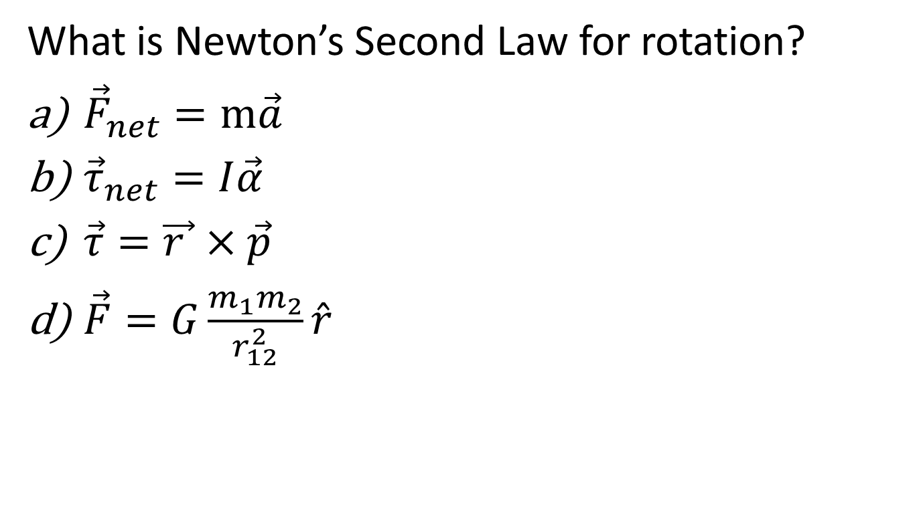
Question
What is Newton’s Second Law for rotation?
${\vec{F}}_{net}=m\vec{a}$
${\vec{τ}}_{net}=I\vec{α}$
$\vec{τ}=\vec{r }×\vec{p}$
$\vec{F}=G\frac{m_{1}m_{2}}{r_{12}^{2}}\hat{r}$

Slide 17
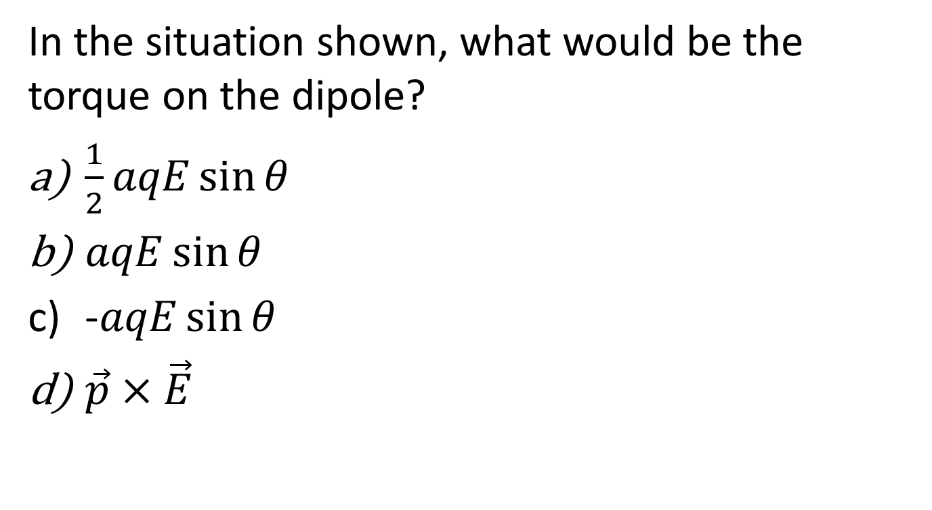
Question
In the situation shown, what would be the torque on the dipole?
$\frac{1}{2}aqE\sin{θ}$
$aqE\sin{θ}$
-$aqE\sin{θ}$
$\vec{p}×\vec{E}$
-q
a
+q

Slide 18
p

Slide 19
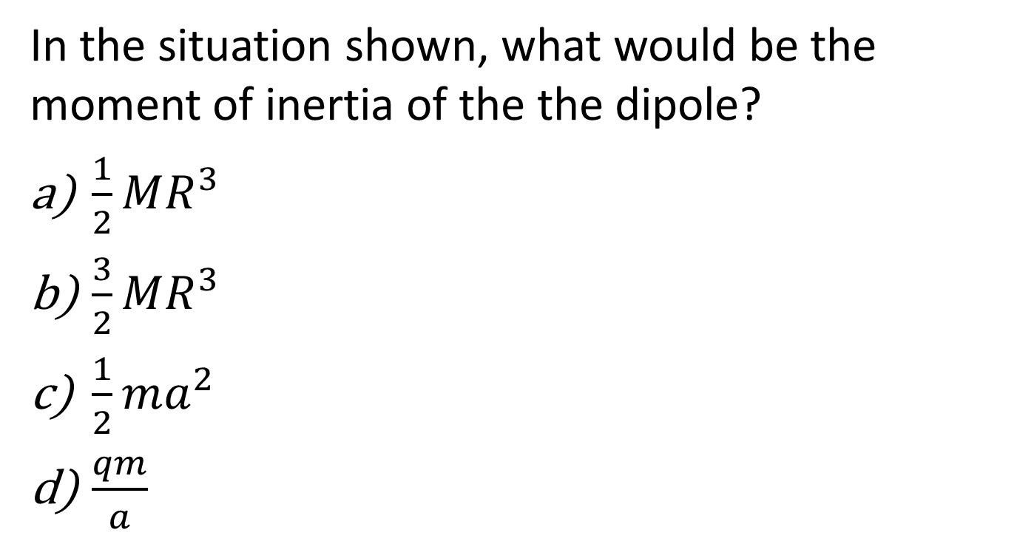
Question
In the situation shown, what would be the moment of inertia of the the dipole?
$\frac{1}{2}MR^{3}$
$\frac{3}{2}MR^{3}$
$\frac{1}{2}ma^{2}$
$\frac{qm}{a}$
-q
a
+q

Slide 20
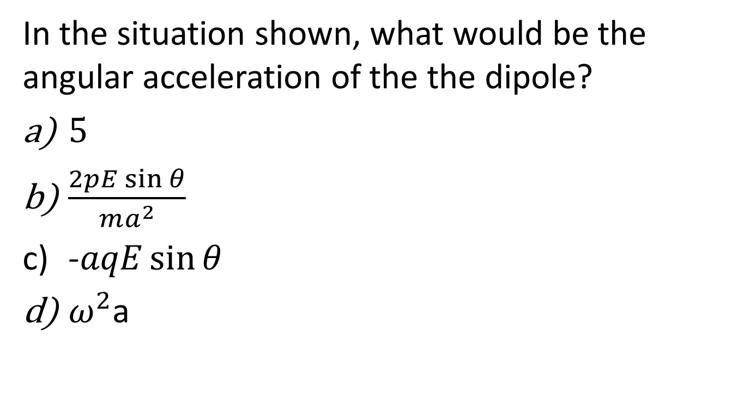
Question
In the situation shown, what would be the angular acceleration of the the dipole?
$5$
$\frac{2pE\sin{θ}}{ma^{2}}$
-$aqE\sin{θ}$
$ω^{2}$a
-q
a
+q

Slide 21
Question
What happens if we put an insulator in a uniform electric field?
Nothing
The atoms in the insulator polarize
The atoms separate, destroying the insulator
The insulator melts

Slide 22
Excess negative charge on the surface will experience a force
Excess negative charge on the surface will experience a force
Interior charges from one dipole cancel charges from another dipole
F₋
F₊

Slide 24
F₋
F₊

Slide 25
Semi-infinite Sheet of Charge
Infinite Line of Charge

Slide 26
Question 223.25.5
Which of the following can be the field of an infinite line of charge viewed on end?
A B C
Line of Charge, End View

Slide 27
Line of Charge, End View
Line of Charge, Reflection

Slide 28
Line of Charge, End View

Slide 29
Question 223.23.6
Which Picture best shows the field from a semi-infinite sheet of charge.
A B C
D

Slide 30
Question 223.25.6
Which Picture best shows the field from a semi-infinite sheet of charge.
A B C
+
+
+
+
+
+
+
+
+
+
+
+
+
+
+
+
+
+
+
+
+
+
+
+
+
+
+
+
+
+
+
+
+
+
+
+
+
+
+
+
+
+
+
+
D

Slide 31
+
+
+
+
+
+
+
+
+
+
+

Slide 32
+
+
+
+
+
+
+
+
+
+
+

Slide 33
Question 223.25.6
Which Picture best shows the field from a capacitor.
A B C
+ + + + + + + + + + + + + + + + + + + + + + + + + +
+ + + + + + + + + + + + + + + + + + + + + + + + + +
+ + + + + + + + + + + + + + + + + + + + + + + + + +
+ + + + + + + + + + + + + + + + + + + + + + + + + +
+ + + + + + + + + + + + + + + + + + + + + + + + + +
+ + + + + + + + + + + + + + + + + + + + + + + + + +
- - - - - - - - - - - - - - - - - - - - - - - - - - - - - -
- - - - - - - - - - - - - - - - - - - - - - - - - - - - - -
- - - - - - - - - - - - - - - - - - - - - - - - - - - - - -
- - - - - - - - - - - - - - - - - - - - - - - - - - - - - -
- - - - - - - - - - - - - - - - - - - - - - - - - - - - - -
- - - - - - - - - - - - - - - - - - - - - - - - - - - - - -
D
+ + + + + + + + + + + + + + + + + + + + + + + + + +
+ + + + + + + + + + + + + + + + + + + + + + + + + +
- - - - - - - - - - - - - - - - - - - - - - - - - - - - - -
- - - - - - - - - - - - - - - - - - - - - - - - - - - - - -

Slide 34
+ + + + + + + + + + + + + + + + + + + + + + + + + +
+ + + + + + + + + + + + + + + + + + + + + + + + + +
- - - - - - - - - - - - - - - - - - - - - - - - - - - - - -
- - - - - - - - - - - - - - - - - - - - - - - - - - - - - -

Slide 35

Question 223.25.6
What would the field look like for an equally but oppositely charged set of concentric cylinders?
A
B
C

Slide 36
Infinite Line of Charge
Charged Coaxial Cylinders

Slide 37
Oppositely Charged Coaxial Cylinders

Slide 38

Question 223.25.6
What would the field look like for an equally but oppositely charged set of concentric cylinders?
A
A
B
C

