Slide 1
Question 223.19.1
Resolution is
The ending argument in a debate
The ability to distinguish separate point sources in an optical image
The distance between bright fringes in a diffraction pattern
The distance between dark fringes in a diffraction pattern

Slide 2
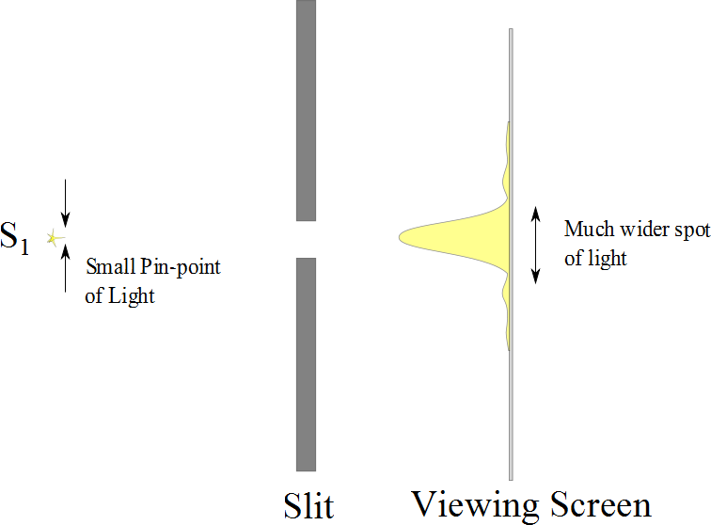

Slide 3
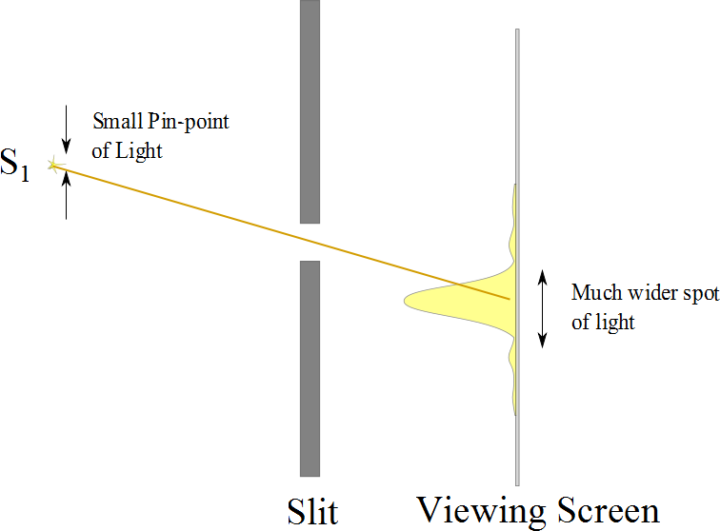

Slide 4
Resolution

Slide 5
Resolution
The ability of optical systems to distinguish between closely spaced objects is limited because of the wave nature of light
If two sources are far enough apart to keep their central maxima from overlapping, their images can be distinguished
The images are said to be resolved
If the two sources are close together, the two central maxima overlap and the images are not resolved

Slide 6
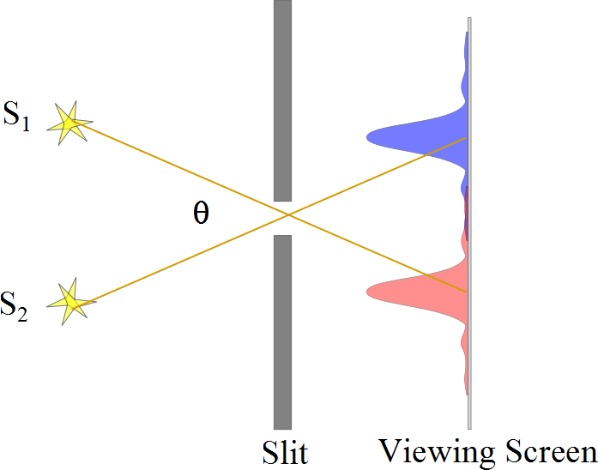
Resolved Images, Example

Slide 7
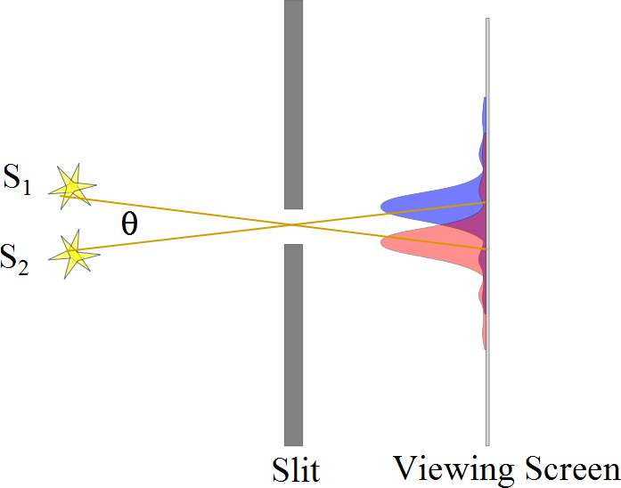
Barely Resolved, Example

Slide 8
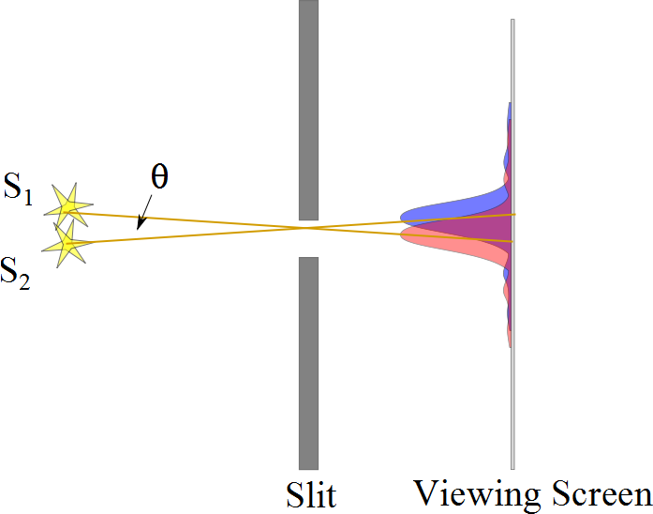
Images Not Resolved, Example

Slide 9
Resolution
The ability of optical systems to distinguish between closely spaced objects is limited because of the wave nature of light
If two sources are far enough apart to keep their central maxima from overlapping, their images can be distinguished
The images are said to be resolved
If the two sources are close together, the two central maxima overlap and the images are not resolved

Slide 11
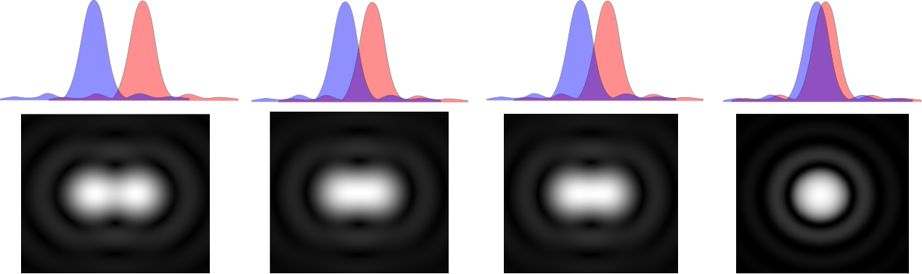

Slide 13
Question 233.19.2
Cat’s eyes have pupils that can be modeled as vertical slits. At night, would cats be more successful in resolving
Headlights on a distant car
Vertically separated lights on the mast of a distant boat?

Slide 14
Resolution, Rayleigh’s Criterion
When the central maximum of one image falls on the first minimum of another image, the images are said to be just resolved
This limiting condition of resolution is called Rayleigh’s criterion

Slide 15
Resolution, Rayleigh’s Criterion, Equation
The angle of separation, θ_{min}, is the angle subtended by the sources for which the images are just resolved
Since λ << a in most situations, sin θ is very small and sin θ ≈ θ
Therefore, the limiting angle (in rad) of resolution for a slit of width a is
To be resolved, the angle subtended by the two sources must be greater than θ_{min}

Slide 16
Circular Apertures
The diffraction pattern of a circular aperture consists of a central bright disk surrounded by progressively fainter bright and dark rings
The limiting angle of resolution of the circular aperture is
D is the diameter of the aperture

Slide 17
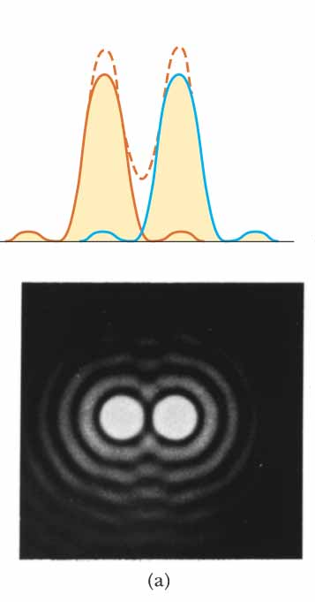
Circular Apertures, Well Resolved
The sources are far apart
The images are well resolved
The solid curves are the individual diffraction patterns
The dashed lines are the resultant pattern

Slide 18
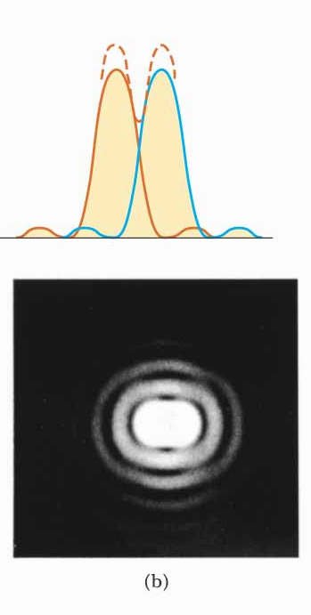
Circular Apertures, Just Resolved
The sources are separated by an angle that satisfies Rayleigh’s criterion
The images are just resolved
The solid curves are the individual diffraction patterns
The dashed lines are the resultant pattern

Slide 19
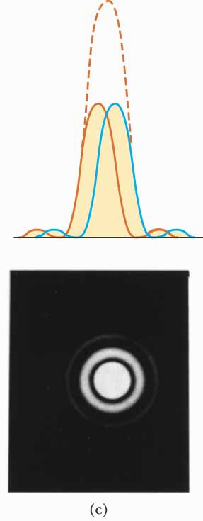
Circular Apertures, Not Resolved
The sources are close together
The images are unresolved
The solid curves are the individual diffraction patterns
The dashed lines are the resultant pattern

Slide 20
Completely Resolved
Rayleigh Criterion
Sparrow Criterion
Unresolved

Slide 21
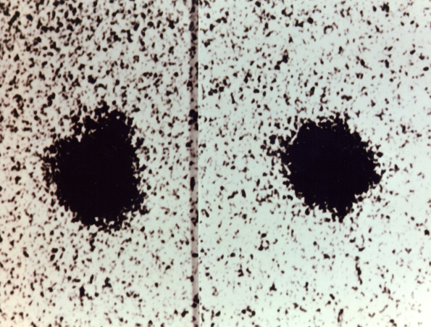

Resolution, Example
Charon
Pluto
Pluto and its moon, Charon
Left: Earth-based telescope is blurred
Right: Hubble Space Telescope clearly resolves the two objects

Slide 22
Disclaimer for Today’s Demonstrations
If the humidity is high, we will be in trouble
The fact that humidity is important is fascinating
If the humidity is high, we will consider why humidity is important as an extra credit problem! – so we will be OK either way.

Slide 23
Question
I rub a balloon on my hair. Now my hair is a mess and the balloon sticks to the wall. What makes this happen?
Hair gel, it’s sticky
Electric charge
The rubber was dissolved by whatever he used in his hair and now the rubber sticks to the wall
Magic

Slide 24
-
-
-
-
-
-
-
-
-
-
-
-
-
-
-
-
-
-
-
-
-
-
-
-
-
-
-
-
-
-
-
-
-
-
-
-
-
-
-
-
-
-
-
-

Slide 25
+
+
+
+
+
+
+
+
+
+
+
+
+
+
+
+
+
+
+
+
+
+
+
+
+
+
+
+
+
+
+
+
+
+
+
+
+
+
+
+

Slide 26
Question 223.19.4 Electric Charge I
Two charged balls are repelling each other as they hang from the ceiling. What can you say about their charges?
1) one is positive, the other is negative
2) both are positive
3) both are negative
4) both are positive or both are negative

Slide 27
ConcepTest 16.1a Electric Charge I
Two charged balls are repelling each other as they hang from the ceiling. What can you say about their charges?
1) one is positive, the other is negative
2) both are positive
3) both are negative
4) both are positive or both are negative
The fact that the balls repel each other only can tell you that they have the same charge, but you do not know the sign. So they can be either both positive or both negative.

Slide 28
-
-
-
-
-
-
-
-
-
+
+
+
+
+
-
-
-
-
-
+
+
+
+
+
-
-
-
-
-
-
-
-
+
+
+
+
+
+
+
+
+
+

Slide 29
Question 223.19.5 Electric Charge II
From the picture, what can you conclude about the charges?
1) have opposite charges
2) have the same charge
3) all have the same charge
4) one ball must be neutral (no charge)

Slide 30
ConcepTest 16.1b Electric Charge II
From the picture, what can you conclude about the charges?
1) have opposite charges
2) have the same charge
3) all have the same charge
4) one ball must be neutral (no charge)
The GREEN and PINK balls must have the same charge, since they repel each other. The YELLOW ball also repels the GREEN, so it must also have the same charge as the GREEN (and the PINK).

Slide 31
Question 223.19.6 Conductors I
A metal ball hangs from the ceiling by an insulating thread. The ball is attracted to a positive-charged rod held near the ball. The charge of the ball must be:
1) positive
2) negative
3) neutral
4) positive or neutral
5) negative or neutral
Notes:
[CORRECT 5 ANSWER]

Slide 32
ConcepTest 16.2a Conductors I
A metal ball hangs from the ceiling by an insulating thread. The ball is attracted to a positive-charged rod held near the ball. The charge of the ball must be:
1) positive
2) negative
3) neutral
4) positive or neutral
5) negative or neutral
Clearly, the ball will be attracted if its charge is negative. However, even if the ball is neutral, the charges in the ball can be separated by induction (polarization), leading to a net attraction.
remember the ball is a conductor!
Follow-up: What happens if the metal ball is replaced by a plastic ball?

Slide 33
Concept Question 16.01 Glass Rod Question
We picked up little bits of paper with a plastic rod or comb
Will a glass rod pick up the paper?
1) Yes, just like the plastic rod
2) No, the paper will fly away from the rod

Slide 34
Concept Question 16.01 Glass Rod Question
We picked up little bits of paper with a plastic rod or comb
Will a glass rod pick up the paper?
1) Yes, just like the plastic rod
2) No, the paper will fly away from the rod
By demonstration we see that the paper is attracted.

Slide 35
-
-
-
-
-
-
-
-
-
+
-
-
-
-
-
-
+
-
-
-
-
-
-
-
-
-
-
+
+
-

Slide 36
-
-
-
-
-
-
-
-
-
-
-
+
+
-
-
-
-
-
-
-
-
-
-
-
-
-
Nucleus
+
+
-
-

Slide 37
+
-

Slide 38
+
-
-
-
-
-
-
-
-
-
-
-
-
-
-
-
-
-
-
-
-
-
-
-
+
-
-
-
-
-
-
-
-
-
-
-
-
-
-
-
-
-
-
-
-
-
-
-

Slide 39
+
-
+
+
+
+
+
+
+
+
+
+
+
+
+
+
+
+
+
+
+
+

Slide 40
+
-
+
-
-
-
-
-
-
+
-
-
-
-
-
-
-
-
-
+
-
-
-
-
-
-
+
-
+
-
-
-
-
-
+
-
+
-
+
-
+
+
-
-
+
-
+
-

Slide 41
+
-
-
-
+
+
+
+
+
-
+
-
-
-
-
+
-
+
-
+
-
+
-
+
+
-
+
-
+
-
+
-
+
-
-
+
-
+
-
-
-
-
-
-
-
-
+
-
-
-
-
-
-
-
-
+
+
+
+
-
-
-
-
-
-
-
-
+
-
-
-
+
+
+
+
+
-
-
-
-
-
-
-
-
-
+
-
-
-
+
+
+
+
+
+
+
-
-
+
+
-
-
-
-
-
-
-
-
-
-
-
-
-
-
-
-
+
+
+
+
-
-
-
-
-
-
-
+
-
-
-
+
+
-
-
-
-
-
-
-
-
-
-
-
+
+
+
-
-
+
+
+
-
+
+
+
+
+
-
-
+
-
-
+
+
-
+
-
+
-
+
+
+
+
+
+
+
-
+
+
+
+
+
+
+
+
+

Slide 42
+
-
+
+
+
+
-
+
-
-
-
-
-
+
-
+
-
+
-
+
-
+
-
+
+
-
+
-
+
-
+
-
+
-
-
-
+
-
+
-
-
-
-
-
-
-
+
-
-
-
-
-
-
-
-
-
+
+
+
+
-
-
-
-
-
-
-
+
-
-
-
+
+
-
-
-
-
-
-
-
-
-
+
-
+
+
-
+
-
+
+
+
+
+
+
+
-
-
+
-
-
-
-
-
+
-
+
-
-
-
-
-
-
-
-
-
+
+
-
-
-
-
-
-
-
+
-
+
+
-
+
-
-
+
+
+
+
+
-
-
-
-
-
-
+
-
-
+
-
-
-
-
-
+
-
-
-
-
-
-
-
-
-

Slide 43
Question 223.19.7 Conductors II
Two neutral conductors are connected by a wire and a charged rod is brought near, but does not touch. The wire is taken away, and then the charged rod is removed. What are the charges on the conductors?
1) 0 0
2) + –
3) – +
4) + +
5) – –
0
0
?
?

Slide 44
ConcepTest 16.2b Conductors II
1) 0 0
2) + –
3) – +
4) + +
5) – –
Two neutral conductors are connected by a wire and a charged rod is brought near, but does not touch. The wire is taken away, and then the charged rod is removed. What are the charges on the conductors?
While the conductors are connected, positive charge will flow from the blue to the green ball due to polarization. Once disconnected, the charges will remain on the separate conductors even when the rod is removed.
0
0
Follow-up: What will happen when the conductors are reconnected with a wire?
?
?

Slide 45
Concept Question 16.05 Saltshaker and Charge
We rubbed the salt shaker just like we rubbed the glass and rubber rods, the salt shaker is made of glass, but the salt shaker remains uncharged because
1) It has a metal top
2) It contains salt
3) It is a combination of materials
4) It is magic, some sort of trick the professor is playing

Slide 46
Concept Question 16.0 Saltshaker and Charge
We rubbed the salt shaker just like we rubbed the glass and rubber rods, the salt shaker is made of glass, but the salt shaker remains uncharged because
1) It has a metal top
2) It contains salt
3) It is a combination of materials
4) It is magic, some sort of trick the professor is playing
The next demo will show this, there is something different about the structure of metals.

